Slide 1
Olist 360 Marketplace Analysis
Presented By: Sebastian Hopgood
For: Olist CEO and Logistics Department

Slide 2
Business Task
Sales
Identify the top 5 product categories by revenue and understand the performance through monthly changes from 2016 to 2018
Seller Insights
Identify sellers in the top 10% by sales volume and pinpoint what states have high demand of customers but low seller presence
Logistics​
Determine the average lead time in business days and identify what states have their average lead time exceed the average estimated average time
Customer Satisfaction
Does shipping cause a lower customer satisfaction? If so, what is the rating penalty for late shipping

Slide 3
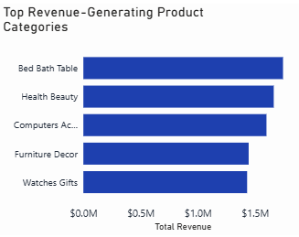
Top 5 Product Categories
Top 5 product categories contribute to approximately $8,000,000
These categories are equivalent to 38.9% of total revenue share
The top 10 product categories are responsible for 62.4% of total revenue share

Slide 4
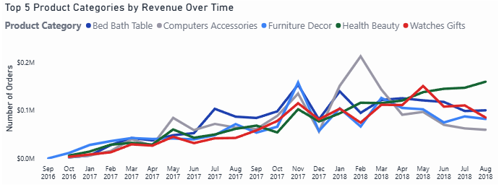
Top 5 Product Categories Over time
Most categories showed consistent growth until a general decline began in April 2018. Health Beauty is the notable exception, maintaining a positive projected growth trajectory.

Slide 5

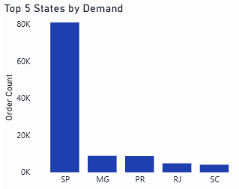
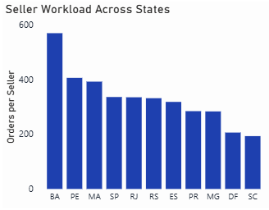
Customer Demand vs Seller Workload
Demand is heavily concentrated in five Brazilian states: SP, MG, PR, RJ, SC
However, these high-demand regions are among the lowest in seller distribution
Top 5 in demand states are in the top 11/27 states for most seller workload

Slide 6
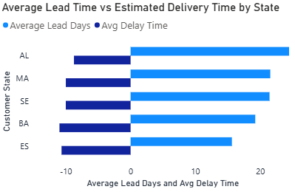
Does the Average Lead Time Ever Exceed Average Estimated Time?
Currently, no state averages exceed their estimated delivery dates, resulting in a 92.1% delivery promise accuracy
The average lead time is 12.5 days
The average seller processing time takes 2.4 days
A list of top 10% sellers is listed in the interactive dashboard

Slide 7
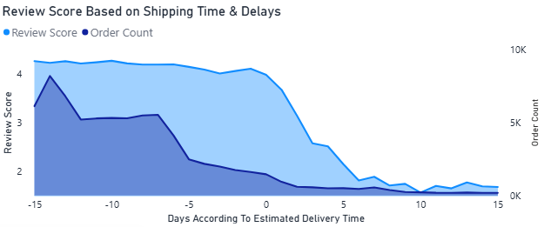
Shipping vs Customer Satisfaction
There is a direct correlation between shipping delays and customer dissatisfaction
While the average rating is 4.0 stars, a delay of just 1 day drops the average to 3.68. Sentiment collapses at the 3-day mark (2.58 stars) and hits a floor of 1.5 stars for delays of 6+ days.

Slide 8
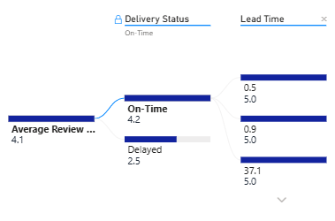
Lead Time vs Customer Satisfaction
0.5, 0.9, 37.1 days all represent lead time within the 5.0 star rating group
Therefore, there is no direct correlation between lead time and customer satisfaction

Slide 9
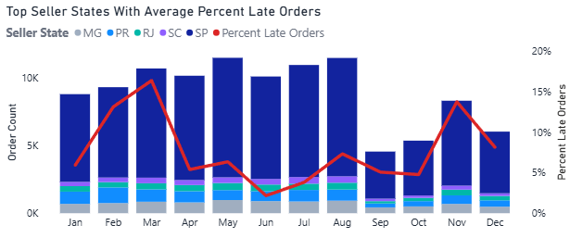
Late Order Percentages Within Top 5 States Based On Order Count Across Time
Late order percentages consistently spike during Q1 and Q4 across all years

Slide 10
Sales and Seller Strategy Recommendations
Regional Seller Acquisition​
Launch a targeted recruitment campaign for sellers in SP, MG, PR, RJ, and SC. By increasing seller density in these high-demand zones, Olist can reduce cross-country shipping distances and improve regional competitiveness.
Category-Specific Incentives
Since Health & Beauty is the primary growth driver, Olist should offer lower commission rates or "featured placement" for new sellers in this category to capitalize on the upward trend.
High-Volume Seller Support ​
​Provide dedicated account management or premium tools for the Top 10% of sellers to ensure the core 62.4% of revenue (from top 10 categories) remains stable.

Slide 11
Logistics and Customer Experience Recommendations
Automated Delay Interventions​
Implement an automated "Early Warning System" that triggers at 48 hours of seller processing time. This gives Olist a 24-hour window to nudge sellers before hitting the 3-day sentiment collapse threshold.
Predictive Delivery Windows
Adjust the "Estimated Delivery Date" algorithm to be more conservative during Q1 and Q4. By proactively extending the promised date during peak seasons, Olist protects the 92.1% accuracy rate and prevents the 1.5-star "late penalty“.
Seller Performance Tiering​
Incorporate the 1.5-star "late penalty" data into seller KPIs. Sellers who consistently exceed the 12.5-day average lead time should receive lower search rankings to protect the overall marketplace reputation.

Slide 12
Data Limitations and Future Work
Date Gaps
Data from months January 2016 - August 2016 and September 2018 -December 2018 is missing.
Marketplace Profitability
Without specific commission rates or operating costs, analysis is limited to Total Sales rather than Olist’s actual Net Profit.
Retention Limits
98.8% of users are one-time buyers.
Future Work
Future Work: Acquire the remaining 2018 datasets to complete a full 3 - year growth study.
Future Work
Future Work: Integrate Olist’s fee structure to calculate actual platform net profit.
Future Work
Future Work: Conduct a Cohort Analysis to identify what drives the small percentage of returning "power users“.

Slide 13





THE END

