Slide 1
Consumer
Spending
Product Market
Payments/
Revenues
Goods/Services Demanded
Goods and
Services supplied
Consumers
Firms
Inputs/Resources Supplied
Inputs/Resources Demanded
Factor Market
Wages/Costs
Income

Slide 2
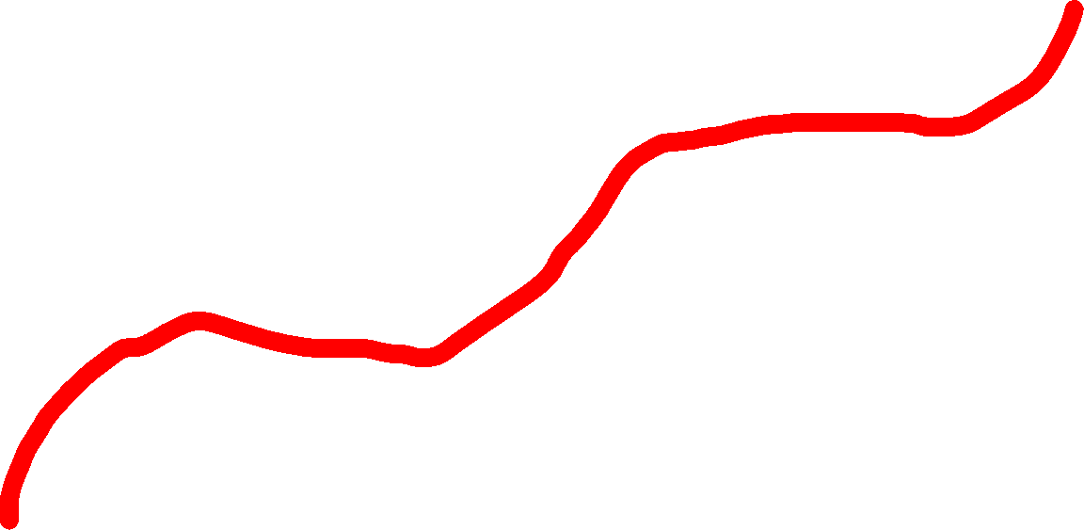
Peak
Trough
Growth Trend Line
RGDP
Peak
Trough
Contraction
Expansion
Time

Slide 3
Price Lvl
Aggregate Demand Curve
P3
P2
P1
AD1
2
5
10
Real GDP

Slide 4
Price Lvl
Demand Curve
P3
P2
P1
D1
Quantity Demanded
2
5
10

Slide 5
S1
Price Lvl
Supply Curve
P3
P2
P1
Quantity Supplied
2
5
10

Slide 6
Short-Run Aggregate Supply
AS1
Price Lvl
P3
P2
P1
Real GDP
2
5
10

Slide 7
Long-Run Aggregate Supply
Price LVL
LRAS
P2
P1
Real GDP

Slide 8
Real Interest Rate
Loanable Funds Market
SLF
RIR3
Surplus
RIR2
Equilibrium
Shortage
RIR1
DLF
QLF
Quantity of LF

Slide 9
Money Market
Nominal Interest Rate
SM
NIR2
NIR1
DM
QM2
QM1
Quantity of Money

Slide 10
Inflation Rate
Phillips Curve
LRPC
5%
1%
SRPC
2%
5%
Unemployment Rate

Slide 11
Foreign Exchange Market
(euros for 1 $)
Exchange Rate
S
E.R.
D
Q$
Quantity of $

Slide 12
Foreign Exchange Market
(euros for 1 $)
Exchange Rate
S1
E.R.1
E.R.2
D1
D2
Q$2
Q$1
Quantity of $

Slide 13
Foreign Exchange Market
(euros for 1 $)
Exchange Rate
S1
E.R.2
E.R.1
D2
D1
Q$1
Q$2
Quantity of $

Slide 14

Policy Rate
Ample Reserves
S
Discount Rate
Interest on Reserves
PR
D
QR
Reserves

Slide 15
Production
Possibilities Curve
Apples
A
8
F
5
B
E
C
2
2
5
8
Bananas

Slide 16
Market Equilibrium
Price LVL
S
P1
D
Y1
Quantity

Slide 17
AD-AS Model
Price Level
LRAS
SRAS
P2
P3
Gvt. Policy
P1
AD2
Crowding Out
AD3
AD1
Y1
RGDP
Y3
Y2

Slide 18
AD-AS Model
Price LVL
LRAS
SRAS1
SRAS2
P1
P2
AD
Y1
Y2
Real GDP

Slide 19
AD-AS Model
Price LVL
LRAS
SRAS1
SRAS2
P2
P1
AD
Y2
Y1
Real GDP

Slide 20
Inflationary Gap
Price LVL
LRAS
SRAS
P1
P2
AD
Y1
Y2
Real GDP

Slide 21
Recessionary Gap
Price LVL
LRAS
SRAS
P1
P2
AD
Y2
Y1
Real GDP

Slide 22
AD-AS Model
(Long-Run Equilibrium)
Price LVL
LRAS
SRAS
P1
AD
Y1
Real GDP

Slide 23
AD-AS Model
Price LVL
LRAS
SRAS1
P1
P2
AD2
AD1
Y2
Y1
Real GDP

Slide 24
AD-AS Model
Price LVL
LRAS
SRAS1
P2
AD2
P1
AD1
Y1
Y2
Real GDP

