Slide 1

Book management Tool
Scraping and management of books in a MySQL database

Slide 2

Goal
Download and store books, by only providing authors name and book title or isbn

Slide 3

GOAL
Providing a unified experience of book management
Efficient and easy
We want to create a tool that helps the majority of the people!

Slide 4

WHY OUR PROJECT
There is a some site that only few people know which provides quantities of pdfs.
Creating a free algorithm that helps you to download and manage books.
We will use Libgen.io and Libgen.pw, and free available data on the web.

Slide 5
OVERVIEW
STRUCTURE
API
DATABASE
OOP
LIBRARY
SCRAPING

Slide 6

STRUCTURE

Slide 7
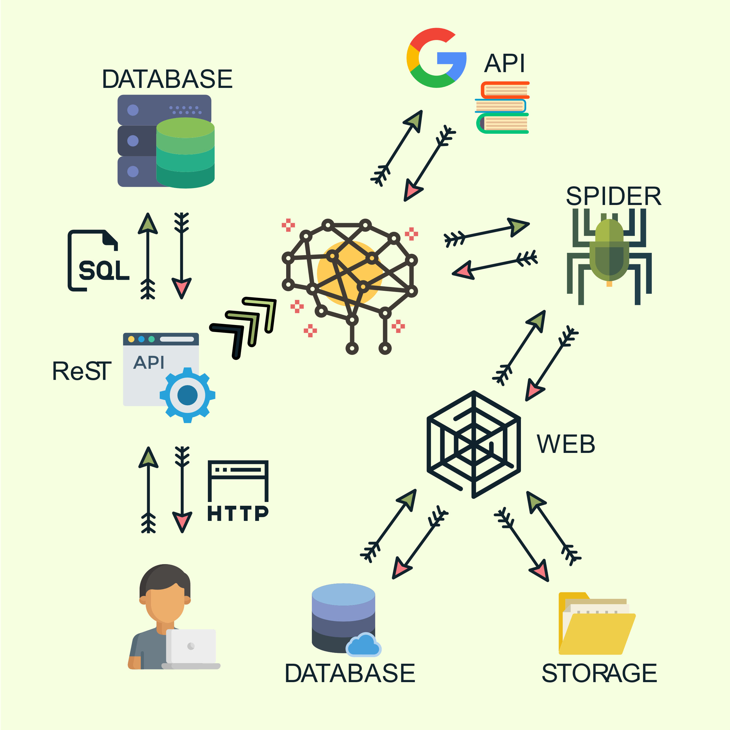
STRUCTURE
Core API:
FLASK-ReSTful
FLASK-SQLALCHEMY
Scraping:
Scrapy
Libgen.io
Libgen.pw
Database
Local or AWS

Slide 8

API

Slide 9
API USED
Google Book api
For additionnal book informations
Wikipedia
For additionnal author informations
We use OUR API
For additional compatibility, and language agnostism

Slide 10

Libraries

Slide 11
LIBRARIES
Flask-ResTful
Flask
Routing
Flask-SQL alchemy
Powerful ORM
Scrapy
Webscraping
Wikipedia
Wikipedia API
Requests
Google book API
ResT
Pymsql
Database driver

Slide 12
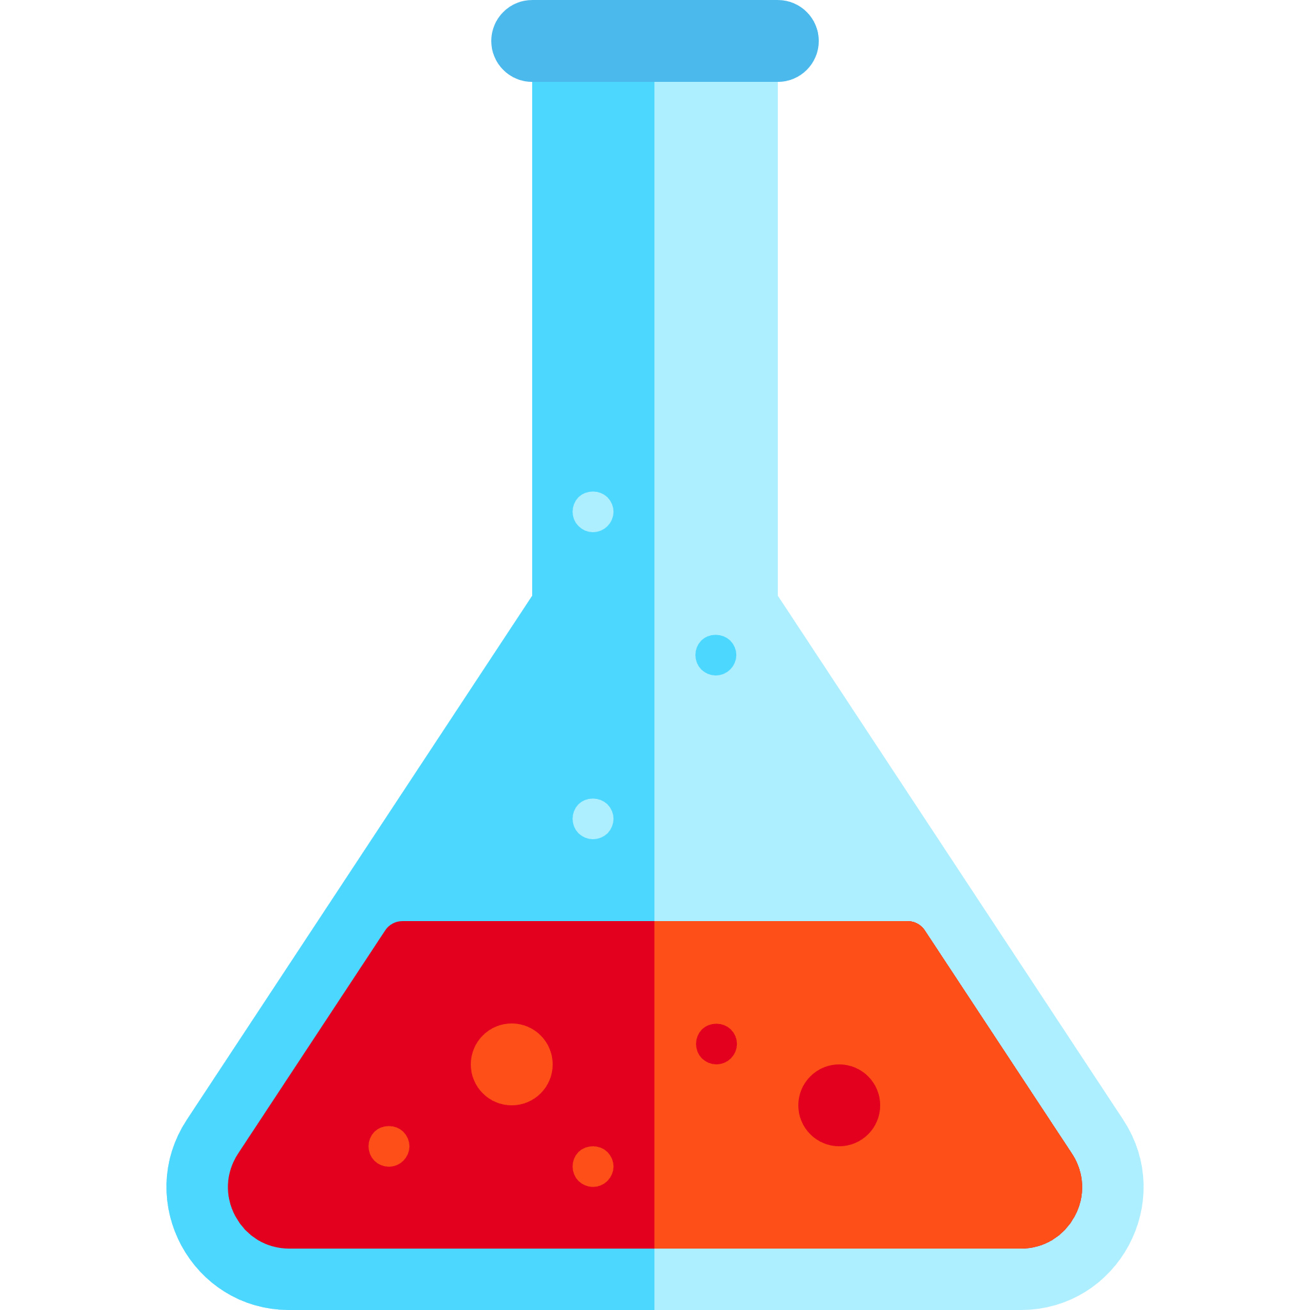
FLASK ReST API
We use FLASK in order to provide a interface between user and the database.
FLASK-ReST for an lightweight library for restful commands

Slide 13
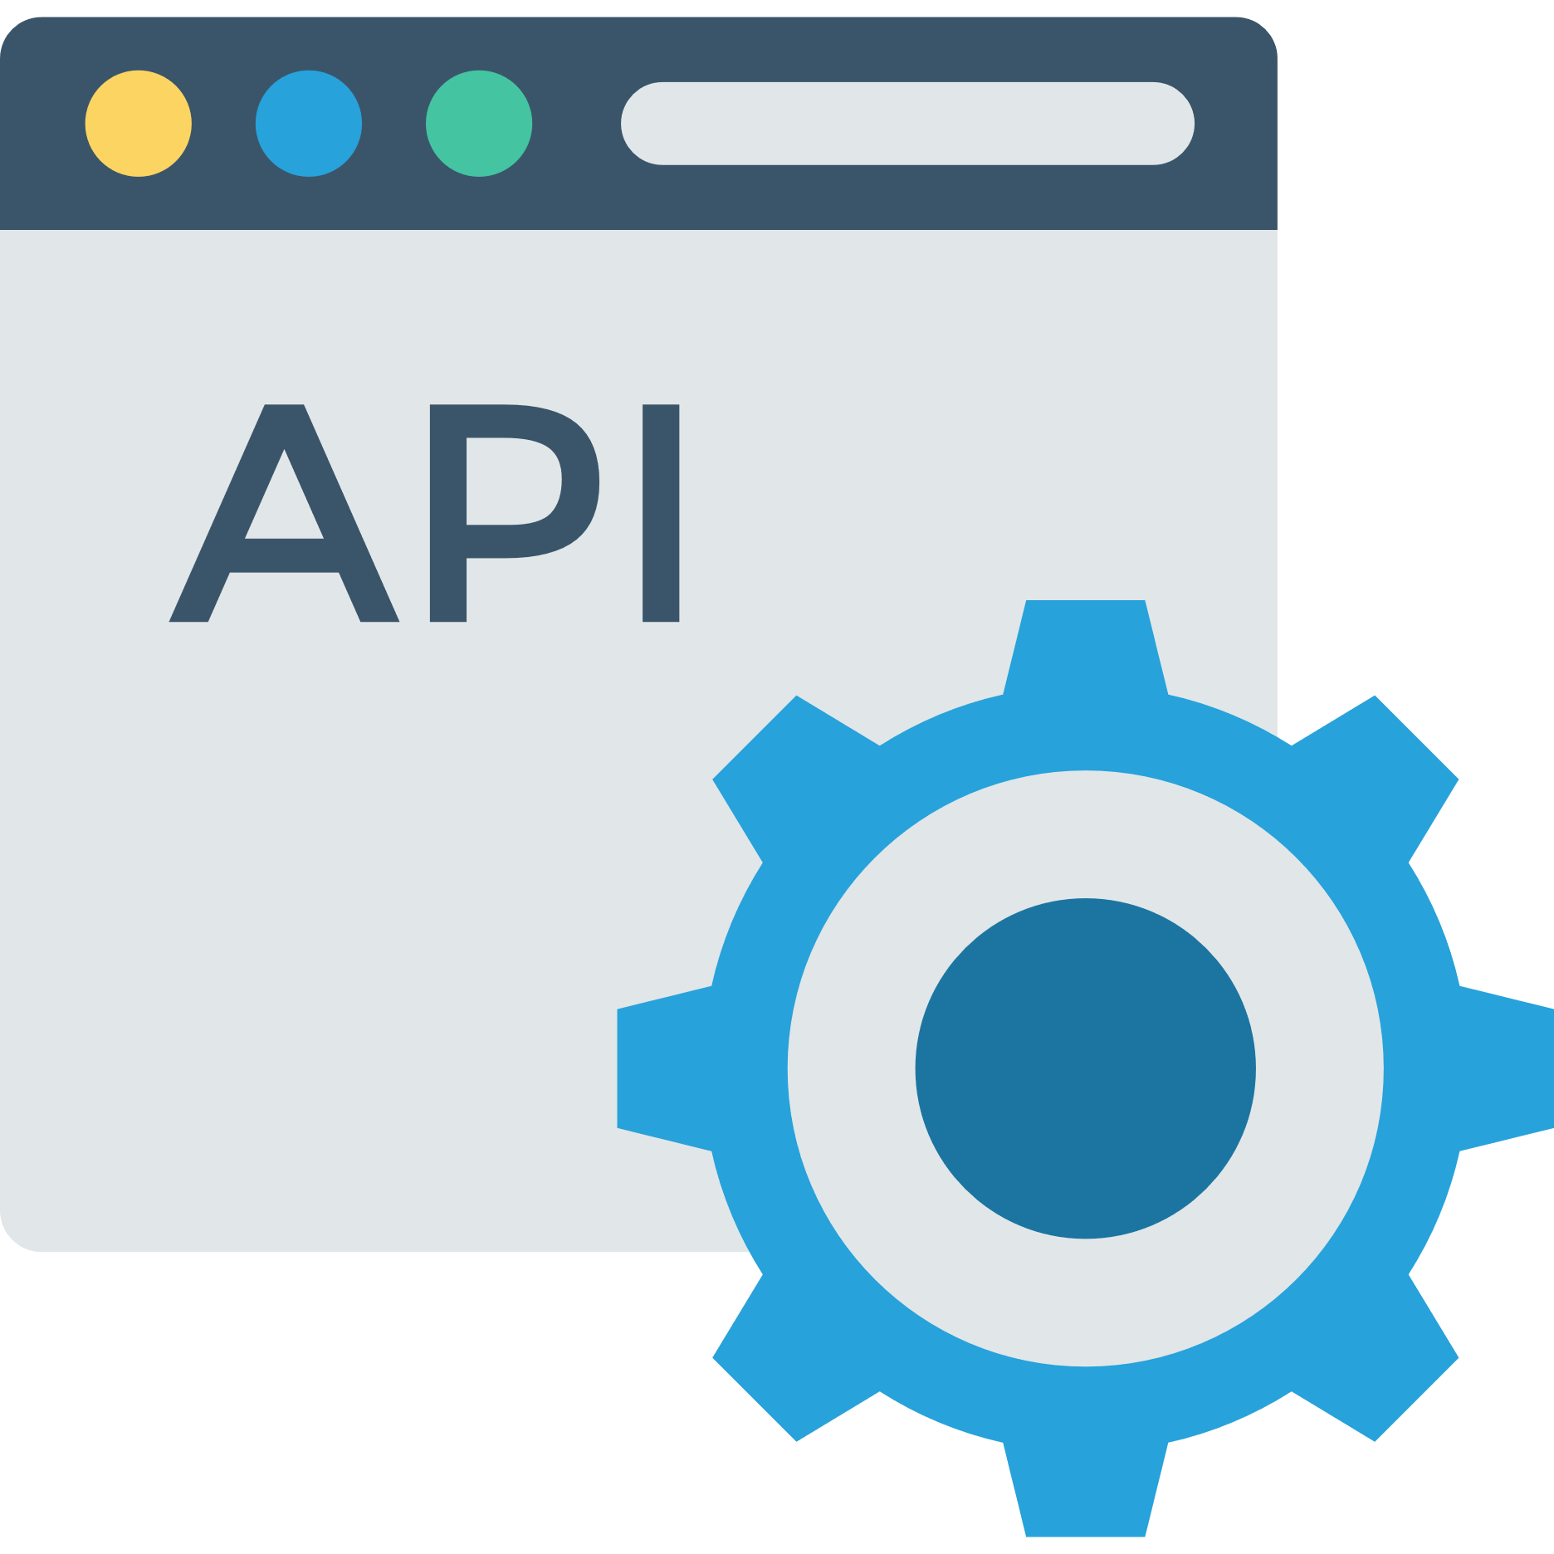
WHY OUR CORE IS ReSTFUL?
Easier to maintain
Language Agnostic
More easily expandable
Ex : Add table in database
It’s only HTTP requests
Debugging is easier

Slide 14

SQL Alchemy
ORM is a object-relational mapping
Helps in simulating an oriented object database:
User = query.filter_by(name=name).first()
Instead of : SELECT * FROM users WHERE users.id == id
Helps also in cascade deletion:
db.session.delete(User)

Slide 15
SQL ALCHEMY EXAMPLE
SQL ALCHEMY
You add the relations to your SQL ALCHEMY Models
portfolios = db.relationship("PortfolioModel", cascade="save-update, merge, delete")
It will delete any children that belongs to the parent we are trying to delete.
You do the same in each model that have children

Slide 16

SCRAPING

Slide 17
SCRAPING
Basically, when you don’t have any
Open Library
Open API
Open Database
You go «Oh Crap!» I scrap.
You parse the HTML of a page to gather DATA.

Slide 18
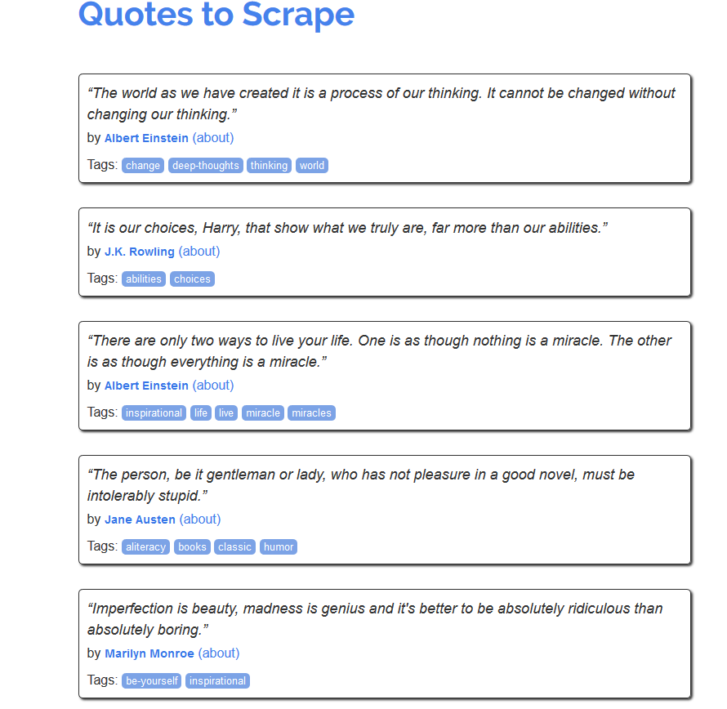
EXAMPLE
We analyze the structure and then gather data.
In this example
We gather all quotes and authors
And also Tags

Slide 19
OUR SCRAPING ALGO
Input user: title, authors, (isbn)
Check book best match on Google book API
String comparison
Go gather data on libgen.io and look for the book best match
Check if the author already exists
If not go on wikipedia if available
Then insert new author
Same for category (except wiki)
Download pdf
Update database with all fields

Slide 20

STRING COMPARISON
Our algorithm take as input an author name and a book title (ISBN is optionnal).
It will fetch additional informations about the book on google book API and then will download the book best match according to the score of a what the user actually meant.
Why ? Because libgen.io website doesn’t cope with misspelling.

Slide 21
WHY STRING COMPARISON
Because we expect the user to misspell at least once the name of the author or the name of the book.
Because the website where we scrap the data has poor searching algorithm
Sometimes a search such as «The Hound of the Baskerville» doesn’t work
A search such as «The Hound of the Baskervilles» Does work
Helps us in gathering more information about the book on google book api.

Slide 22
HOW DO WE DO STRING COMPARISON
Matching system
Compute a comparability ratio
Number of matches
Length of string

Slide 23
MATCHING SYSTEM
0 | 1 | 2 | 3 | 4
A | B | X | C | D
String a
0 | 1 | 2 | 3 | 4
A | B | C | D
String b
A | B
(a=0, b=0, size=2)

Slide 24
MATCHING SYSTEM
0 | 1 | 2 | 3 | 4
A | B | X | C | D
String a
0 | 1 | 2 | 3 | 4
A | B | C | D
String b
C | D
(a=3, b=2, size=2)

Slide 25

COMPUTE COMPARABILITY RATIO
$$Ratio= \frac{2.0M}{T}$$
Where :
$$M :Number of matches \\ T :Total length of both strings$$

Slide 26
CUMULATIVE
We compute this ratio for each of the detail:
Author
Book Title
Subtitle

Slide 27

DATABASE

Slide 28
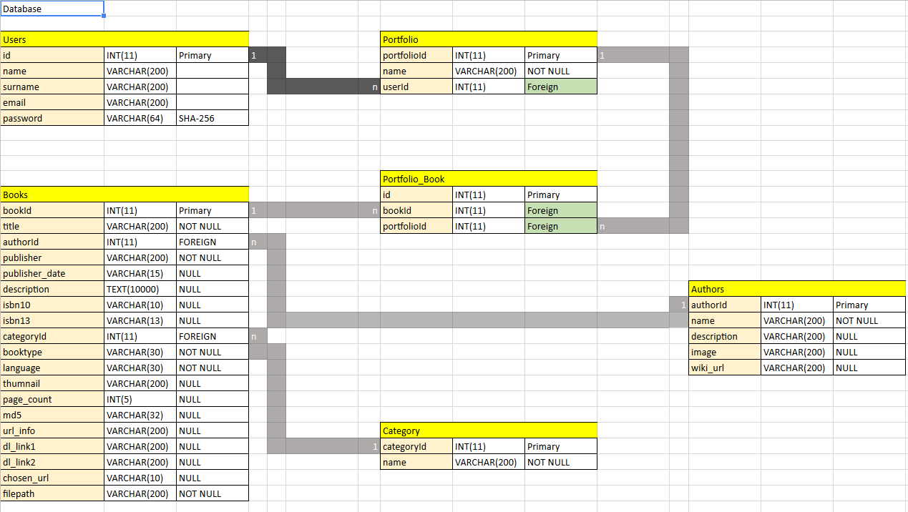
DATABASE

Slide 29
DATABASE WHERE DOES IT COME FROM
WIKIPEDIA
GOOGLE BOOK API AND LIBGEN

Slide 30

Object Oriented Programming

Slide 31
OOP
We modeled our algorithm according to Flask, SQLAlchemy, and Scrapy requirements.
Flask and Flask_restfull
Resources
SQL Alchemy
Models
Scrapy
Item
Models
Pipeline
Controller
View
(optional json output)
BookInfo
Gather additionnal information on google Book API

Slide 32
PROBLEMS ENCOUNTERED
Book best match
Not as accurate as we wanted
How should start the scraper
Python (even threading doesn’t work)
CLI
Sequential requests
User call API -> API calls Scrapy -> Scrapy needs to update db via API -> BUG
Threaded = True
Cascade deletion

Slide 33
CASCADE DELETION
WE WANT TO DELETE

Slide 34
CASCADE DELETION
WE WANT TO DELETE
THIS IS DEPENDENT

Slide 35
CASCADE DELETION
WE WANT TO DELETE
THIS IS DEPENDENT
THIS IS DEPENDENT

Slide 36
CASCADE DELETION
WE WANT TO DELETE
THIS IS DEPENDENT
THIS IS DEPENDENT

Slide 37
CASCADE DELETION
WE WANT TO DELETE
THIS IS DEPENDENT
THIS IS DEPENDENT

Slide 38
CASCADE DELETION
WE WANT TO DELETE
THIS IS DEPENDENT
THIS IS DEPENDENT

Slide 39
IMPROVEMENTS
Book best match
Find a better way of doing it. It’s good but not great.
Cover more websites
Libgen.pw, scientific papers, etc..
Create a service
Legal problem ?
Improve user interface
Instead of Postman something more friendly and easier.

Slide 40

THANKS

