Slide 1
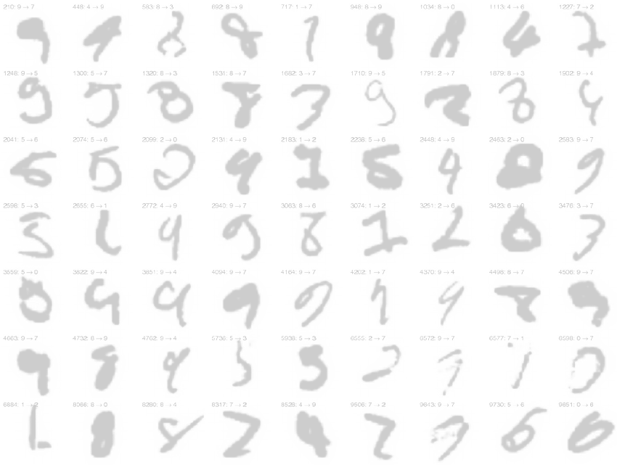
PR – Exercise 2a – SVM
Outline
Tools
Data transformation
Kernel functions
Grid search
Training & Testing
Output
Louis Müller and Sebastian Graf
Pattern Recognition, 2018, UniFr

Slide 2
Tools
Libsvm 3.22 by Chih-Chung Chang and Chih-Jen Lin
Super easy to understand and use
Bindings with most common programming languages and nice utils
… so we were sold!

Slide 3
Process outline
Data transformation
Kernel functions
Grid search
Training & Testing

Slide 4
Data transformation
Transform data (given MNIST dataset) into the suitable libsvm format
Simple scaling on the feature value range
No feature set reduction

Slide 5
Kernel functions
Gaussian RBF
performed best on MNIST out of the box
Smoothness
Polynomial
Sigmoid ~ Linear

Slide 6
Grid search
Use cross-validation to find the best parameter
Gaussian RBF Kernel
hyperparameters: C missclassification cost and gamma, how tight the Gaussian RBF should be.
Polinomial Kernel
C, gamma and degree

Slide 7
Grid search results (1/3)
Average accuracy
Gaussian RBF Kernel
10 fold Cross Validation on 3K images
gamma = 0.015625, C = 16
avg accuracy = 95.5%
5 fold CV on 1K images
gamma = 0.03125, C = 4
avg accuracy = 91.9%
Contrary to expectations: we got better results training with gamma = 0.03125 and C = 4

Slide 8
Grid search (2/3)
Average accuracy
Polynomial Kernel
10 fold Cross Validation on 3K images
gamma = 1, degree = 2, C = 32
avg accuracy = 94.63%
5 fold CV on 1K images
gamma = 0.25, degree = 2, C = 64
avg accuracy = 89.6%

Slide 9
Grid search (3/3)
Finer coarse - meaning more granular - search on gamma for RBF and Polynomial Kernels did not show any significant step up considering avg acc.
Best average accuracies for
1. Linear Kernel
settings: 3K Images, 10 fold CV
avg accuracy = 91.03% with C = 8
2. Sigmoid Kernel, same settings
avg accuracy = 91.67%
with gamma = 2^-10 and C = 32

Slide 10
Accuracy on the test set with optimized parameters
RBF Kernel
gamma = 0.03125, C = 4
Accuracy = 98.04% (14707/15001) (classification)
Polynomial Kernel
gamma = 1, degree = 2, C = 32
Accuracy = 97.5% (14623/15001) (classification)
RBF result validation: 10 fold CV on the entire training set, resulted in an avg accuracy = 97.95% (which holds against 98.04%)

