Slide 1
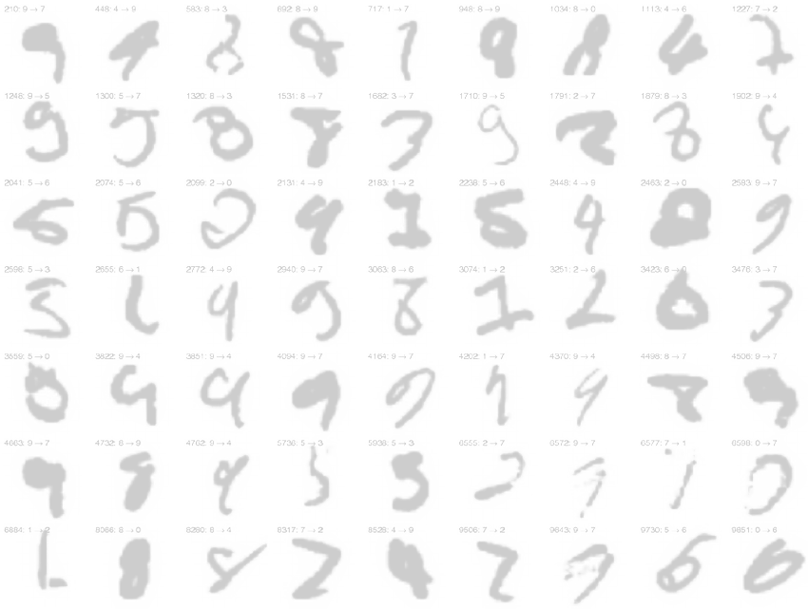
PR – Exercise 3 – Keyword Spotting
Outline
Problem and approach
Tools
Preprocessing
Feature extraction
Testing and results
Louis Müller and Sebastian Graf
Pattern Recognition, 2018, UniFr

Slide 2
Problem and overall approach
Keyword spotting in handwritten text
Dataset: Washington DB containing handwritten documents of George Washington
Word segmentation → one image each word
Image binarization, white space cropping and overall width & height normalization
Sliding window method for feature extraction
Compute DTW distance between sequences of feature vectors

Slide 3
Tools
.. we finally switched to Python
mply for DTW implementation
Pillow and OpenCV for image processing and MinMax feature value range scaling

Slide 4
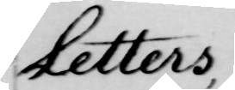

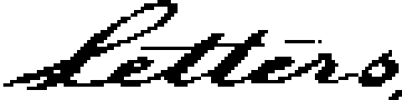
Preprocessing (½)
Images
Segmented word (png)
Binarized and white border cropped
Resized down to
120 x 30

Slide 5
Preprocessing (2/2)
Considerations
Resizing images on equal width & height, eg.: 200x200, didn't work for our feature set
  The contrast in images is already very decent and this made binarization straightforward
We did not deal with words with commas, points, punctuation in general

Slide 6
Feature extraction
Method: 1 px sliding window from left to right
Out of each 1px column of b&w pixels we computed:
  Overall fraction of black pixels
  Position of first black pixel, from above.
  uc (upper contour)
  Max number of consecutive black pixels
  Number of b&w transitions
Feature left out:
  Difference between previous uc and current uc

Slide 7
Testing (1/3)
Choices
DTW needs as train sample for each keyword search and we pick simply the first example we get out of the Transcript.txt
We decided to concentrate on the recall rate in order to try to spot all occurrences
We compute the recall rate out of a top 50 nearest spotted keywords

Slide 8
Testing (2/3)
Results
Even considering a top 50 list of nearest spotted keywords we have not a 100% recall rate
Using the entire keyword set we remain on a recall rate which is around 79%
I'd not consider our precision result because it is not meaningful: for each word we spot, we have top 50 list of nearest words, and 50 goes beyond the occurrences of many numbers in our set

Slide 9
Testing (3/3)
Results
Considering a top 20 list (because there is a word which occurs 20 times) we get a recall rate of 70%
and this somehow tells us that DTW is working
Concluding, about performance:
- having images of 120x30
- 4 features for each of the 120 columns
the computation time for a complete run is not that quick: ~45min for the entire keyword.txt (107 words) on all images (3'726), on an 5 year old
i7-3635MQ

