Slide 1
Start
PDE
DDE
ODE
Discretiziation in space
ODE
Biuld ODE with finite many control inputs
SUR Problem
Linearized problem
Build surrogate model for every control input
SUR with surrogate model
Lin.Pr. with surrogate model

Slide 2
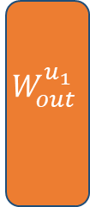



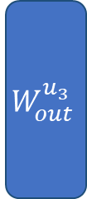
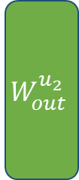
Input Layer
Reservoir Layer
Output Layer
$$W_{out}^{u_{1}}$$
$$W_{in}$$
$$W_{out}^{u_{2}}$$
$$x\left(t\right)$$
$$W_{out}^{u_{3}}$$
$$x\left(t+Δt\right)$$

