Slide 1

.Net Standard 2.0
John Titor
Goran Karacic

Slide 2
Agenda
Who am I?
.Net Today
What is .Net Standard 2.0
What’s new?
How does it work?
????? (Demo should be here)
Are my Shared projects/PCL’s compatible?
Demo will be here! :D
Final thoughts and timelines
Questions & …

Slide 3

Who am I?
Goran Karacic
26 years young from Croatia
former Microsoft Student Partner
WPF developer at Vicoinz
Ice Cream addict

Slide 4
.Net Today

Slide 5
.Net Today
.NET FRAMEWORK
.NET CORE
XAMARIN
APP
MODELS
WPF
Windows Forms
UWP
iOS
Android
ASP.NET
ASP.NET Core
OS X
BASE
LIBRARIES
Base Class Library
Core Library
Mono Class Library
COMMON INFRASTRUCTURE
Compilers
Languages
Runtime components

Slide 6
.Net Today
.NET FRAMEWORK
.NET CORE
XAMARIN
APP
MODELS
WPF
Windows Forms
UWP
iOS
CHALLENGES
Android
Difficult to reuse skills
Need to master 3+1 base class libraries
Difficult to reuse code
Need to target a small common denominator
Difficult to innovate
Need implementations on each platform
ASP.NET
ASP.NET Core
OS X
BASE
LIBRARIES
Base Class Library
Core Library
Mono Class Library
COMMON INFRASTRUCTURE
Compilers
Languages
Runtime components

Slide 7
PCLs Today
Platform 1
Platform 3
Platform 2
Intersection Profiles

Slide 8
.Net Standard 2.0

Slide 9
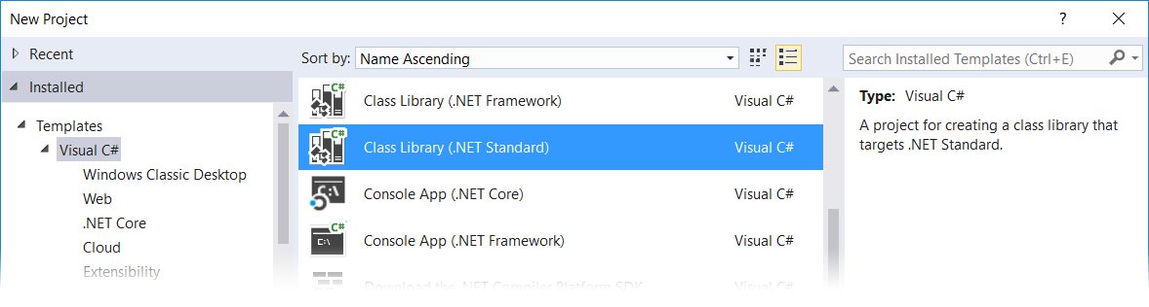
.Net Standard 2.0
.NET Standard is a specification
Represents a set of APIs that all .NET platforms have to implement
Is a type of class library & provided as a NuGet package

Slide 10
.Net Standard 2.0
.NET FRAMEWORK
.NET CORE
XAMARIN
APP
MODELS
WPF
Windows Forms
UWP
iOS
Android
ASP.NET
ASP.NET Core
OS X
BASE
LIBRARIES
.NET STANDARD
One BCL to rule them all
Base Class Library
Core Library
Mono Class Library
COMMON INFRASTRUCTURE
Compilers
Languages
Runtime components

Slide 11
.Net Standard 2.0
.NET FRAMEWORK
.NET CORE
XAMARIN
APP
MODELS
WPF
Windows Forms
UWP
iOS
BENEFITS
Reuse skills
Master one library, not a platform
Reuse code
Big surface area - no small common denominator
Faster innovation
.NET Standard can grow without updating platforms
Android
ASP.NET
ASP.NET Core
OS X
BASE
LIBRARIES
.NET STANDARD LIBRARY
One library to rule them all
BASE
LIBRARIES
Base Class Library
Core Library
Mono Class Library
Base Class Library
Core Library
Mono Class Library
COMMON INFRASTRUCTURE
Compilers
Languages
Runtime components

Slide 12
Targeting a .Net Standard
2.0
Higher versions incorporate all APIs from previous versions.
Projects targeting version X.Y can reference libraries & projects targeting any version between 1.0 and X.Y
Concrete .NET platforms implement a specific version of .NET Standard
From that platform you can reference libraries up to that version
1.6
1.3
1.0

Slide 13
What’s new?

Slide 14
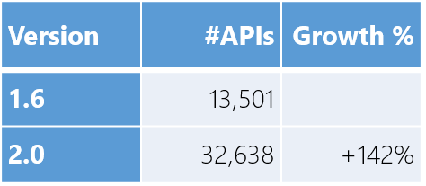
What’s new?
Many more APIs!
.NET standard 2.0 more than doubles the number of available APIs!

Slide 15
What’s new?
Compat with .NET Framework libs!
Most libraries are still targeting .NET Framework
A compat shim makes them usable on other platforms, with caveats
Target | Usage on NuGet
.NET Framework | 46,894
.NET Standard | 1,886
PCL | 4,501

Slide 16
What’s new?
XML
XLinq • XML Document • XPath • Schema • XSL
SERIALIZATION
BinaryFormatter • Data Contract • XML
DATA
Abstractions • Provider Model • DataSet
NETWORKING
Sockets • Http • Mail • WebSockets
IO
Files • Compression • MMF
THREADING
Threads • Thread Pool • Tasks
CORE
Primitives • Collections • Reflection • Interop • Linq

Slide 17
How does it work?

Slide 18
How does it work?
.NET Standard is represented by
The NuGet package NetStandard.Library which contains
The reference assembly netstandard.dll
At build time
.NET Standard bridges references to existing .NET Framework and PCL assemblies via type forwarding
At runtime
Each platform provides an implementation for netstandard.dll that type forwards to its implementation

Slide 19
How does it work?
.NET FRAMEWORK
.NET CORE
XAMARIN
My Standard Library 2.x
.NET Standard Library
Portable Class Library
.NET Framework Library
Legend
Is able to reference
Application Type
Via Portability
Via Compatibility Shim

Slide 20

How does it work?
YOUR .NET STANDARD-BASED CLASS LIBRARY
netstandard!Object
NETSTANDARD.DLL
DIFFERENT TYPE IDENTITIES (BAD)
TYPE
FORWARDING
.NET FRAMEWORK OR PORTABLE CLASS LIBRARY
mscorlib!Object
EXISTING .NET FRAMEWORK CLASS LIBRARY
MSCORLIB.DLL
MSCORLIB.DLL
MSCORLIB.DLL
FRAMEWORK ASSEMBLIES
This happens when you build a .NET Standard-based Library

Slide 21
How does it work?
YOUR .NET APPLICATION
FRAMEWORK ASSEMBLIES
TYPE
FORWARDING
YOUR .NET STANDARD-BASED CLASS LIBRARY
NETSTANDARD.DLL

Slide 22
Are my Shared projects/PCL’s compatible?

Slide 23
Final thoughts and timelines

Slide 24

That’s it!

