Slide 1
Stop using Entity Framework as a DTO provider!
https://www.youtube.com/watch?v=ZYfdjszs8sU
https://github.com/ChrisKlug/efcore-dto-demo

Slide 2
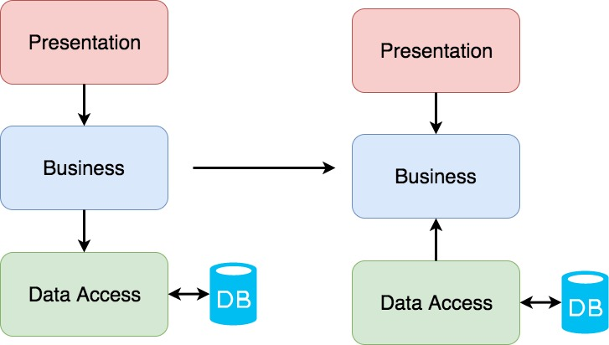
3-layer vs Clean architectures
https://crosp.net/blog/software-architecture/clean-architecture-part-1-databse-vs-domain/

