Slide 2
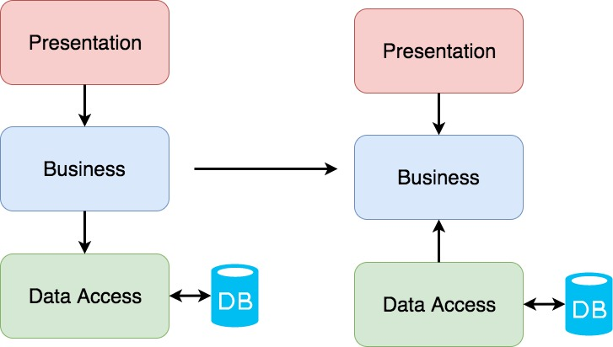
3-layer vs Clean architectures
https://crosp.net/blog/software-architecture/clean-architecture-part-1-databse-vs-domain/

