Slide 1

Coursera Capstone The Battle of Neighborhoods
Coursera Data Science Project
Sebastian Steiber

Slide 2
Description of the problem
We deal with the following fictive scenario:
A friend of mine wants to move from Morocco to NYC to open an African restaurant. He asked me to analyze where in NYC to open it. It should be a place with a high density of African population. On the other hand, the density of African restaurants should not be "too high" in order to prevent high competition.

Slide 3
Description of the Data
In order to find the best location for the restaurant we use data of NYC population from "Demographics of New York City“ (Link: "https://en.wikipedia.org/wiki/Demographics_of_New_York_City").
The data to analyze the local competition we get from Foursqauare API. On the basis of this data we try to find an optimum between the density of African population and local competition in order to determinethe the best place to open a restaurant.

Slide 4
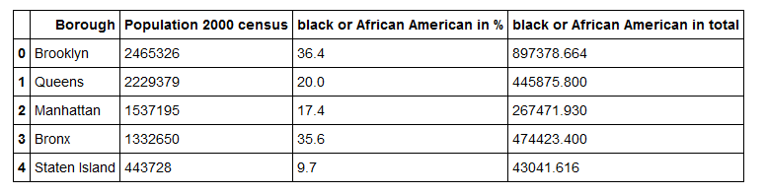
Methodology
I used data from "https://en.wikipedia.org/wiki/Demographics_of_New_York_City" to derive information on the ethnic diversity of New York City's boroughs:
Quelle:https://en.wikipedia.org/wiki/Demographics_of_New_York_City
On the other hand I analyzed data from FOURSIDE API to derive information on the competition which is expected in the boroughs by other African restaurants. Further details on the calculations are included as comments in the notebook.

Slide 5
Results

Slide 6
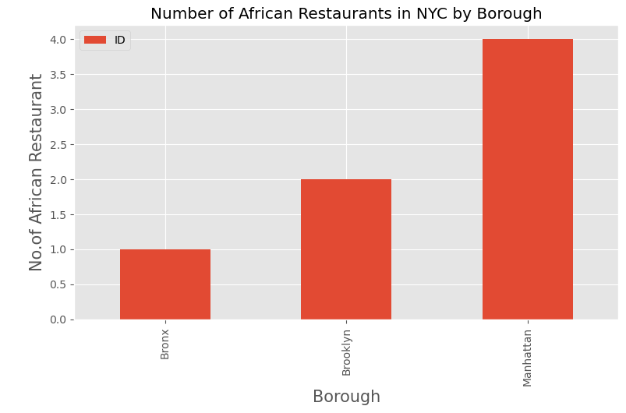
Part 1
First of all we see that the total number of African restaurants is very low in general.
Reasons for this need to bee further analyzed, but I do not have data for it. Reasons might be very different. Maybe it is not profitable to open an African restaurant in NYC at all.

Slide 7
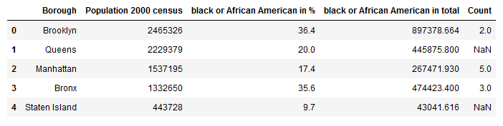
Part 2
We see that Brooklyn the borough with the highest black or African American population has only two African restaurant. The data is presented in the following table:
Bronx the borough with the second highest population has 3. Queens has none but on the other hand the total number of black or African American population is almost the same as in Bronx.

Slide 8
Discussion
I would recommend my friend to open a restaurant in Queens since there there is zero competition but almost as many black or African American as in Bronx who might be interested in local African cuisine.

Slide 9
Conclusion
I think the main point is that we need additional data to analyze the reason why there are only such a few African restaurants in NYC. If nevertheless my friend wants to open an African restaurant, i would recommend Queens for the reasons mentioned above.

