Slide 1
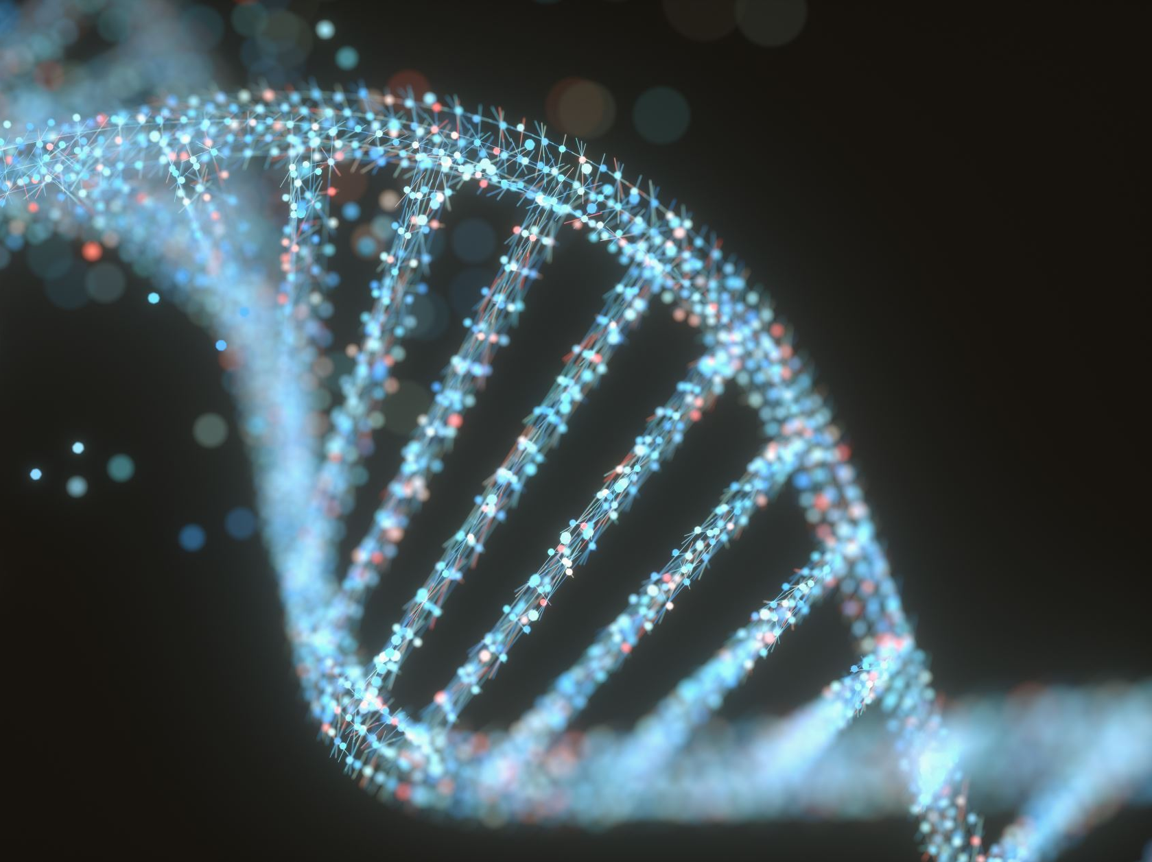
Biomarkers for the Identification of Prostate Cancer
Carson Hamel, Dylan Maillart, Lior Harouche, Sebastian Tirado [Group 4]
11-23-2021

Slide 2
Background
As the field of bioinformatics progressively plays a greater role in the development of cancer treatments, if becomes more important to pursue comparative investigations of tumor and non-tumor samples. These investigations can help expose certain biomarkers that can help us understand the natures of cancers and their pathologies, in addition to effective treatments.
Specifically, the investigations of biomarkers for identifying and understanding prostate cancer have become a large focus in the field of bioinformatics as prostate cancer accounts for about 15% of all cancer diagnoses worldwide.
However, further developments and holistic analyses are necessary in order to make greater advancements in the field. Thus, our group focused on this topic of major importance.

Slide 3
Introduction
The central question to our investigation is,
Can we identify prostate cancer in humans based on the tissues that we are examining?
This question is structured around the idea of being able to identify certain significant and consistent biomarkers that are associated with prostate cancer tumor-presence in human tissue. Being able to statistically pinpoint certain genes in our project is also dependent on the dataset that we utilized.
Our dataset was a set of tumor, bone marrow (involved), and non-tumor (distal) cell samples taken from several humans with prostate cancer. Each sample’s RNA-Seq data was used, and analyses compared each individual’s samples to each other
Controlled for inter-individual variation

Slide 4
Hypothesis
Hypothesis:
We will be able to use genomic data to find biomarkers that help us distinguish between prostate cancer tumor tissue samples and other tissue samples.
We think this due to the central dogma: DNA codes RNA, RNA makes proteins, and proteins take action in the body. Therefore, if the action in the body is different, like abnormal amounts of cellular reproduction, it stands to reason the genetic coding is also different. In addition, other forms of cancer can be clearly linked to external forces that change DNA such as radiation and skin exposure to sunlight.
Furthermore, our raw data can be processed through methods such as differential expression, enrichment analysis, and clustering in order to identify the desired biomarkers / genes.

Slide 5
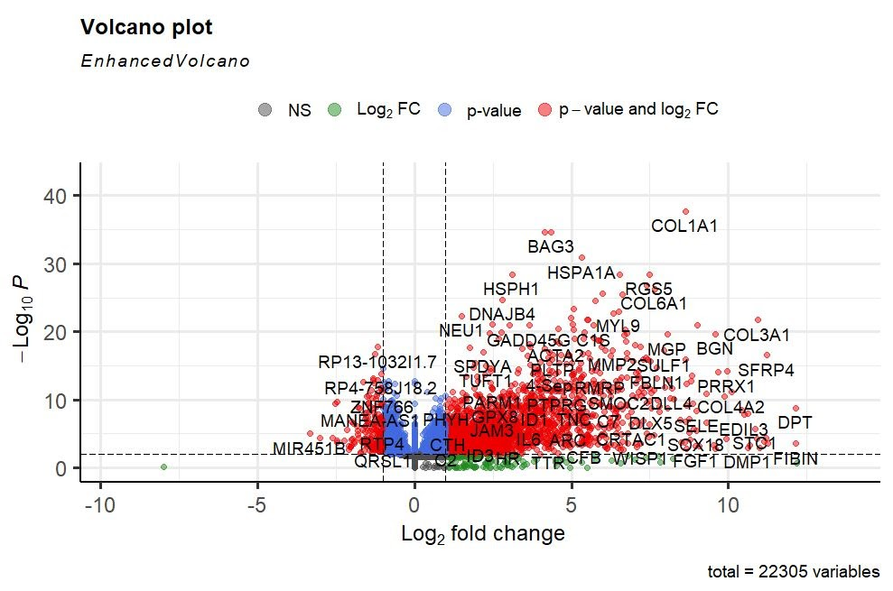
Differential Expression and Enrichment Analysis
We performed differential expression analysis on our tissue samples through the use of the DESeq2 package in R. Using this package, we formatted our data into a DESeqDataSet and performed the analysis using the DESeq() wrapper function.
To visualize the result, we created a volcano plot (using the EnhancedVolcano package) which plots the log2 fold change on the x-axis and the adjusted p-value on the y-axis.
An interesting result is that the gene COL1A1 seems to have a very high significance in the tumor tissues.

Slide 6
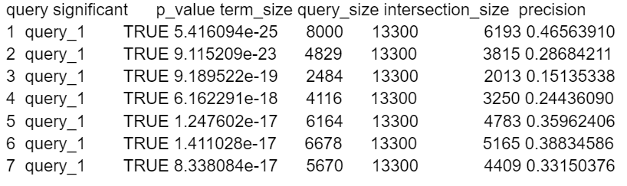
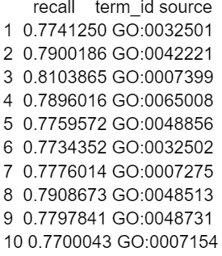

Differential Expression and Enrichment Analysis
GProfiler2 Gene Set Enrichment Analysis:
- Using GProfiler2, we generated the following table which shows the 10 most statistically significantly enriched genes and some statistical data to go along with the query.
- This shows that there are many genes which are extremely statistically significant, with a p-value with 19+ decimal places.

Slide 7
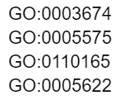
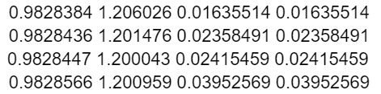
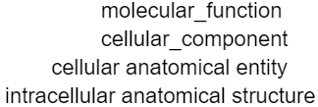
Differential Expression and Enrichment Analysis
ClusterProfiler Gene Set Enrichment Analysis:
- Using ClusterProfiler, we generated the following table which describes four sets of gene clusters and their corresponding descriptors: molecular_function, cellular_component, cellular anatomical entity, and intracellular anatomical structure.
- All four sets of data were found to be statistically significant as they produced p-values below 0.05.

Slide 8
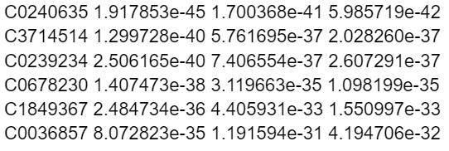
Differential Expression and Enrichment Analysis
ClusterProfiler Disease Ontology Enrichment Analysis:
- Using ClusterProfiler, we generated the following table which shows the 6 most statistically significantly enriched genes and some statistical data to go along with the query.
- This process, again, shows that there are many genes which are extremely statistically significant, as we found that all 6 of these genes produced remarkably low p-values.

Slide 9
Differential Expression and Enrichment Analysis
RESULTS:
- Overall, the results that we obtained from differential expression analysis and gene set/disease ontology enrichment analysis do help to support our hypothesis.
- As the goal of our hypothesis is to identify markers to distinguish between cancerous and non-cancerous prostate tissue samples, the low p-values obtained by the enrichment analysis suggests a way to identify this difference.
- However, without clustering, these results are not enough on their own to definitively answer our research question and fully support our hypothesis.

Slide 10
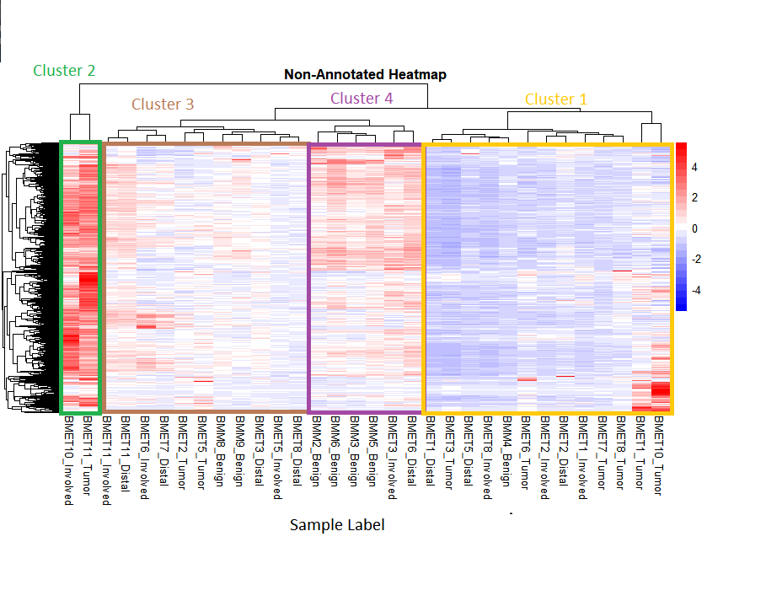
Clustering & Enrichment Analysis
HClust:
K-value of 4 found to be best fit for the clustering
Some clusters have clear patterns in the heatmap while others seem less closely related
Outlier cluster seen very clearly

Slide 11
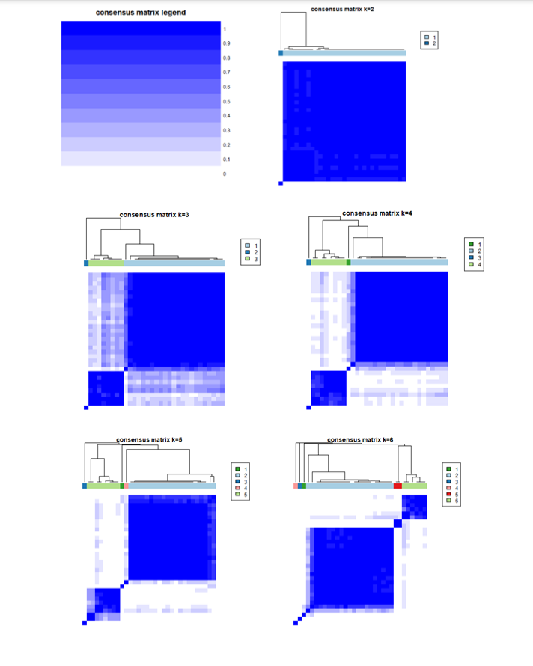
Clustering & Enrichment Analysis
Consensus Cluster Plus:
Maximum k-value is selected, and model is generated for all values from 2 to k
Very low number of clusters (2) and high (6) did not give good results
Best results found with k = 3
After 1000 genes, adding more genes does not affect clustering

Slide 12
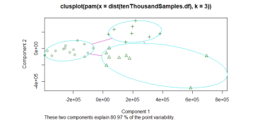
Clustering & Enrichment Analysis
PAM Clustering:
Best k found to be 3 with sufficient data
When using small numbers of genes, best k was 2
Note: outlier sample cluster combined into other cluster for this method

Slide 13
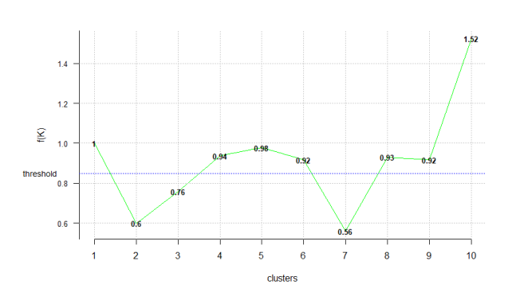
Clustering & Enrichment Analysis
KNN
K must be chosen for this method, using a sum of Euclidean distance f() we can find ideal k-values
The ideal k value depends on amount of data used (number of genes)
Best k is 7 for smaller number of genes (10, 100), 2 for higher number of genes (1000+)

Slide 14
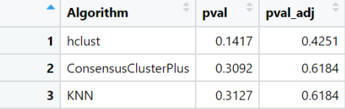
Clustering & Enrichment Analysis
Statistics:
Chi-square independence test used to test for statistical significance
None of our methods found a significant p-value, even before multi-hypothesis correction
Does not support our hypothesis as tests were unable to distinguish tumor and non-tumor samples

Slide 15
Clustering & Enrichment Analysis
Overall:
No clustering method was statistically significant in grouping our data into tumor and non-tumor samples, thus they did not support our hypothesis
Methods did not agree about the best k for our samples
This does not mean there are not defining features that distinguish these groups, but these clustering methods may not be the best way to find them
Outlier group of 2 samples that were very different may have confounded results
Splitting samples into benign and non-benign may show different results

Slide 16
Conclusions & Future Work
The broad approach in terms of analyses that was taken in this project served to thoroughly investigate our sample set of tissues. Although several of our clustering analyses produced confounding results and were limited in statistical significance, we did discover a large set of very differentially expressed genes and were able to focus on a few to further extend our understanding of the possible biomarkers, in addition to organizing future biomarkers to investigate that may prove important towards detecting prostate cancer.
Our hypothesis of believing that we would be able to find biomarkers in the tissue samples that would allow us to successfully identify prostate cancer in other human tissue samples has not been completely satisfied by our analyses. This is because although we found several significant genes, the overall statistical power was lacking in the array of analyses that we did. Overall, we were able to learn volumes regarding the most effective ways to analyze the data sets that we were provided and interpreting the respective findings.

Slide 17
Conclusions & Future Work
The future extensions of this project should incorporate a much more diverse and larger sample size of data across human samples for the purpose of not only aiding the statistical significance of any findings, but also for providing a more uniform representation of humanity as it pertains to prostate cancer diagnoses.
New Question: Since we were able to find a strong marker of COL1A1 gene which is known to promote metastitization in bowel and breast cancers, how might we be able to identify the different stages at which a cell is tumorous or not? This is also a relevant future direction to take since the idea of identifying general prostate-tumor related genes may be too large of a task, or possible an insignificant task if we cannot understand the genes in the context of their function.

Slide 18
Conclusions & Future Work
Thank you
for your time!

