Slide 1
Survival analysis of heart failure patients – based on a case study by Ahmad et al. (2017)
Data Science Applications – B0925
Sebastian Veuskens
Jose Gabriel Escarraman
Desmond Reynolds
Maximilian Schlake

Slide 2
Table of Contents
Introduction to the data
Univariate analysis
Multivariate Cox regression model
Base model
Reduced model
With time varying coefficients
Linearity test
Choice of the ‘best’ parametric model

Slide 3
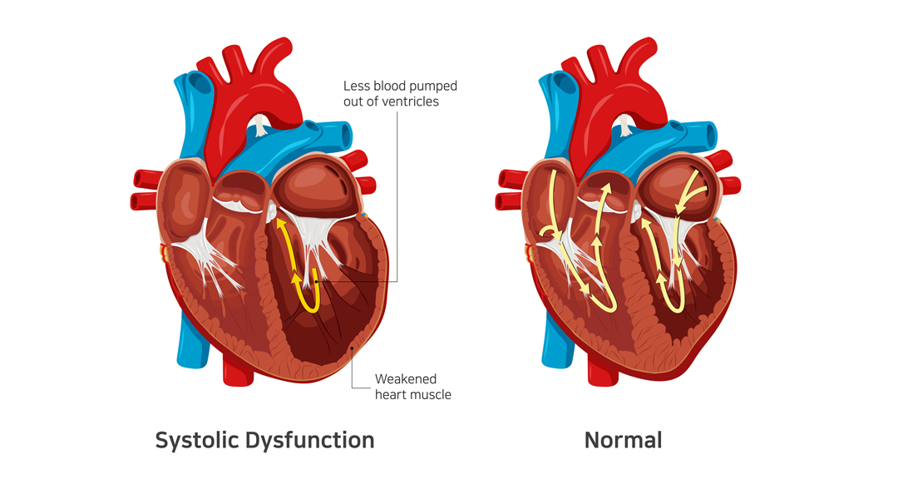
i. Introduction to the data
Data set:
299 patients of heart failure
105 women / 194 men
more than 40 years old
with left ventricular systolic dysfunction
Event: Death of the patient (32%)
TIME: Follow-up time (4 – 285 days)
Variable list:
Gender – 2 levels: 1 = male?
Smoking – 2 levels: 1 = yes?
Diabetes – 2 levels: 1 = yes?
BP (blood pressure) – 2 levels: 1 = high blood pressure?
Anaemia – 2 levels: 1 = yes?
Age – numerical*
Ejection.Fraction – integer*
Sodium – integer*
Creatinine – numerical*
Pletelets – numerical*
CPK (Creatine Phosphokinase) – integer*
* indicates that an additional factor variable with 4 levels was added
Notes:
Anaemia: Problem of not having enough healthy red blood cells or hemoglobin to carry oxygen to the body's tissues
Ejection fraction: Percentage of the total amount of blood in the heart that is pumped out with each heartbeat
Creatinine: Serum creatinine level is based on a blood test that measures the amount of creatinine in the blood. When the kidneys are not working well, serum creatinine level goes up.
Platelets: Pieces of very large cells in the bone marrow called megakaryocytes. They help form blood clots to slow or stop bleeding and to help wounds heal. Having too many or too few platelets or having platelets that don't work as they should can cause problems.
CPK (Creatine Phosphokinase): An enzyme (a protein that helps to elicit chemical changes in the body) found in the heart, brain, and skeletal muscles. When muscle tissue is damaged, CPK leaks into your blood. Therefore, high levels of CPK usually indicate some sort of stress or injury to the heart or other muscles

Slide 4
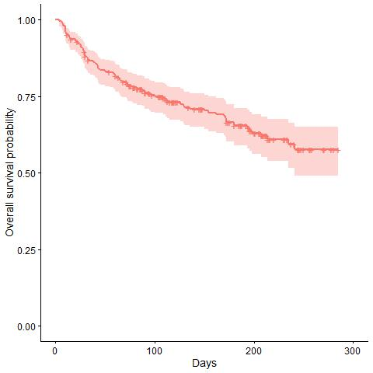
ii. Univariate analysis
Overall Survival Probability:

Slide 5
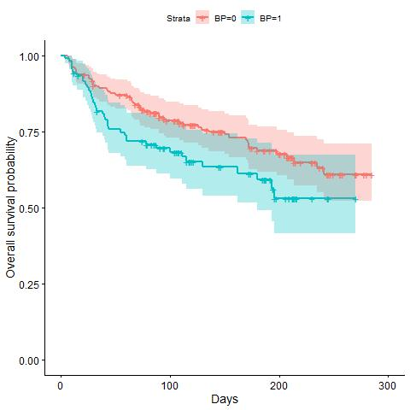
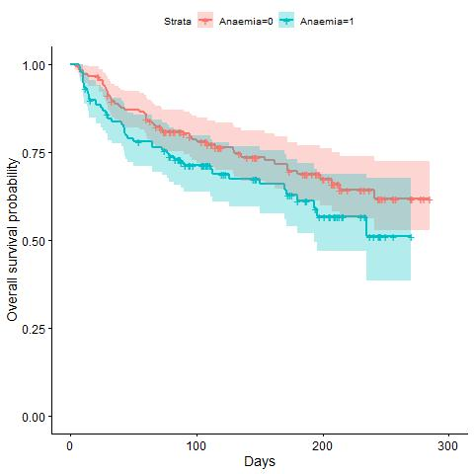
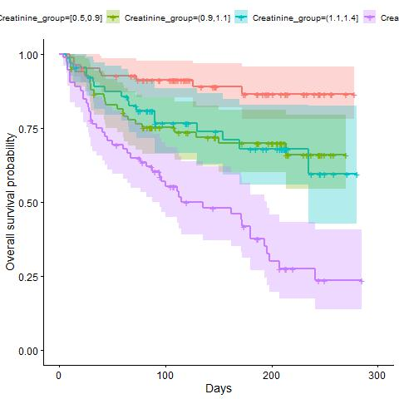
ii. Univariate analysis
Survival Probability by Blood Pressure, Anaemia and Creatinine_group:

Slide 6
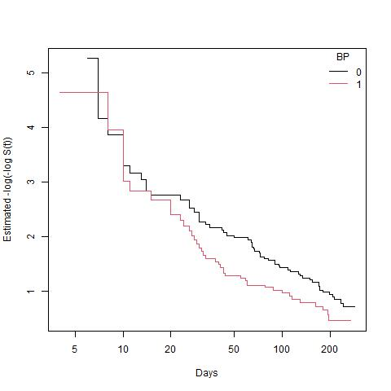
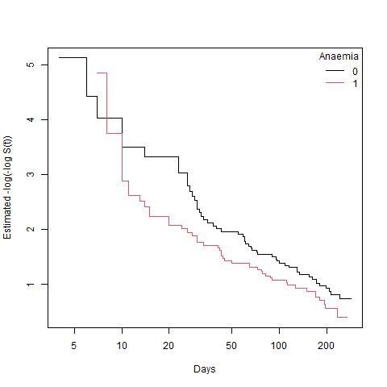
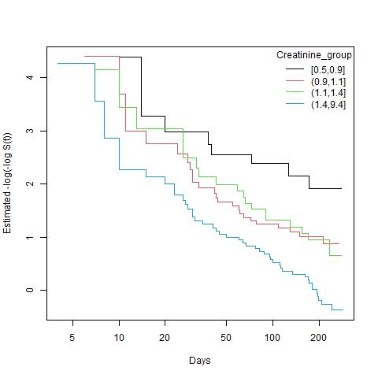
ii. Univariate analysis
Cloglog transformation to test PH assumption:

Slide 7
ii. Univariate analysis
Logrank and Wilcoxon tests: (* indicates significance on the 5%-level)
Variable | Logrank test (p-value) | Wilcoxon test (p-value)
Gender | 0.9 | 0.9
Smoking | 1.0 | 1.0
Diabetes | 0.8 | 0.9
BP | 0.04* | 0.03*
Anaemia | 0.1 | 0.08
Age_group | 0.000004* | 0.000007*
Ejection.Fraction | 0.0000006* | 0.000007*
Sodium_group | 0.001* | 0.002*
Creatinine_group | 0.000000001* | 0.000000008*
Pletelets_group | 0.3 | 0.2
CPK_group | 0.3 | 0.3

Slide 8
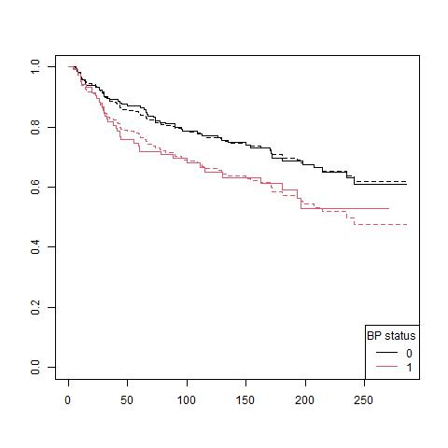
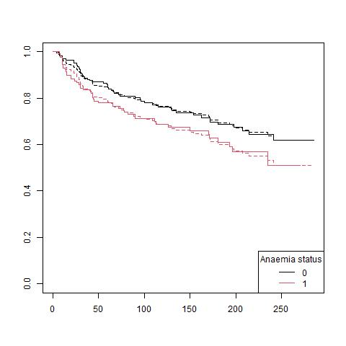
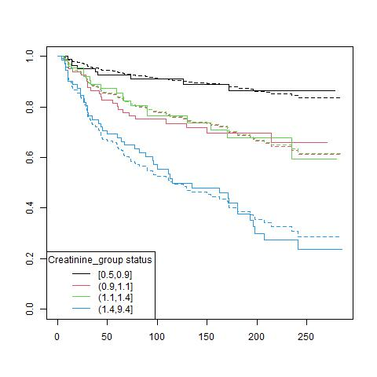
ii. Univariate analysis
Fitting KM vs. Cox:

Slide 9
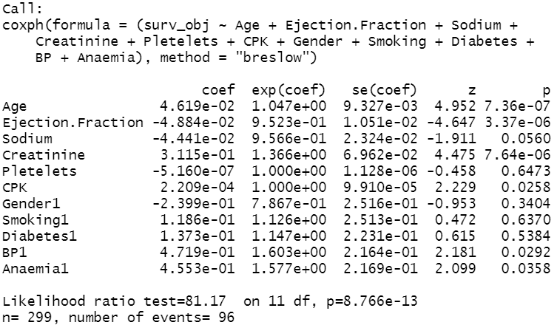
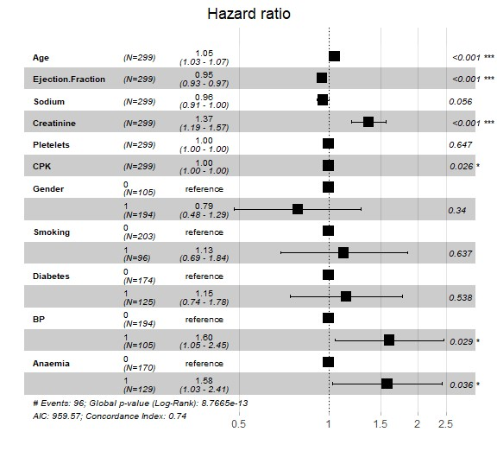
ii. Multivariate Cox regression model A. Base model
Significant risk factors: Age, Creatinine, BP, Anaemia
Significant protective factors: Ejection.Fraction,
Borderline cases: Sodium, CPK

Slide 10
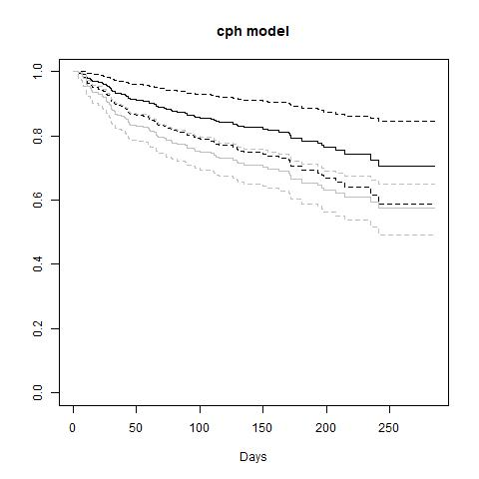
ii. Multivariate Cox regression model A. Base model
Cox Proportional Hazard model: The Cox model including all variables overestimates survival compared to the observed KM estimates.

Slide 11
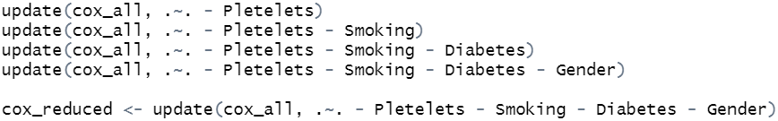
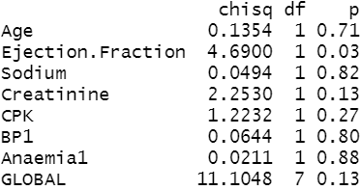
ii. Multivariate Cox regression model B. Reduced model
Backward selection: We are gradually reducing our baseline model, cox_all, by four variables which do not show significant effects. The remaining variables in cox_reduced are all significant.
Testing for proportional hazard: Globally, the PH assumption stands in all tests. Only Ejection.Fraction shows inconsistent behaviour for the PH assumption under the 'identity' and 'km’ transformations.

Slide 12
ii. Multivariate Cox regression model C. With time varying coefficients

Slide 13
iii. Linearity test

Slide 14
iv. Choice of the ‘best’ parametric model

Slide 15
References
Tanvir Ahmad, Assia Munir,Sajjad Haider Bhatti, Muhammad Aftab, Muhammad Ali Raza (2017): Survival analysis of heart failure patients: A case study, PLoS ONE 12(7), https://journals.plos.org/plosone/article?id=10.1371/journal.pone.0181001

