Slide 1
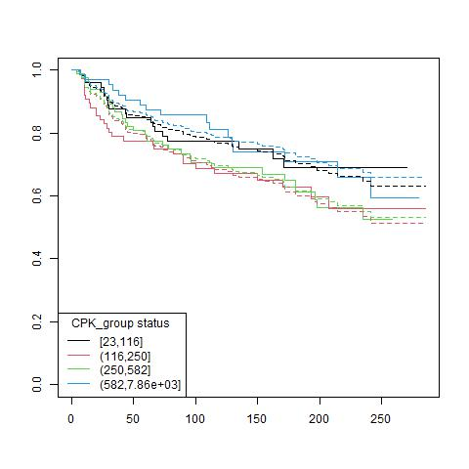
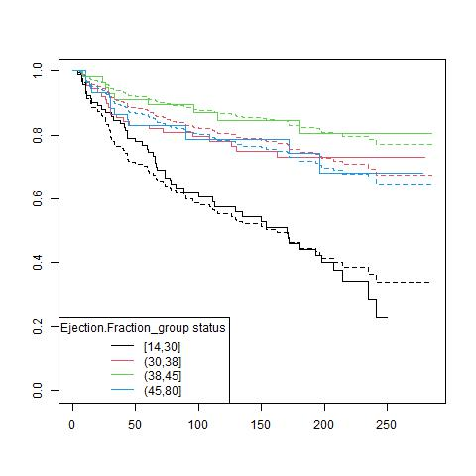
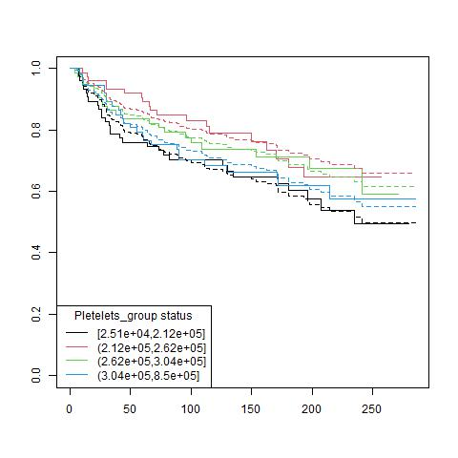
ii. Univariate analysis
Fitting KM vs. Cox:
Notes:
DONE: Show some bad examples like CPK

