Slide 1
Survival analysis of heart failure patients – based on a case study by Ahmad et al. (2017)
Data Science Applications – B0925
Sebastian Benno Veuskens
Jose Gabriel Escarraman Reyes
Desmond Reynolds
Maximilian Schlake

Slide 2
Table of Contents
Introduction to the data
Univariate analysis
Multivariate Cox regression model
Base model
Reduced model
Mode with time varying coefficients
Linearity test
Choice of the ‘best’ parametric model

Slide 3
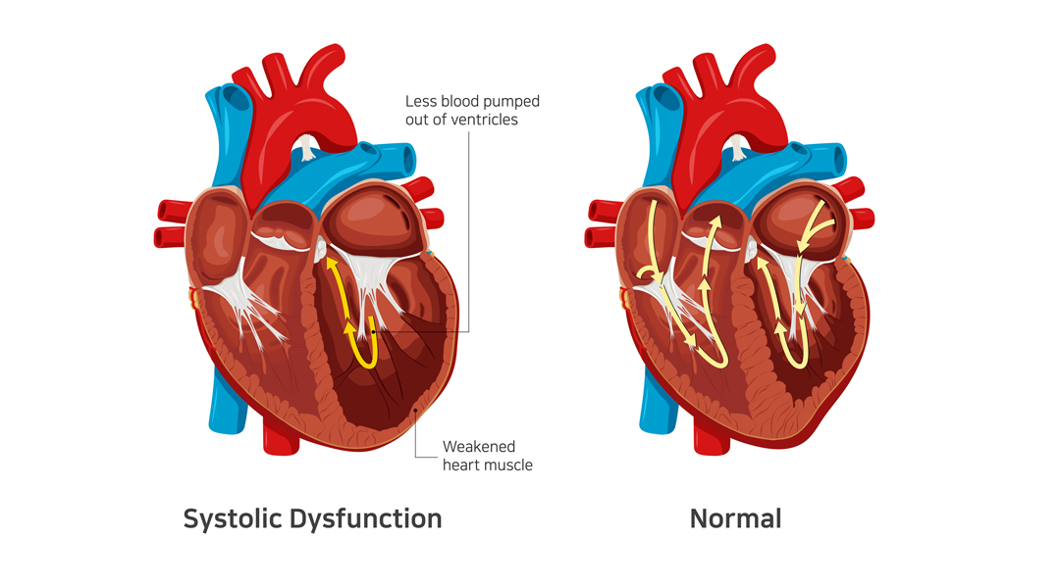
i. Introduction to the data
Data set:
299 patients of heart failure
105 women / 194 men
more than 40 years old
with left ventricular systolic dysfunction
Event: Death of the patient (32%)
TIME: Follow-up time (4 – 285 days)
Variable list:
Gender – 2 levels: 1 = male
Smoking – 2 levels: 1 = yes
Diabetes – 2 levels: 1 = yes
BP (blood pressure) – 2 levels: 1 = higher than normal
Anaemia – 2 levels: 1 = yes
Age – numerical*
Ejection.Fraction – integer*
Sodium – integer*
Creatinine – numerical*
Pletelets – numerical*
CPK (Creatine Phosphokinase) – integer*
* indicates that an additional factor variable with 4 levels was added
Notes:
Anaemia: Problem of not having enough healthy red blood cells or hemoglobin to carry oxygen to the body's tissues
Ejection fraction: Percentage of the total amount of blood in the heart that is pumped out with each heartbeat
Creatinine: Serum creatinine level is based on a blood test that measures the amount of creatinine in the blood. When the kidneys are not working well, serum creatinine level goes up.
Platelets: Pieces of very large cells in the bone marrow called megakaryocytes. They help form blood clots to slow or stop bleeding and to help wounds heal. Having too many or too few platelets or having platelets that don't work as they should can cause problems.
CPK (Creatine Phosphokinase): An enzyme (a protein that helps to elicit chemical changes in the body) found in the heart, brain, and skeletal muscles. When muscle tissue is damaged, CPK leaks into your blood. Therefore, high levels of CPK usually indicate some sort of stress or injury to the heart or other muscles

Slide 4
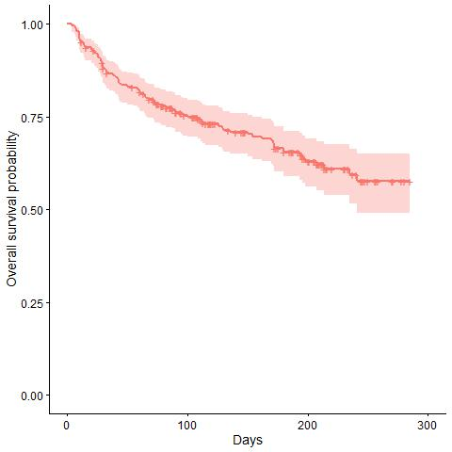
ii. Univariate analysis
Overall Survival Probability:

Slide 5
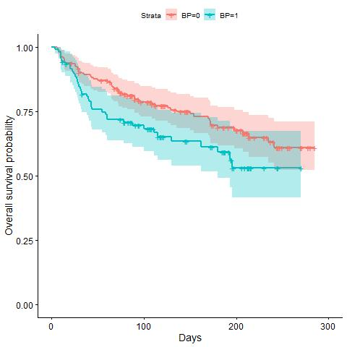
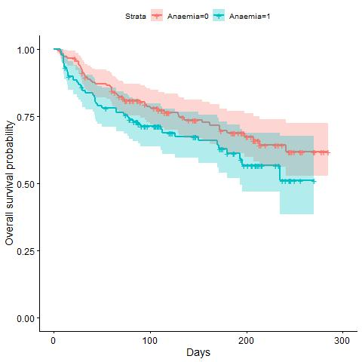
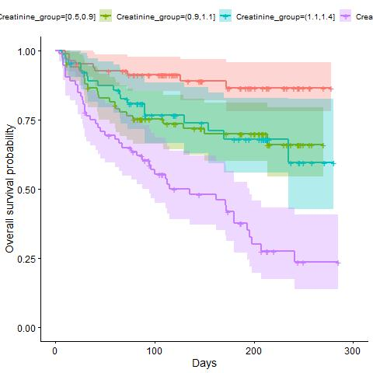
ii. Univariate analysis
Survival Probability by Blood Pressure, Anaemia and Creatinine_group:
Notes:
SOLVED: As explained in the code, we could decide to go for a 3-way instead of 4-way split for the Creatinine variable. The two levels in the middle are very close (also in the next slide)-> NO

Slide 6
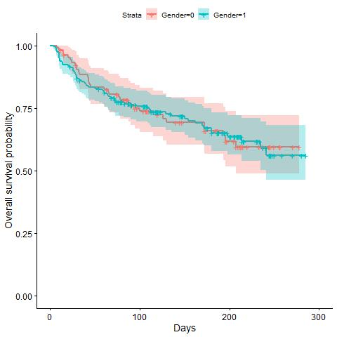
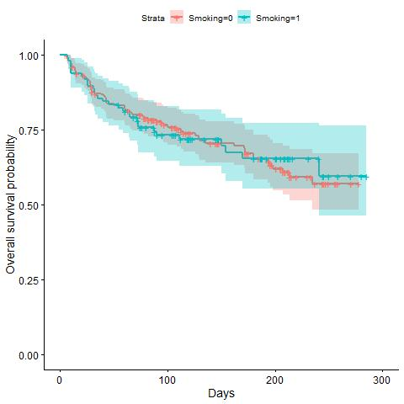
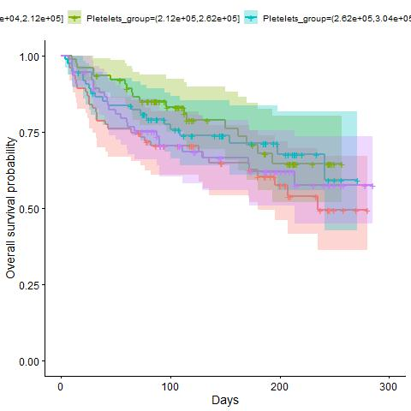
ii. Univariate analysis
Survival Probability by Gender, Smoking and Pletelets_group:
Notes:
DONE: add some badly separated aswell

Slide 7
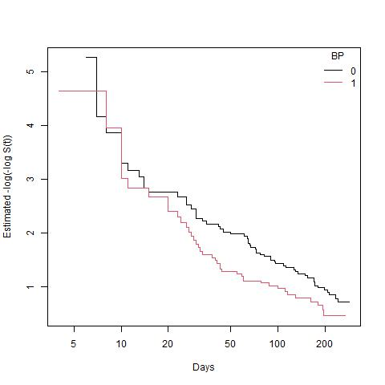
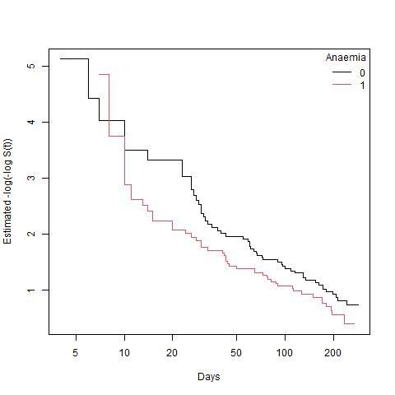
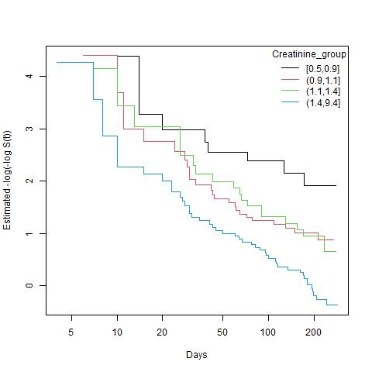
ii. Univariate analysis
Cloglog transformation to test PH assumption:
Notes:
SOLVED: I am not sure if these three variables qualify as PH, as there are still some overlaps between the lines. If yes, then we should argue on the next slide that the logrank test can only be considered for these 3. For the rest, Wilcoxon should be looked at.

Slide 8
ii. Univariate analysis
Logrank and Wilcoxon tests: (* indicates significance on the 5%-level)
Variable | Logrank test (p-value) | Wilcoxon test (p-value)
Gender | 0.9 | 0.9
Smoking | 1.0 | 1.0
Diabetes | 0.8 | 0.9
BP | 0.04* | 0.03*
Anaemia | 0.1 | 0.08
Age_group | 0.000004* | 0.000007*
Ejection.Fraction | 0.0000006* | 0.000007*
Sodium_group | 0.001* | 0.002*
Creatinine_group | 0.000000001* | 0.000000008*
Pletelets_group | 0.3 | 0.2
CPK_group | 0.3 | 0.3
Notes:
With PH, the logrank test is more powerful. Without it is better to use Wilcoxon.

Slide 9
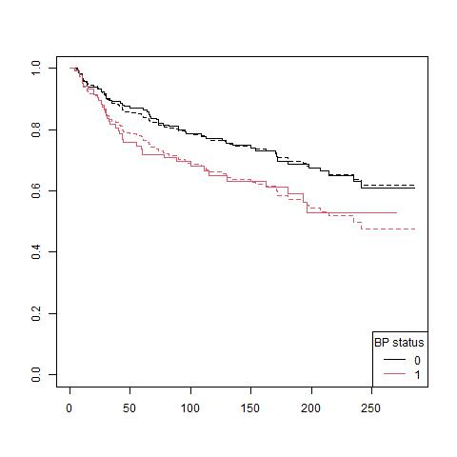
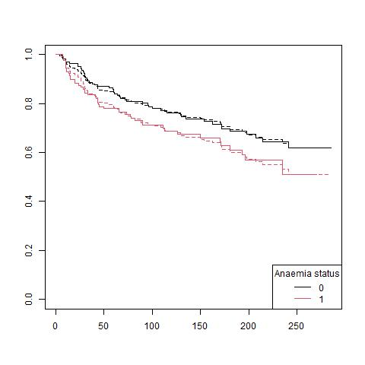
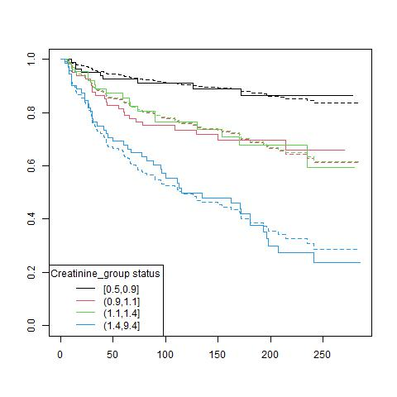
ii. Univariate analysis
Fitting KM vs. Cox:

Slide 10
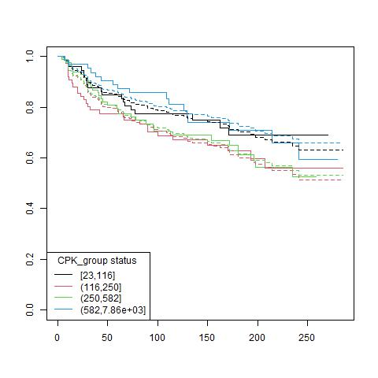
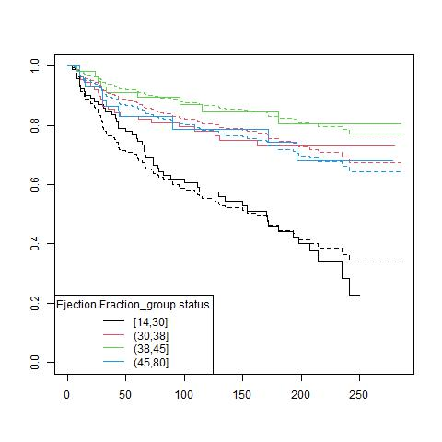
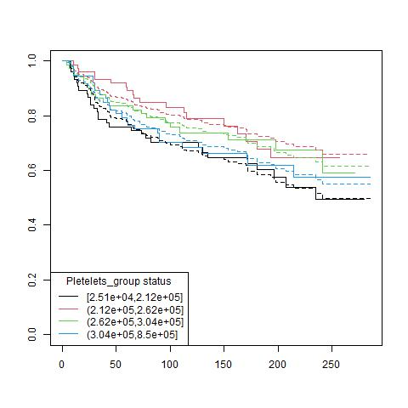
ii. Univariate analysis
Fitting KM vs. Cox:
Notes:
DONE: Show some bad examples like CPK

Slide 11
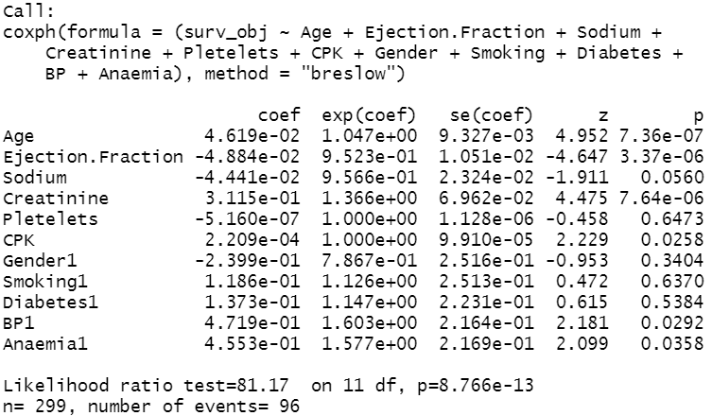
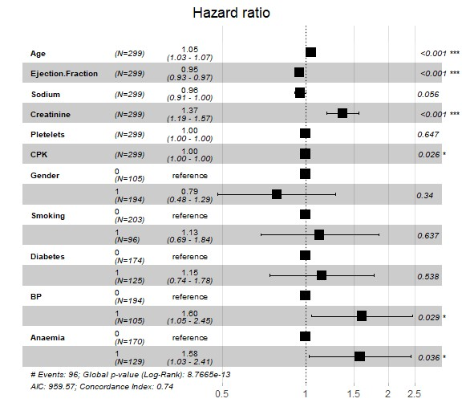
iii. Multivariate Cox regression model A. Base model
Significant risk factors: Age, Creatinine, BP, Anaemia, CPK
Significant protective factors: Ejection.Fraction
Borderline cases: Sodium
Notes:
For CPK, the exact value is: exp(coef) = 1.000221 -> significant risk factor

Slide 12
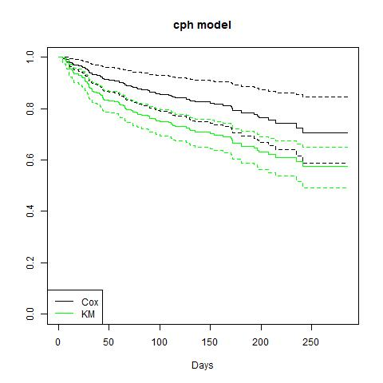
iii. Multivariate Cox regression model A. Base model
Cox Proportional Hazard model: The Cox model including all variables overestimates survival compared to the observed KM estimates.
Notes:
DONE: add legend and change color of KM

Slide 13
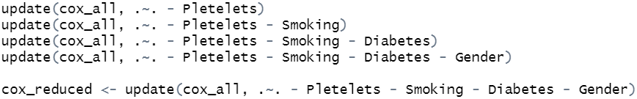
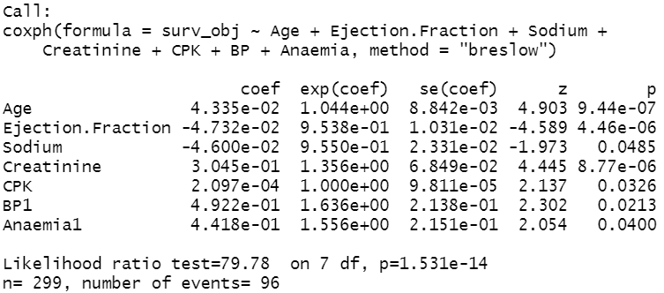
iii. Multivariate Cox regression model B. Reduced model
Backward selection: gradually reduce our baseline model, cox_all, by four variables which do not show significant effects.
The remaining variables in cox_reduced are all significant.
Significant risk factors: Age, Creatinine, BP, Anaemia, CPK
Significant protective factors: Ejection.Fraction, Sodium
Notes:
For CPK, the exact value is: exp(coef) = 1.000221 -> significant risk factor

Slide 14
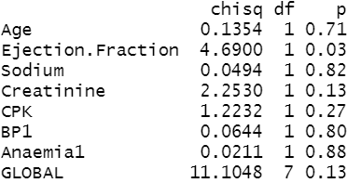
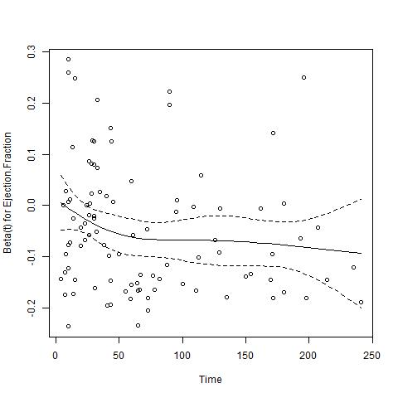
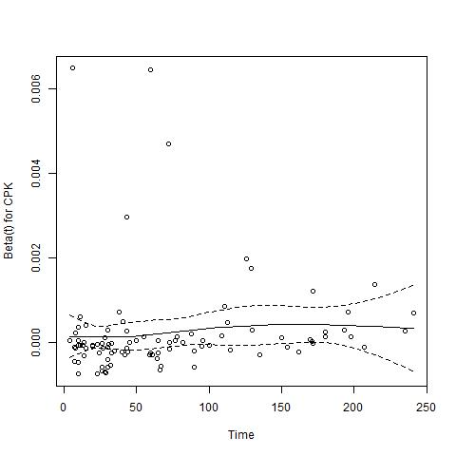
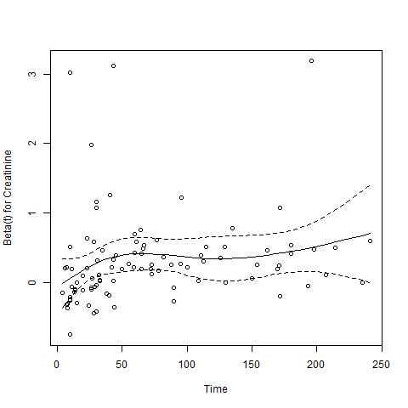
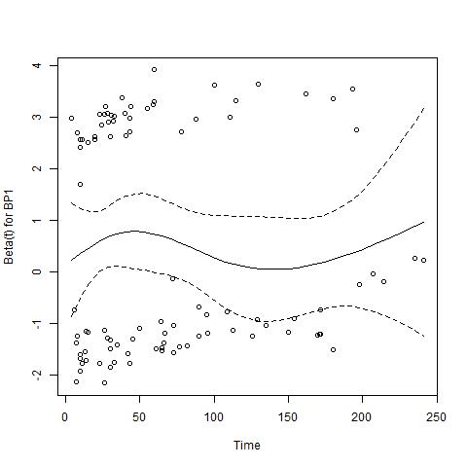
iii. Multivariate Cox regression model C. Reduced model
Global test on Schoenfeld residuals: Globally, the PH assumption stands in all tests (under ‘identity’, ‘rank’, ‘log’, and ‘km’ transformations).
Only Ejection.Fraction shows inconsistent behaviour: The PH assumption is rejected under the 'identity' and 'km’ transformations.
Generally, the Schoenfeld residuals show a mixed behaviour:
Notes:
SOLVED: Globally, the PH assumptions holds, but all our residuals look pretty non-constant. How does that fit together? -> 1) depends on the scale, 2) CIs seem to include a constant line

Slide 15
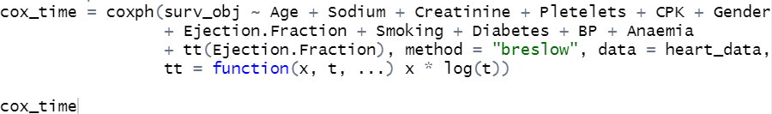
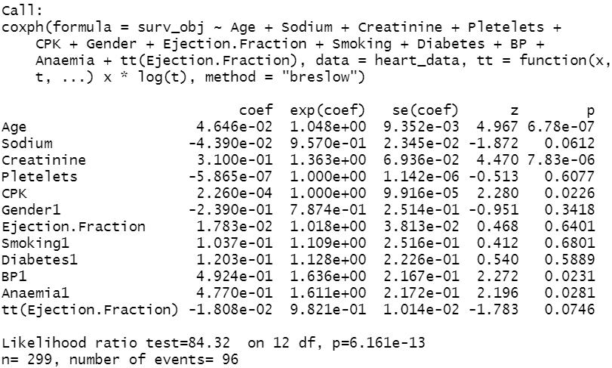
iii. Multivariate Cox regression model C. Model with time varying coefficients
Refitting with time varying coefficient: We are fitting another model, called cox_time.
It includes an interaction of Ejection.Fraction with the logarithm of time.
The interaction is not yet shown as significant on the 5% level.
Notes:
SOLVED: We go for the model with log(time) instead of just time here, right? -> yes
DONE: change to complete time model

Slide 16
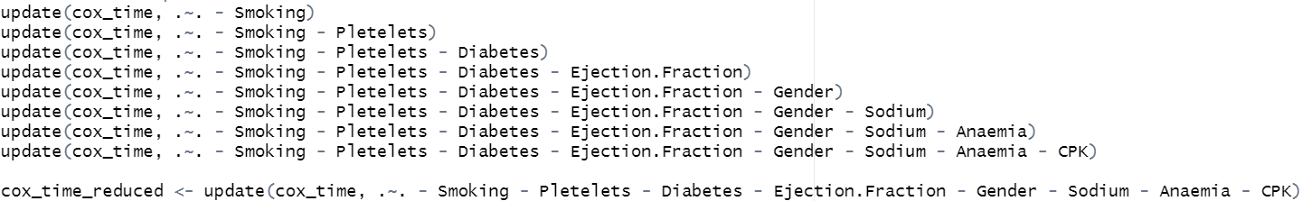
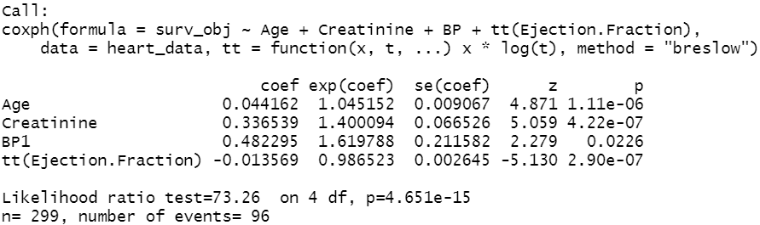
iii. Multivariate Cox regression model C. Model with time varying coefficients
We perform another backward selection on cox_time, until we are left with significant coefficients only.
This gives us: cox_time_reduced
We can see that the log(time) interaction with Ejection.Fraction remains as a significant factor.
This points back to the Global test on Schoenfeld residuals: However, note that the PH assumption was not rejected for the log transformation of time, but for ‘identity’ and ‘km’.
Significant risk factors: Age, Creatinine, BP
Significant protective factors: tt(Ejection.Fraction)
Notes:
DONE: change to complete time model

Slide 17
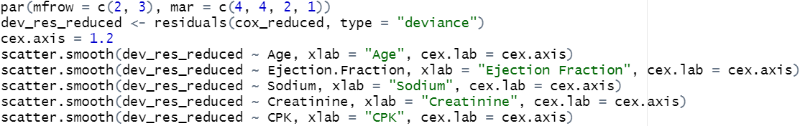
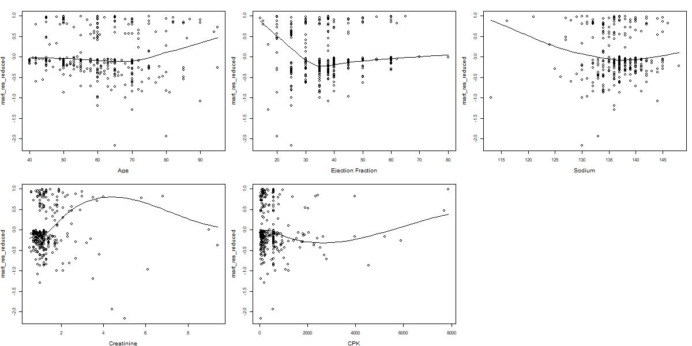
iv. Linearity test
Martingale residuals are clearly showing some trends
Notes:
Note: Martingale residuals are useful to check the linearity assumption as it gives us an idea of the effect for each covariate
Question: Should we give any reason why we are choosing cox_reduced here? -> still open

Slide 18
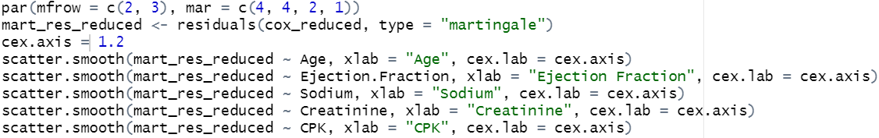
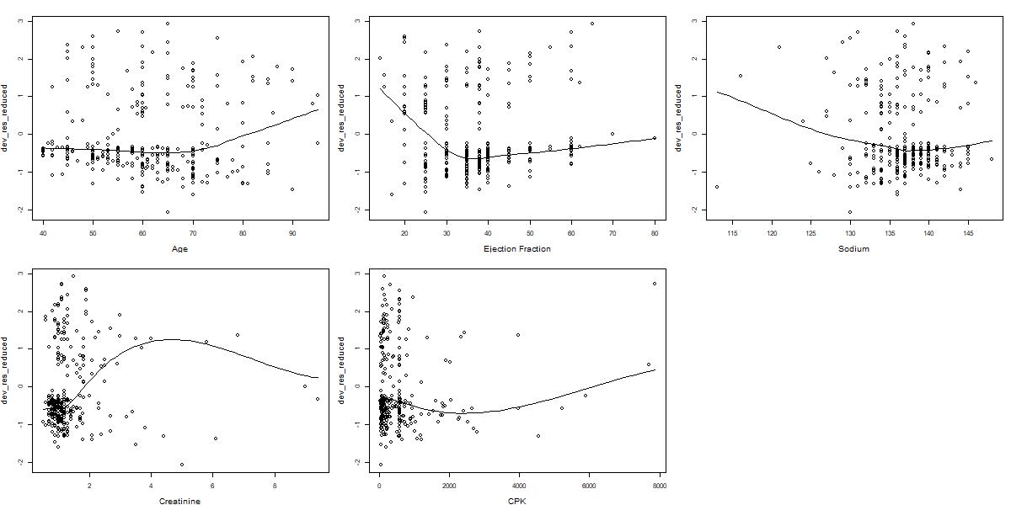
iv. Linearity test
Deviance residuals are clearly showing some trends
Notes:
Note: Deviance residuals are transformations of Martingale residuals. They can be used more or less like standardized residuals for linear models

Slide 19
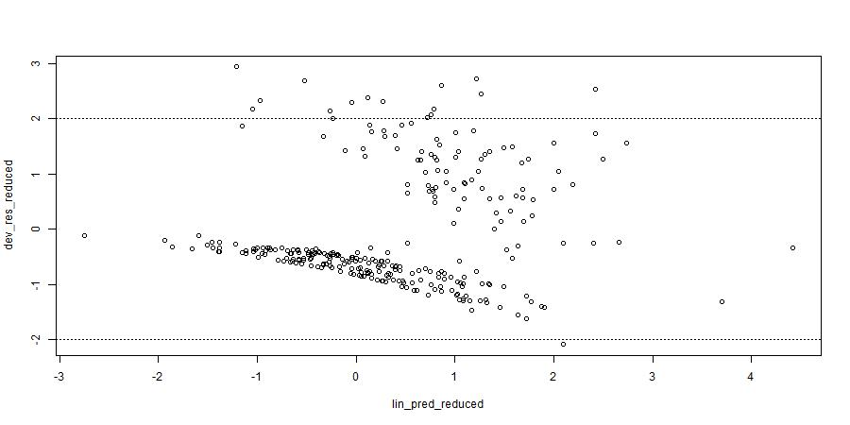
iv. Linearity test
Plotting deviance residuals against the linear predictor (for cox_reduced)
We do not seem to have any outliers, as all deviance residuals are smaller than 3 in absolute terms. The mean is close to zero. However, the residuals are not evenly scattered and we are seeing a slightly decreasing trend. Also, we can recognize two clusters in the data.
Notes:
Question: Not sure how else to interpret this part. Basically our linearity assumption is does not hold which gives us another argument for the Royston/Altman test? (next slide)

Slide 20
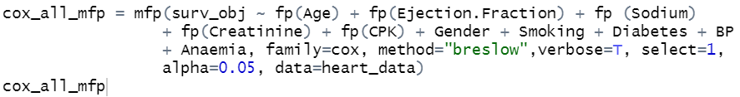
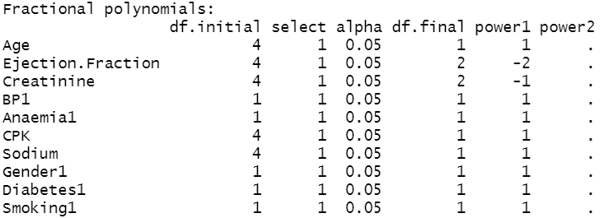
iv. Linearity test
To deal with the issue of nonlinearity in our quantitative variables, fractional polynomials are used which gives us the model: cox_all_mfp
The test from Royston & Altman (1994) indicates that the variables Ejection.Fraction should be added to the model with a negative power of -2 and the variable Creatinine with a negative power of -1, the other variables can be left in their linear form.
Notes:
Note: Deviance residuals are transformations of Martingale residuals. They can be used more or less like standardized residuals for linear models

Slide 21

iv. Linearity test
Comparison with AIC:
Model | AIC
cox_reduced | 952.97
cox_time_reduced | 953.48
cox_all_mfp | 938.76
Notes:
DONE: add AIC

Slide 22
v. Choice of the ‘best’ parametric model
Comparison with AIC & BIC:
Model | AIC | BIC
Exponential PH | 1280.421 | 1324.827
Weibull PH | 1282.236 | 1330.341
Gompertz PH | 1333.842 | 1381.948
Log-Normal AFT | 1287.371 | 1335.477
Gamma AFT | 1301.284 | 1353.090
Log-Logistic AFT | 1310.362 | 1358.468

Slide 23
v. Choice of the ‘best’ parametric model
Hazard function of Exponential PH model

Slide 24
References
Tanvir Ahmad, Assia Munir,Sajjad Haider Bhatti, Muhammad Aftab, Muhammad Ali Raza (2017): Survival analysis of heart failure patients: A case study, PLoS ONE 12(7), https://journals.plos.org/plosone/article?id=10.1371/journal.pone.0181001

