Slide 1
Experimental Study:
How sequentially shown information facilitates performance of working memory: A comparison between single- and multimedia presentations
Final Presentation - Group Project KP HT2019 - Group 1 - Sebastian Veuskens, Thomas Castro, Thibaud Marchand and Lena Spitz

Slide 2
Contents
Theoretical Background
Experimental Study
Results
Discussion
Limitations

Slide 3
Background
Central Executive
Topic: Working Memory
Phonological Loop
Visuospatial Sketchpad
words
annotated pictures
pictures
Notes:
Working Memory: (by Baddeley in 1986) to remember practical information needed to perform a task. Central executive, 2 slave systems. Phonological Loop: inner voice + ear to repeat words. Visuospatial Sketchpad: visually imagine pictures in the mind. Both to remember.
Follows that words -> phonologcal loop, pictures -> visuospatial sketchpad (though there is some overlap) -> which is better?
Multimedia combines single media (pics + words), therefore uses both slave systems -> possibly better remembering?

Slide 4
Research Question
How does the type of presentation of items (words, pictures, or both) affect the human working memory, and is one type better to memorize as much items as possible?
Notes:
Therefor our research question is: How does presentation of items affect working memory, and is one of them better?

Slide 5
Experiment
Dependent variable: working memory -> here: amount of correctly remembered items
Independent variable: presentation of items -> pictures, words, annotated pictures
Control variables:
Minimum English level: B1
Items to remember are always the same, regardless of presentation
Items are sequentially displayed for a set amount of time (2 seconds)
Items are presented in the same size in the same way in a controlled environment
Notes:
Experiment: we show items to participants in different ways and then ask them to list the items they remember seeing in order to evaluate the working memory.
Working memory performance in therefore our dependent variable -> we evaluate it by counting the amount of correctly remembered items.
Independent variable is the presentation of the items, here as either pictures, words or annotated pictures for the multimedia angle.
Control variables are the english level or participants, it needs to be a minimum of B1 so they can like… know what the items are.
Items are always the same, they are always shown the same way for an exact amount of time (2s) in a controlled environment (booked group room)

Slide 6
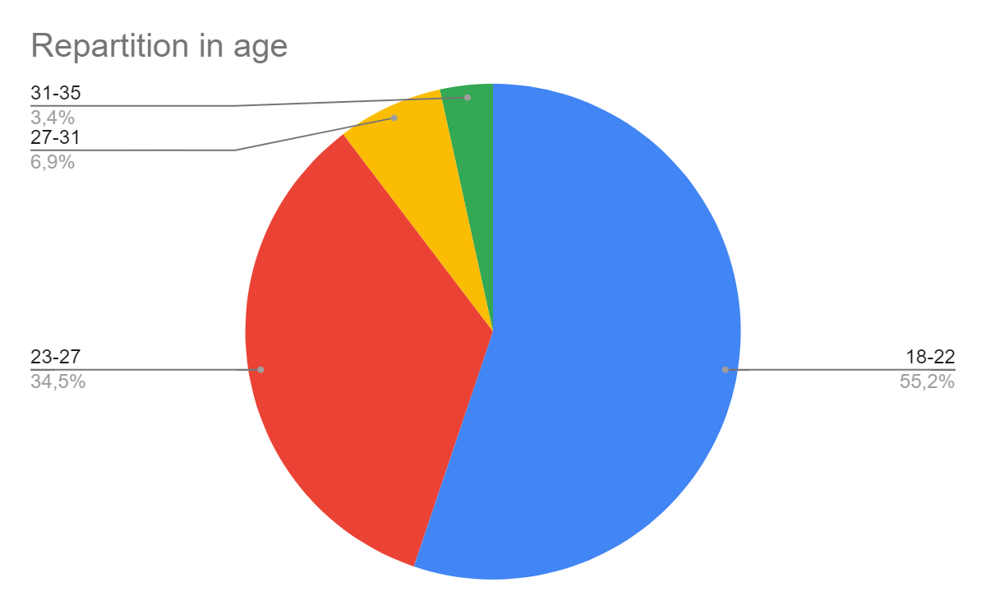
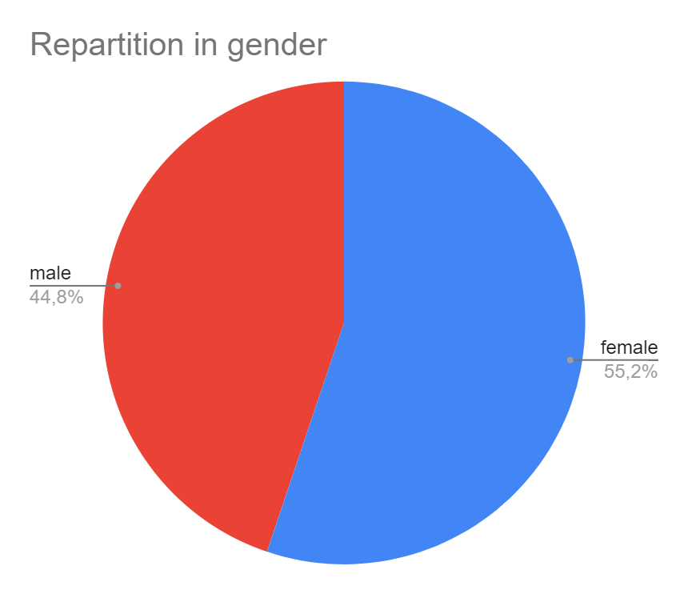
Results
30 participants
Notes:
10 participants per presentation

Slide 7
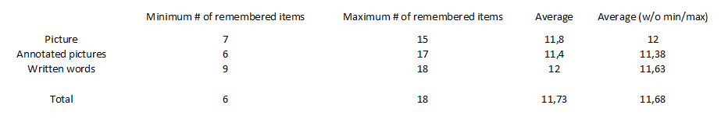
Results

Slide 8
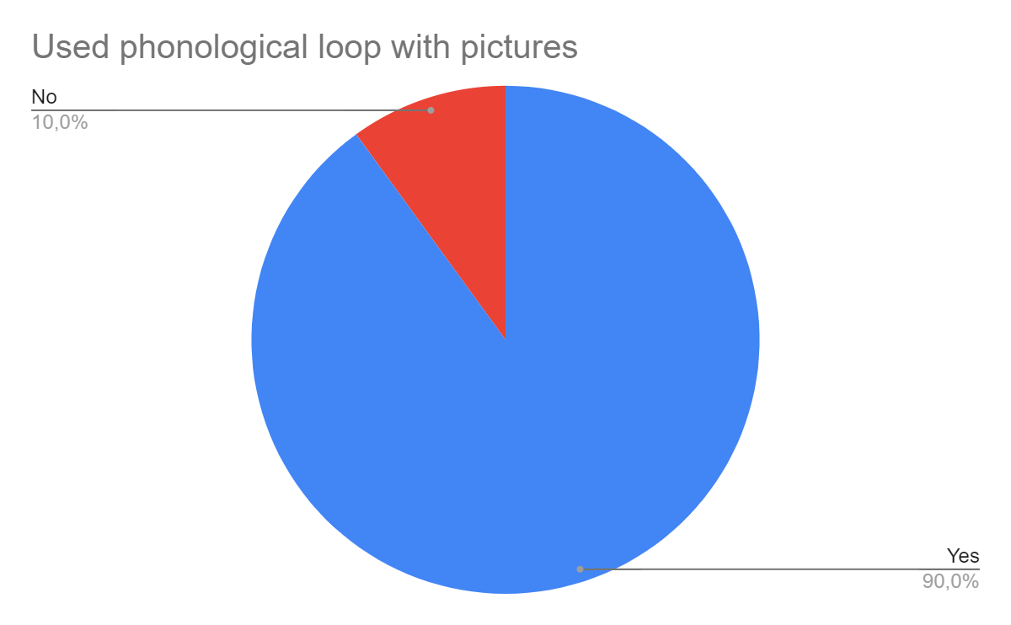
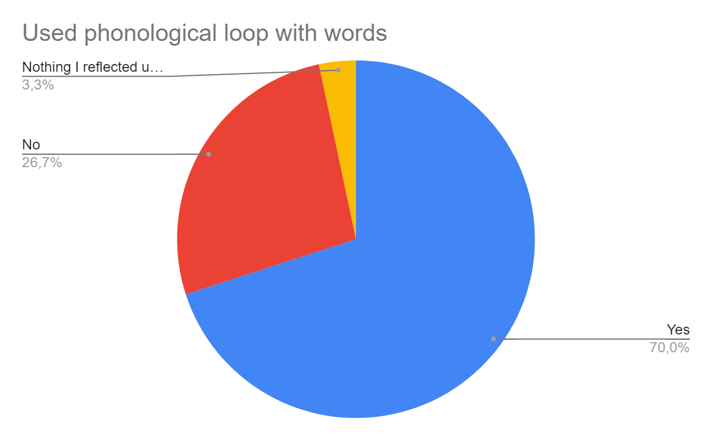
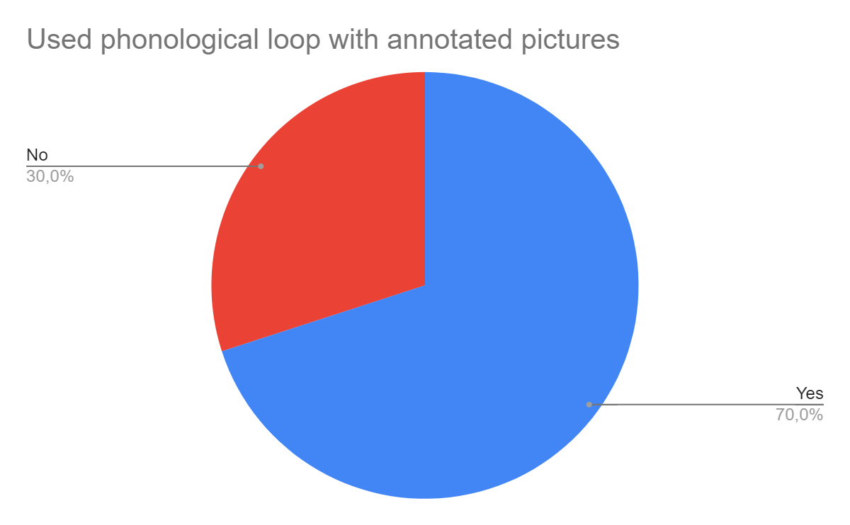
Use of phonological loop

Slide 9
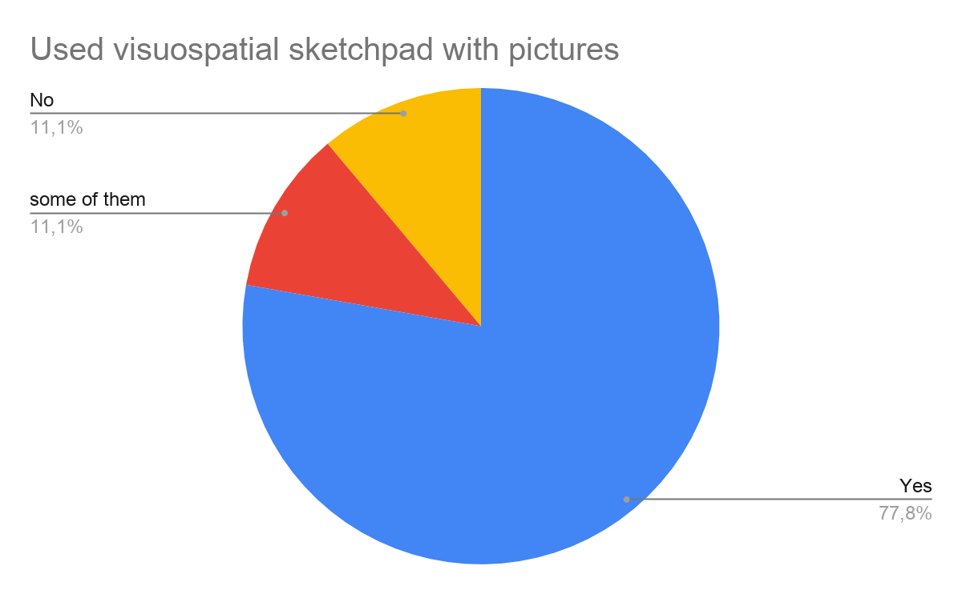
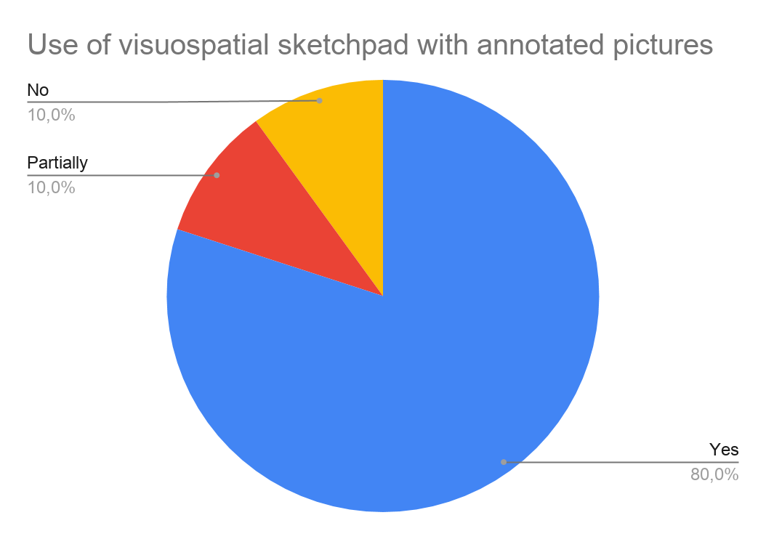
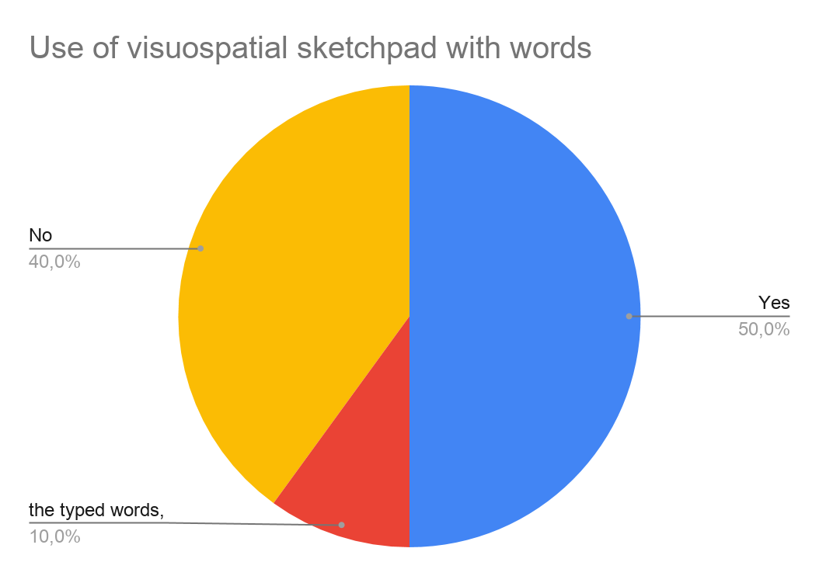
Use of visuospatial sketchpad

Slide 10
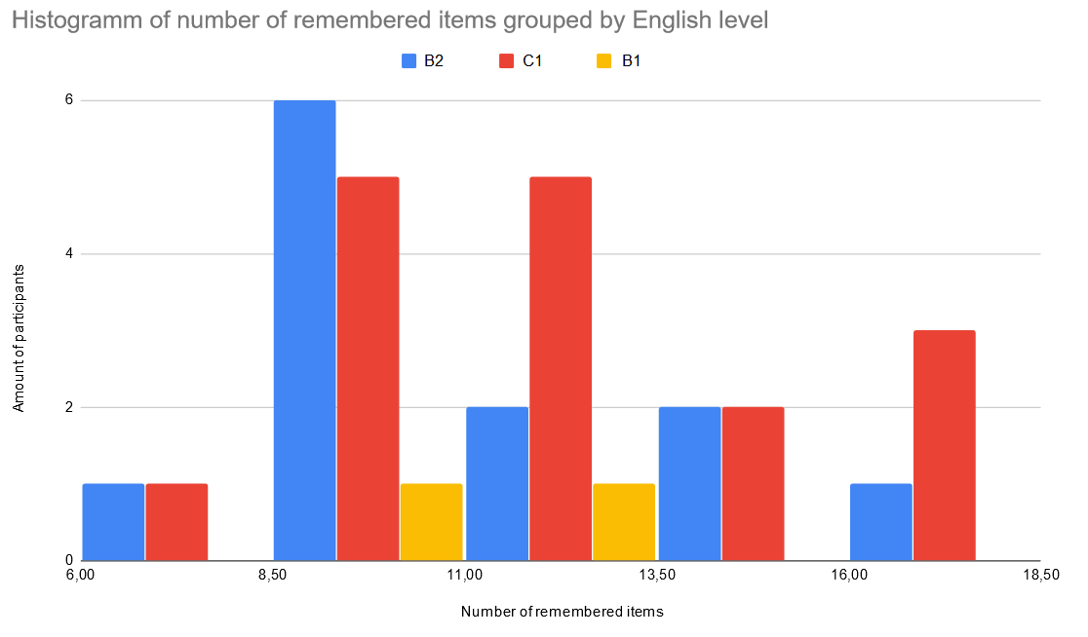
Influence of english level

Slide 11
Discussion
Presentations consisting only words or pictures had nearly the same score, both combined lead to a lower score
Contrary to our hypothesis, the combined/multimedia presentations therefore did not facilitate working memory compared to single media presentations -> supports common reviews
Written words are not necessarily bound to phonological loop but can also be processed in the visual sketchpad
Embedding the presented items into a meaningful context helped the participants to remember
Single media presentations left more space to create meaningful context
The poorer performance of the multimedia presentation group could be caused by the generally lower english level in that group to some extent

Slide 12
Limitations and Future Work
Conduct the same experimental study with a much larger number of participants
In order to quantify the differences between the single- and multimedia presentations
Compare auditory and visual presentations
Instruct participants to only use one specific method to remember the items
Increase comparableness of the presentation types in this way

