Slide 1

First Steps in Web Scraping in R
Access to new data
Sebastian Wójcik, PhD
Statistical Office in Rzeszów
Statistics Poland
Madrid, 6th July 2023

Slide 2
Contents
HTML elements
Selecting elements
Introduction to webscraping
2

Slide 3
What is Web Scraping?
Web scraping is the process of collecting data from webpages.
Scraped data is especially useful for research in the social sciences because this data does not usually exist in an easily downloadable format suited to the research question.
The simplest form of web scraping is copying and pasting text from a webpage into a document.

Slide 4
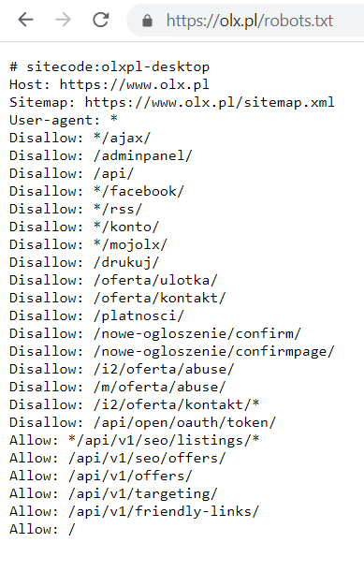
Access to data - Robots.txt
The robots.txt file can be found at the root level of a website (typically, right after the .com, org, etc.) and gives instructions to web crawlers and scrapers as to what areas of the websites they can scrape data.
In each one, you will find instructions for various “user-agents”, names of software.
We are interested in the User-agent: * section, where * is a wildcard character that gives instructions to any bot not elsewhere listed in that text file, including us.
There can be defined multiple rules for various agents
The lines that follow and begin with Allow: or Disallow: tell us what parts of the site we can scrape. In olx.pl robots.txt file, we see

Slide 5
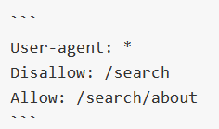
Access to data - Robots.txt
The leading slash / in the (dis)allowed paths indicate that they start from the root directory. “/search” refers to google.com/search. These lines mean that we can scrape google.com/search/about, but not anything else starting with google.com/search. In other words, we cannot program a scraper to run Google searches for us.
The good news is that we there is no need to read through the robots.txt files when scraping. We can use the polite R package, which checks file for us and the Url we want to scrap, only letting us scrape is we are allowed to.
The instructions in robots.txt files cannot enforce crawler behavior to your site; it's up to the crawler to obey them. Robots.txt is not a law.
If we do not adhere to the guidelines in this file, we risk being blocked by the website

Slide 6
Package polite
Compared to the manual scraping method of copy-paste, automated web scrapers are very, very fast. It is possible to crash a website by sending too many requests, called a Denial-of-Service (DoS) attack.
The polite R package also imposes a minimum of five seconds’ delay between scrapes, and we can make this longer if we want. We may also see longer limits in the robots.txt file
What’s more, polite will this line and adjust our scraping speed. Function bow() checks whether we can scrape a site, it means that polite is checking robots.txt file for us.

Slide 7
HTML
HTML is the language used to create webpages. When we copy and paste text from a webpage, we are interacting with the result of the HTML code, which tells our internet browsers how to display the content.
When we scrape, we download the HTML code, so we need to dive into this language and understand its syntax so that we can extract the information we want. Webpages are designed for the user experience, not data collection, so it can get messy.

Slide 8
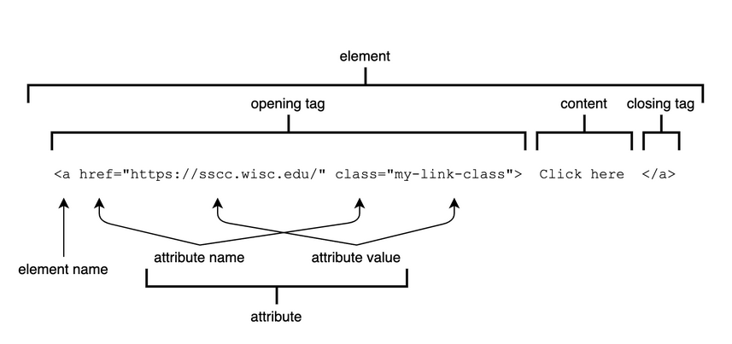
Elements of code

Slide 9
Elements of HTML code
This line of code consists of one element. Elements are the fundamental unit in HTML, and elements are composed of several pieces:
Element names, which determinate the output of the code. Such as a link ( a ), paragraph ( p ) or a level-four header ( h4 ).
Opening tags and closing tags, which mark the start ( <a . . . > ) and the end of element (</a > ) .
Content, or text, which is outside angled brackets (< > ) and typically what we see dispalyed on the webpage.
Atributes, which determine additional properties of the elements, such as the link destination ( href ) or an element’s class , which is used for styling pages.

Slide 10
Common HTML elements include
a , anchor, for links
body , the body of the document
br , line break
div and section , sections of the document
em , italicized (emphasized) text
h1 , h2 , h3 , h4 , h5 , and h6 , level-one through level-six headers
html , which defines the document as an HTML document
p , paragraph with line breaks before and after
span , inline text
strong , b bold text
table , table
Each element can take class and id attributes, and different elements can take different additional attributes. (An id is simply a unique identifier for an element.)

Slide 11
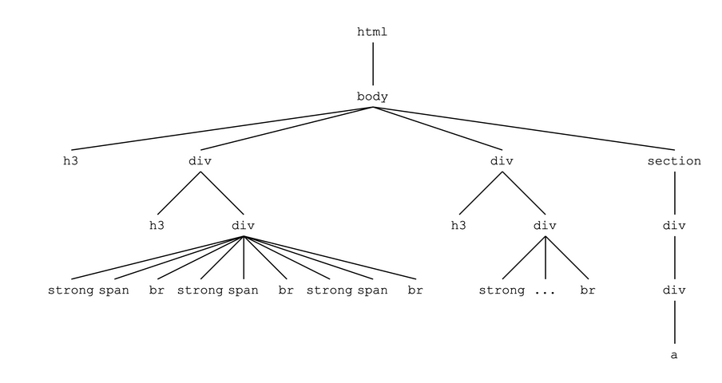
Structure of HTML code

Slide 12
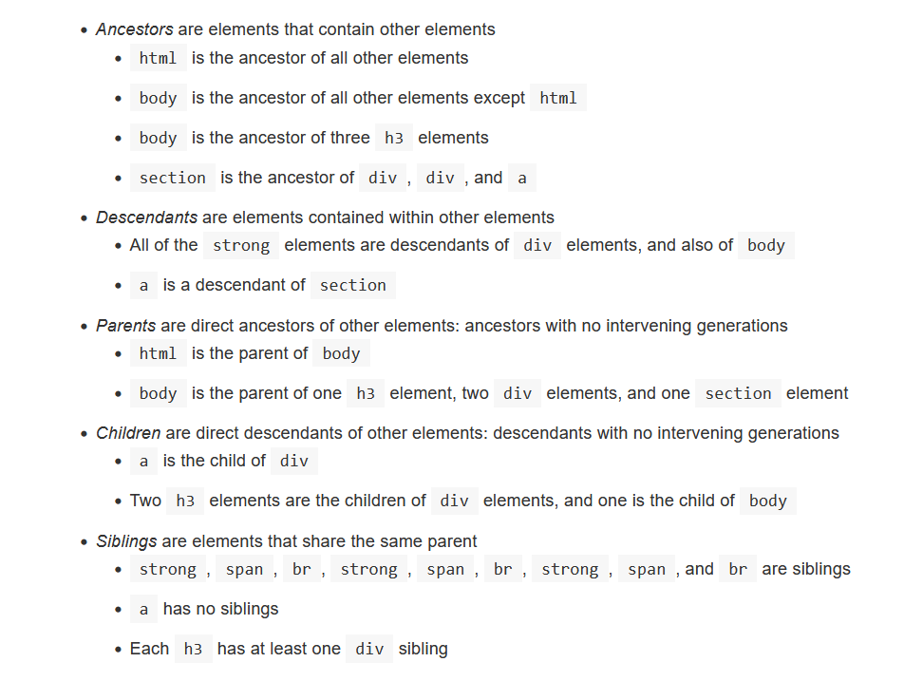

Slide 13
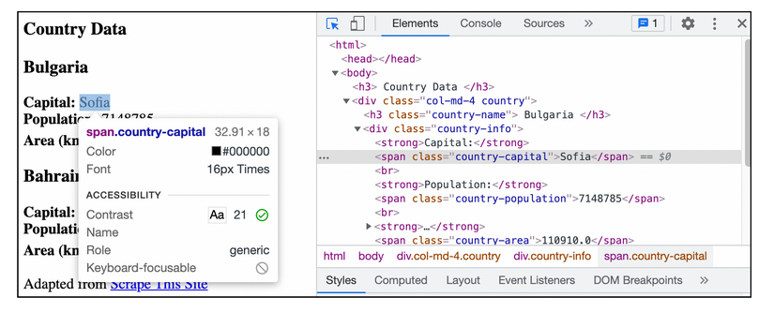
Inspecting Elements
To get the information necessary for writing CSS selectors, we need to first view the page we want to scrape in our browser with the “Inspector”, which allows us to explore the HTML source code for the webpage.
To scrap chosen feature, firstly you need find out the name of variable to scrap by clicking inspect on that field.

Slide 14
CSS Selectors
CSS selectors provide a way to extract (filter) HTML elements by their element name, class, id, and other attributes, as well as by the relationships they share with other elements.
For now, we will use CSS selectors to get elements and then extract their content (text).
The “Selection Criteria” column contains the different ways we can select elements: by their components or relationships, and by combining these with logical operators (and, or, not).
The “Operator” column gives the symbol (if any) we need to use, and the “Example” column has example usage.
The final column, “Result of html_text2()”, gives the output of taking the values in “Example” and substituting them for “SELECTOR” in this code, where countries is the webstite http://www.scrapethissite.com/pages/simple/.

Slide 15
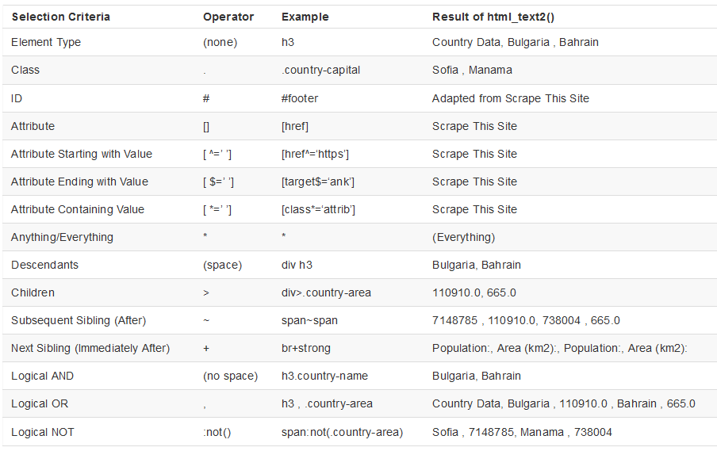
Here is the example from the first line:
countries |> html_elements("h3") |> html_text2()
The output matches what we see in the final column, except without quotes.

Slide 16
Extract Data
After downloading our webpage, it is time to pull out the data we want by writing CSS selectors that we pass to html_elements.
After we have our elements selected, we can then extract specific data from these elements.
We have 3 type of data that we can extracts from webpage by commend:
html_text2() pulls the content from the element,
html_attr() gets attribute values,
html_table() turns table elements into dataframes.

Slide 17
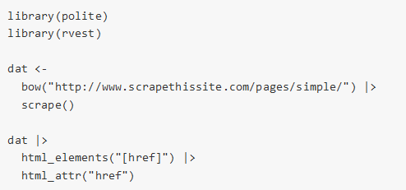
Atrributes
We can use html_attr() to pull these URLs, and then scrape these pages. If we have a page with links to many other pages, we can easily scrape all of them.
We can pull out the link by first getting elements with an href attribute and then pull the value of those attributes. html_attr() just takes the name of the attribute in quotes, so there is no need to use the square brackets we use for CSS selectors ([href]).

Slide 18
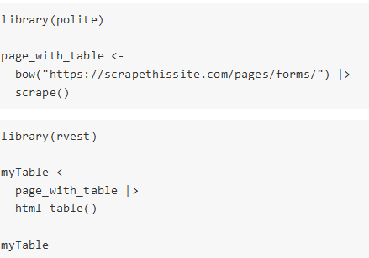
Tables
Tables are another element we may want to scrape.
Html_table() returns a list of dataframes made from the table elements in a webpage .
We do not need to use html_elements() with a CSS selector before html_table(), but we might want to in some situations where we only want one of several tables.
The data we scrape is bound to be a mess, and we need to work it into a usable format, usually a dataframe. This process is called data wrangling
To scrape multiple pages, we need to gather all of our URLs, download multiple pages, and save HTML files to checkpoint our work

Slide 19
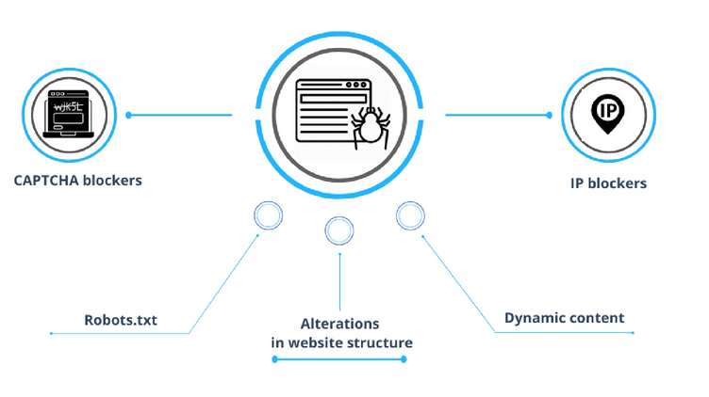
Potencial issues
Different data based on country of origin
Frequent structural changes
Dynamic websites
Invasive web scraping
Differences between data collected from websites and official statistics databases

Slide 20
Summary
We can scrap in 5 steps:
Get permission
Download a page
Extract data: Inspect elements and use CSS selectors
Wrangle scraped data
Scale up to multiple pages

Slide 21
R packages
polite -The goal of package is to promote responsible web etiquette. The package’s two main functions bow and scrape define and realize a web harvesting session. bow is used to introduce the client to the host and ask for permission to scrape (by inquiring against the host’s robots.txt file), while scrape is the main function for retrieving data from the remote server.
rvest- wrappers around the 'xml2' and 'httr' packages to make it easy to download, then manipulate, HTML and XML.
tidyverse -general-purpose data wrangling
dplyr –pipe operator
rebus -Verbose regular expressions

Slide 22

Thank you for your attention!
Sebastian Wójcik, PhD
Statistical Office in Rzeszów
s.wojcik@stat.gov.pl
Madrid, 6th July 2023

