Slide 1


Text strings
Cleaning, Standardazing and Fuzzy Matching
Sebastian Wójcik, PhD
Statistical Office in Rzeszów
Statistics Poland
03/05/2023

Slide 2
Contents
Fuzzy matching
Edit distance
Similarity based on tokens
Cleaning and normalization

Slide 3

Fuzzy string matching
Questions and Problems:
Q: How to check which scraped establishments we have already in the survey frames?
A: You can use object names, addresses and geographic coordinates of establishments.

Slide 4
Fuzzy string matching
Q: How to use names and addresses of establishments?
A: Calculate the similarity between names and addresses in the survey frame and the scraped data. Such approach is used in the so-called fuzzy look-up in search engines.
Q: And what next?
A: Link establishments with the most similar names or addresses.

Slide 5
Fuzzy string matching
Q: In what way we compare text strings?
A: You can tokenize a text string into words or n-grams and use cosine distance, Jaccard distance etc. Dedicated to long text strings.
Q: And what for short text strings?
A: You can use edit distances which are based on comparing strings letter by letter, e.g. Levenshtein, Damerau–Levenshtein, Jaro, Jaro-Winkler, Hamming etc.

Slide 6
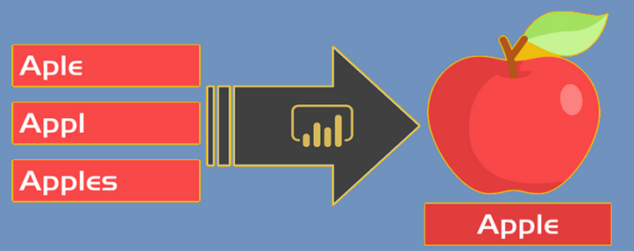
Fuzzy string matching
How does fuzzy matching work?
Method of identification non-exact matches of text strings.
Commonly used by search engines to deal with typos, missing letters etc.
Based on counting of transformations (deletions, insertions, or substitutions) required to transform a source string into the target one.

Slide 7
Comparing letter by letter
Edit distance
7

Slide 8
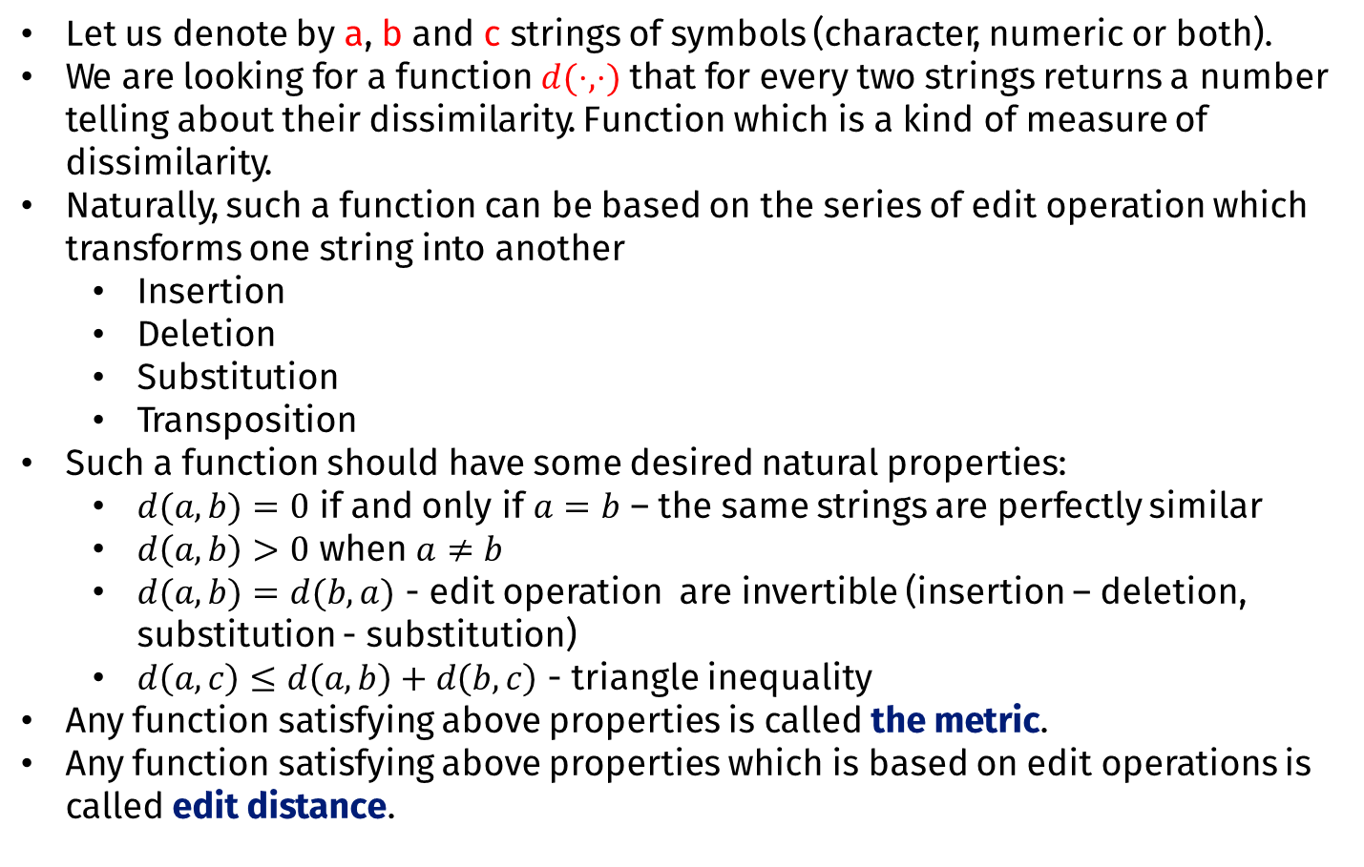
Fuzzy string matching
Let us denote by a, b and c strings of symbols (character, numeric or both).
We are looking for a function $d(⋅,⋅)$ that for every two strings returns a number telling about their dissimilarity. Function which is a kind of measure of dissimilarity.
Naturally, such a function can be based on the series of edit operation which transforms one string into another
Insertion
Deletion
Substitution
Transposition
Such a function should have some desired natural properties:
$d(a,b)=0$ if and only if $a=b$ – the same strings are perfectly similar
$d\left(a,b\right)>0$ when $a≠b$
$d(a,b)=d(b,a)$ - edit operation are invertible (insertion – deletion, substitution - substitution)
$d\left(a,c\right)≤d\left(a,b\right)+d\left(b,c\right)$ - triangle inequality
Any function satisfying above properties is called the metric.
Any function satisfying above properties which is based on edit operations is called edit distance.

Slide 9
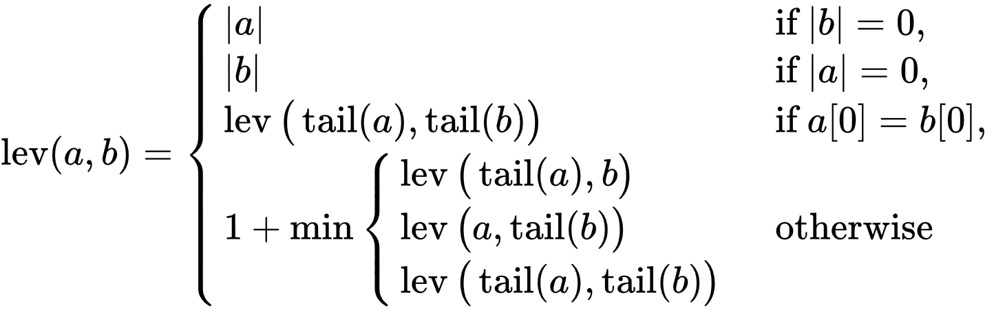
Levenshtein distance
For two strings a, b of length m and n, by tail(a) let us denote a string of all but the first character and by a[i] the (i+1)-th character of string a.
Takes into account insertion, deletion, substitution equivalently.
It is zero if and only if the strings are equal.
It is at least the absolute value of the difference of the sizes of the strings.
It is at most the length of the longer string.
Levenshtein distance is a metric.

Slide 10
Damerau-Levenshtein distance
It is an extension of Levenshtein distance. Takes into account insertion, deletion, substitution and transposition, equivalently.
Restricted version called also Optimal String Alignment distance allows transposition only for adjacent character.
Full version allows multiple edits on strings.

Slide 11
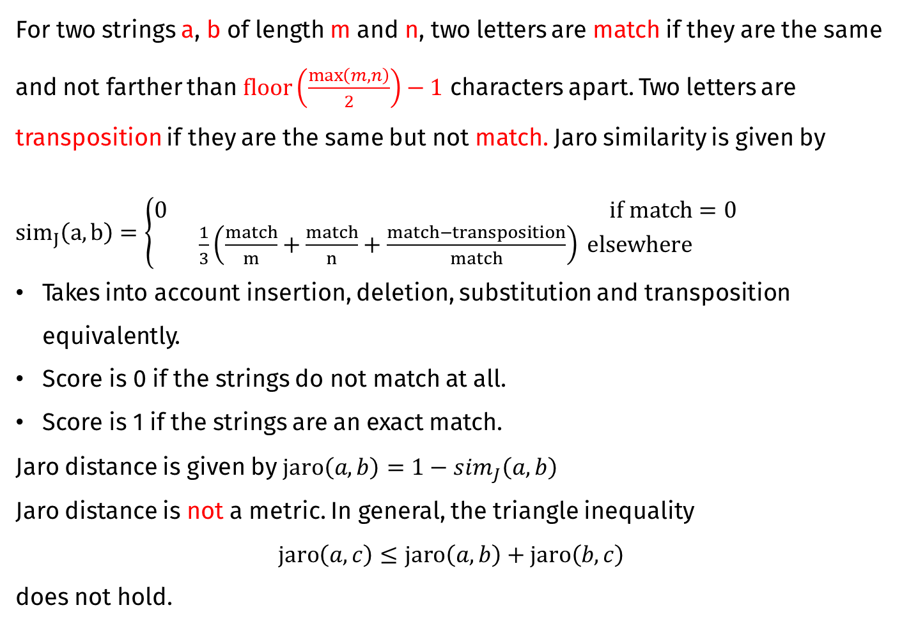
Jaro distance
For two strings a, b of length m and n, two letters are match if they are the same and not farther than $floor\left(\frac{\max\left(m,n\right)}{2}\right)−1$ characters apart. Two letters are transposition if they are the same but not match. Jaro similarity is given by $sim_{J}\left(a,b\right)=\left\{\begin{aligned}0 if match=0 \\ \frac{1}{3}\left(\frac{match}{m}+\frac{match}{n}+\frac{match−transposition}{match}\right) elsewhere\end{aligned}\right.$
Takes into account insertion, deletion, substitution and transposition equivalently.
Score is 0 if the strings do not match at all.
Score is 1 if the strings are an exact match.
Jaro distance is given by $jaro\left(a,b\right)=1−sim_{J}\left(a,b\right)$
Jaro distance is not a metric. In general, the triangle inequality
$$jaro\left(a,c\right)≤jaro\left(a,b\right)+jaro\left(b,c\right)$$
does not hold.

Slide 12
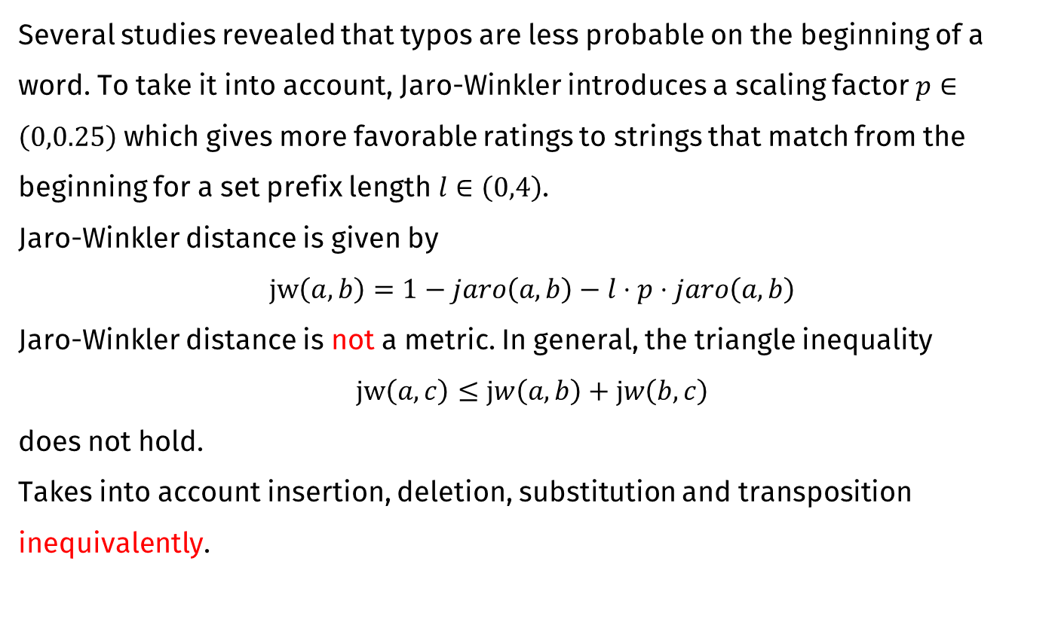
Jaro-Winkler distance
Several studies revealed that typos are less probable on the beginning of a word. To take it into account, Jaro-Winkler introduces a scaling factor $p∈\left(0,0.25\right)$ which gives more favorable ratings to strings that match from the beginning for a set prefix length $l∈\left(0,4\right)$.
Jaro-Winkler distance is given by
$$jw\left(a,b\right)=1−jaro\left(a,b\right)−l⋅p⋅jaro\left(a,b\right)$$
Jaro-Winkler distance is not a metric. In general, the triangle inequality
$$jw\left(a,c\right)≤jw\left(a,b\right)+jw\left(b,c\right)$$
does not hold.
Takes into account insertion, deletion, substitution and transposition inequivalently.

Slide 13
Longest Common Substring
The longest common substring (lcs) is defined as the longest string that can be obtained by pairing characters from the strings a and b while keeping the order of characters intact.
The lcs-distance is defined as the number of unpaired characters.
The distance is equivalent to the edit distance allowing only deletions and insertions equivalently.

Slide 14
Hamming distance
The Hamming distance between two equal-length strings is the number of positions at which the corresponding symbols are different.
Transpositions and substitution are equivalent.
It is a metric.
Limited usage.

Slide 15
Comparing words and n-grams
Tokenizing text strings
15

Slide 16
Tokenization
For matching purposes, we can use names, addresses etc. which are short texts.
What about longer text?
Think about some possibilities:
Comparing tweets, posts or comments for sentiment analysis.
Comparing description of accommodation establishments of different portals e.g. Booking.com and Hotel.com for deduplication.
Comparing articles for detection of plagiarism.

Slide 17
Tokenization
Comparing long text strings with edit distance might be an exhaustive process for your hardware. In such case, you can use a bigger chunks of texts than the letters and use dedicated methods for comparison of long text strings. These bigger chunks of text are called tokens.
In practice, the following tokens are used:
N-grams
Words
Sentences
Paragraphs
Process of splitting a text string into tokens is called tokenization.

Slide 18
Tokenization
N-gram is a sequence of N adjacent elements from a string of tokens. Usually N-grams of letters and words are used. In a case when N=2 we say bigram, when N=3 we say trigram.
There are also gappy bigrams or skipping bigrams which are pairs of word which allow gaps e.g. stopwords, that is a set of words which are of a little meaning (a, the, on, at…). More about it in text cleaning and standardization.

Slide 19
Tokenization
Example:
In the text string „simple statistical analysis of text” we have the following word bigrams:
„simple statistical”
„statistical analysis”
„analysis of”
„of text”
and the letter bigrams „si”, „im”, „mp”, „pl”, „le” etc.

Slide 20
Tokenization
From tokenized text it can be derived a word-frequency table and so-called term-matrix. The frequency table for the text
„It is a dog. This dog is old.”
would look like this
Word | Frequency
it | 1
is | 2
a | 1
dog | 2
this | 1
old | 1

Slide 21
Tokenization
For multiple tokenized text strings there would be multiple word-frequency table. The term-matrix integrates all of them by indicating a frequency of each word from a set of all words in text strings under analysis. For these text string
„It is a dog. This dog is old.”
„It is a parrot. This parrot is young.”
„I have a parrot and a dog.”
The term matrix would look like this
String | it | is | a | dog | this | old | parrot | young | I | have | and
1 | 1 | 2 | 1 | 2 | 1 | 1 | 0 | 0 | 0 | 0 | 0
2 | 1 | 2 | 1 | 0 | 1 | 0 | 2 | 1 | 0 | 0 | 0
3 | 0 | 0 | 2 | 1 | 0 | 0 | 1 | 0 | 1 | 1 | 1

Slide 22
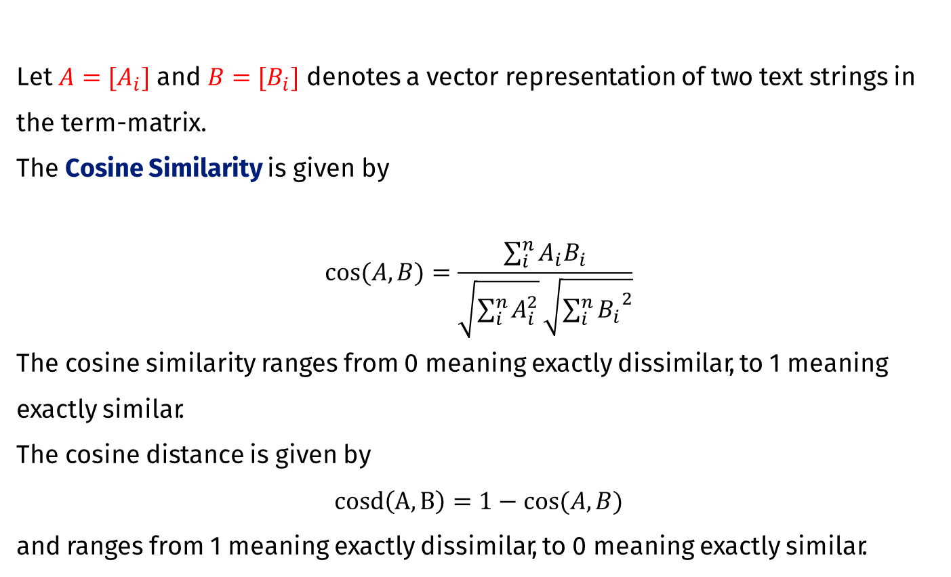
Cosine Distance
Let $A=[A_{i}]$ and $B=[B_{i}]$ denotes a vector representation of two text strings in the term-matrix.
The Cosine Similarity is given by
$$cos⁡(A,B)=\frac{\sum_{i}^{n}{A_{i}B_{i}}}{\sqrt{\sum_{i}^{n}{A_{i}^{2}}}\sqrt{{\sum_{i}^{n}{B_{i}}}^{2}}}$$
The cosine similarity ranges from 0 meaning exactly dissimilar, to 1 meaning exactly similar.
The cosine distance is given by
$$cosd\left(A,B\right)=1−cos⁡(A,B)$$
and ranges from 1 meaning exactly dissimilar, to 0 meaning exactly similar.

Slide 23
Cosine Distance
The cosine similarity for text strings in previous example
amounted to
String | it | is | a | dog | this | old | parrot | young | I | have | and
1 | 1 | 2 | 1 | 2 | 1 | 1 | 0 | 0 | 0 | 0 | 0
2 | 1 | 2 | 1 | 0 | 1 | 0 | 2 | 1 | 0 | 0 | 0
3 | 0 | 0 | 2 | 1 | 0 | 0 | 1 | 0 | 1 | 1 | 1
String | 1 | 2 | 3
1 | 1 | 0,583 | 0,333
2 | 0,583 | 1 | 0,333
3 | 0,333 | 0,333 | 1

Slide 24
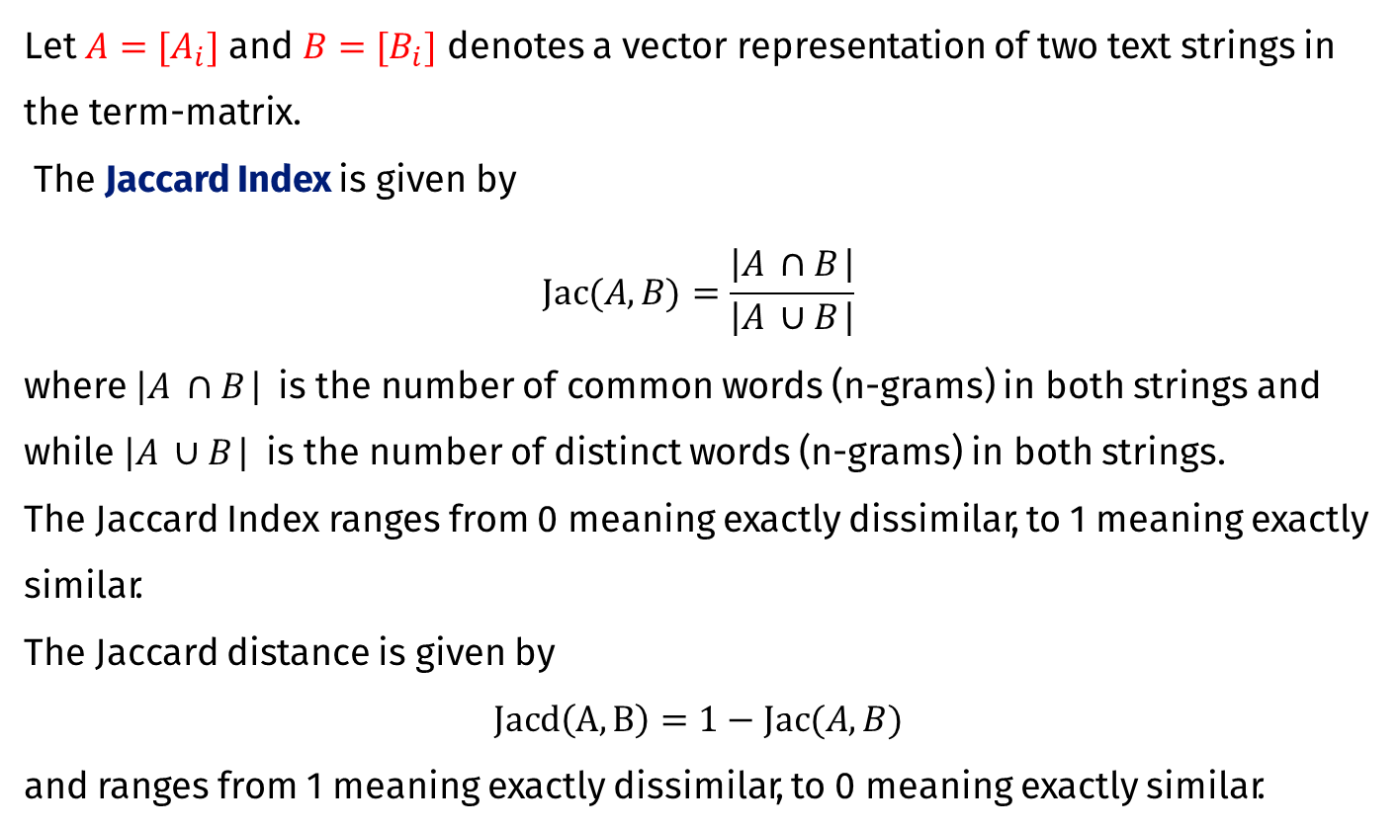
Jaccard Distance
Let $A=[A_{i}]$ and $B=[B_{i}]$ denotes a vector representation of two text strings in the term-matrix.
The Jaccard Index is given by
$$Jac⁡(A,B)=\frac{\left|A_{ }∩B_{ }\right|}{\left|A_{ }∪B_{ }\right|}$$
where $\left|A_{ }∩B_{ }\right|$ is the number of common words (n-grams) in both strings and while $\left|A_{ }∪B_{ }\right|$ is the number of distinct words (n-grams) in both strings.
The Jaccard Index ranges from 0 meaning exactly dissimilar, to 1 meaning exactly similar.
The Jaccard distance is given by
$$Jacd\left(A,B\right)=1−Jac⁡(A,B)$$
and ranges from 1 meaning exactly dissimilar, to 0 meaning exactly similar.

Slide 25
Jaccard Distance
The Jaccard index for text strings in previous example
amounted to
String | it | is | a | dog | this | old | parrot | young | I | have | and
1 | 1 | 2 | 1 | 2 | 1 | 1 | 0 | 0 | 0 | 0 | 0
2 | 1 | 2 | 1 | 0 | 1 | 0 | 2 | 1 | 0 | 0 | 0
3 | 0 | 0 | 2 | 1 | 0 | 0 | 1 | 0 | 1 | 1 | 1
String | 1 | 2 | 3
1 | 1 | 0,5 | 0,2
2 | 0,5 | 1 | 0,2
3 | 0,2 | 0,2 | 1

Slide 26
Tidying up text strings
Pre-processing text strings for better performance of comparison techniques
26

Slide 27
Cleaning and normalization
The success of data linkage depends on the quality of the data. Pre-processing and data cleaning are the most difficult and time-consuming steps in data linkage, but they are necessary to ensure a successful and accurate linkage.
Remove accents, special characters
Remove punctuation, whitespaces and tabs
Remove duplicates
Convert to lower/upper case
Remove stopwords
Normalize numbers, dates, etc.
Stemming and lemmatization

Slide 28
Cleaning and normalization
Remove accents
ő -> oe or ő -> o (Műller ~ Muller ~ Mueller)
Remove punctuation, whitespaces and tabs
„Please, help me!” - > „Please help me”
Convert to lower/upper case
„To Lower Case” -> „to lower case” (for case sensitive functions)
Remove stopwords
„a”, „the”, „on”, „at” – increase similarity without a significant contribution to the meaning of the text.

Slide 29
Cleaning and normalization
Standardisation can be done through regular expressions
The concept of regular expressions, usually referred to as regex, exists in many programming languages, such as R, Python, C, C++, Perl, Java, and JavaScript. You can access the functionality of regex either in the base version of those languages or via libraries.
A regular expression, regex, is a sequence of characters (or even one character) that describes a certain pattern found in a text.
Regex represents a very flexible and powerful tool widely used for processing and mining unstructured text data. For example, they find their application in search engines, lexical analysis, spam filtering, and text editors.

Slide 30
Cleaning and normalization
The main functions from base R that search for regex matches
grep(), grepl() – return the indices of strings containing a match (grep()) or a logical vector showing which strings contain a match (grepl()).
regexpr(), gregexpr() – return the index for each string where the match begins and the length of that match. While regexpr() provides this information only for the first match (from the left), gregexpr() does the same for all the matches.
sub(), gsub() – replace a detected match in each string with a specified string only for the first match, or for all the matches, respectively.
regexec() – works like regexpr() but returns the same information also for a specified sub-expression inside the match.
regmatches() – works like regexec() but returns the exact strings detected for the overall match and a specified sub-expression.

Slide 31
Cleaning and normalization
More convenient and consistent way to work with R regex is to use a specialized stringr package of the tidyverse collection (all the functions start with str_ ). All base function has its equivalent form in stringr package, e.g.
Nice cheatsheet for stringr package can be found here
cheatsheets/strings.pdf at main · rstudio/cheatsheets · GitHub
Base R | stringr
grep() | str_subset()
grepl() | str_detect()
sub() | str_replace()
gsub () | str_replace_all()
regexpr() | str_extract()
gregexpr() | str_locate_all()

Slide 32
Cleaning and normalization
Anchors
^ – matches from the beginning of the string (for multiline strings – the beginning of each line)
$ – matches from the end of the string (for multiline strings – the end of each line)
By default – matches from the beginning, middle and end of the string
Examples
str_detect(c('Hotel Rosa',' Paradise Hotel ','Guest rooms Rosa '), '^Hotel’) returns TRUE FALSE FALSE
str_detect(c('Hotel Rosa',' Paradise Hotel ','Guest rooms Rosa '), ‚Rosa$’) returns TRUE FALSE TRUE
str_detect(c('Hotel Rosa',' Paradise Hotel ','Guest rooms Rosa', 'Hotel’) returns TRUE TRUE FALSE

Slide 33
Cleaning and normalization
Quantifiers
* - 0 or more
+ - at least 1
? - at most 1
{n} - exactly n
{n,} - at least n
{n,m} - at least n and at most
Examples
str_extract_all('Where is a doodle dog?', 'do*') returns "doo" "d" "do"
str_extract_all('Where is a doodle dog?', 'do+') returns "doo" "do"
str_extract_all('Where is a doodle dog?', 'do?') returns "do" "d" "do"
str_extract_all('Where is a doodle dog?', 'do{1}') returns "do" "do"
str_extract_all('Where is a doodle dog?', 'do{2}') returns "doo"

Slide 34
Cleaning and normalization
Character classes
\w - Any word character (any letter, digit, or underscore)
\W - Any non-word character
\d - Any digit
\D - Any non-digit
\s - Any space character (a space, a tab, a new line, etc.)
\S - Any non-space character
Examples
str_extract('Hotel Paradise 35-111', '\\d\\d-\\d\\d\\d') returns "35-111"
str_extract('Hotel Paradise 35 111', '\\d\\d\\s\\d\\d\\d') returns "35 111"
str_extract('Hotel Paradise 35-111', '\\D*') returns "Hotel Paradise "

Slide 35
Cleaning and normalization
Buld-in character classes
[:alpha:] - Any letter
[:lower:] [:upper:] - Any lowercase (uppercase) letter
[:digit:] - Any digit
[:alnum:] - Any letter or digit
[:punct:] - Any punctuation character
[:space:] - Any space character (a space, a tab, a new line)
[:graph:] - Any letter, number, or punctuation character
Examples
str_extract_all('Hotel Paradise 35-111', '[[:digit:]]') returns "3" "5" "1" "1" "1"
str_extract_all('Hotel Paradise 35 111', '[[:digit:]]') returns "3" "5" "1" "1" "1"
str_extract('Hotel Paradise 35-111', '\\D*') returns "Hotel Paradise "

Slide 36
Cleaning and normalization
Languages such as English, Hindi consists of several words which are often derived from one another. Inflected Language is a term used for a language that contains derived words.
Consider a family of words
work
rework,
worker,
working,
workshop,
workmanship
It is easy to note that all of them are inflected from their common part – work. That common part is called the headword, base, stem, or root.

Slide 37
Cleaning and normalization
Now consider a family of words
break,
breaks,
broke,
broken,
breaking
Note that break is not their common part. Nevertheleses, all these words are inflected or alternating forms of break. Such a word is called a lemma.

Slide 38
Cleaning and normalization
The stem is the part of the word that never changes even when morphologically inflected while a lemma is the least marked form of the word. For example, from "produced", the lemma is "produce", but the stem is "produc".
Some family of words have several stems but one lemma. For instance the verb "to go" has the stems "go" and "went" but one lemma.
Stemming is the process of reducing infected words to their stem/root by removing prefixes and suffixes. For instance, stemming with replace words “produced” and “production” with “produc”.
Lemmatization is the process of assigning a lemma for a given set of words. Lemmatization with replace words “produced” and “produc” with “produce”.
In stemming, for some words, it may not give may not give meaningful representation such as “produc”. Lemmatization always provides words as an output.

Slide 39
Cleaning and normalization
Scopre of cleaning and normalization depends on the task – it is not compulsory. For instance, in a case of GPT (generative pre-trained trnasformer) model we are looking for the next word or in a case of BERT model we are prediciting a mask.
„It is very hot. He […] to eat an ice-cream” -> [wants]
Stemming and lemmatization would be a bad idea to use. On the other hand, whenever we want to Focus on the meaning of the text, cleaning and normalization are desired.
Consider two text strings
„He is breaking a speed limit!”
„He has broken a limit of speed.”

Slide 40
Cleaning and normalization
After removing punctuation, stopwords and after lemmatization we have
„He is breaking a speed limit!” ->
„He is breaking a speed limit” ->
„He breaking speed limit” ->
„He break speed limit”
„He has broken a limit of speed.” ->
„He has broken a limit of speed” ->
„He broken limit speed” ->
„He break limit speed”
When tokenized, both strings are the same.

Slide 41
R packages
textstem – stemming and lematization
tm – text mining in R
stringr – working with regular expressions
stringdist – Levenshtein, Jaro-Winkler, Jaccard, cosine formula
comparator – Levenshtein, Jaro-Winkler, Hamming formula
dplyr – mutaing data frames and pipe operator
41

Slide 42

Thank you for your attention!
Sebastian Wójcik, PhD
Statistical Office in Rzeszów
s.wojcik@stat.gov.pl
Madrit, 7th July 2023

