Slide 1


Probabilistic record linkage
Data sources merging without unique identifiers
Sebastian Wójcik, PhD
Statistical Office in Rzeszów
Statistics Poland
07/05/2023

Slide 2
Agenda
Deterministic vs. Probabilistic Linkage
Blocking variables
Probabilistic Linkage in details
1

Slide 3
Deterministic vs. Probabilistic record linkage
Consider two datasets
Tax payers and their tax statements
Benefactors of government program „My Photovoltaics”
Tax ID | Revenues [th EUR] | VAT [th EUR]
813-444-86 | 124,4 | 34,1
611-569-99 | 41,4 | 9,3
774-121-29 | 329,8 | 78,8
Tax ID | Funding [th EUR] | PV power [kW]
611-569-99 | 3,4 | 8
774-121-29 | 6,8 | 16
113-486-44 | 3,4 | 8
2

Slide 4
Deterministic vs. Probabilistic record linkage
Such data sets can be linked by unique key
Think about ID cards, Business ID, Tax ID
If there is a unique variable to link datasets, we say it is a deterministic data linkage (record linkage)
Tax ID | Revenues [th EUR] | VAT [th EUR] | Funding [th EUR] | PV power [kW]
813-444-86 | 124,4 | 34,1
611-569-99 | 41,4 | 9,3 | 3,4 | 8
774-121-29 | 329,8 | 78,8 | 6,8 | 16
113-486-44 |  |  | 3,4 | 8
2

Slide 5
Deterministic vs. Probabilistic record linkage
Consider two datasets
Benefactors of scholarship
EURASMUS participants
Name | Surname | Date of birth | Scholarhip [EUR]
Jan | Nowak | 02.06.1977 | 700
Sebastian | Wójcik | 28.08.19xx | 500
Robert | Lewandowski | 05.05.1985 | 1000
Name | Surname | Date of birth | Country
Sebastian | Wójcik | 28.08.19xx | Spain
Robert | Lewandowski | 05.05.1985 | Spain
Andrzej | Kowalski | 14.12.1966 | Germany
2

Slide 6
Deterministic vs. Probabilistic record linkage
Sometimes there is no unique key. Then
Consider a set of variables: first name, last name, birth date, birth place, address, zipcode, gender
None of them is unique
Nevertheless, what is a chance that two person will have the same first name, last name, birth date, birth place, address, zipcode, gender?
2

Slide 7
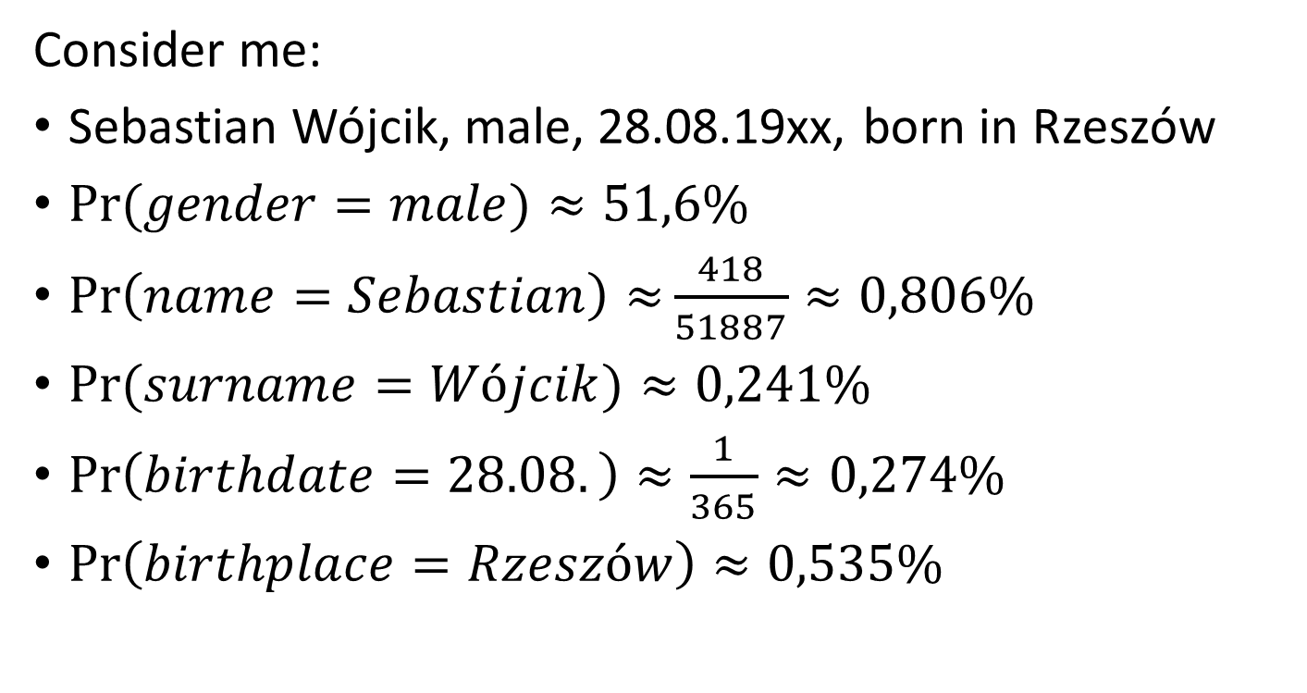
Deterministic vs. Probabilistic record linkage
Consider me:
Sebastian Wójcik, male, 28.08.19xx, born in Rzeszów
$Pr⁡(gender=male)≈51,6\%$
$\operatorname{Pr}\left(name=Sebastian\right)≈\frac{418}{51887}≈0,806\%$
$Pr⁡(surname=Wójcik)≈0,241\%$
$\operatorname{Pr}\left(birthdate=28.08.\right)≈\frac{1}{365}≈0,274\%$
$\operatorname{Pr}\left(birthplace=Rzeszów\right)≈0,535\%$
2

Slide 8
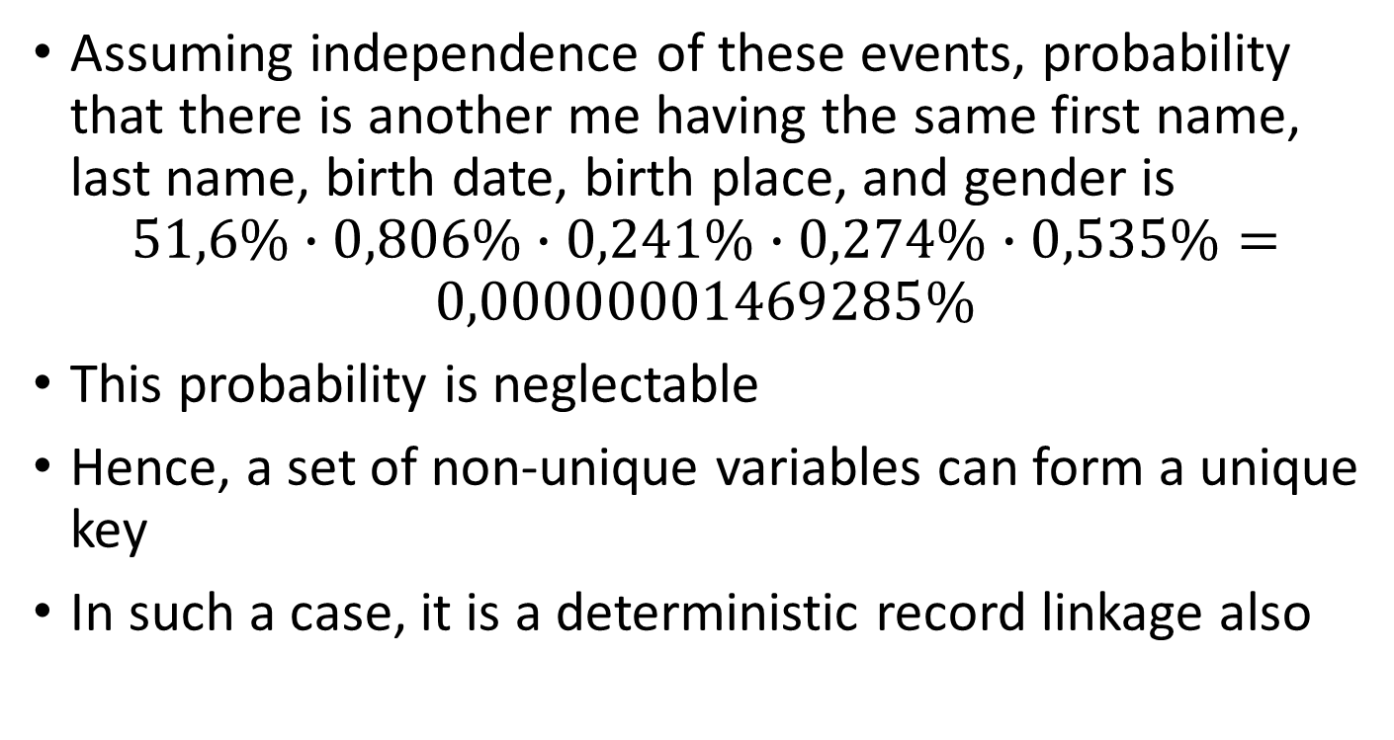
Deterministic vs. Probabilistic record linkage
Assuming independence of these events, probability that there is another me having the same first name, last name, birth date, birth place, and gender is
$$51,6\%∙0,806\%∙0,241\%∙0,274\%∙0,535\%=$$
$$0,00000001469285\%$$
This probability is neglectable
Hence, a set of non-unique variables can form a unique key
In such a case, it is a deterministic record linkage also
2

Slide 9
Deterministic vs. Probabilistic record linkage
Suppose we have partially anonymized data
Benefactors of scholarship
EURASMUS participants
Gender | Month of birth | Scholarhip [EUR]
Male | June | 700
Male | August | 500
Female | May | 1000
Gender | Month of birth | Country
Male | August | Spain
Female | May | Spain
Female | May | Germany
2

Slide 10

Deterministic vs. Probabilistic record linkage
Consider a case:
Female, born in May
$Pr⁡(gender=female)≈48,4\%$
$\operatorname{Pr}\left(birthmonth=May\right)≈\frac{1}{12}≈8,33\%$
2

Slide 11
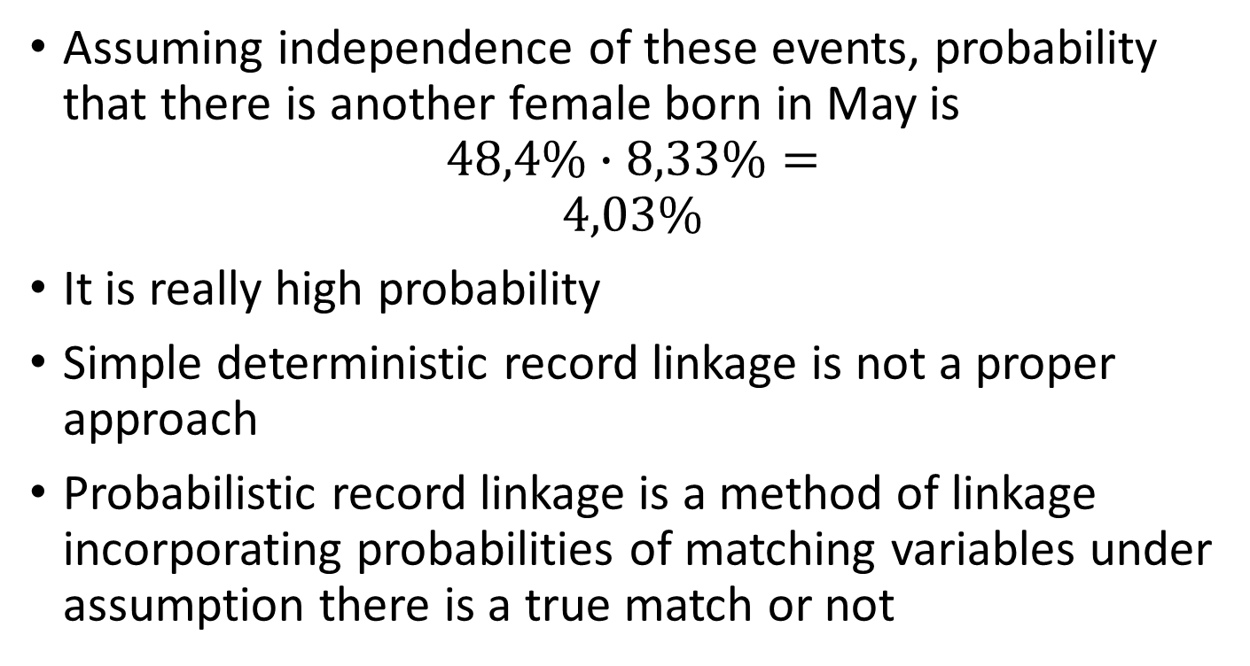
Deterministic vs. Probabilistic record linkage
Assuming independence of these events, probability that there is another female born in May is
$$48,4\%∙8,33\%=$$
$$4,03\%$$
It is really high probability
Simple deterministic record linkage is not a proper approach
Probabilistic record linkage is a method of linkage incorporating probabilities of matching variables under assumption there is a true match or not
2

Slide 12
Probabilistic record linkage
A probabilistic data linkage application typically involves three stages:
Pre-linkage: editing and data cleaning, parsing fused strings, selecting and standardising matching variables, adding a unique identifiers.
Linkage: bringing pairs together for comparison and determining correct matches, i.e. the pair belongs to the same entity.
Post-linkage: checking residuals for the unmatched, determining error rates and other quality indicators and carrying out analysis taking into account linkage errors.
2

Slide 13
Probabilistic Matching Workflow
Preprocessing: developing link keys, extracting information from link keys, normalization of link keys
Reduction of search space: Blocking
Comparison: string metrics, dates comparisons, numeric comparisons
Classification: Fellegi-Sunter Model
Final prediction: cut off scores, validation
3

Slide 14
Preprocessing
The success of data linkage depends on the quality of the data. Pre-processing and data cleaning are the most difficult and time-consuming steps in data linkage, but they are necessary to ensure a successful and accurate linkage.
You can use all techniques presented in Text strings
Strings might contain extra words such as ‘Mr’, ‘Mrs’, ‘Dr’, ‘Jr’. These redundant words should be removed
Standardize all variables that can be standardized e.g. postal code
Since there is no unique key, a reference number needs to be generated and added to each record across all datasets.
3

Slide 15
Matching variables
Matching variables need to be selected. The choice depends on the type and contents of the datasets.
Proper names rarely change during the lifetime of a person, for example, birth surname, first forename.
Personal characteristics that are fixed at birth very rarely change: gender, ethnicity, date of birth, place of birth.
Social demographic variables may change over time: street name, postcode, marital status.
Matching variables might include fused strings, such as first name given together with last name, or house number given together with street name. These matching variables need to be parsed into separate matching variables, as this increases the power of the decision rule to determine correct matches
Matching variables should have high discriminating power, that is with a large number of value states, such as zip code and last name. Examples of variables with low discriminating power are those with a small number of value states, such as gender and month of birth.
4

Slide 16
Blocking Variables
Suppose both datasets have 10,000 individuals. If a one-to-one match is to be carried out, this results in 100 million pairs to compare. It may cause a computational burden.
A blocking variable aims to reduce the search space between datasets by avoiding the comparison of record pairs that are least likely to be matches.
The search space can be dramatically reduced by forming pairs for comparison only among those with the potential to be matches, such as those with a common geographical area.
For example, the postcode can be used as a blocking variable.
Record pairs are brought together only if they agree (exactly) on the blocking variable.
8

Slide 17
Blocking Variables
The typical approach, especially for one-to-one matching, is to carry out the probabilistic data linkage sequentially, starting with a restrictive deterministic matching on the blocking variable and forming all record pairs for comparison.
Once matches are determined, they are set aside and a second linkage is carried out through the residual datasets, where the blocking variable can now be less restricted.
This is carried out multiple times until the residual datasets are small enough that no blocking variable is needed.
9

Slide 18
Linkage Stage Parameters of Data Linkage
In probabilistic data linkage, a frequency analysis of data values is carried out to calculate a weight or score for each matching variable, which indicates how likely it is that they refer to the same entity.
Uncommon value agreements should give stronger evidence of linkage.
Large weights assigned to matching variables are expected when there is a correct match and small weights assigned to matching variables when there is no match.
Note that there is still a positive, albeit small, weight even for an incorrect match, due to the potential for errors in the matching variable.
11

Slide 19
Parameters of Data Linkage
The weight is a ratio of two frequencies:
Number of agreements of the value of the matching variable in record pairs that represent that same entity (true match)
Number of agreements of the value of the matching variable in record pairs that do not represent the same entity
There are three key parameters for probabilistic data linkage, which are represented by the following concepts:
The quality of the data
The chance that the values of a matching variable will randomly agree
The ultimate number of true matches that exist in the database
This original framework for data linkage was developed by Newcombe et al. (1959) and formalised into the well-known probabilistic framework described in Fellegi and Sunter (1969), referred to hereafter as F&S.
12

Slide 20
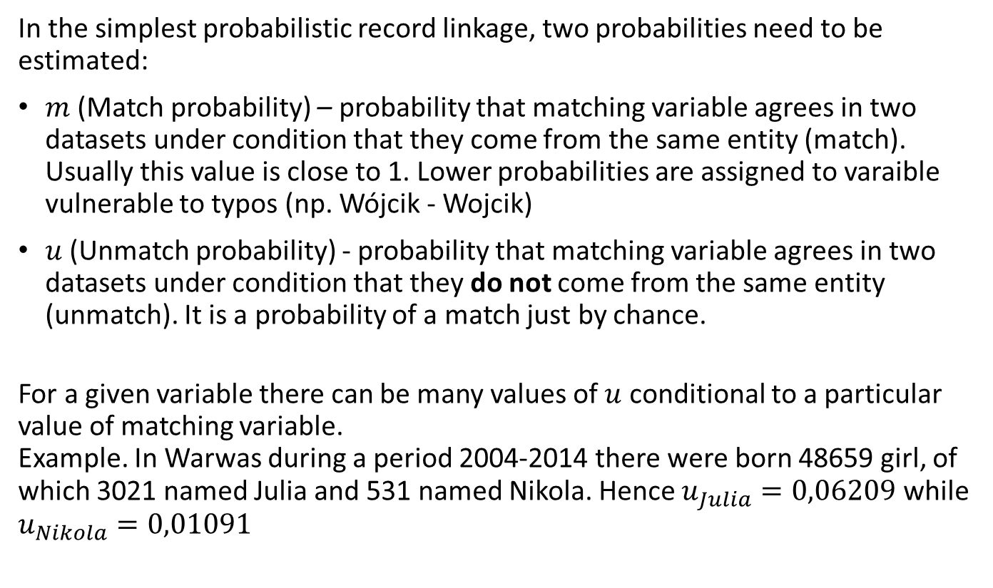
Probabilistic Record Linkage
In the simplest probabilistic record linkage, two probabilities need to be estimated:
$m$ (Match probability) – probability that matching variable agrees in two datasets under condition that they come from the same entity (match). Usually this value is close to 1. Lower probabilities are assigned to varaible vulnerable to typos (np. Wójcik - Wojcik)
$u$(Unmatch probability) - probability that matching variable agrees in two datasets under condition that they do not come from the same entity (unmatch). It is a probability of a match just by chance.
For a given variable there can be many values of $u$ conditional to a particular value of matching variable. Example. In Warwas during a period 2004-2014 there were born 48659 girl, of which 3021 named Julia and 531 named Nikola. Hence $u_{Julia}=0,06209$ while $u_{Nikola}=0,01091$
27

Slide 21
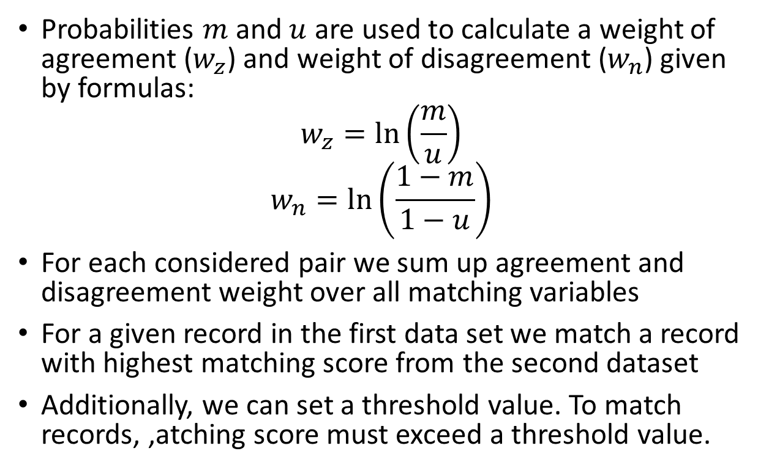
Probabilistic Record Linkage
Probabilities $m$ and $u$ are used to calculate a weight of agreement ($w_{z}$) and weight of disagreement ($w_{n}$) given by formulas:
$$w_{z}=\ln\left(\frac{m}{u}\right)$$
$$w_{n}=\ln\left(\frac{1−m}{1−u}\right)$$
For each considered pair we sum up agreement and disagreement weight over all matching variables
For a given record in the first data set we match a record with highest matching score from the second dataset
Additionally, we can set a threshold value. To match records, ,atching score must exceed a threshold value.
28

Slide 22
2nd example
2 data sets
Setting probabilities
No. | Sex | Month of birth | Salary
P1 | F | 1 | 3700
P2 | F | 2 | 3800
P3 | F | 4 | 4200
P4 | M | 2 | 5500
P5 | M | 4 | 3900
No. | Sex | Month of birth | Health self- assessment
Q1 | F | 1 | 4
Q2 | F | 4 | 5
Q3 | M | 1 | 3
Q4 | M | 4 | 5
Result of sex comparison | Correct linkage | Incorrect linkage | Weight
Match | 0,99 | 0.5 | 0,9855
Unmatch | 0,01 | 0.5 | -5,6438
Result of month comparison | Correct linkage | Incorrect linkage | Weight
Match | 0,95 | 0,0833 | 3,5110
Unmatch | 0,05 | 0,9167 | -4,1964
29

Slide 23
Total weight
The most likely links
No. | Q1 | Q2 | Q3 | Q4
P1 | 4,496 | -3,211 | -2,133 | -9,840
P2 | -3,211 | -3,211 | -9,840 | -9,840
P3 | -3,211 | 4,496 | -9,840 | -2,133
P4 | -9,840 | -9,840 | -3,211 | -3,211
P5 | -9,840 | -2,133 | -3,211 | 4,496
No. | Q
P1 | 1
P2 | 2,3
P3 | 4
P4 | 3,4
P5 | 2
Dataset after linkage process
No. | Sex | Month of birth | Salary | Health self- assessment
P1 | F | 1 | 3700 | 4
P2 | F | 2 | 3800 | 5
P3 | F | 4 | 4200 | 3
P4 | M | 2 | 5500 | 3
P5 | M | 4 | 3900 | 4
30

Slide 24
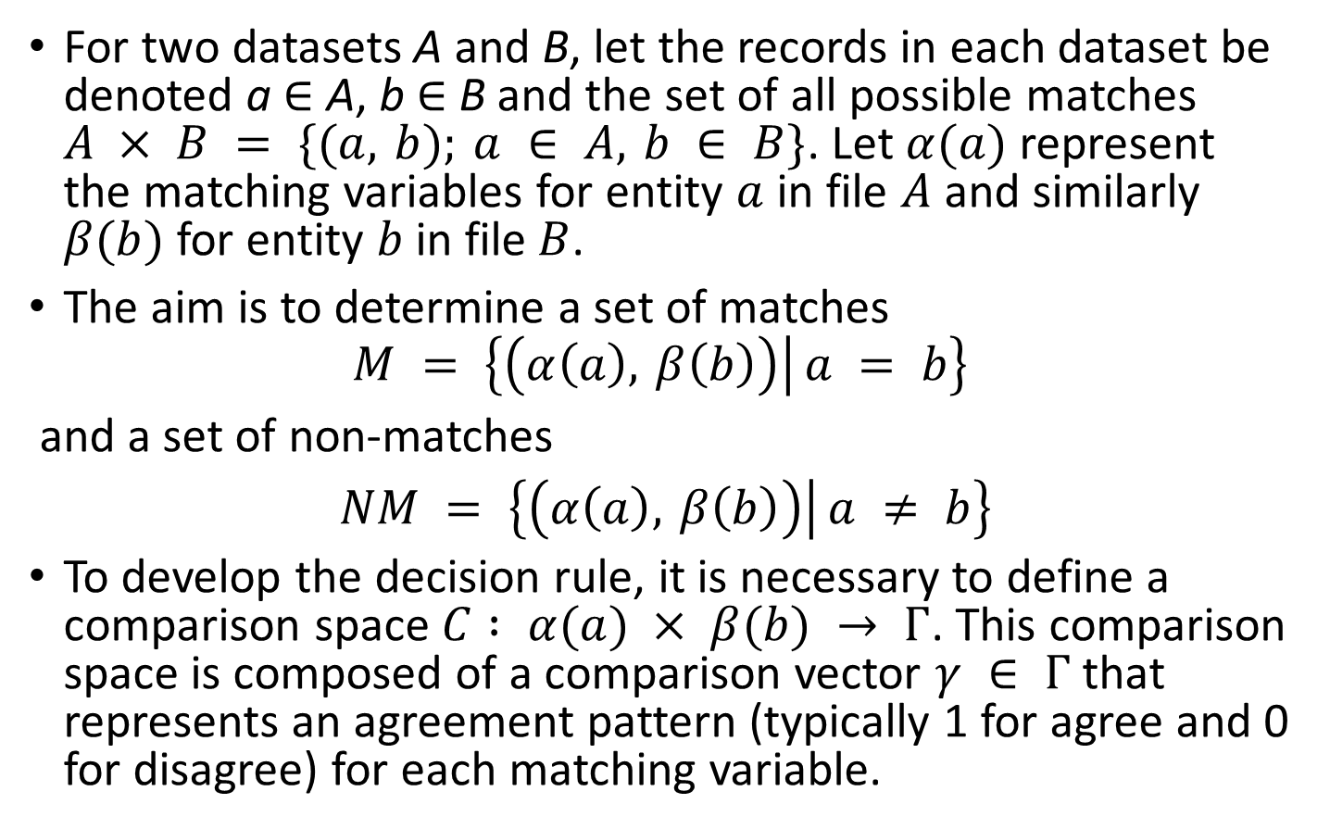
Basic Concepts in Probabilistic Data Linkage
For two datasets A and B, let the records in each dataset be denoted a ∈ A, b ∈ B and the set of all possible matches $A × B = \{(a, b); a ∈ A, b ∈ B\}$. Let $α(a)$ represent the matching variables for entity $a$ in file $A$ and similarly $β(b)$ for entity $b$ in file$B$.
The aim is to determine a set of matches
$$M = \left\{\left(α\left(a\right), β\left(b\right)\right) | a = b\right\}$$
and a set of non-matches
$NM = \left\{\left(α\left(a\right), β\left(b\right)\right) | a ≠ b\right\}$
To develop the decision rule, it is necessary to define a comparison space $C : α(a) × β(b) → Γ$. This comparison space is composed of a comparison vector $γ ∈ Γ$that represents an agreement pattern (typically 1 for agree and 0 for disagree) for each matching variable.
16

Slide 25
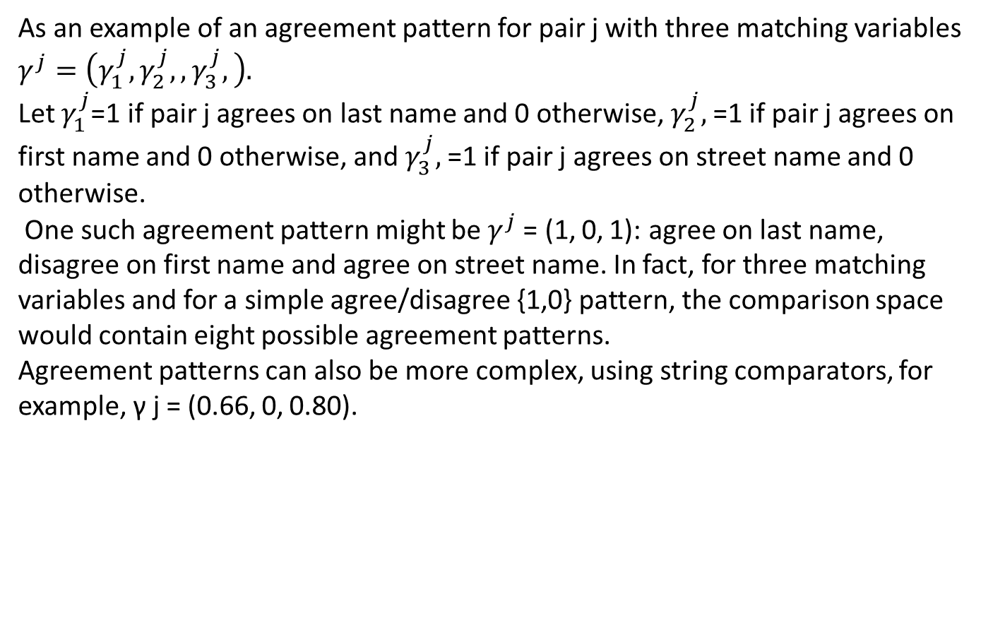
Example
As an example of an agreement pattern for pair j with three matching variables $γ^{j}=\left(γ_{1}^{j},γ_{2}^{j},,γ_{3}^{j},\right).$
Let $γ_{1}^{j}$=1 if pair j agrees on last name and 0 otherwise, $γ_{2}^{j},$=1 if pair j agrees on first name and 0 otherwise, and $γ_{3}^{j},$=1 if pair j agrees on street name and 0 otherwise.
One such agreement pattern might be $γ^{j}$= (1, 0, 1): agree on last name, disagree on first name and agree on street name. In fact, for three matching variables and for a simple agree/disagree {1,0} pattern, the comparison space would contain eight possible agreement patterns.
Agreement patterns can also be more complex, using string comparators, for example, γ j = (0.66, 0, 0.80).
16

Slide 26
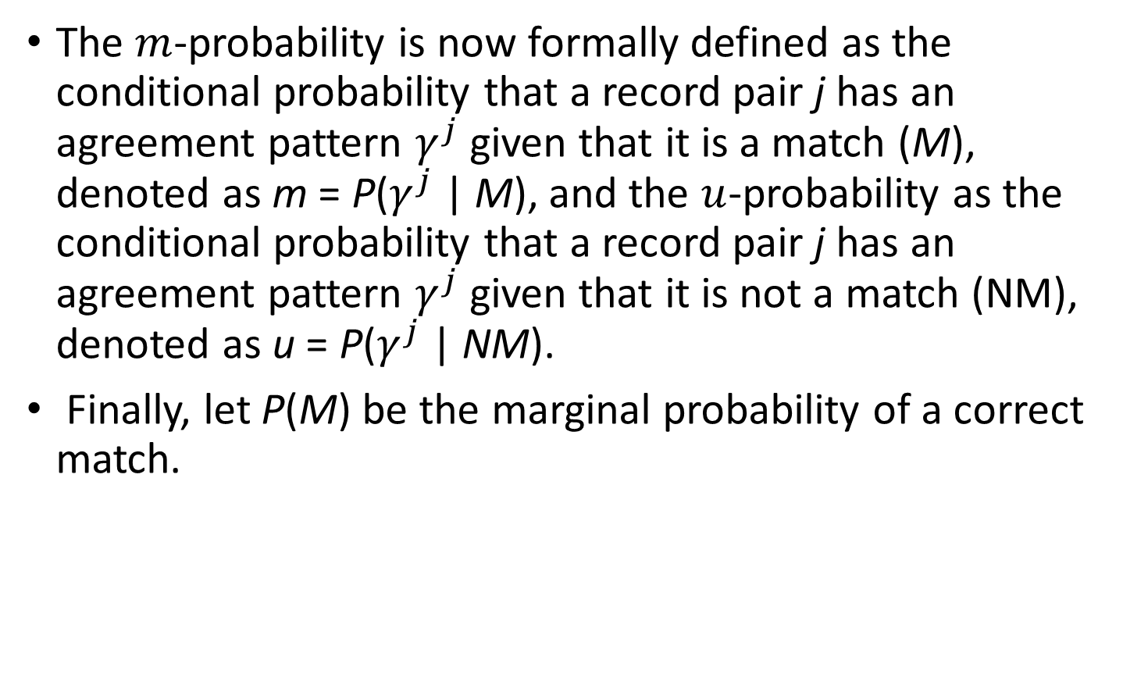
Basic Concepts in Probabilistic Data Linkage
The $m$-probability is now formally defined as the conditional probability that a record pair j has an agreement pattern $γ^{j}$given that it is a match (M), denoted as m = P($γ^{j}$| M), and the $u$-probability as the conditional probability that a record pair j has an agreement pattern $γ^{j}$given that it is not a match (NM), denoted as u = P($γ^{j}$| NM).
Finally, let P(M) be the marginal probability of a correct match.
17

Slide 27
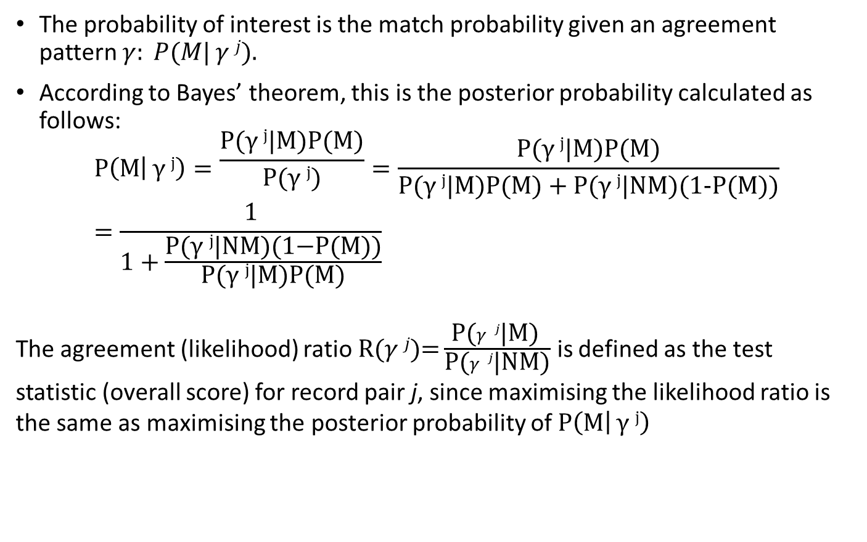
Basic Concepts in Probabilistic Data Linkage
The probability of interest is the match probability given an agreement pattern $γ: P(M| γ j).$
According to Bayes’ theorem, this is the posterior probability calculated as follows:
$$P\left(M | γ j\right)=\frac{\text{P}\text{(}γ j\text{|}\text{M}\text{)}\text{P}\text{(}\text{M}\text{)}}{\text{P}\text{(}γ j\text{)}}=\frac{\text{P}\text{(}γ j\text{|}\text{M}\text{)}\text{P}\text{(}\text{M}\text{)}}{\text{P}\text{(}γ j\text{|}\text{M}\text{)}\text{P}\text{(}\text{M}\text{)}+\text{P}\text{(}γ j\text{|}\text{N}\text{M}\text{)(1−}\text{P}\text{(}\text{M}\text{))}}=\frac{1}{1+\frac{\text{P}\text{(}γ j\text{|}\text{NM}\text{)(1−}\text{P}\text{(}\text{M}\text{))}}{\text{P}\text{(}γ j\text{|}\text{M}\text{)}\text{P}\text{(}\text{M}\text{)}}}$$
The agreement (likelihood) ratio $\text{R}\text{(}γ j\text{)}\text{=}\frac{\text{P}\text{(}γ j\text{|}\text{M}\text{)} }{\text{P}\text{(}γ j\text{|}\text{N}\text{M}\text{)}}$ is defined as the test statistic (overall score) for record pair j, since maximising the likelihood ratio is the same as maximising the posterior probability of $P\left(M | γ j\right)$
18

Slide 28
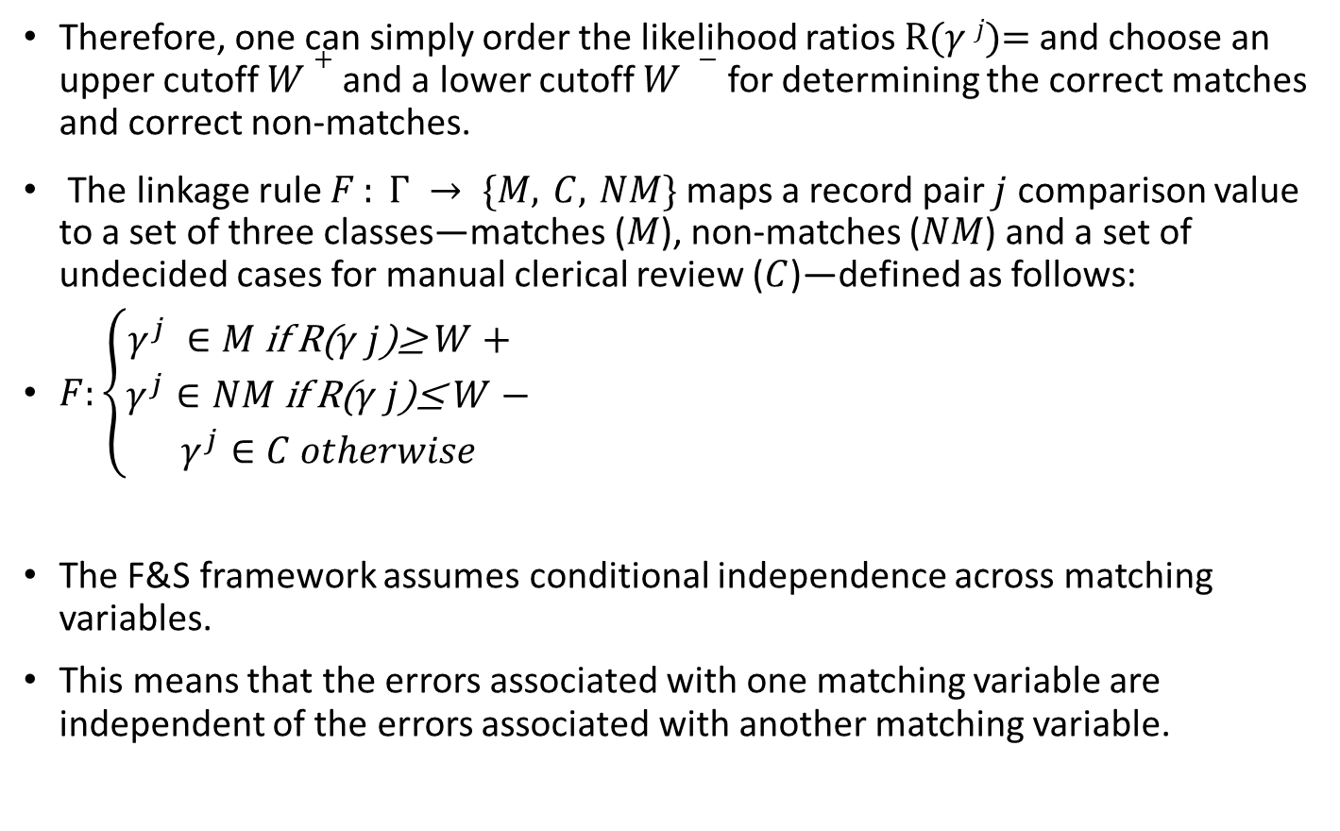
Basic Concepts in Probabilistic Data Linkage
Therefore, one can simply order the likelihood ratios $\text{R}\text{(}γ j\text{)=}$and choose an upper cutoff $W+$and a lower cutoff $W −$for determining the correct matches and correct non-matches.
The linkage rule $F : Γ → \{M, C, NM\}$maps a record pair $j$ comparison value to a set of three classes—matches ($M$), non-matches ($NM$) and a set of undecided cases for manual clerical review ($C$)—defined as follows:
$F:\left\{\begin{aligned}γ^{j} ∈M \text{if} \text{R}\text{(}γ j\text{)≥} W+ \\ γ^{j}∈NM \text{if} \text{R}\text{(}γ j\text{)≤} W− \\ γ^{j}∈C otherwise\end{aligned}\right.$
The F&S framework assumes conditional independence across matching variables.
This means that the errors associated with one matching variable are independent of the errors associated with another matching variable.
19

Slide 29
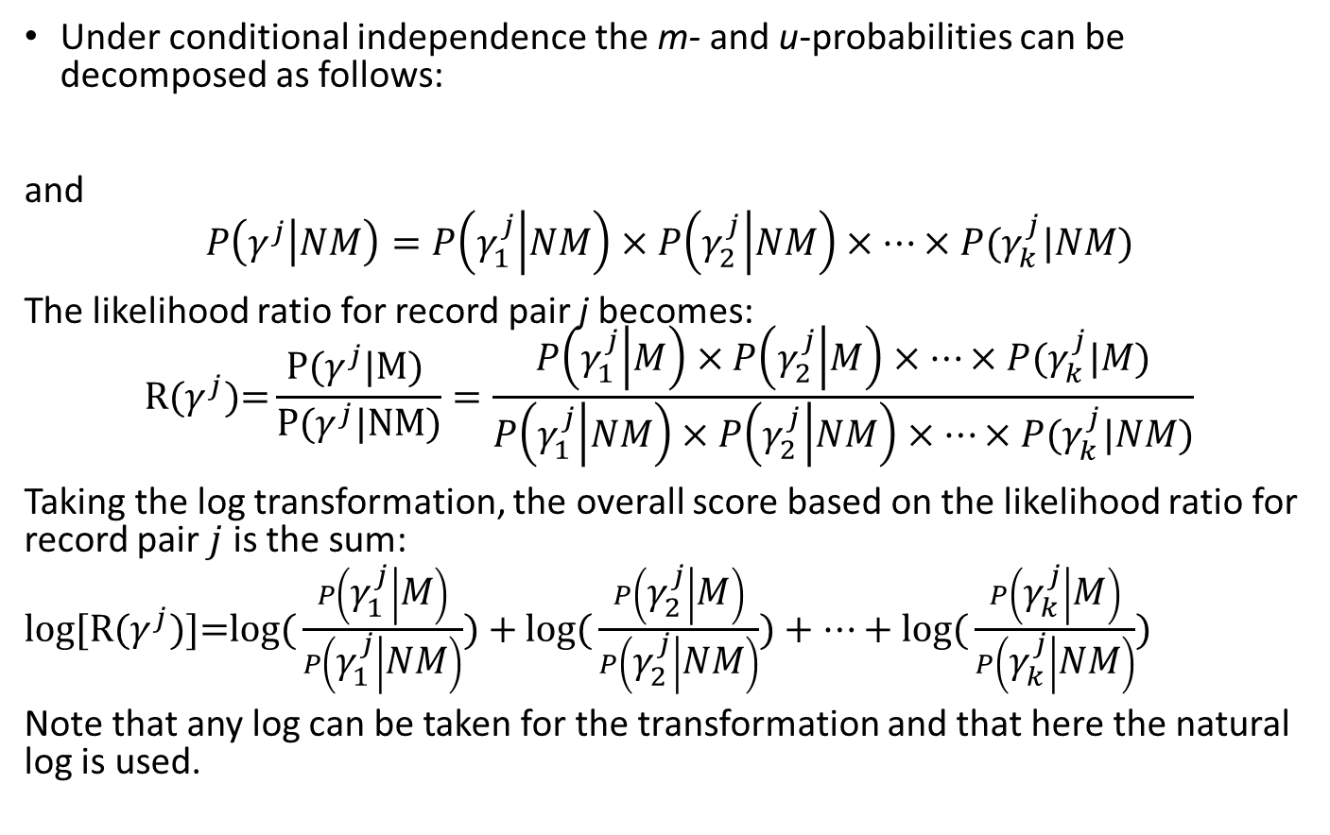
Basic Concepts in Probabilistic Data Linkage
Under conditional independence the m- and u-probabilities can be decomposed as follows:
and
$$P\left(γ^{j} | NM\right)=P\left(γ_{1}^{j} | NM\right)×P\left(γ_{2}^{j} | NM\right)×…×P(γ_{k}^{j}|NM)$$
The likelihood ratio for record pair j becomes:
$$\text{R}\text{(}γ^{j}\text{)=}\frac{\text{P}\text{(}γ^{j}\text{|}\text{M}\text{)} }{\text{P}\text{(}γ^{j}\text{|}\text{NM}\text{)}}=\frac{P\left(γ_{1}^{j} | M\right)×P\left(γ_{2}^{j} | M\right)×…×P(γ_{k}^{j}|M)}{P\left(γ_{1}^{j} | NM\right)×P\left(γ_{2}^{j} | NM\right)×…×P(γ_{k}^{j}|NM)}$$
Taking the log transformation, the overall score based on the likelihood ratio for record pair $j$ is the sum:
log[$\text{R}\text{(}γ^{j}\text{)]=}\text{log}\text{(}\frac{P\left(γ_{1}^{j} | M\right)}{P\left(γ_{1}^{j} | NM\right)})+$ $\text{log}\text{(}\frac{P\left(γ_{2}^{j} | M\right)}{P\left(γ_{2}^{j} | NM\right)})+…+\text{log}\text{(}\frac{P\left(γ_{k}^{j} | M\right)}{P\left(γ_{k}^{j} | NM\right)})$
Note that any log can be taken for the transformation and that here the natural log is used.
$$P\left(γ^{j} | M\right)=P\left(γ_{1}^{j} | M\right)×P\left(γ_{2}^{j} | M\right)×…×P(γ_{k}^{j}|M)$$
20

Slide 30
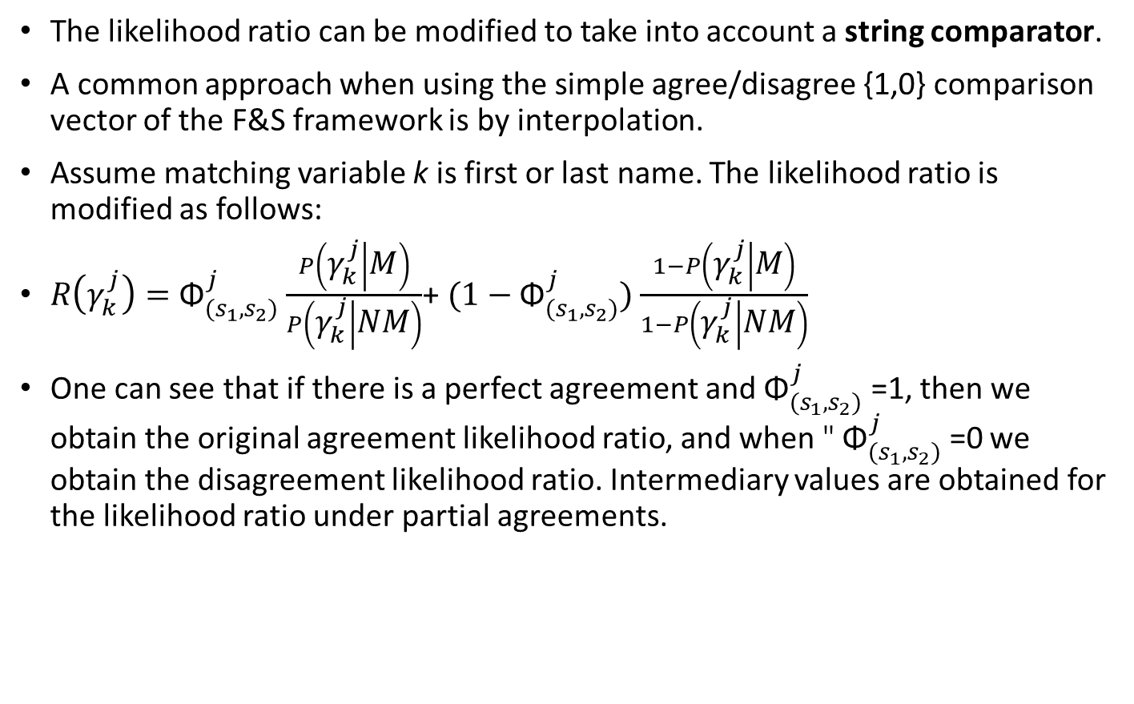
Basic Concept in Probabilistic Data Linkage
The likelihood ratio can be modified to take into account a string comparator.
A common approach when using the simple agree/disagree {1,0} comparison vector of the F&S framework is by interpolation.
Assume matching variable k is first or last name. The likelihood ratio is modified as follows:
$R\left(γ_{k}^{j}\right)={\text{Φ}}_{(s_{1},s_{2})}^{j}$ $\frac{P\left(γ_{k}^{j} | M\right)}{P\left(γ_{k}^{j} | NM\right)}$+ ${(1−\text{Φ}}_{(s_{1},s_{2})}^{j})$ $\frac{1−P\left(γ_{k}^{j} | M\right)}{1−P\left(γ_{k}^{j} | NM\right)}$
One can see that if there is a perfect agreement and ${\text{Φ}}_{(s_{1},s_{2})}^{j}$ =1, then we obtain the original agreement likelihood ratio, and when " ${\text{Φ}}_{(s_{1},s_{2})}^{j}$ =0 we obtain the disagreement likelihood ratio. Intermediary values are obtained for the likelihood ratio under partial agreements.
24

Slide 31
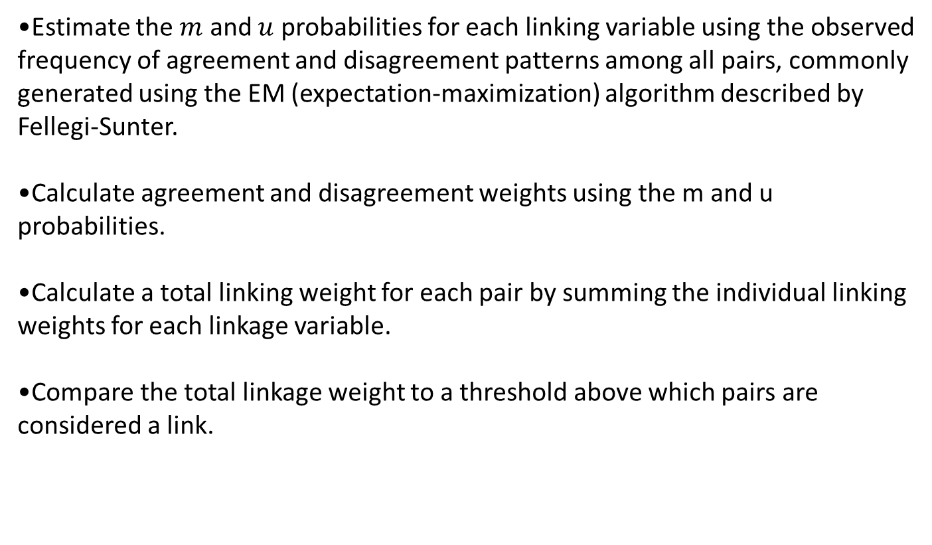
Summary of Steps for Probabilistic Record Linkage
Estimate the $m$ and $u$ probabilities for each linking variable using the observed frequency of agreement and disagreement patterns among all pairs, commonly generated using the EM (expectation-maximization) algorithm described by Fellegi-Sunter.
Calculate agreement and disagreement weights using the m and u probabilities.
Calculate a total linking weight for each pair by summing the individual linking weights for each linkage variable.
Compare the total linkage weight to a threshold above which pairs are considered a link.
26

Slide 32
R packages
reclin - implements methodology for linking records based on inexact keys. It allows for maximum flexibility by giving users full control over each step of the linking procedure.
comparator – Levenshtein, Jaro-Winkler, Hamming formula
31

Slide 33

Thank you for your attention!
Sebastian Wójcik, PhD
Statistical Office in Rzeszów
s.wojcik@stat.gov.pl
Madrit, 7th July 2023

