Slide 1


Debugging with Claude,
through Visual Studio
An MCP server for the Visual Studio 2026 debugger
Sebastián Zonta
Notes:
Welcome. Three minutes of context, then a live demo where Claude debugs two running apps through Visual Studio.

Slide 2


Visual Studio
The IDE — and its debugger is the star
Write
VS logo
(optional)
Editor, IntelliSense, refactoring
Build
Solutions, projects, .NET
Debug
Breakpoints · call stack · live variables
Notes:
Formality slide. Everyone here knows VS. The one thing to remember: the debugger. Breakpoints, stack, variables — that's what we'll hand to the AI.

Slide 3



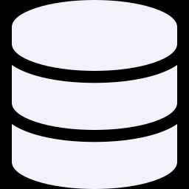
Model Context Protocol
“USB-C for AI tools”
Files
AI client
Claude Code
GitHub
Databases
MCP
Visual Studio debugger
One standard plug: any client, any tool.
Notes:
MCP: an open standard so an AI client can call tools exposed by servers. Write a server once, every MCP client can use it. Ours exposes the VS debugger.

Slide 4

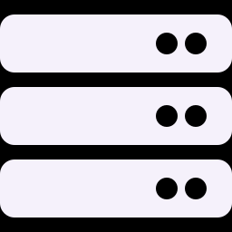


The bridge
VsDebugMcp: Claude drives your debugger
Claude Code
VsDebugMcp
Visual Studio
Your app
MCP client
MCP server
VS instance
target process
list_instances
attach
set_breakpoint
launch_process
read_stack
evaluate
detach
21 tools — discover, bind, break, inspect, release
Notes:
Claude talks MCP to VsDebugMcp; VsDebugMcp drives the Visual Studio you already have open; VS debugs your app. Three words: VS instance, debug session (Claude's handle on one VS), target process (the app).

Slide 5



Why this approach
Evidence, not guesses
Your VS, your setup
Proves the bug from live state
Reuses the instance you have open
Multi-app
Safe by default
One debug session per VS instance
Read-only evaluate, explicit consent
Notes:
Reading code gives hypotheses; a stopped process gives facts. No new tooling: your VS. Follows one request across two services. Nothing mutates without explicit consent.

Slide 6



Today’s demo
Two apps, two VS instances, one wrong total
Orders.Api
HTTP
Pricing.Engine
:5201 · frontend
:5202 · pricing rules
Order 1
Order 2
widget × 1
widget × 10 + SAVE20
108.00
108.00 ?
as expected
should be 756.00
Notes:
Two ASP.NET Core apps, each open in its own VS. Order 1 is right. Order 2 returns a plausible but wrong total. No code changes during the demo. Claude must find why — through the debugger only.

Slide 7
Let’s debug.
claude
> start
Discover → Bind → Breakpoints → Repro → Inspect → Verdict
Notes:
Switch to the terminal. Type: start. Narrate each step as Claude runs it.

Slide 8
By the numbers
Built with Claude Code
21
238
~10
129
MCP tools
automated tests
days
commits
Oct 19 → Oct 29, 2026 · spec → issues → TDD → live E2E
Notes:
Ten days, AI-assisted end to end: specs, issues, test-first, and real-VS E2E passes. 238 tests run against a fake bridge; live checks run against real VS.

Slide 9



What’s next
Live tool-call dashboard
Flow-testing skills
Your idea here
Every call of a client session, live, grouped by debug session
Flow plans = acceptance criteria the debugger checks · 1 of 3 shipped
What would you hand to the debugger?
Notes:
Dashboard: watch the tool calls stream instead of reading a terminal. Flow-testing skills: what you just saw, but written by Claude from your code: flow plans, then a verdict. Third card opens Q&A.

Slide 10

Questions?
¿Preguntas? — en español también
github.com/SebastianZonta/Unofficial-VisualStudio-MCP
Notes:
Invite questions, in Spanish is fine.

