Slide 1
SoW
Sebastian Ostrowski
January 23, 2026

Slide 2
Tackling the “DLS puzzle” in SMASH
(BSc project)

Slide 3
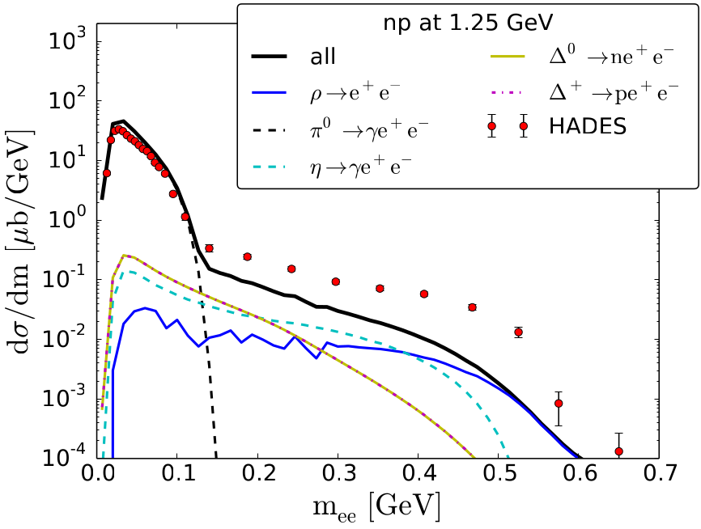
What is the “DLS puzzle”?
BEVALAC dilepton spectrometer (DLS) and corresponding DLS collaboration measured dilepton (e⁺e⁻) emission in NN collisions
Observed dilepton yield in full dataset (released 1997) larger than calculated yields from transport models (UrQMD, BUU); observations later supported by HADES
→ Discrepancy between models and observations resulted in term “DLS puzzle”

Slide 4
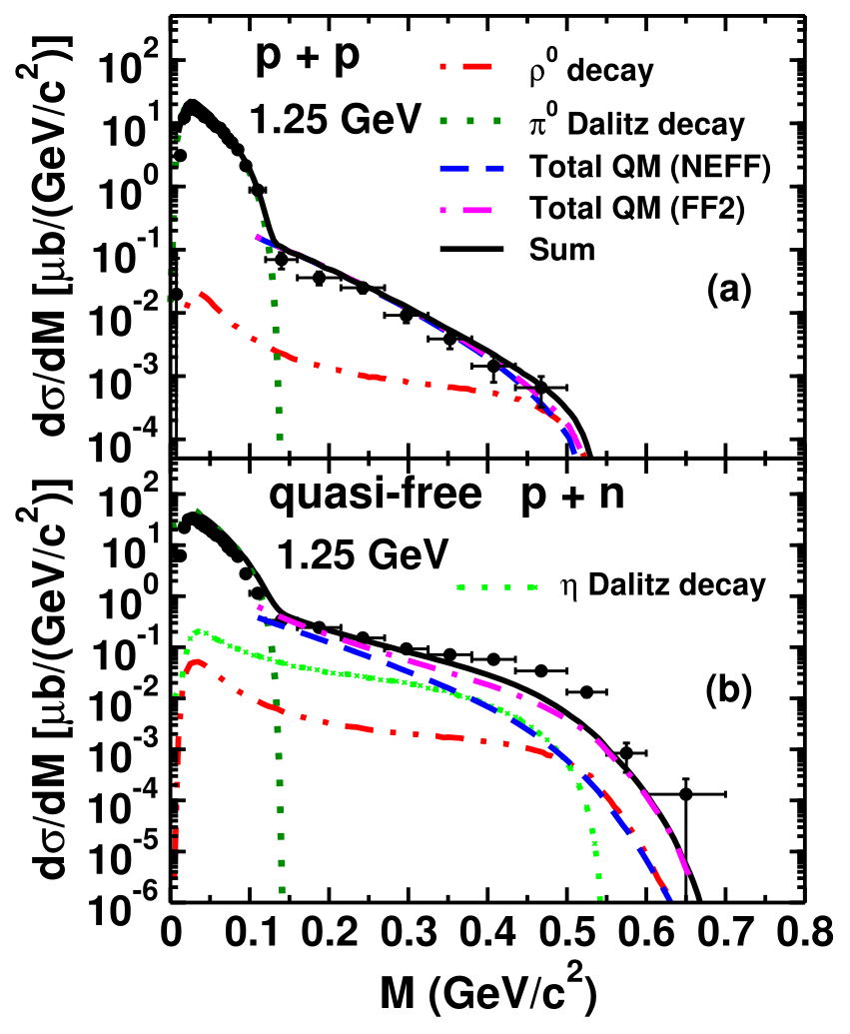
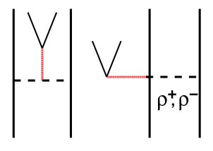
Goal and solution ideas
Goal of the BSc project
“Bring model closer to observations”
Idea
Include additional dilepton production channel via bremsstrahlung stemming from charged internal meson line

Slide 5
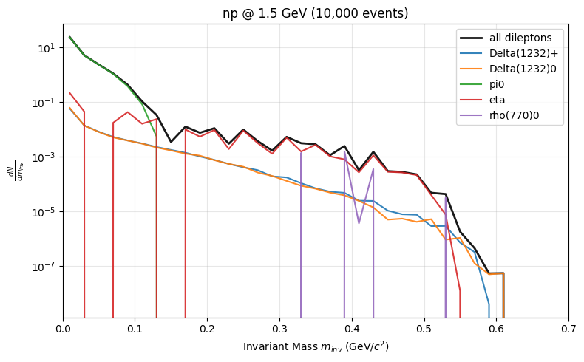
Current status
First graph with current release (SMASH-3.3)

