Slide 1
Quantitative description of products

Slide 2
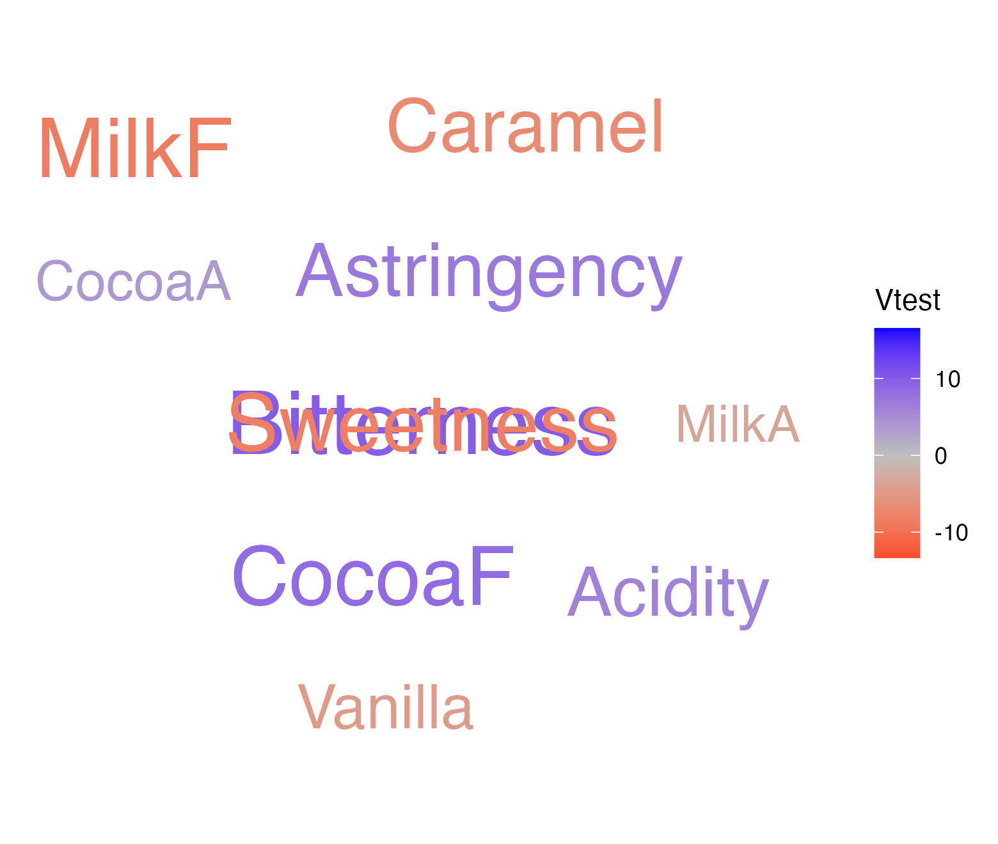
Result of the T-test for choc1
Descriptor | Coeff | Adjust mean | P-value | Vtest
Bitterness | 2.457 | 7.069 | 0.000 | 9.950
CocoaF | 1.724 | 8.069 | 0.000 | 8.479
Astringency | 1.647 | 4.759 | 0.000 | 7.084
Acidity | 1.480 | 4.655 | 0.000 | 6.141
CocoaA | 0.799 | 7.086 | 0.000 | 3.896
MilkA | -0.828 | 3.586 | 0.001 | -3.409
Vanilla | -0.966 | 1.103 | 0.000 | -4.766
Caramel | -1.681 | 1.672 | 0.000 | -6.986
Sweetness | -1.945 | 3.138 | 0.000 | -8.291
MilkF | -1.885 | 1.569 | 0.000 | -8.696

Slide 3
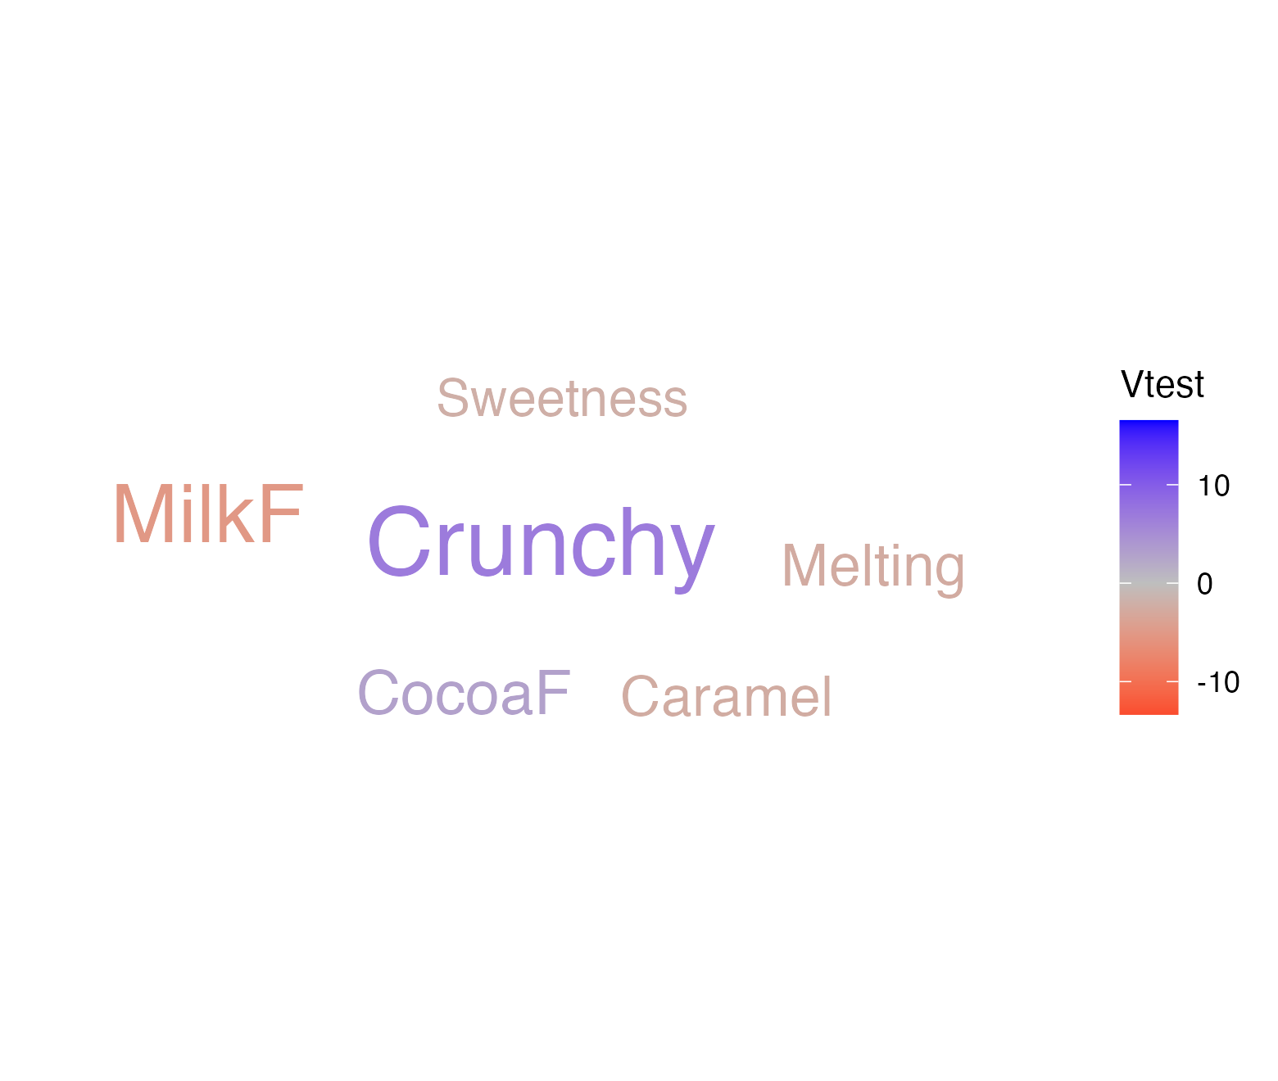
Result of the T-test for choc2
Descriptor | Coeff | Adjust mean | P-value | Vtest
Crunchy | 1.586 | 7.707 | 0.000 | 6.917
CocoaF | 0.569 | 6.914 | 0.003 | 2.946
Sweetness | -0.463 | 4.621 | 0.038 | -2.078
Caramel | -0.578 | 2.776 | 0.013 | -2.485
Melting | -0.624 | 4.328 | 0.010 | -2.590
MilkF | -1.075 | 2.379 | 0.000 | -5.161

Slide 4
Result of the T-test for choc3
Descriptor | Coeff | Adjust mean | P-value | Vtest
MilkF | 4.253 | 7.707 | 0.000 | 16.523
Caramel | 2.974 | 6.328 | 0.000 | 11.523
Sweetness | 2.520 | 7.603 | 0.000 | 10.394
Melting | 2.359 | 7.310 | 0.000 | 9.194
Vanilla | 1.603 | 3.672 | 0.000 | 7.684
MilkA | 1.638 | 6.052 | 0.000 | 6.577
Sticky | 1.055 | 5.034 | 0.000 | 4.291
Granular | -1.397 | 1.603 | 0.000 | -5.442
Acidity | -1.606 | 1.569 | 0.000 | -6.631
CocoaA | -1.615 | 4.672 | 0.000 | -7.608

Slide 5
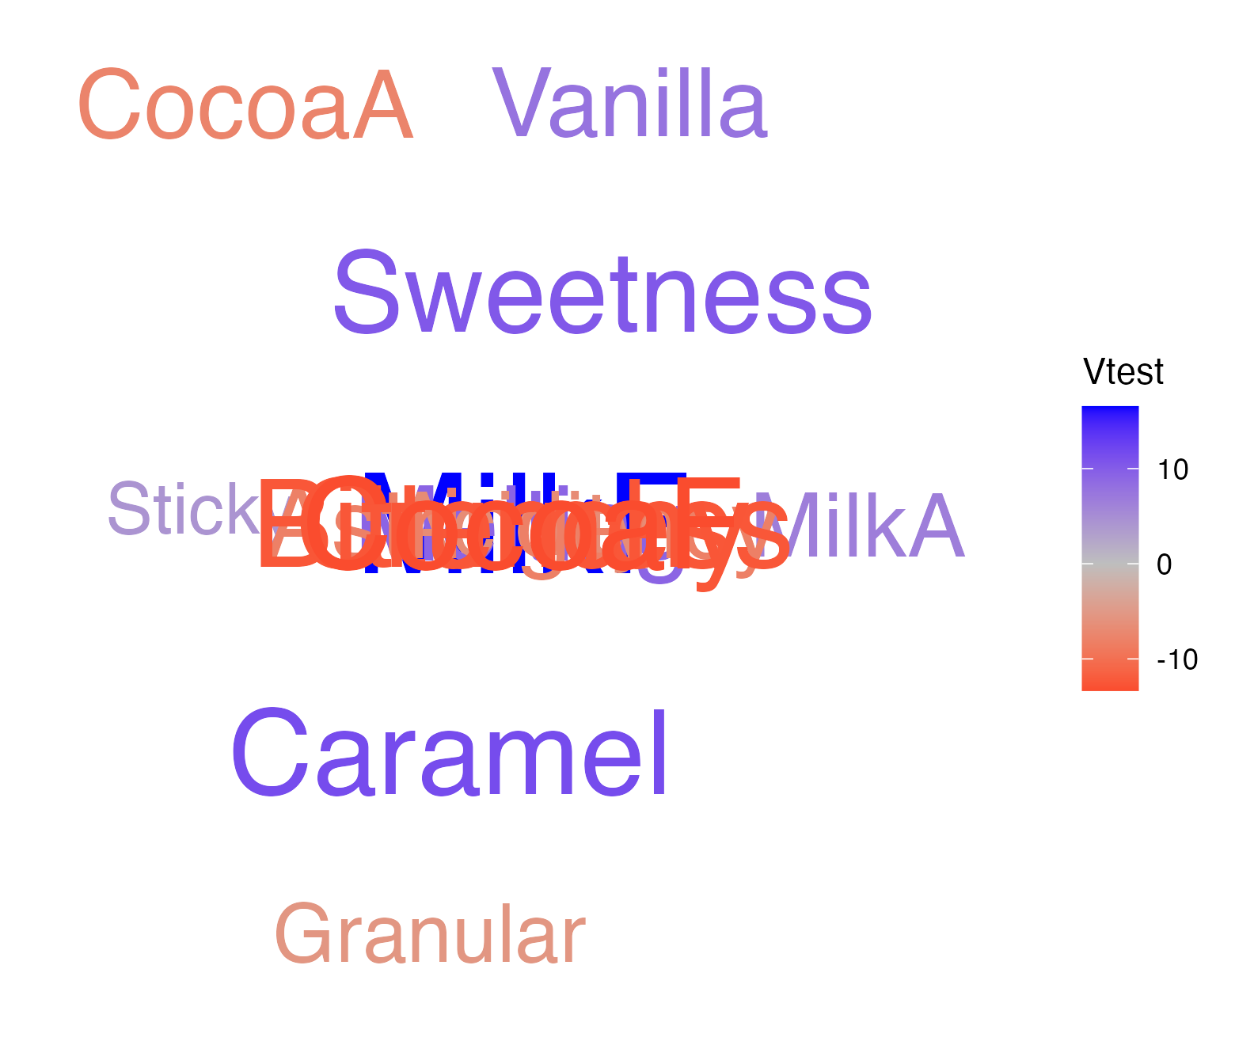
Result of the T-test for choc3
Descriptor | Coeff | Adjust mean | P-value | Vtest
Astringency | -1.905 | 1.207 | 0.000 | -8.094
Bitterness | -3.216 | 1.397 | 0.000 | -12.424
Crunchy | -3.138 | 2.983 | 0.000 | -12.494
CocoaF | -2.966 | 3.379 | 0.000 | -13.330

Slide 6
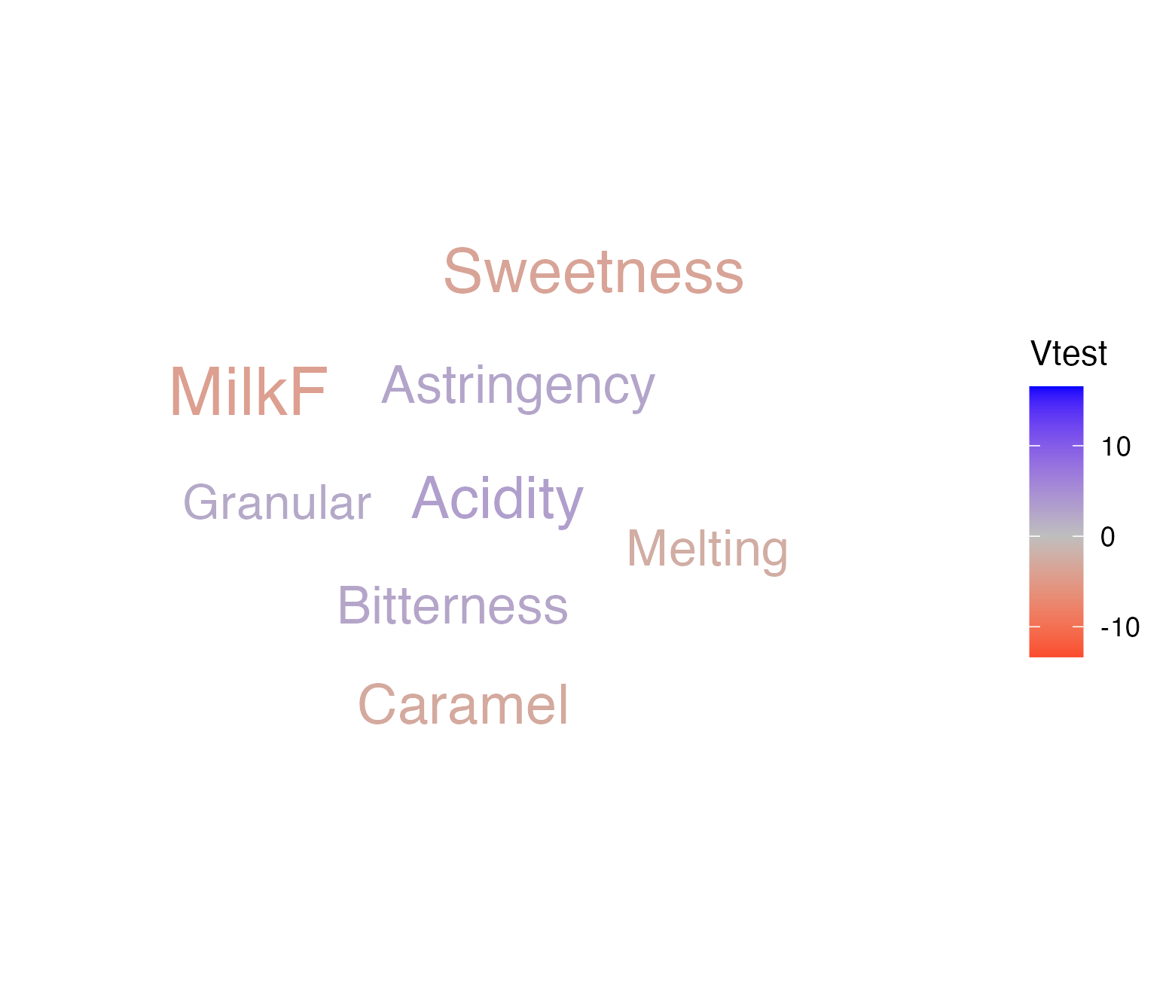
Result of the T-test for choc4
Descriptor | Coeff | Adjust mean | P-value | Vtest
Acidity | 0.756 | 3.931 | 0.001 | 3.206
Astringency | 0.578 | 3.690 | 0.010 | 2.574
Bitterness | 0.578 | 5.190 | 0.012 | 2.524
Granular | 0.552 | 3.552 | 0.028 | 2.193
Melting | -0.572 | 4.379 | 0.017 | -2.377
Caramel | -0.681 | 2.672 | 0.003 | -2.924
Sweetness | -0.790 | 4.293 | 0.000 | -3.526
MilkF | -0.868 | 2.586 | 0.000 | -4.198

Slide 7
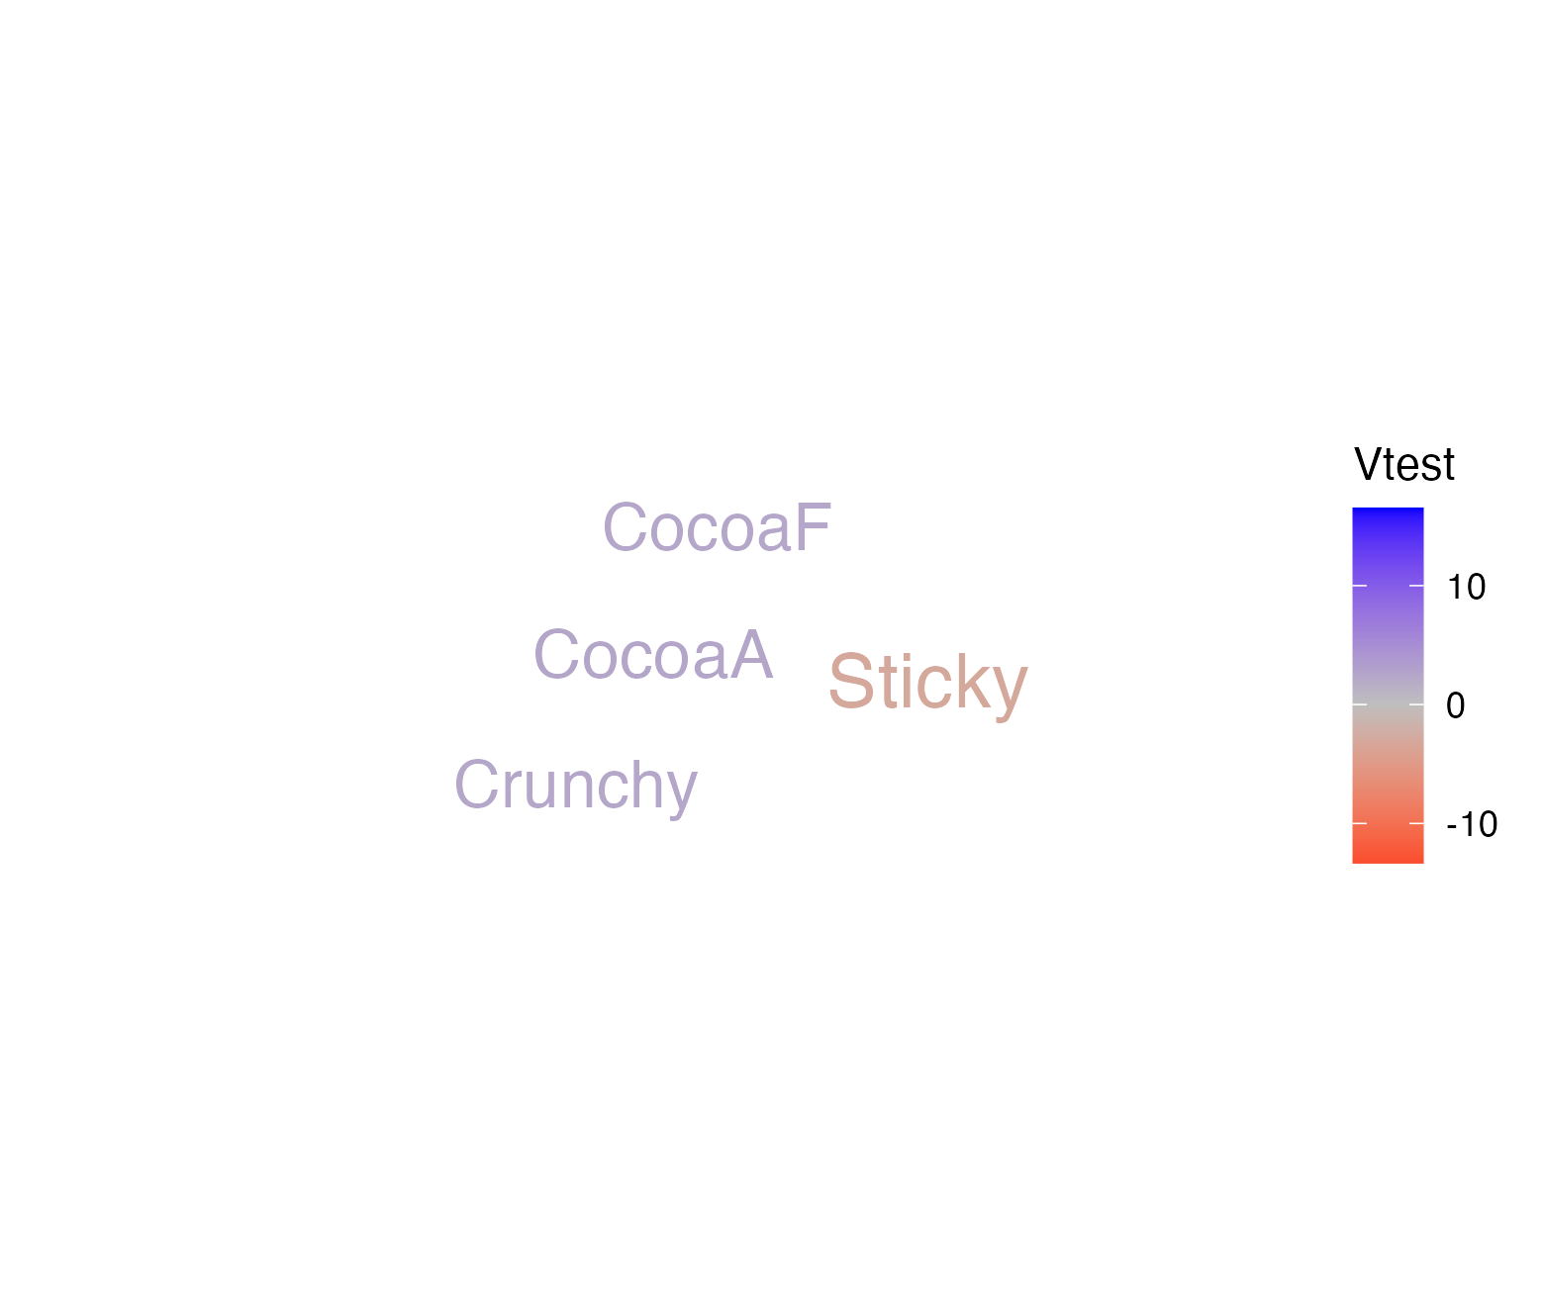
Result of the T-test for choc5
Descriptor | Coeff | Adjust mean | P-value | Vtest
CocoaA | 0.506 | 6.793 | 0.013 | 2.484
Crunchy | 0.517 | 6.638 | 0.020 | 2.334
CocoaF | 0.448 | 6.793 | 0.020 | 2.327
Sticky | -0.756 | 3.224 | 0.002 | -3.097

Slide 8
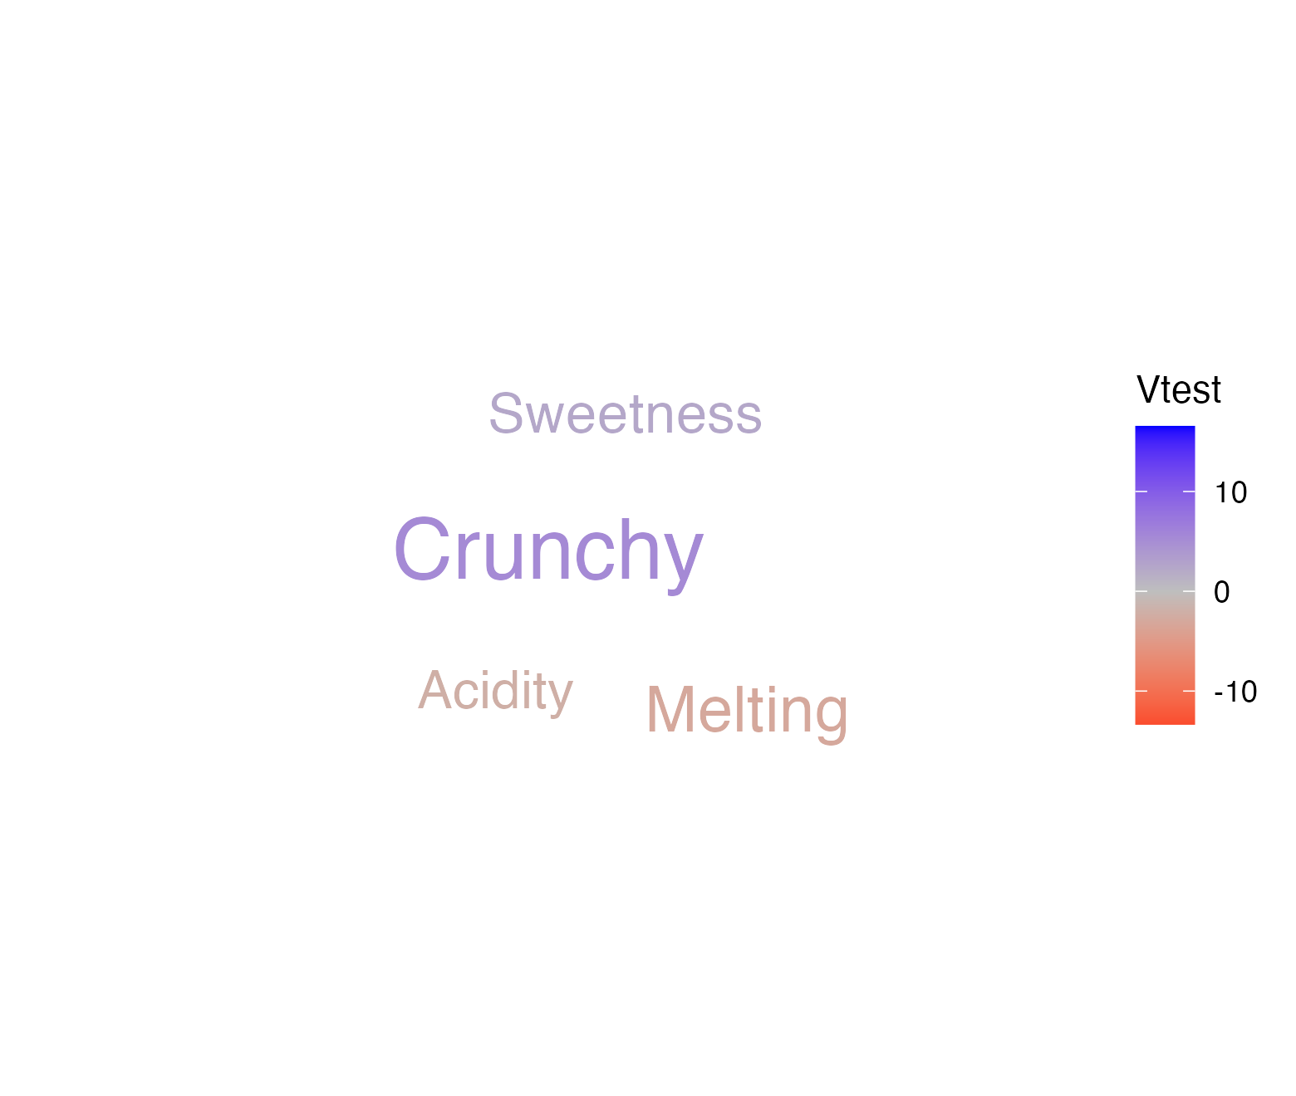
Result of the T-test for choc6
Descriptor | Coeff | Adjust mean | P-value | Vtest
Crunchy | 1.207 | 7.328 | 0.000 | 5.346
Sweetness | 0.537 | 5.621 | 0.016 | 2.410
Acidity | -0.503 | 2.672 | 0.032 | -2.143
Melting | -0.744 | 4.207 | 0.002 | -3.084

Slide 9
Product space

Slide 10
Attributes structuring the product space
Descriptor | Vtest | P-value
MilkF | 16.399 | 0.000
CocoaF | 13.481 | 0.000
Bitterness | 13.343 | 0.000
Crunchy | 12.662 | 0.000
Caramel | 11.532 | 0.000
Sweetness | 11.441 | 0.000
Astringency | 8.959 | 0.000
Melting | 8.415 | 0.000
Acidity | 7.723 | 0.000
Vanilla | 7.318 | 0.000

Slide 11
Attributes structuring the product space
Descriptor | Vtest | P-value
CocoaA | 7.070 | 0.000
MilkA | 5.926 | 0.000
Granular | 4.371 | 0.000
Sticky | 3.563 | 0.000

Slide 12
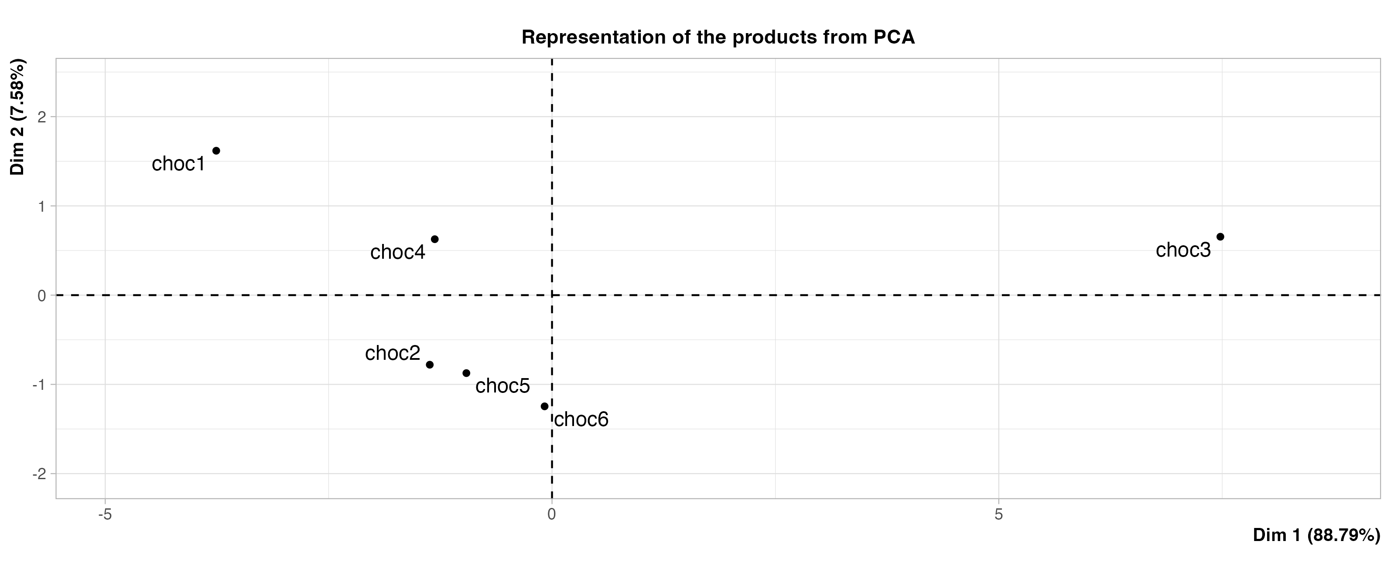
Representation of the products from PCA

Slide 13
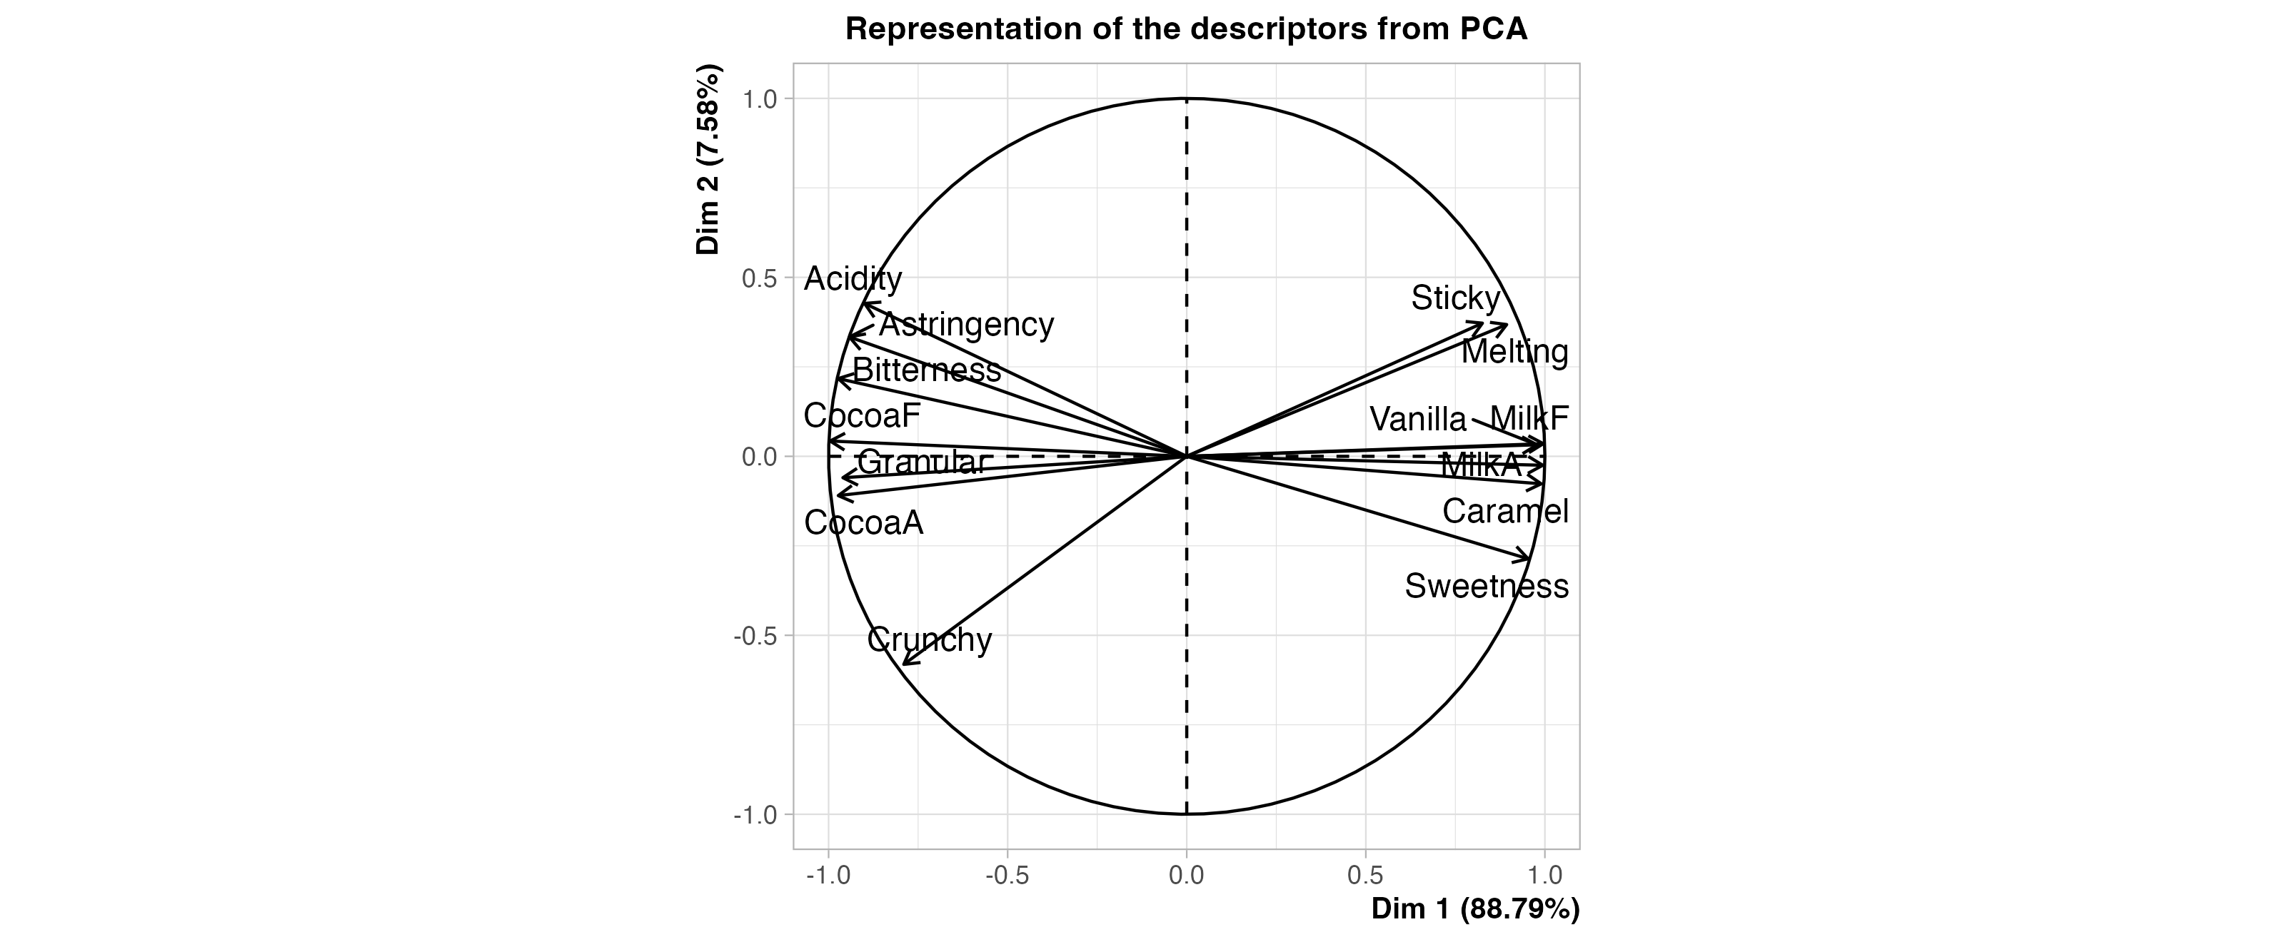
Representation of the descriptors from PCA

Slide 14
Representation of the sensory profiles
 | CocoaF | Bitterness | CocoaA | Granular | Astringency | Acidity | Crunchy | Sticky | Melting | Sweetness | Vanilla | Caramel | MilkA | MilkF
choc1 | 8.069 | 7.069 | 7.086 | 3.448 | 4.759 | 4.655 | 5.966 | 3.759 | 4.741 | 3.138 | 1.103 | 1.672 | 3.586 | 1.569
choc2 | 6.914 | 4.948 | 6.552 | 3.155 | 3.155 | 3.138 | 7.707 | 3.828 | 4.328 | 4.621 | 1.810 | 2.776 | 4.000 | 2.379
choc4 | 6.690 | 5.190 | 6.259 | 3.552 | 3.690 | 3.931 | 6.103 | 4.103 | 4.379 | 4.293 | 2.121 | 2.672 | 4.103 | 2.586
choc5 | 6.793 | 4.879 | 6.793 | 3.069 | 3.103 | 3.086 | 6.638 | 3.224 | 4.741 | 5.224 | 1.793 | 3.414 | 4.172 | 3.121
choc6 | 6.224 | 4.190 | 6.362 | 3.172 | 2.759 | 2.672 | 7.328 | 3.931 | 4.207 | 5.621 | 1.914 | 3.259 | 4.569 | 3.362
choc3 | 3.379 | 1.397 | 4.672 | 1.603 | 1.207 | 1.569 | 2.983 | 5.034 | 7.310 | 7.603 | 3.672 | 6.328 | 6.052 | 7.707

Slide 15
Appendix

Slide 16
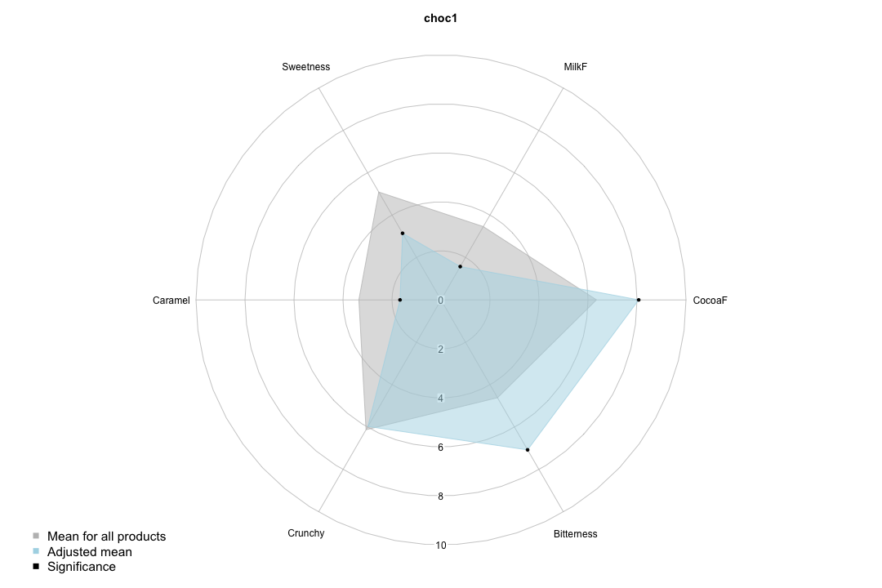
Sensory profile of choc1

Slide 17
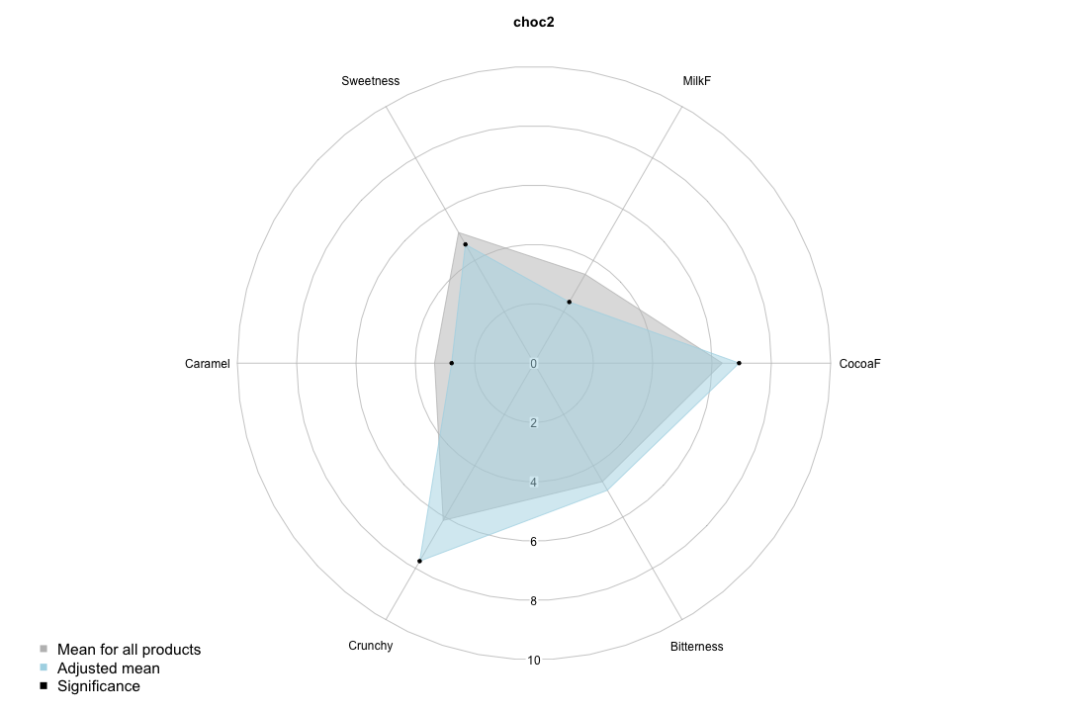
Sensory profile of choc2

Slide 18
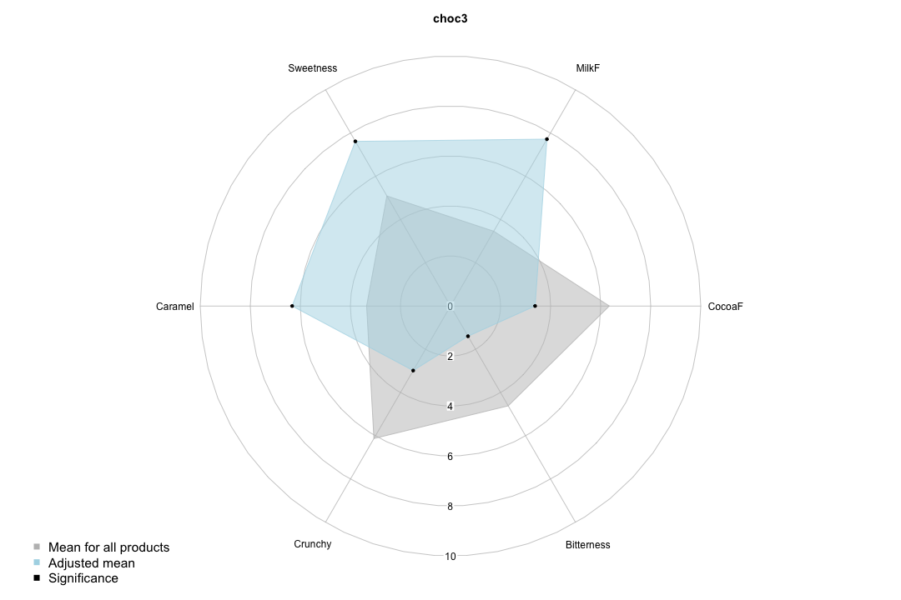
Sensory profile of choc3

Slide 19
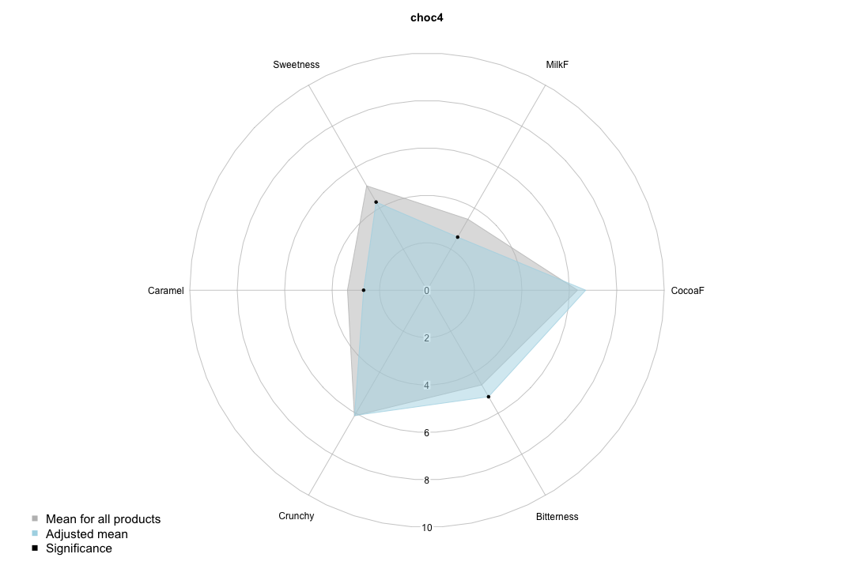
Sensory profile of choc4

Slide 20
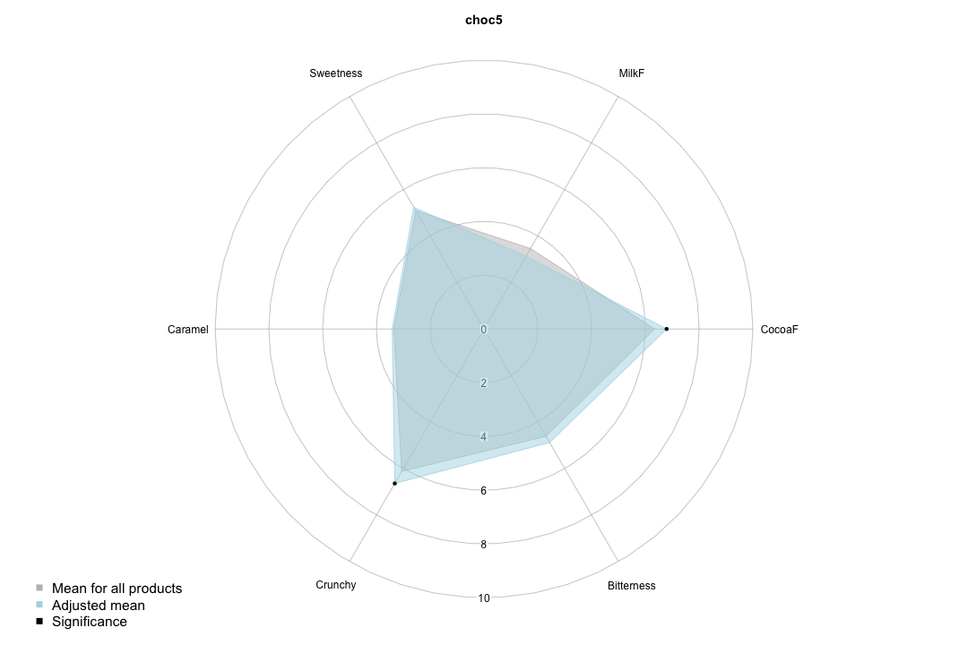
Sensory profile of choc5

Slide 21
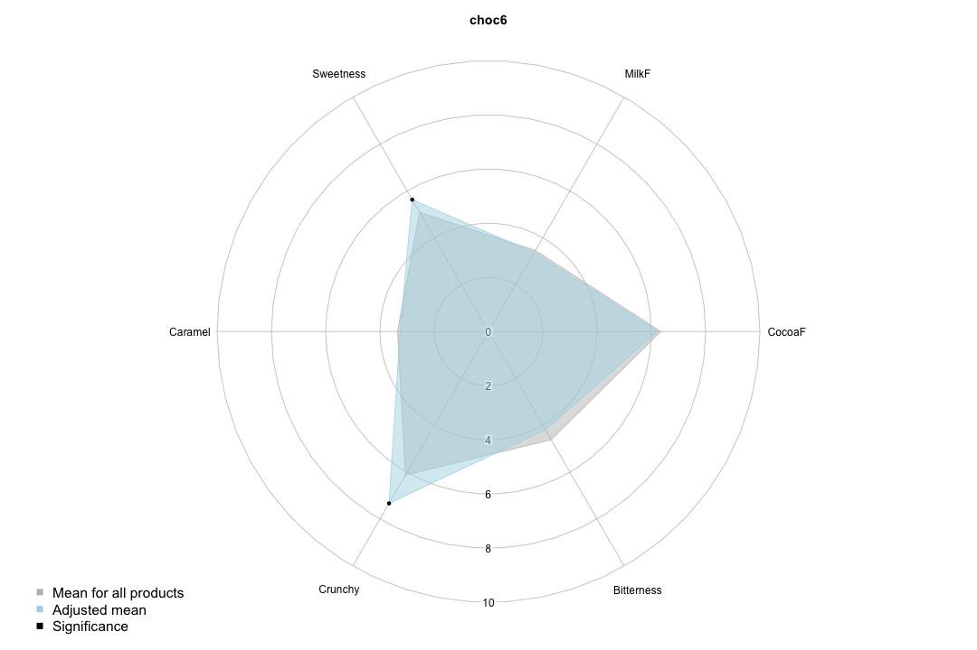
Sensory profile of choc6

