Slide 1
PCA + HCPC

Slide 2
Eigenvalues Decomposition
Dimension | Eigenvalue | Percentage of variance | Cumulative percentage of variance
comp 1 | 3.272 | 32.719 | 32.719
comp 2 | 1.737 | 17.371 | 50.090
comp 3 | 1.405 | 14.049 | 64.139
comp 4 | 1.057 | 10.569 | 74.708
comp 5 | 0.685 | 6.848 | 81.556
comp 6 | 0.599 | 5.993 | 87.549
comp 7 | 0.451 | 4.512 | 92.061
comp 8 | 0.397 | 3.969 | 96.030
comp 9 | 0.215 | 2.148 | 98.178
comp 10 | 0.182 | 1.822 | 100.000

Slide 3
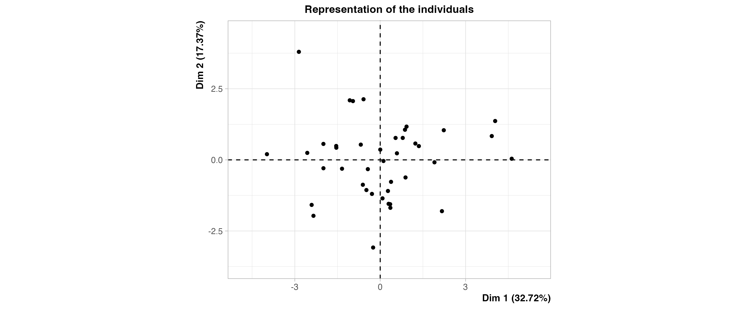
Representation of the individuals

Slide 4
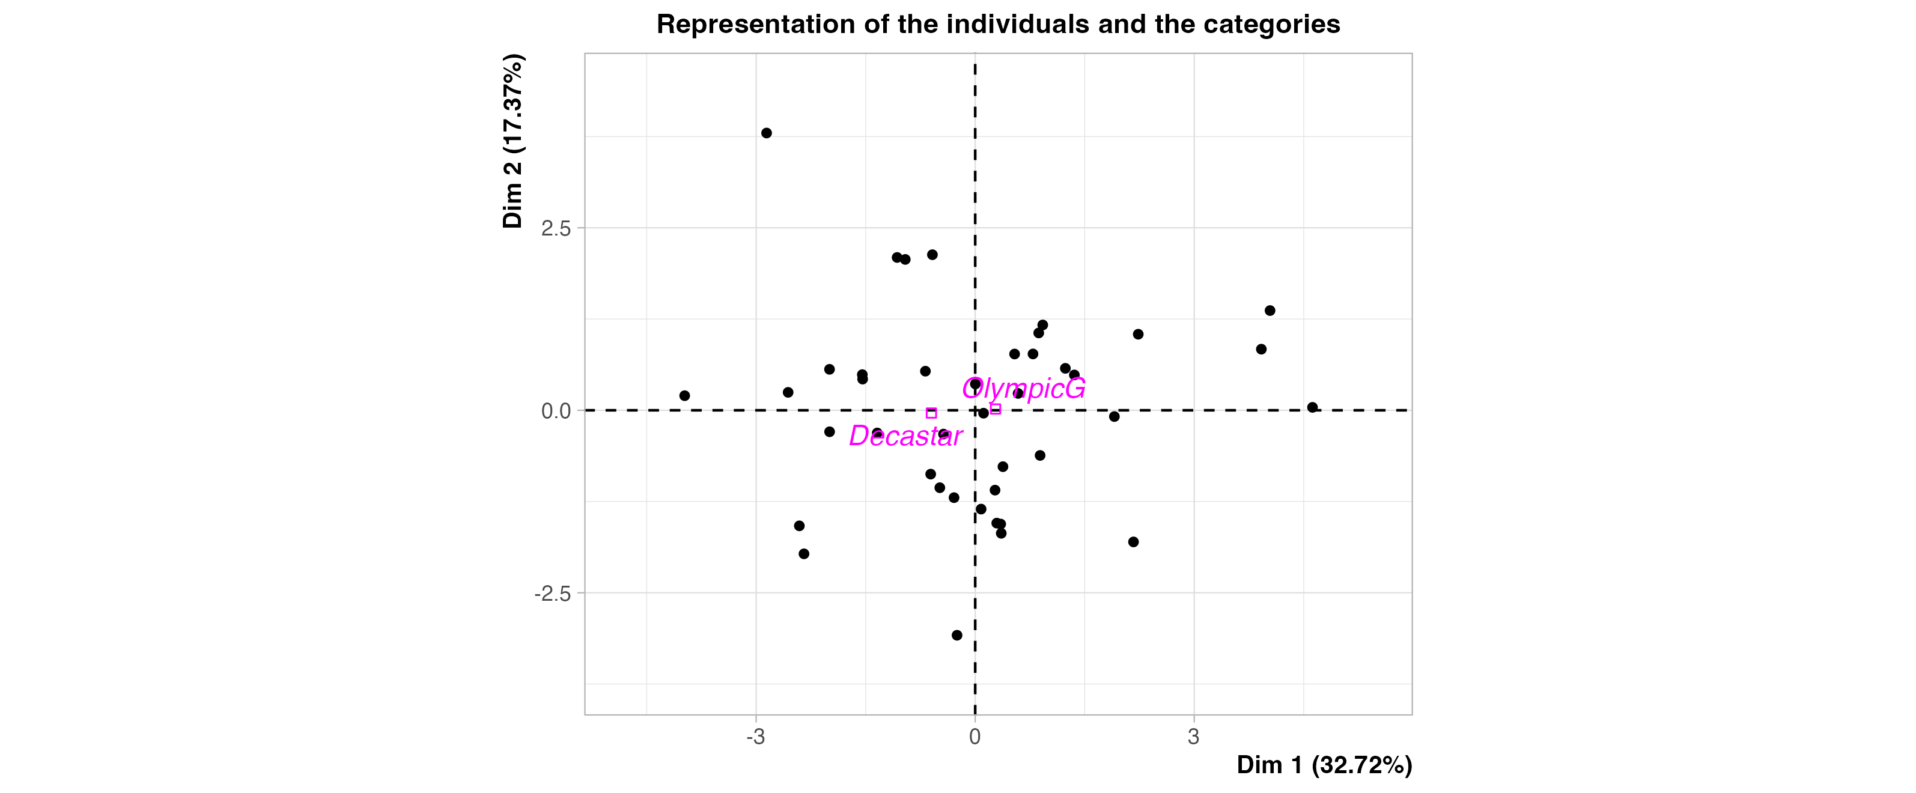
Representation of the individuals and the categories

Slide 5
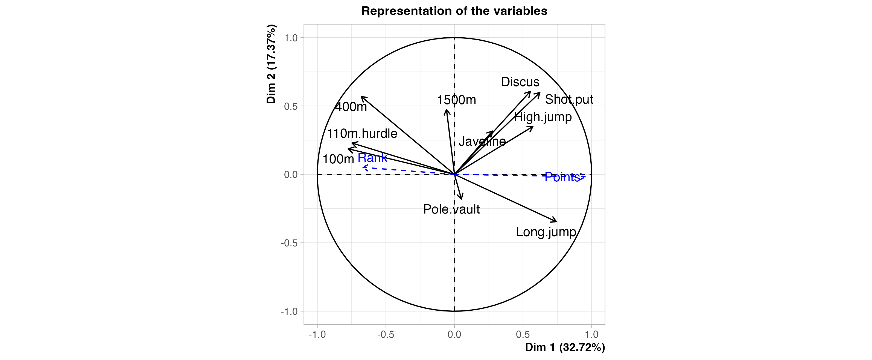
Representation of the variables

Slide 6
Description of Dimension 1

Slide 7
Description of Dimension 1 with Quantitative Variables
Variable | correlation | p.value
Points | 0.956 | 0.000
Long.jump | 0.742 | 0.000
Shot.put | 0.623 | 0.000
High.jump | 0.572 | 0.000
Discus | 0.552 | 0.000
Rank | -0.671 | 0.000
400m | -0.680 | 0.000
110m.hurdle | -0.746 | 0.000
100m | -0.775 | 0.000

Slide 8
Description of Dimension 2

Slide 9
Description of Dimension 2 with Quantitative Variables
Variable | correlation | p.value
Discus | 0.606 | 0.000
Shot.put | 0.598 | 0.000
400m | 0.569 | 0.000
1500m | 0.474 | 0.002
High.jump | 0.350 | 0.025
Javeline | 0.317 | 0.043
Long.jump | -0.345 | 0.027

Slide 10
Hierarchical Clutering

Slide 11
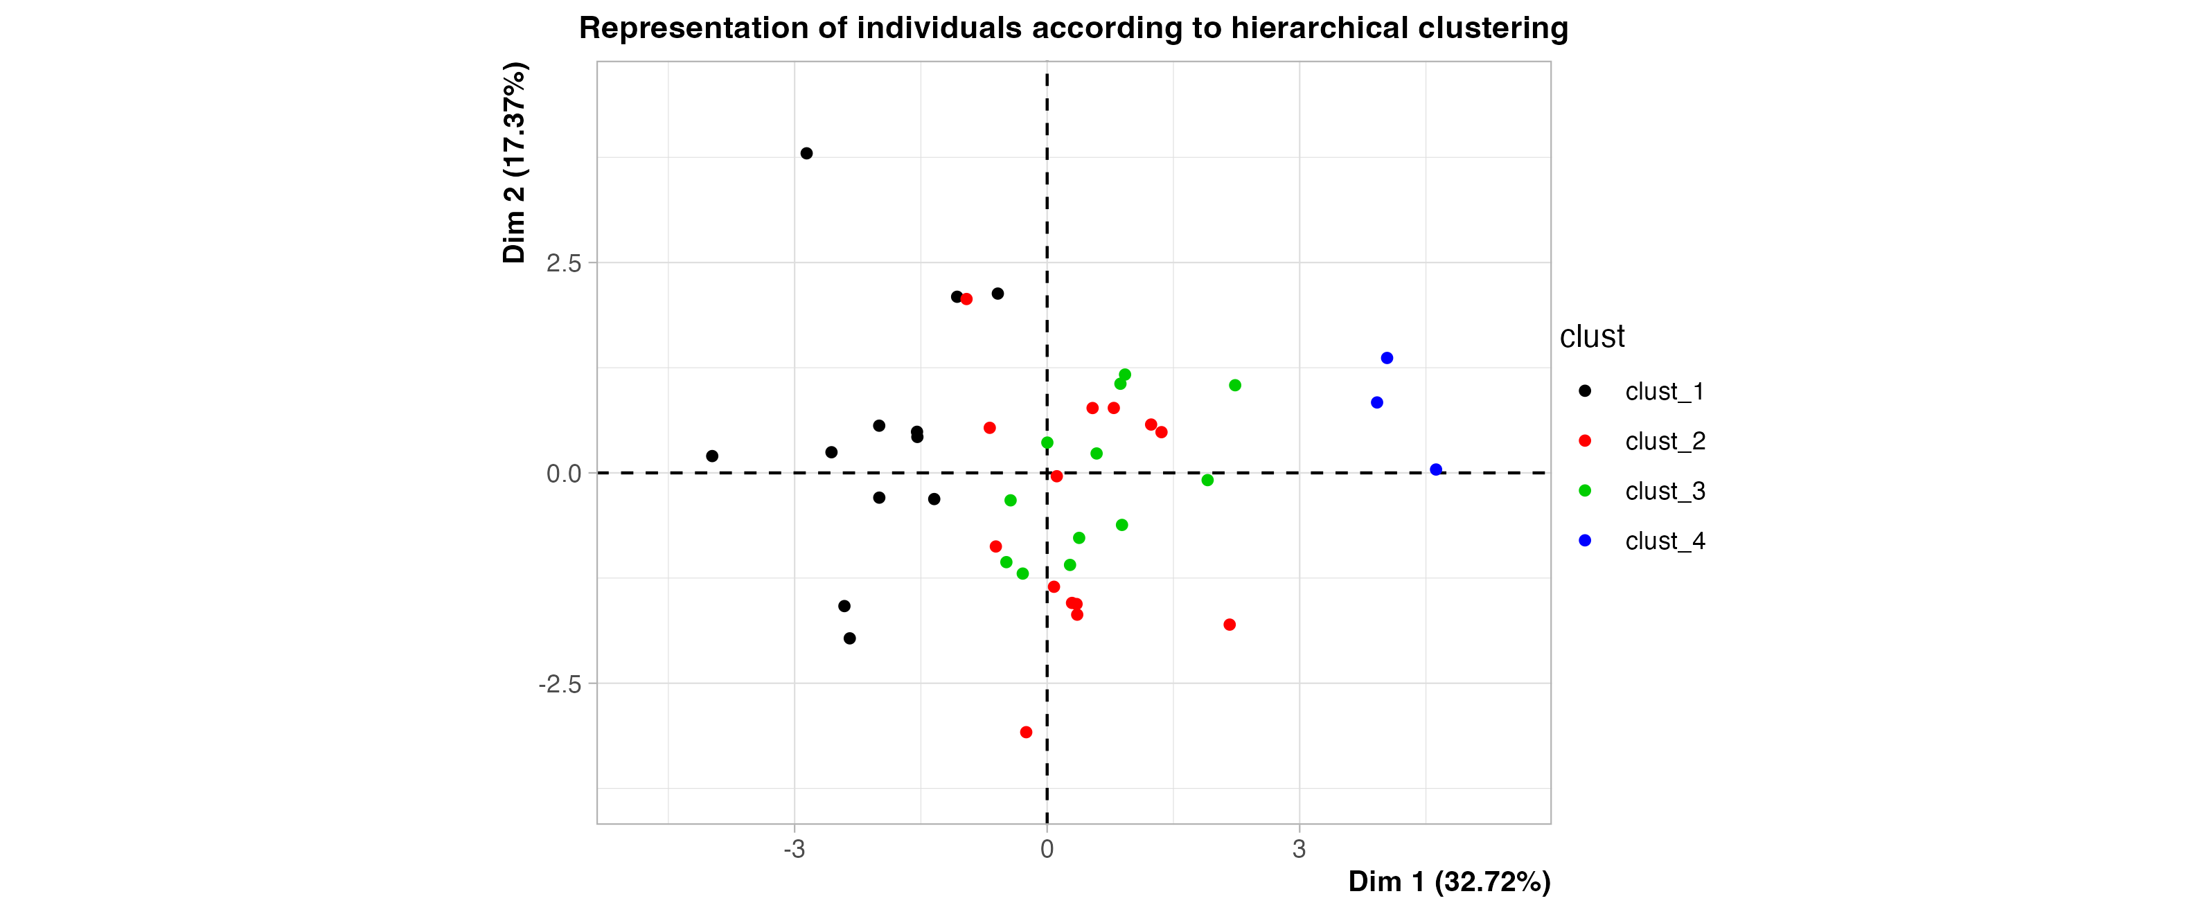
Representation of individuals according to hierarchical clustering

Slide 12
Description of Cluster 1 with Active Variables
Variable | v.test | Mean in category | Overall mean | sd in category | Overall sd | p.value
100m | 4.742 | 11.301 | 10.998 | 0.145 | 0.260 | 0.000
110m.hurdle | 3.965 | 15.060 | 14.606 | 0.380 | 0.466 | 0.000
400m | 3.822 | 50.687 | 49.616 | 1.070 | 1.139 | 0.000
Shot.put | -2.100 | 14.057 | 14.477 | 0.870 | 0.814 | 0.036
Long.jump | -3.406 | 6.998 | 7.260 | 0.259 | 0.313 | 0.001

Slide 13
Description of Cluster 2 with Active Variables
Variable | v.test | Mean in category | Overall mean | sd in category | Overall sd | p.value
Pole.vault | 4.295 | 5.021 | 4.762 | 0.192 | 0.275 | 0.000
1500m | 2.602 | 285.613 | 279.025 | 12.758 | 11.530 | 0.009
100m | -1.969 | 10.886 | 10.998 | 0.154 | 0.260 | 0.049
Javeline | -2.126 | 56.091 | 58.317 | 4.504 | 4.768 | 0.034

Slide 14
Description of Cluster 3 with Active Variables
Variable | v.test | Mean in category | Overall mean | sd in category | Overall sd | p.value
1500m | -2.893 | 270.825 | 279.025 | 5.896 | 11.530 | 0.004
Pole.vault | -3.716 | 4.512 | 4.762 | 0.164 | 0.275 | 0.000

Slide 15
Description of Cluster 4 with Active Variables
Variable | v.test | Mean in category | Overall mean | sd in category | Overall sd | p.value
Long.jump | 3.469 | 7.870 | 7.260 | 0.065 | 0.313 | 0.001
Discus | 3.108 | 50.160 | 44.326 | 1.197 | 3.336 | 0.002
Shot.put | 2.974 | 15.840 | 14.477 | 0.466 | 0.814 | 0.003
Javeline | 2.587 | 65.257 | 58.317 | 6.879 | 4.768 | 0.010
High.jump | 2.289 | 2.090 | 1.977 | 0.024 | 0.088 | 0.022
110m.hurdle | -2.120 | 14.050 | 14.606 | 0.065 | 0.466 | 0.034
400m | -2.334 | 48.120 | 49.616 | 0.986 | 1.139 | 0.020
100m | -2.746 | 10.597 | 10.998 | 0.181 | 0.260 | 0.006

Slide 16
Description of Cluster 1 with Quantitative Illustrative Variables
Variable | v.test | Mean in category | Overall mean | sd in category | Overall sd | p.value
Rank | 2.667 | 17.250 | 12.122 | 7.704 | 7.822 | 0.008
Points | -4.132 | 7,661.917 | 8,005.366 | 196.172 | 338.184 | 0.000

Slide 17
Description of Cluster 4 with Quantitative Illustrative Variables
Variable | v.test | Mean in category | Overall mean | sd in category | Overall sd | p.value
Points | 4.242 | 8,812.667 | 8,005.366 | 68.781 | 338.184 | 0.000
Rank | -2.300 | 2.000 | 12.122 | 0.816 | 7.822 | 0.021

