Slide 1
Output of a De Bruijn Graph assembler ?
reads

Slide 2
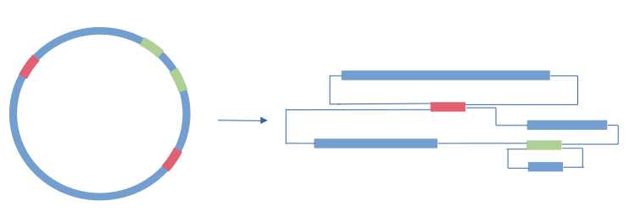
Output of a De Bruijn Graph assembler ?

Slide 3
Output of a De Bruijn Graph assembler ?

Slide 4
Output of a De Bruijn Graph assembler ?
Strain 1
Strain2

Slide 5
Output of a De Bruijn Graph assembler ?
Strain 1
Strain2

Slide 6
Sequencing errors
0,1 % over 300 nuc
17 %
22,5 %
22.5 %
15 %
5 %
OR
OR

Slide 7
Summary
OR
OR
Dereplication of sequence at the scale of the read length
Strain diversity increase complexity
→ smaller contigs
Assembly does not conserve strain level informations

Slide 8
Single Sample Assembly VS Assembly

Slide 9
Single Sample Assembly VS Assembly
Strain 1
Strain2
Strain 1
Strain2

Slide 10
10
20
30
40
60
80
100
Median = 40
N50 ~ 80
Total length = 340
Half = 170

Slide 11
.smk file
Request : generate G
→ G exists ? Can it be generated ?
No, Rule3 can
→ Rule 3 needs D, exists, generated ?
Doesn't exist, Rule 2 can
→ Rule 2 needs C, exists, generated ?
Doesn’t exist, Rule 1 can
→ Rule 1 needs A,B, exist, generated ?
YES !
Input
Output
A
Rule 1
C
B
Rule 2
C
D
Schedule :
Rule 3
F
D
Rule 1
Rule 2
Rule 3
G

Slide 12
R1.fastq
F
R2.fastq
G

Slide 15
Sample A Sample B
Assembly A Assembly B
20 5
5 20

Slide 17
0 1 1 2 15 2 212 2 232 1 12

