Slide 1
Integral(t)
Limiter
*(-Ki)
actual
*(-Kp)
-
+
output
target
Delta(t)
Low pass filter
*(-Kd)
PID block

Slide 2
roll rate
roll angle
PID
roll_quad_ control
PID
desired roll rate
commanded
roll

Slide 3
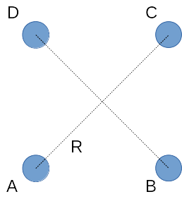
y
x

Slide 4
D
R
A
C
y
B
x

Slide 5
C
alpha
R_{B}
B
R_{A}
y
A
x

