Slide 1
Introduction to Classical Machine Learning with scikit-learn

Slide 2
What is Machine Learning?
It is a change of paradigm
Set of logical rules
Data
Classical programming
Answer/Solution
Data
Answer/Solution
Machine learning
Rules generalizable to new unknown data
Apply those to unknown data

Slide 3
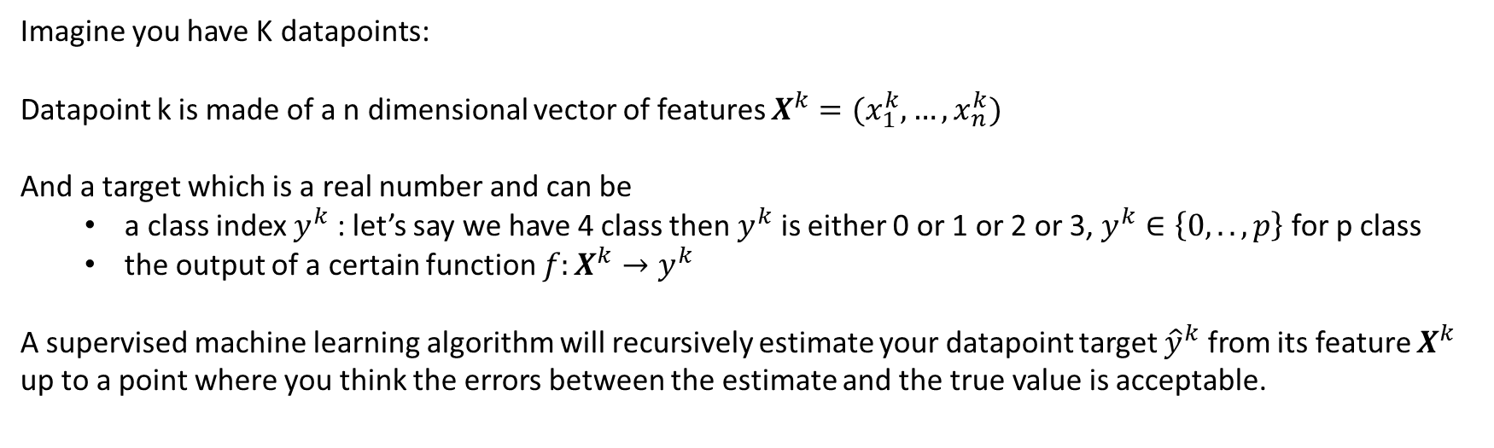
Different types of Machine Learning
Supervized
Data is labelled with a target :
deviation between true label
and estimated label is minimized
Classification : identify rules to separate different labels
Regression : fit the data (here the label is the value
of our target)
Imagine you have K datapoints:
Datapoint k is made of a n dimensional vector of features $X^{k}=(x_{1}^{k},…,x_{n}^{k})$
And a target which is a real number and can be
a class index $y^{k}$ : let’s say we have 4 class then $y^{k}$ is either 0 or 1 or 2 or 3, $y^{k}∈\left\{0,..,p\right\}$ for p class
the output of a certain function $f:X^{k}→y^{k}$
A supervised machine learning algorithm will recursively estimate your datapoint target ${\hat{y}}^{k}$ from its feature $X^{k}$
up to a point where you think the errors between the estimate and the true value is acceptable.

Slide 4
Different types of Machine Learning
Supervized
Classification
Regression
Iris dataset :
150 datapoints
3 types of iris : 3 labels/targets
4 features describing an iris : sepal length, sepal width, petal length, petal width
One dimensional data : 1 feature
Linked by a certain function
To our target y
y
Feature x

Slide 5
Different types of Machine Learning
Targets/labels are not always available.
Still they might exist but were not identified yet.
Unsupervised learning is useful as a result itself but also during your data exploration phase
Unsupervized
Data is not labelled with a target
but have a intrinsic organization.
Goal is to Rationalize the organization.
Clustering :labelling points ‘close’ to each other on a manifold
Dimensionality reduction: find a subset of the features that
Concentrate most of the information about your dataset.

Slide 6
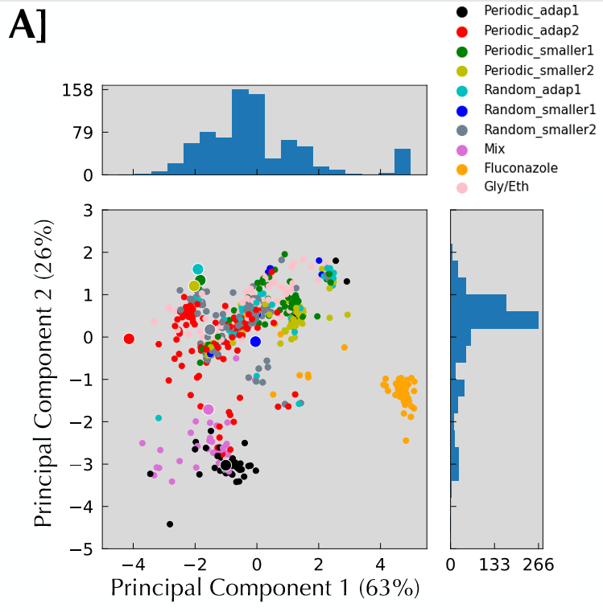
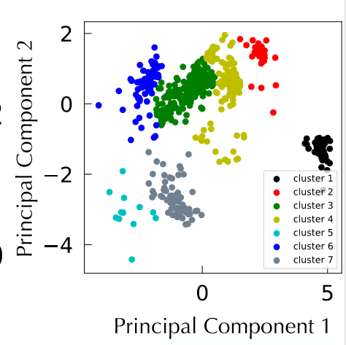
Different types of Machine Learning
Unsupervized
Each points were 5 dimensional.
The dataset was a concatenation of 8 experiments.
What are the most important features and can we rationalize similarities and differences between experiments?

Slide 7
Different type of machine learning
Reinforcement
Algorithm learns from its environment : a mistake/success becomes a label
Dynamical decision making : how to react to an environment
Not covered in this class

Slide 8
Classical ML vs Deep Learning
This class focuses on classical Machine Learning and will not touch the subject of Deep Learning.
Classical ML and DL differ conceptually by their architecture but more interestingly for us by what they are good at.
DL>Classical ML
Best performance in field like :
Image recognition
Speech recognition
Natural language
Scales effectively with data
No need for too much data exploration
Adaptable and transferable
Classical ML>DL
Best on small dataset
Financially and computationally cheap
Easier to interpret

Slide 9
A typical ML job
Training set
Data are split in 3 different sets
Training set is dedicated to models training
Validation set is dedicated to performance evaluation of the different models you are training and choice of the best model : hyperparameters tuning
Test set : isolated from the rest of the data from the beginning and only used at the final step for a final and fair evaluation of model performance and generalizability
Data preprocessing
Validation set
Normalization
Encoding
Exploratory analysis
Dimensionality reduction
Test set

Slide 10
Hyperparameters choices and the need for a validation set
All the parameters that your model is not going to learn, that you have to put as an input.
For example the kind of model you are going to use is an hyper parameter. Other could be non exhaustively, optimizer, learning rate, depth of the decision tree, marge on your SVM, standard deviation of your radial basis function kernel, regularization choice etc…

Slide 11
Hyperparameters choices and the need for a validation set
All the parameters that your model is not going to learn, that you have to put as an input.
For example the kind of model you are going to use is an hyper parameter. Other could be non exhaustively, optimizer, learning rate, depth of the decision tree, marge on your SVM, standard deviation of your radial basis function kernel , regularization choice etc …

Slide 12
Hyperparameters choices and the need for a validation set
To choose the right model you train a bunch of them with different range of parameters.
Then you evaluate their performance on the validation set and take the best for the next step which would be its evaluation od the test set.

Slide 13
The curse of dimensionality and the test set necessity

Slide 14
The curse of dimensionality and the test set necessity

Slide 15
The curse of dimensionality and the test set necessity
You need a test set to see how generalizable on new data your model is : It can be easy to make a perfect model on known data, but this is not what you should be interested in. You should be interested in having a model good to predict unknown data.
Those examples show the trade off that you are trying to find between bias ( can cause underfitting) and variance (can cause overfitting).
Variance is modelling the noise present in your data rather the phenomenon of importance
Bias is making erroneous assumption on the type of model to use so that you don’t even recover good prediction on trained set.
One particular sub gender of hyperparameter (regularization) is of particular importance for those problems

Slide 16
A typical ML job
Training phase with model 1
Validation phase with model 1
Trained model1
Best model chosen according to validation
performance
Best Trained model
Final
performance
evaluation
of the model
Training data
Validation data
Training phase with model z
Validation phase with model z
Trained model z
Test phase

Slide 17
Good material to check
https://scikit-learn.org/stable/modules/classes.html
https://www.youtube.com/user/joshstarmer #simply explain
https://towardsdatascience.com/ #a little bit of math
https://xavierbourretsicotte.github.io/ #quite some math

