Slide 1
Basic FPGA Architecture (Spartan-6)
Clocking Resources

Slide 2
Objectives
After completing this module, you will be able to:
Describe the global and I/O clock networks in the Spartan-6 FPGA
Describe the clock buffers and their relationships to the I/O resources
Describe the DCM capabilities in the Spartan-6 FPGA

Slide 3
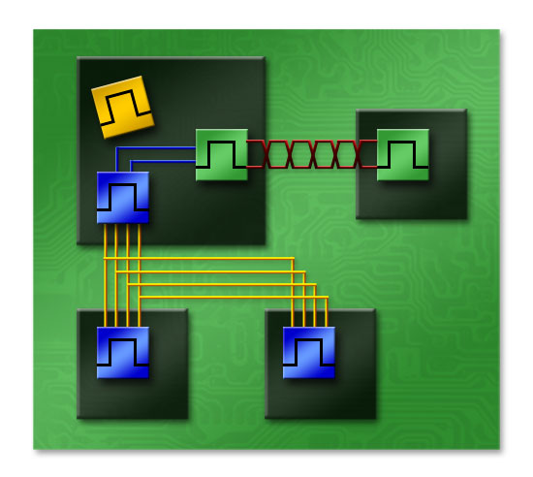
Spartan-6 High-Performance Clocking
Two clock networks
  Global clock network
    Supports up to 16 global clocks
    Maximum frequency of 400 MHz
  I/O clock networks
    Ultra-fast speed: up to 1+ GHz
    Four I/O clocks per half edge
    Two I/O clocks spanning entire edge
Combination of digital and analog
technology in the Clock Management Tile (CMT)
  Two DCMs and one PLL (per CMT)
  One to six CMTs per FPGA

Slide 4
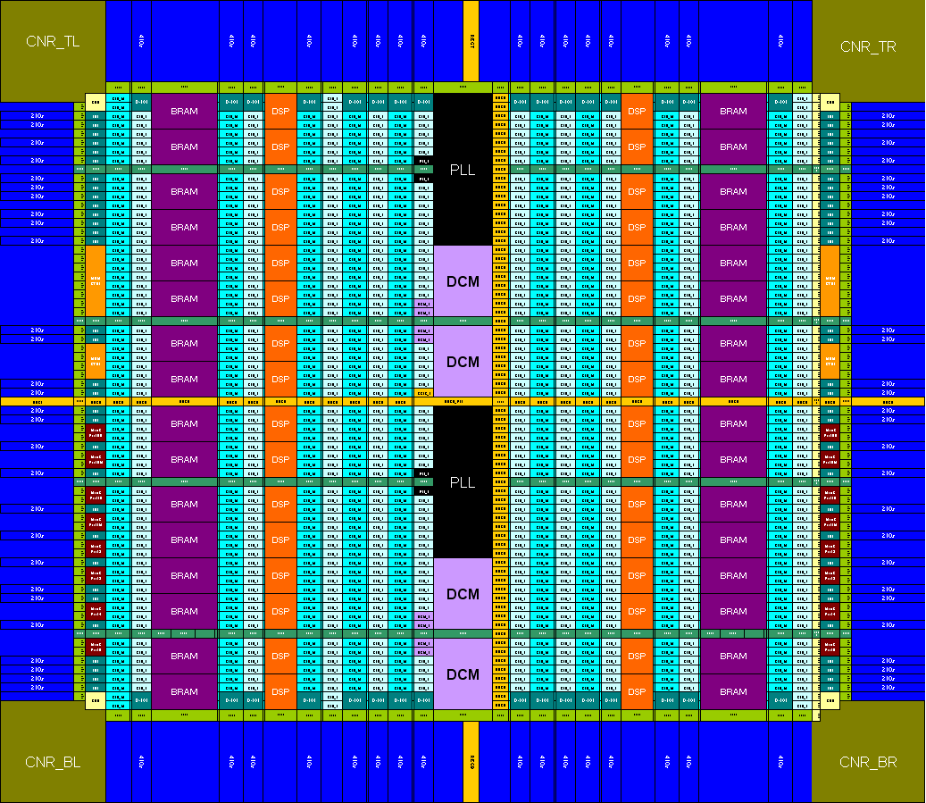
Global Clock Pins
Eight global clock pins (GCLK) per edge
4 clocks (2 pairs)
4 clocks (2 pairs)
4 clocks (2 pairs)
4 clocks (2 pairs)
4 clocks (2 pairs)
4 clocks (2 pairs)
4 clocks (2 pairs)
4 clocks (2 pairs)

Slide 5
Using Global Clock Pins
The global clock pins are the only pins that should be used for clock inputs
  These are the clock inputs for both the global and I/O clocking resources
  No dedicated I/O clock input pins
Each GCLK pin can be used as a single-ended clock input
  Use the IBUFG primitive for instantiation
Adjacent pairs can be used as differential clock inputs
  Use the IBUFGDS primitive for instantiation
If not used as clock pins, the GCLK pins can be used as regular I/O
GCLK pins can be any I/O standard that is compatible with the bank in which they reside
  For devices with six I/O banks, the GCLK pins are located in banks 2 and 7
Notes:
The GCLK pins numbered 2i and 2i+1 are an adjacent pair.
The name “global clock pin (GCLK)” is a bit of a misnomer because they are the clock inputs for both the global and I/O clock networks. The name is kept for consistency with previous generations.

Slide 6
Global Clock Networks
Global Clock Vertical Spines
Horizontal Clock
(HCLK) Rows
Distributes clocks to every clocked element on the die
  Slice, blockRAM, DSP, cores
  IOLOGIC, CLKDIV of IOSERDES
Sixteen global clocks
  All 16 clocks available to all resources
    No limitations per region
Each clock is driven by a global clock buffer (BUFG) onto a vertical spine
  Run vertically in center of die
Global clocks can only drive CLK or RESET ports
Notes:
While intended for distribution of global clocks, the global clock network can also be used for the distribution of global reset signals. Driving more than one global reset port on a global clock network is not recommended. Global clock networks cannot reach the CE inputs or data inputs of the slice flip-flops.

Slide 7
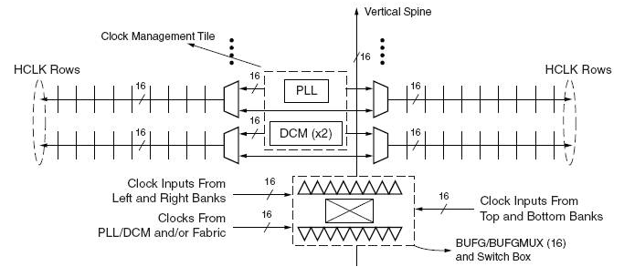
Horizontal Clock Rows
The clock network spans out along Horizontal Clock (HCLK) rows
HCLK rows can be driven by the associated vertical spine or an output of the CMT elements directly adjacent to that row
  Each row is either adjacent to the PLL in one CMT, or both DCMs in a CMT
  Direct connections from the CMT allow for more than 16 clocks per device
  Instantiate a BUFH primitive for this connection
Notes:
To connect a CMT output directly to an HCLK row, instantiate a BUFH clock buffer. This is a simple buffer with no attributes; connect the I port to the desired DCM or PLL output, and use the O port as the clock signal. Clocked elements connected to that clock will be restricted to one row.
Using the direct connections from the CMT to the HCLK rows can be complex and should only be used when it is necessary to access more than 16 clocks. The BUFH instantiation is required here and is but is not recommended in any other way.

Slide 8
Global Clock Multiplexer (BUFGMUX)
Multiplexes two clocks together and drives the result onto a global clock
The I0 input can be driven directly by one of two GCLK pins
  Top BUFG: one on the top edge and one on the right edge
  Bottom BUFG: one on the bottom edge and one on the left edge
The I1 input can be driven from a second set of pins on the same two edges
Either input can be driven by BUFIO2 outputs
  Top BUFG: two BUFIO2 on the top edge and two BUFIO2 on the right edge
  Bottom BUFG: two BUFIO2 on the bottom edge and two BUFIO2 on the left edge
  BUFIO2 routes add extra delay on clock path
BUFGMUX can be driven from DCM/PLL outputs
BUFGMUX can be driven directly from fabric logic
  Phase of resulting clock is not controlled
I1
BUFGMUX
O
I0
S
Notes:
The I0 and I1 inputs of a BUFG in the top half of the FPGA die can only be driven directly by one GCLK pin on the top edge and one GCLK on the right edge. The BUFGs on the bottom half share the bottom and left-edge GCLK input pins.
It is important to note that the two GCLKs input pins of the BUFGMUX primitive conflict with each other. If one of them is used, the other cannot be routed to any BUFG. In addition, each BUFGMUX input pins can be driven by either of two BUFIO2 pins on the top edge and two BUFIO2 pins on the right edge. Note that the BUFIO2 primitives are located beside the GCLK input pins. More information on the BUFIO2 primitive is given in the “I/O Clock Resources” lesson of this module.
It is recommended that users let the implementation tools assign the global clock pins and place BUFGMUX primitives. It can be very challenging for new users to do this.

Slide 9
Glitch Free Clock Switching
Changing the S input switches clock sources without a glitch
  S input must change synchronously to currently selected clock
Adjacent BUFGMUX cells share clock inputs
  The I0 connections of one are the I1 connections of the other
  A clock on a given GCLK pin can only be multiplexed with another GCLK pin on the same edge and two GCLK pins on another edge
    Bottom and right edges for bottom BUFGs
    Top and left edges for top BUFGs
Setting CLK_SEL_TYPE = ASYNC
makes this an asynchronous
multiplexer
  This can glitch
I1
BUFGMUX
O
I0
S
I1
I0
S
O
T1
T2
Notes:
BUFGMUX_X(i)Y(2j) and BUFGMUX_X(i)Y(2j+1) form an adjacent pair. Be sure to check the pin assignments of your GCLK inputs carefully to ensure that you do not have any conflicts if you plan to assign your clock pins and BUFGMUXs manually. The complete mapping of GCLK pins to BUFGMUX inputs is shown in the user guide.
It is recommended that users let the implementation tools assign the global clock pins and place BUFGMUX primitives. It can be very challenging for new users to do this.

Slide 10
Simple and Gated Clock Buffer
BUFG: Simple clock buffer
  The tools will use the I0 or I1 input appropriately and tie
  S to logic 0 or 1
BUFGCE: Gated clock buffer
  Allows glitch free gating of a global clock using the
  CE input
  The tools will tie either the I0 or I1 clock input to logic 0
  CE input must be synchronous
  to the non-gated clock
    Generally driven by logic running
    on a regular BUFG sharing the
    same input source
BUFG
I
O
CE
BUFGCE
I
O
I
CE
O
Held Low
Enable Clock after
High-to-Low Transition on I
Notes:
The BUFGCE must be instantiated.

Slide 11
Clock Insertion
Clock insertion delay moves the sampling window of inputs
Clock insertion delay increases the clock-to-out time of outputs
Clock insertion delay is PVT dependent
  Increases required setup/hold window
Clock insertion delay includes
  GCLK input delay
  Routing to BUFG (from edge to center)
  Delay of BUFG
  Delay of global clock tree (back to edge)
Clock insertion delay is significant
GCLK
BUFG

Slide 12
Removing Clock Insertion Delay
A DCM or PLL can be used to de-skew the clock (remove clock insertion delay)
The BUFIO2 to PLL/DCM path is matched to the BUFIO2FB to PLL/DCM path
  PLL/DCM keeps the IN and FBIN in phase
  Therefore, inputs to BUFIO2 and BUFIO2FB are also in phase
Results in no clock insertion delay as measured at the ILOGIC in the IOB
BUFIO2 and BUFIO2FB are inserted automatically by tools
Edge of
FPGA
Center of
FPGA
IBUFG
BUFG
BUFIO2
PLL/DCM
CLK
IN
CLK0
BUFIO2FB
Matched
FBIN
IBUF
Global Clock Network
DATA
D
Q
Notes:
The BUFIO2FB is another type of clock buffer. It is located beside each BUFIO2 and is intended to drive the feedback path when clock de-skew is performed. The delay of the BUFIO2FB is designed to match the delay of the BUFIO2 in all modes (and has some of the attributes available to a BUFIO2).
The connection from the global clock network to the input of the BUFIO2FB passes through the ILOGIC block of the GCLK IOB, effectively placing the BUFIO2FB input on the clock port of an IOB flip-flop.

Slide 13
I/O Clock Networks
BUFIO2
From GCLK Pins
BUFPLL
IOLOGIC
IOLOGIC
IOLOGIC
IOLOGIC
From CMTs
Half Edge
Half Edge
Special clock network dedicated for I/O logical resources
  Can only drive ILOGIC/OLOGIC and high-speed clock inputs of ISERDES/OSERDES
  Speeds of up to 1080 MHz in the fastest speed grade
Dedicated clock drivers
  BUFIO2: driven from GCLK inputs
  BUFPLL: driven from CMTs
Fast I/O clocks are dedicated for I/O logical resources
Notes:
There are four high-speed I/O clock networks driven by BUFIO2 drivers in every half edge (total of eight groups of four). There are two high-speed I/O clock networks driven by BUFPLL drivers on every edge (total of four groups of two). There are additional dedicated high-speed I/O clock networks that are used exclusively by the integrated memory controller.

Slide 14
I/O Clock Network Driver (BUFIO2)
BUFIO2
Located in the center of each of the four edges
  Input I comes from the GCLK pins or
  GTPCLKOUT pins on the same edge
IOCLK output drives the I/O clock network
  For clocking IOLOGIC and high-speed clocks of IOSERDES
DIVCLK output drives BUFG or CMT in the center column
  Frequency is divided by the DIVIDE attribute
  Intended to drive the CLKDIV input of IOSERDES (among other things)
SERDESSTROBE output drives IOCE of IOSERDES
  Asserted for one IOCLK period out of every DIVIDE to transfer data from the IOCLK domain to the DIVCLK domain (or vice versa) in the IOSERDES
  Timing of SERDESSTROBE ensures maximum time for clock crossing
÷N
DIVCLK
I
IOCLK
SERDESSTROBE
Notes:
The BUFIO2 is designed specifically for use with the ISERDES and OSERDES resources. In addition to driving the IOCLK output onto the I/O clock network, this buffer also generates the divided clock and chip enable required to manage the data transfer within the IOSERDES.
The SERDESSTROBE (which is intended to be connected directly to the IOCE input of the IOSERDES) determines which rising edge of IOCLK should be used to launch/capture data going to/coming from the DIVCLK domain. The DIVCLK output of the BUFIO2 has a dedicated connection to the center column of the chip, where it can access the BUFG and CMT resources.
The GTPCLKOUT pins are the output clocks of the GTP transceivers. For more information, see the Designing with Multi-Gigabit Serial I/O class.

Slide 15
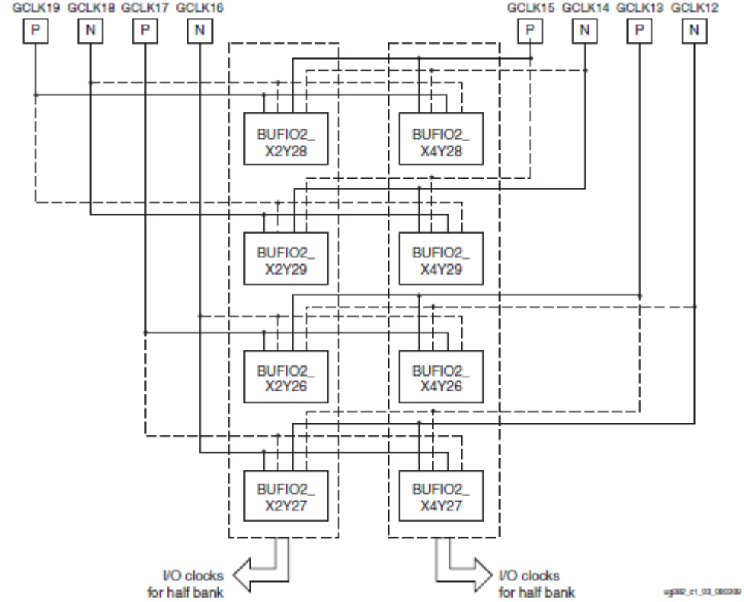
BUFIO2 Inputs
BUFIO2 inputs are driven by GCLK pins
  Subsets of all eight GCLKs on an edge can drive each BUFIO2
The BUFIO2 on each half edge only drives the I/O clock network on that half edge
  However, the cross connection shown here allows for a single GCLK to drive the I/O clock networks in both half edges on an edge
Notes:
The twists in this diagram represent the flexible connection between a fixed global clock pin and its connections to the available BUFIO2 buffers associated with two half edges. This enables a single clock input pin to drive one BUFIO2 in each half edge.
When an input delay is used in a clock input pin, that clock input can only drive a single BUFIO2 buffer, in the same half edge.

Slide 16
BUFIO2 Clock Routing
BUFIO2 routes an input clock through dedicated paths to
  IOCLK to I/O clock network
  DIVCLK to BUFG to drive general fabric
  DIVCLK to PLL/DCM
GCLK Pin
GCLK Pin
BUFIO2
BUFIO2
IOCLK
IOCE
DIVCLK
DIVCLK
IOCE
IOCLK
I/O Logical
Resource
I/O Logical
Resource
I/O Logical
Resource
I/O Logical
Resource
BUFG
PLL/
DCM
BUFG
PLL/
DCM
Notes:
In addition to routing a clock from its input pin onto the I/O clock network, the BUFIO2 also provides a dedicated clock path to PLLs/DCMs and BUFGs.

Slide 17
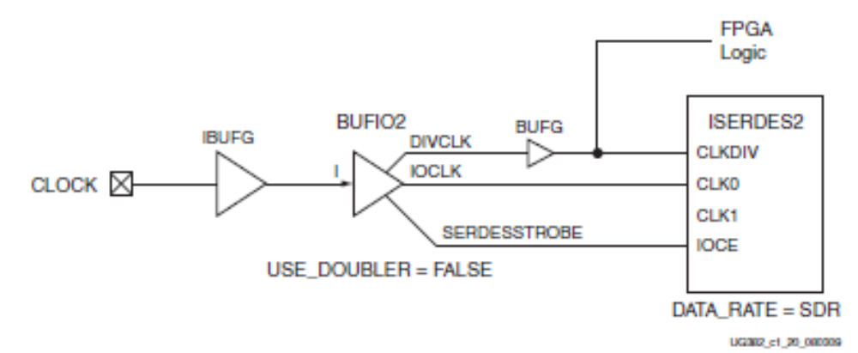
Using I/O Clocks for SDR Input Interfaces
For high-speed data signals accompanied by a Single Data Rate (SDR) clock
  The DIVIDE attribute of the BUFIO2 should be set to the same value as the DATA_WIDTH attribute of the ISERDES2
  The DIVCLK can be driven directly to a BUFG
    The globally buffered clock can be used for the CLKDIV input of the ISERDES2 as well as the FPGA logic to process the resulting parallel data

Slide 18
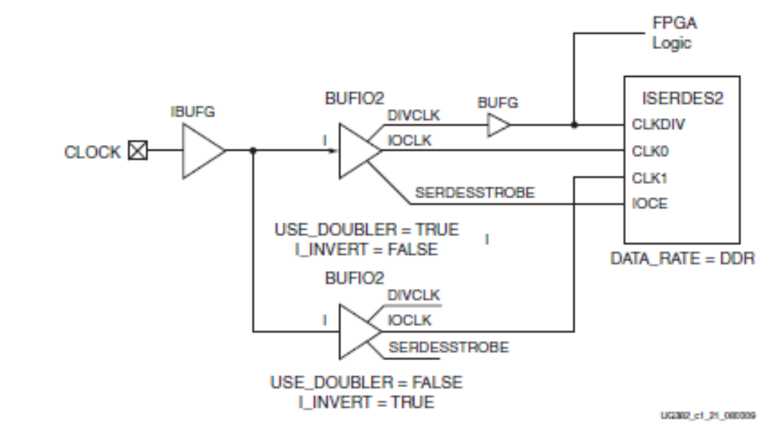
Using I/O Clocks for DDR Input Interfaces
For high-speed data signals accompanied by a Double Data Rate (DDR) clock
  Need two IOCLK networks—one for C0, another inverted for C1 (I_INVERT)
  Set USE_DOUBLER to true for the primary BUFIO2

Slide 19
I/O Clock Network Driver (BUFPLL)
BUFPLL
For driving the other two I/O clock networks
  Each I/O clock network spans an edge
Takes in two clock inputs from the same PLL
  PLLIN: High-speed clock from OUT0 or OUT1
    Can run at extremely high speeds
      1080 MHz in –4 speed grade
  GCLK (global clock): Divided clock from another output of the same PLL
    Via a BUFG
    Used to clock user logic and the CLKDIV port of the IOSERDES
IOCLK output drives the I/O clock network
SERDESSTROBE output drives IOCE of IOSERDES
LOCK output is the PLL LOCKED signal synchronized to the global clock
GCLK
LOCK
PLLIN
IOCLK
LOCKED
SERDESSTROBE
Notes:
The BUFPLL is designed specifically for use with the ISERDES and OSERDES. Like the BUFIO2, it generates the IOCLK output onto the I/O clock network and also generates the chip enable required to manage the data transfer within the IOSERDES. Unlike the BUFIO2, it does not generate the divided clock; this is intended to come from the same PLL that generates the high speed clock.
The GCLK input of the BUFPLL is the low-speed clock coming from a global clock network (via a BUFG). This should not be confused with a GCLK pin of the FPGA, which is a clock capable input pin.
In devices with six CMTs, the BUFPLL can only be fed by four of the six PLLs (PLL_ADV_X0Y0, PLL_ADV_X0Y2, PLL_ADV_X0Y3, and PLL_ADV_X0Y5).

Slide 20
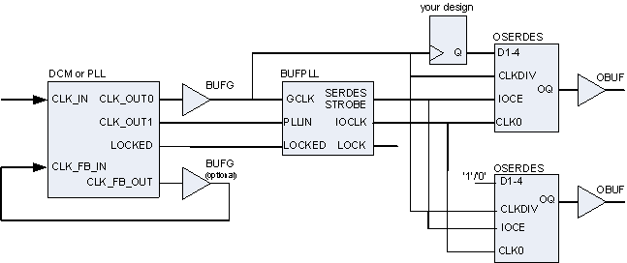
Clock-Forwarded Output Interface (DDR)
Using the clocks generated from a PLL and BUFPLL, generating a high-speed, clock-forwarded output interface is easy
  The PLL generates the high-speed clock
    Must run at the bit rate of the data interface (that is, SDR; DDR is not supported)
  The PLL also generates the low-speed clock for driving user logic and CLKDIV
  A DDR clock for forwarding is generated by sending 1010101…
DATA
CLOCK
Notes:
The BUFPLL aligns the IOCLK to the global clock and also generates the SERDESSTROBE required for managing the data transfer in the IOSERDES. Internal to the FPGA, the high-speed clock must be single data rate. The high-speed clock must run at N times the low-speed clock, where N is also the DATA_WIDTH of the OSERDES used both for clock and data.
The data OSERDES sends the high-speed data. The CLOCK OSERDES sends a fixed 101010 pattern, thus making one transition per bit period. This is the DDR clock associated with the interface. An interface generated in this manner can be easily received by an FPGA using the clocking described for receiving a high-speed DDR interface.
For higher serialization rates (up to 8), each OSERDES can be cascaded with the associated slave OSERDES. The outputs can be implemented using any I/O standard, but for higher data rates, it is common to use differential standards (that is, LVDS).

Slide 21
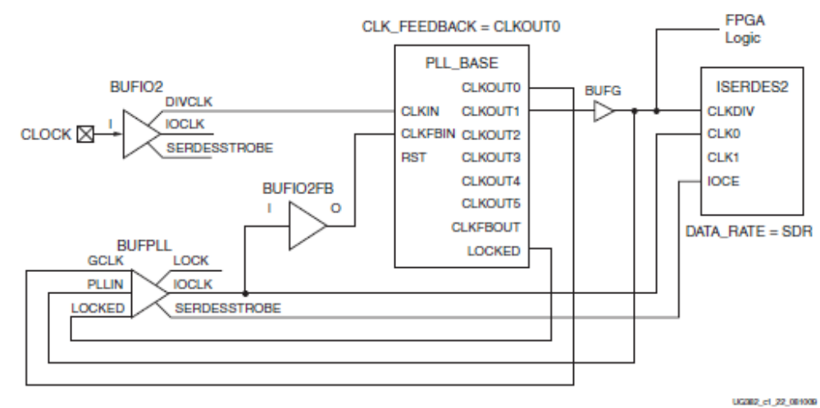
Clock-Forwarded Input Interface with Divided Clock
When high-speed data is brought into the FPGA along with a phase-related, low-speed clock
Use the PLL to generate the high-speed clock
Use the BUFIO2FB to match the phase to the incoming low-speed clock
Notes:
In some interfaces, the clock is sent at a much slower rate than the data (a divided clock is sent instead of a high-speed clock). The edges of the divided clock are used to provide the correct phase for sampling the high-speed data signal.
For this interface, a PLL is required to multiply the frequency of the incoming clock. However, the phase of the high-speed clock must match the phase of the incoming clock for data sampling in the ISERDES.
This circuit accomplishes this; the PLL keeps the CLKIN and CLKFBIN in phase. Because the BUFIO2-to-PLL path is matched to the BUFIO2FB-to-PLL path, the two clocks are in phase at the inputs of BUFIO2 and BUFIO2FB. Thus, the phase of the high-speed clock is locked to the phase of the incoming clock and is correct for sampling the input in the ISERDES.
Using CLK_FEEDBACK=CLKOUT0 enables the “divide by M” divider on the CLKFBIN input, thus resulting in the frequency of the input and feedback clock being the same at the input of the phase detector (because CLKIN is the low-speed clock and CLKFBIN is the CLKOUT0 output, which is the high-speed clock).

Slide 22
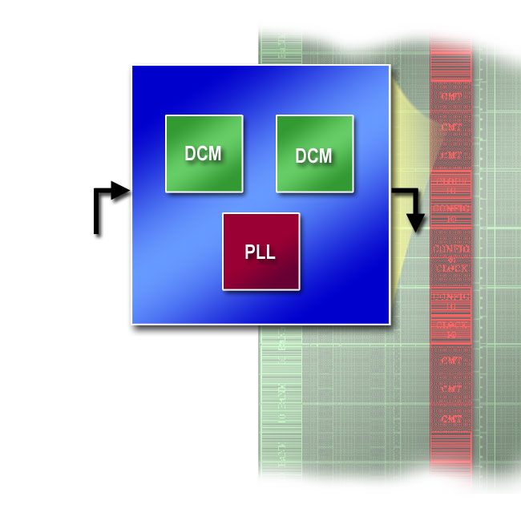
Spartan-6 Clock Management Tile (CMT)
Up to six CMTs per device
  Each with two DCMs and one PLL
  Located in center column
DCM
  All-digital technology
  Provides the most clocking functions
PLL
  Reduces internal clock jitter
  Supports higher jitter on reference clock inputs
  Replaces discrete PLLs and Voltage
  Controlled Oscillators (VCOs)
CMT
Powerful combination of flexibility and precision

Slide 23
CMT Location and Connectivity
CMTs are located in the center column of the FPGA
DCM inputs are restricted to certain BUFIO2
  CLKIN can be fed only by the ones located in the same half (top/bottom)
    That is, a DCM on the bottom can be fed by all 8 on the bottom and the bottom 4 on both sides
  CLKFB can be fed only by the ones located in the same half
PLL inputs are restricted to certain BUFIO2
  CLKIN1 can be fed by the ones in one quadrant
  on the same half (top/bottom)
  CLKFB can be fed only by the BUFIO2FB located
  in the same half
    That is, CLKIN1 of a PLL on the top can be fed by
    the 8 in the top-left quadrant, and CLKIN2 can be
    fed by the 8 in top-right quadrant
CMT outputs can drive the BUFGs in the
same half
Notes:
The sources for the CLKIN1 and CLKIN2 ports of the bottom PLLs are opposite to those of the top PLLs. CLKIN1 can be sourced by the bottom-right quadrant and CLKIN2 can be sourced by the bottom-left quadrant. The tools will automatically swap the CLKIN1 and CLKIN2 ports, if necessary.

Slide 24
Standard CMT Configurations
CMT
Use each DCM and PLL individually
InClk 1
PLL
InClk 2
DCM
To Global
Clocks
InClk 3
DCM
CMT
InClk 1
PLL
Filter high clock jitter before reaching the DCM
DCM
To Global
Clocks
InClk 2
DCM
Filter DCM output clock jitter
CMT
PLL
InClk 1
DCM
To Global
Clocks
InClk 2
DCM
Notes:
The grouping of the three elements in each Clock Management Tile (CMT) is meaningful. Within each CMT, DCMs and PLLs can be cascaded together through direct local connections. In the past these, functions may have been required to be done using external PLLs on the PCB board. Now these functions can be pulled inside the FPGA, saving PCB board space and cost.
There are three configurations:
Option 1: All three clocking elements (two DCMs and one PLL) can be used independently.
Option 2: The PLL can be used to condition an input clock jitter before passing the clock to one or both DCMs for clock generation functions. This configuration is expected to be used most often.
Option 3: The PLL can take a single DCM output clock and create an ultra-low jitter version for global clock distribution.
The PLL can accept a much wider range of input frequencies, duty cycles and input clock jitter than the DCM. Using the dividers, jitter filtering and duty cycle correction in the PLL allows the resulting clock to be fed to the DCM, which can then perform its functions.
Note that either DCM in the CMT can be cascaded with the PLL.

Slide 25
DCM Features
Delay-Locked Loop (DLL)
  Operates from 5 MHz to 250 MHz*
  De-skew clock
  Correct clock duty cycles
Phase shifting
  Static phase shift clocks in increments of period/256
  Dynamic phase shift in increments of the tap delay
Digital Frequency Synthesis (DFS)
  Operates from 0.5 MHz to 333 MHz
  Synthesize FOUT = FIN * M/D
  M, D range is different for DCM_SP and DCM_CLKGEN
DCM_SP
CLKIN
CLKFB
CLK0
CLK90
CLK180
CLK270
CLK2X
CLK2X180
CLKDV
CLKFX
CLKFX180
LOCKED
PSINCDEC
PSEN
PSCLK
PSDONE
STATUS[7:0]
RST
Two primitives for different functions
DCM_CLKGEN
CLKIN
CLKFX
CLKFX180
CLKFXDIV
LOCKED
PROGEN
PROGDATA
PROGCLK
PROGDONE
STATUS[2:1]
FREEZEDCM
RST
Notes:
* In DLL mode, the clock input can be divided by two, effectively supporting frequencies up to 500 MHz.
See the data sheet for the dynamic phase shift increment (DCM_DELAY_STEP).
If you have used the DCM before, you should note that it is no longer necessary to specify a low or high frequency mode for the DCM.
DCM_SP has been characterized to receive spread-spectrum clocks.
Any DCM on the die can be configured as either a DCM_SP or a DCM_CLKGEN.

Slide 26
DCM Theory of Operation
A DCM works by inserting delay on the clock net until the clock input rising edge is in phase with the clock feedback rising edge
  The delay is implemented via a series of delay elements
  The control circuitry changes the selection for the output clock based on the feedback
CLKIN
Delay
Delay
Delay
Delay
CLKOUT
Clock
Distribution
Network
Phase Delay
Control
CLKFB
Notes:
This slide shows how clock de-skew is performed. The output clock is a delayed copy of the input clock. The control circuitry adjusts the delay up or down by selecting the output of an earlier or later delay element. These adjustments manifest as additional jitter on the output clock. The implementation tools automatically calculate and adjust for this extra jitter during timing analysis.

Slide 27
Delay-Locked Loop (DLL)
Implements clock de-skewing
  Matches the phase of the CLKIN and CLKFB ports
  Can be used for clock insertion delay removal, zero delay buffer, or clock mirror, for example
Corrects duty cycle to 50/50
All DCM output clocks have fixed phase relationship with CLK0
  CLK90, CLK180, CLK270
  CLK2X, CLK2X180
  CLKDV
    CLKIN divided by 1.5, 2, 2.5, 3, 3.5, ..., 6, 6.5, 7, 7.5, 8, 9, 10, ..., 16 (CLKDV_DIVIDE)
  CLKFX, CLKFX180
    Digital Frequency Synthesis (DFS)

Slide 28
Phase Shifting
Phase shifts all clock outputs
  All clock outputs retain their phase relationship with CLK0
Mode determined by the CLKOUT_PHASE_SHIFT attribute
  NONE: CLKIN and CLKFB are kept in phase
  FIXED: CLKIN and CLKFB phases are statically determined
    Attribute PHASE_SHIFT = integer (– 255 to +255)
      Specifies shift in increments of the 1/256 of the clock period
      Phase shift remains constant across temperature and voltage
  VARIABLE: CLKIN and CLKFB phase can be changed dynamically
    Shift amount can be changed by using the DPS interface
      Can be increased or decreased step by step
      Variable steps are not PVT compensated; see the data sheet for the delay range
Notes:
The initial phase shift amount is set by the PHASE_SHIFT attribute (specified in 1/256 of the clock period).
The phase shifting is compensated for PVT in all modes.
In the VARIABLE mode, the phase shift is set by the PHASE_SHIFT attribute and can be modified dynamically. This requires the user to assert the PSINCDEC input to HIGH to increase the tap delay by one, or assert the input to LOW to decrease the delay by one. The user will then wait until the PSDONE output is asserted, which indicates that the new phase shift amount has been locked in. The additional delay (on top of the fixed delay) is not compensated for PVT.

Slide 29
Digital Frequency Synthesis (DFS)
Frequency of CLKFX is M/D of CLKIN frequency
  2 ≤ M ≤ 32
  1 ≤ D ≤ 32
CLKFX180 is 180° out of phase with CLKFX
If CLKFB is used, the phase of CLKFX and CLKIN will be locked
  For every M cycles of CLKFX, there will be D cycles of CLKIN
  The phase of the corresponding edge will be phase related according to the phase shift settings of the DCM
  CLKFB can be left unconnected if no phase relationship is required
    Set attribute CLK_FEEDBACK to NONE
Notes:
The frequency of CLKFX is the frequency of CLKIN multiplied by M, divided by D. M is defined by the CLKFX_MULTIPLY attribute. D is defined by the CLKFX_DIVIDE attribute.

Slide 30
DCM_CLKGEN Primitive
Provides advanced clock management features
  Dynamic programming of frequency synthesis
    Change M and D dynamically
  Wider range of M and D
    2 ≤ M ≤ 256, 1 ≤ D ≤ 256
  Spread-spectrum clock generation
  Free-running oscillator
    Freeze DCM once LOCK is achieved
CLKFXDV is CLKFX divided by 2,4, 8, 16, or 32 (CLKFXDV_DIVIDE)
Improved jitter tolerance on CLKIN input and lower jitter on CLKFX output
Does not have external CLKFB
  No clock de-skew
  No phase shifting
DCM_CLKGEN
CLKIN
CLKFX
CLKFX180
CLKFXDIV
LOCKED
PROGEN
PROGDATA
PROGCLK
PROGDONE
STATUS[2:1]
FREEZEDCM
SPI Like Interface
RST

Slide 31
Dynamic Programming of the DCM
Program the DCM with a SPI-like interface
  Send command and data serially over PROGDATA
After GO command, CLKFX will smoothly transition to new frequency
Load D
command
Load M
command
GO
command
PROGCLK
PROGEN
PROGDATA
GAP
GAP
PROGDONE
LOCKED
“D-1” value
(2 = 00000010)
“M-1” value
(13 = 00001101)
Notes:
Dynamic frequency synthesis allows the M and D values to be changed on the fly by three different commands. The user just needs to execute a series of commands (Load D, Load M, and GO). These are typical of SPI interface transactions and are easy to adopt.
A gap is required between consecutive commands. The user guide defines the required gap (two or three clocks).
The LOCKED signal will de-assert after the GO command and will re-assert after the new frequency is locked. The lock time depends on the magnitude of the frequency change.

Slide 32
Free-Running Oscillator
After DCM has locked to an input clock, the DCM updates can be frozen
  The number of delay elements used will no longer be updated
  The CLKFX output will continue to toggle at the correct frequency
When frozen (using FREEZEDCM pin), the input clock is no longer required
  The input clock will be ignored (can be stopped)
DCM_CLKGEN
CLKIN
CLKFX
FPGA soft control logic
FREEZEDCM
LOCKED
Notes:
This could be useful if your clock source is not from a static oscillator, such as if your clock source just simply came from a cable.
Note that when the DCM updates are frozen, the DCM will not adapt to PVT changes. If the temperature or voltage changes after FREEZEDCM has been applied, the CLKFX frequency will drift.

Slide 33
Spread-Spectrum Clock Generation
DCM_CLKGEN can generate spread-spectrum clocks
  The frequency of the output varies slowly over time between controlled limits
  This feature is useful for reducing the measured electromagnetic emissions of a system
Several spread-spectrum modes are supported
  Some are implemented internally to the DCM
  Others need an external state machine to manage the dynamic programming interface
A DCM output can be cascaded to a PLL to reduce output jitter, but preserve the spread-spectrum attributes of the generated clock

Slide 34
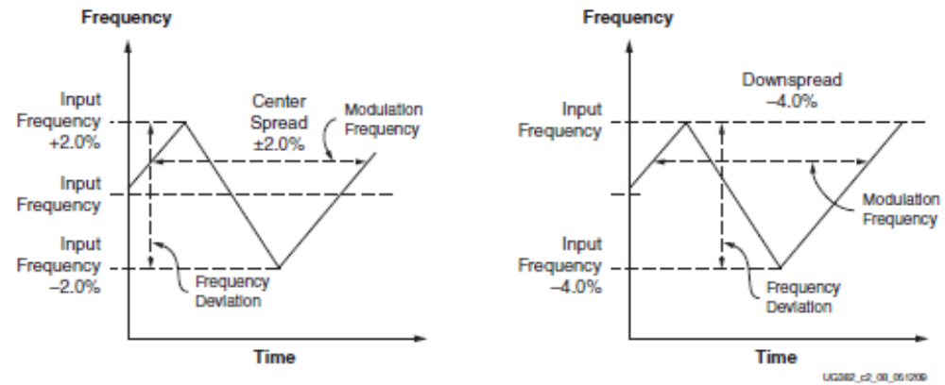
Spread-Spectrum Modes
Spread-spectrum mode is set via the SPREAD_SPECTRUM attribute
  The CENTER_SPREAD_LOW and CENTER_SPREAD_HIGH modes are done natively in the DCM
    Triangular distribution, centered around the input frequency
    CENTER_SPREAD_HIGH has a higher frequency deviation
  Other modes require an IP module for controlling the programming interface

Slide 35
Summary
There are sixteen global clock networks that
can span the entire FPGA
There are two I/O clock networks driven by
BUFPLL that span the each edge
  Sourced from CMT outputs
There are four I/O clock networks driven by
BUFIO2 that span each half edge
  Sourced from the GCLK pins and GTPCLKOUT
BUFIO2 and BUFPLL provide the clock and
control outputs required by the IOSERDES
The CMT comprises two DCMs and one PLL
The DCM_CLKGEN primitive provides advanced clock management features
  Dynamic frequency synthesis, spread spectrum, free-running oscillator

Slide 36
Where Can I Learn More?
User Guides
  Spartan-6 FPGA User Guide
    Describes the complete FPGA architecture, including distributed memory, block memory and the MCB
  Sparfan-6 FPGA Memory Controller User Guide
    Detailed description of all MCB functionality
Xilinx Training
  www.xilinx.com/training
  Designing with the Spartan-6 and Virtex-6 Families course
    Xilinx tools and architecture courses
    Hardware description language courses
    Basic FPGA architecture, Basic HDL Coding Techniques, and other Free training videos!

Slide 37
Trademark Information
Xilinx is disclosing this Document and Intellectual Propery (hereinafter “the Design”) to you for use in the development of designs to operate on, or interface with Xilinx FPGAs. Except as stated herein, none of the Design may be copied, reproduced, distributed, republished, downloaded, displayed, posted, or transmitted in any form or by any means including, but not limited to, electronic, mechanical, photocopying, recording, or otherwise, without the prior written consent of Xilinx. Any unauthorized use of the Design may violate copyright laws, trademark laws, the laws of privacy and publicity, and communications regulations and statutes.
Xilinx does not assume any liability arising out of the application or use of the Design; nor does Xilinx convey any license under its patents, copyrights, or any rights of others. You are responsible for obtaining any rights you may require for your use or implementation of the Design. Xilinx reserves the right to make changes, at any time, to the Design as deemed desirable in the sole discretion of Xilinx. Xilinx assumes no obligation to correct any errors contained herein or to advise you of any correction if such be made. Xilinx will not assume any liability for the accuracy or correctness of any engineering or technical support or assistance provided to you in connection with the Design.
THE DESIGN IS PROVIDED “AS IS" WITH ALL FAULTS, AND THE ENTIRE RISK AS TO ITS FUNCTION AND IMPLEMENTATION IS WITH YOU. YOU ACKNOWLEDGE AND AGREE THAT YOU HAVE NOT RELIED ON ANY ORAL OR WRITTEN INFORMATION OR ADVICE, WHETHER GIVEN BY XILINX, OR ITS AGENTS OR EMPLOYEES. XILINX MAKES NO OTHER WARRANTIES, WHETHER EXPRESS, IMPLIED, OR STATUTORY, REGARDING THE DESIGN, INCLUDING ANY WARRANTIES OF MERCHANTABILITY, FITNESS FOR A PARTICULAR PURPOSE, TITLE, AND NONINFRINGEMENT OF THIRD-PARTY RIGHTS.
IN NO EVENT WILL XILINX BE LIABLE FOR ANY CONSEQUENTIAL, INDIRECT, EXEMPLARY, SPECIAL, OR INCIDENTAL DAMAGES, INCLUDING ANY LOST DATA AND LOST PROFITS, ARISING FROM OR RELATING TO YOUR USE OF THE DESIGN, EVEN IF YOU HAVE BEEN ADVISED OF THE POSSIBILITY OF SUCH DAMAGES. THE TOTAL CUMULATIVE LIABILITY OF XILINX IN CONNECTION WITH YOUR USE OF THE DESIGN, WHETHER IN CONTRACT OR TORT OR OTHERWISE, WILL IN NO EVENT EXCEED THE AMOUNT OF FEES PAID BY YOU TO XILINX HEREUNDER FOR USE OF THE DESIGN. YOU ACKNOWLEDGE THAT THE FEES, IF ANY, REFLECT THE ALLOCATION OF RISK SET FORTH IN THIS AGREEMENT AND THAT XILINX WOULD NOT MAKE AVAILABLE THE DESIGN TO YOU WITHOUT THESE LIMITATIONS OF LIABILITY.
The Design is not designed or intended for use in the development of on-line control equipment in hazardous environments requiring fail-safe controls, such as in the operation of nuclear facilities, aircraft navigation or communications systems, air traffic control, life support, or weapons systems (“High-Risk Applications”). Xilinx specifically disclaims any express or implied warranties of fitness for such High-Risk Applications. You represent that use of the Design in such High-Risk Applications is fully at your risk.
© 2009 Xilinx, Inc. All rights reserved. XILINX, the Xilinx logo, and other designated brands included herein are trademarks of Xilinx, Inc. All other trademarks are the property of their respective owners.

