Slide 1
Retention and mobilization of talent among employment equity groups
Presented to ISED by Team -udem-1885:
Siying Chen, Sébastien Garneau, Yuxi Wang, Yan Watts

Slide 2
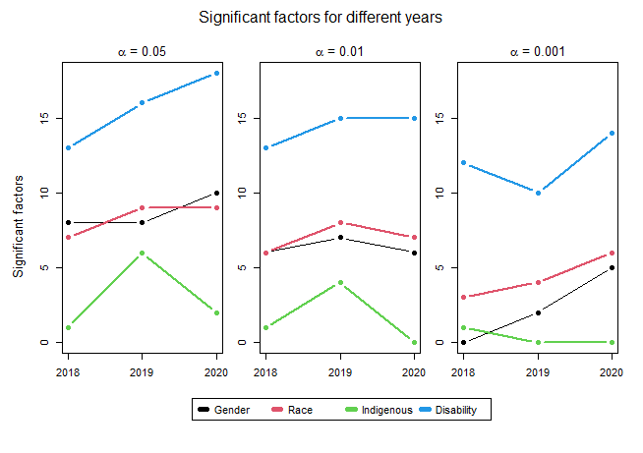
Methodology
Each factor is reflected by certain questions (ex : Empowerment (Q13, Q14, Q15, Q44)
Statistical analysis
Weighted average between questions was calculated for each factor giving us a pooled percentage of agreement
Testing the equality of proportions between groups for each factor
Ex : For Gender, testing if p(Men) = p(Women) for Empowerment

Slide 3
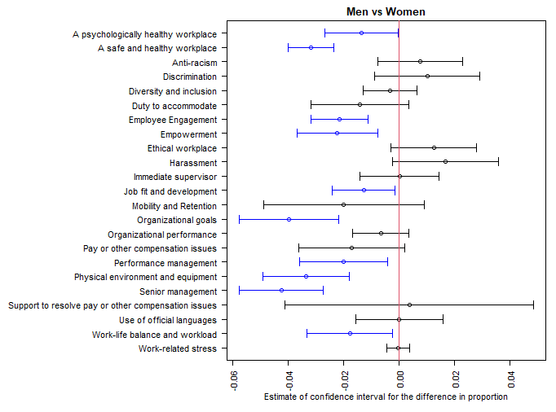
Women (2020)
Results
Men tend to disagree more than women in general
Research
Men tend to voice their dissatisfaction more than women

Slide 4
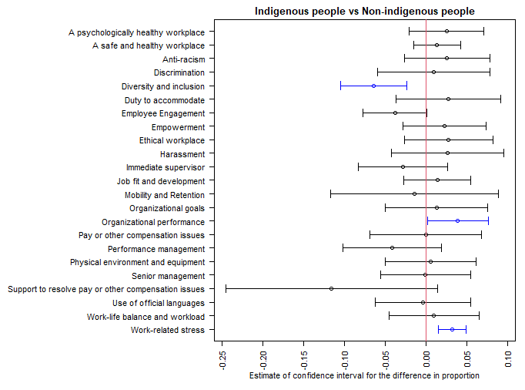
Indigenous people (2020)
Results
Diversity and inclusion is the most important factor
Research
Few career opportunities and perceived low salary are the main factor leading to turnover

Slide 5
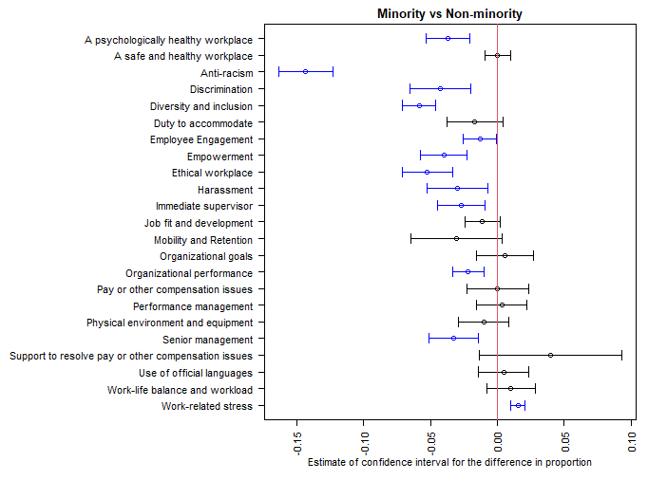
Racialized people (2020)
Results
Anti-racism is the most important factor
Research
Perceived salary and career opportunities are the most common reasons leading to turnover

Slide 6
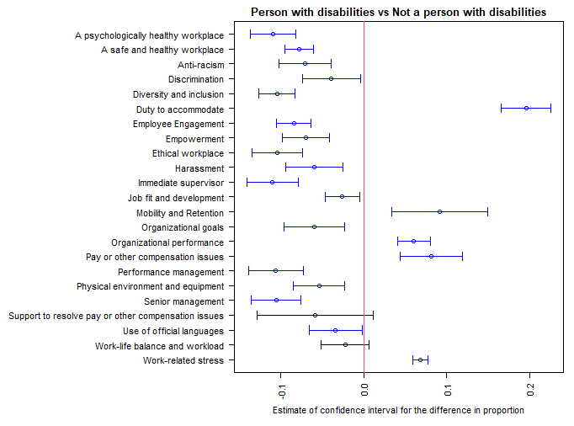
Disabilities (2020)
Results
A lot of disagreement in many factors
Research
Discrimination and harrasment are two of the most important factors regarding their level of dissatisfaction

Slide 7
Concluding remarks
Encourage women to voice their dissatisfaction
Promote Anti-racism for racialized people
More Diversity and inclusion for indigenous people
Help disabled people in many aspects of their work
Research shows that mentoring helps with increasing satisfaction with jobs in most groups
Exploration : Sexual orientation

Slide 8
References
Landes, Scott D., and Suzie S. Weng. “Racial–Ethnic Differences in Turnover Intent Among Home Health Aides.” Journal of Applied Gerontology, vol. 39, no. 5, May 2020, pp. 490–501, doi:10.1177/0733464819827806.
Wei Sun & Andrew Jared Critchfield (2021) Asian Americans’ perceived work-related stress: Impacts on job satisfaction and retention, Qualitative Research Reports in Communication, 22:1, 66-79, DOI: 10.1080/17459435.2020.1844789
Randy Hodson (1989) Gender Differences in Job Satisfaction: Why Aren't Women More Dissatisfied?, The Sociological Quarterly, 30:3, 385-399, DOI: 10.1111/j.1533-8525.1989.tb01527.x
Uppal, S. (2005), "Disability, workplace characteristics and job satisfaction", International Journal of Manpower, Vol. 26 No. 4, pp. 336-349. https://doi.org/10.1108/01437720510609537
Lai GC, Taylor EV, Haigh MM, Thompson SC. Factors Affecting the Retention of Indigenous Australians in the Health Workforce: A Systematic Review. International Journal of Environmental Research and Public Health. 2018; 15(5):914. https://doi.org/10.3390/ijerph15050914ic Health. 2018; 15(5):914. https://doi.org/10.3390/ijerph15050914

Slide 9
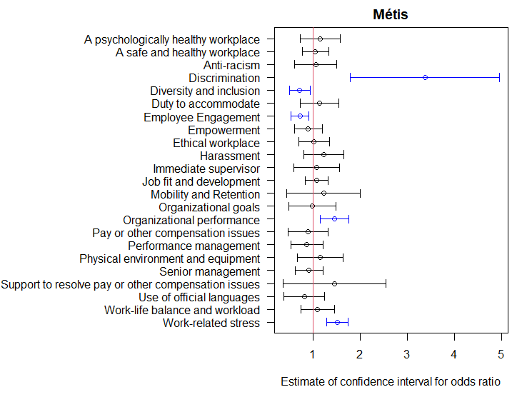
Appendix
Subgroup analysis for Métis people

Slide 10
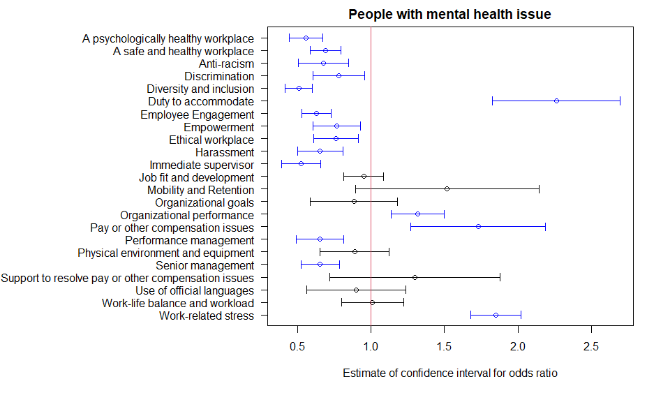
Appendix
Subgroup analysis for people with mental health issue

Slide 11
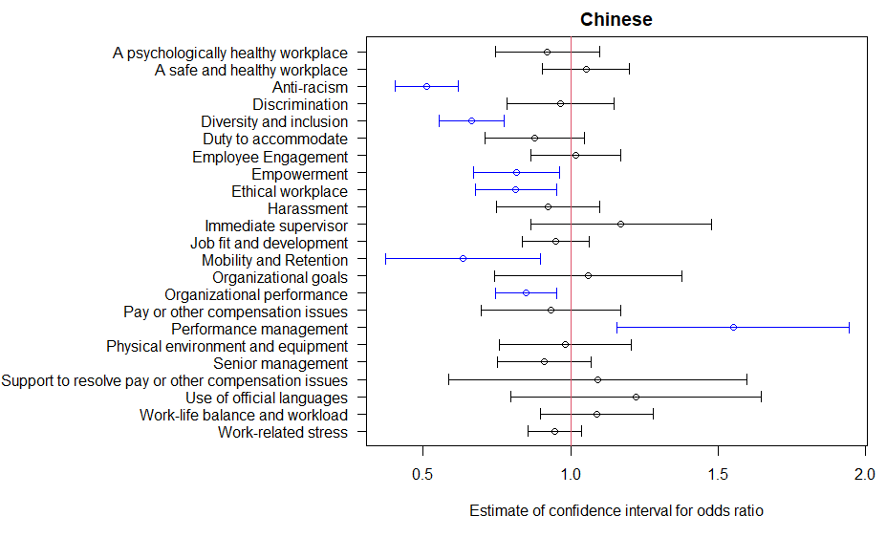
Appendix
Subgroup analysis for chinese people

Slide 12
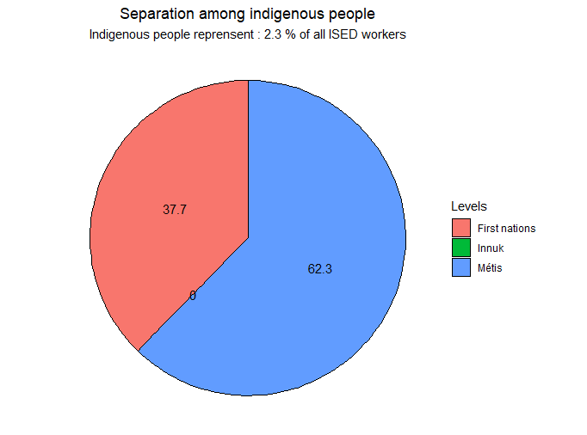
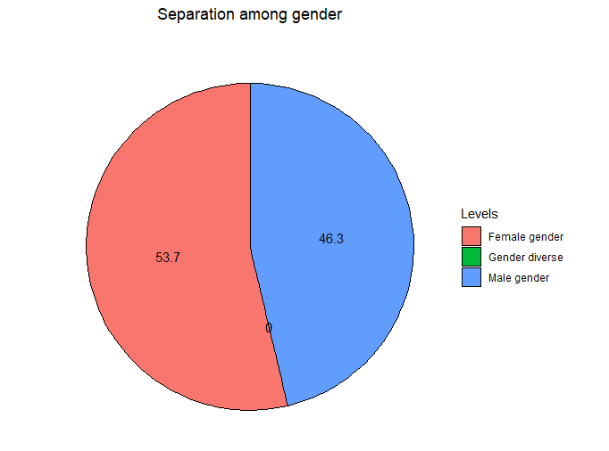
Appendix : Gender and Indigenous people

Slide 13
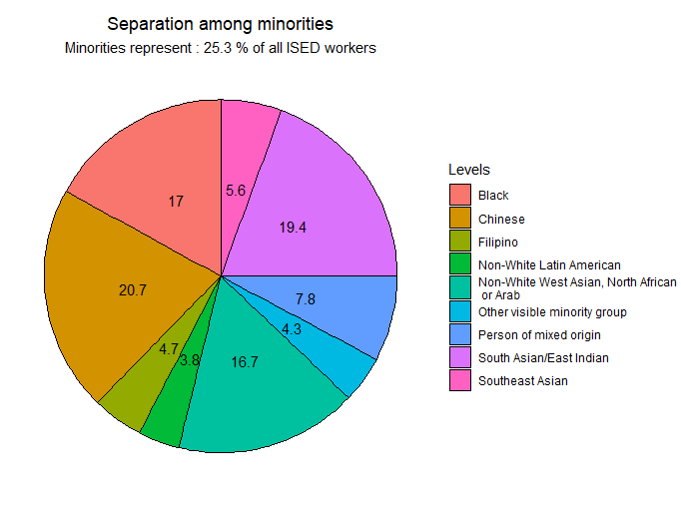
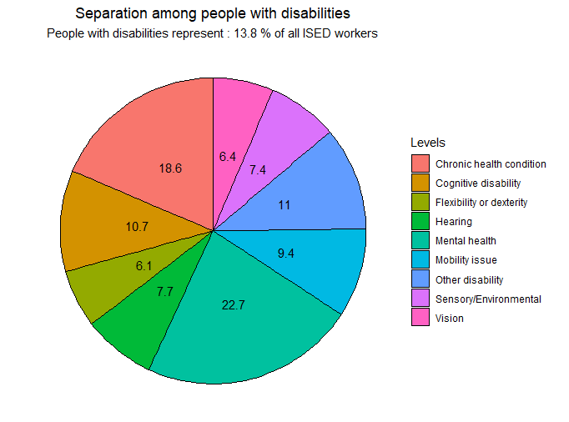
Appendix : Minorities and people with disabilities

Slide 14
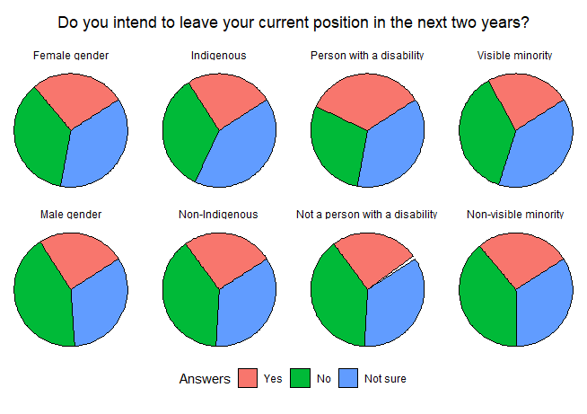
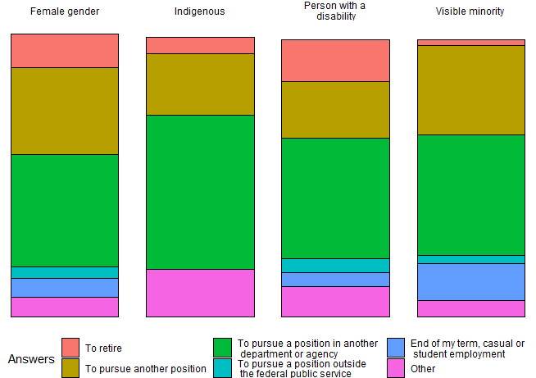
People with disability want to quit more than people without a disability
People from all groups want to pursue a position in another department or agency

