Slide 1
Boundaries of Microservices How to build them and how to cross them
Linda van der Pal – Trailblazers
Régina ten Bruggencate – Trailblazers
Gunnar Morling – Redhat
Emmanuel Bernard – Redhat
`

Slide 2
Plan for the day
Splitting up your problem into microservices
…Crossing the boundaries…

Slide 3
Splitting up your problem into µs
Inspired by Erik Talboom & Koen Metsu

Slide 4
Possible splitting criteria
Implementation technology
Computationally heavy
I/O heavy
Geography
location of team
Domain Driven Design

Slide 5
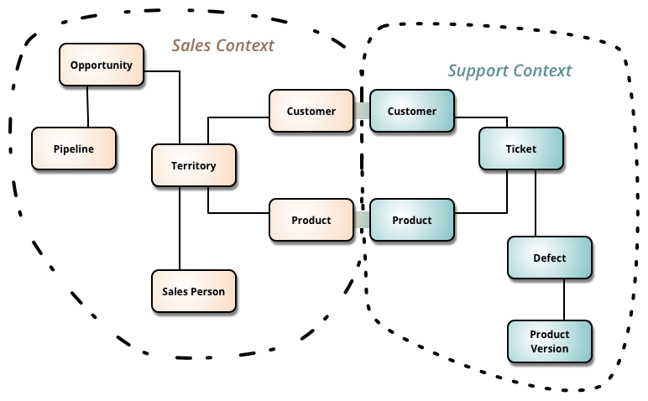
DDD terms explained
domain
model
ubiquitous language
context
bounded context

Slide 6
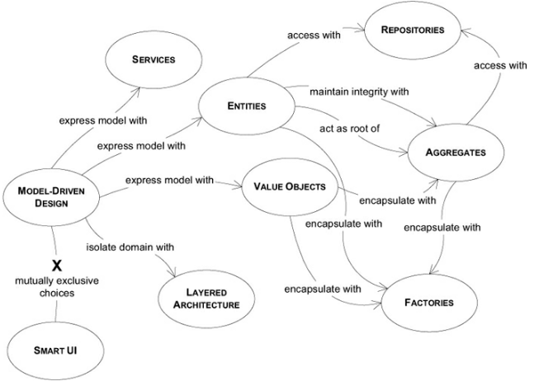
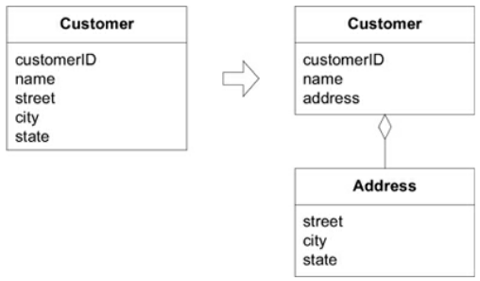
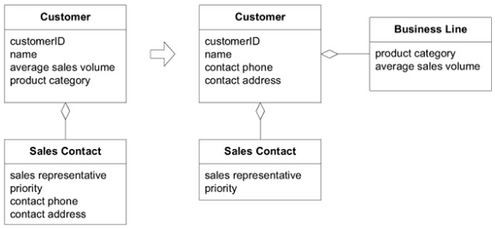
Building blocks
layered architecture
entities
value objects
services
The operation relates to a domain concept that is not a natural part of an ENTITY or VALUE OBJECT.
The interface is defined in terms of other elements of the domain model.
The operation is stateless.

Slide 7
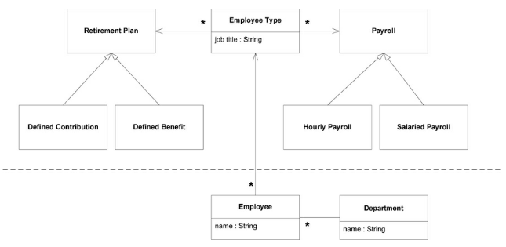
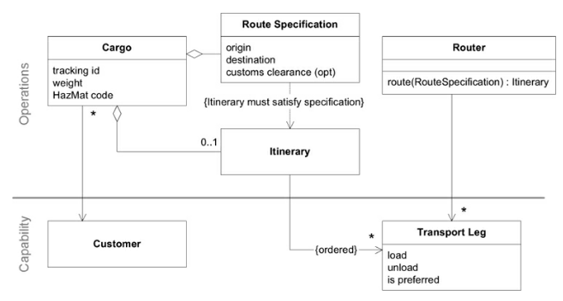
Large-scale structure
system metaphor
responsibility layers
knowledge level

Slide 8
References
Building Microservices
Sam Newman
Domain Driven Design
Eric Evans
Microservice Architecture
Irakli Nadareishvili, Ronnie Mitra, Matt McLarty & Mike Amundsen
Microservices for Java Developers
Christian Posta

