Slide 1
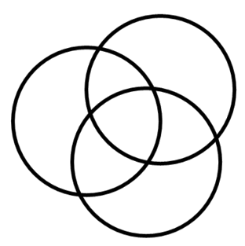
OMA PRESENTATION
Group 21
Barili Alessandro
Barletta Nicola
Battaglino Samuele
De Rosa Simone
Volpe Valerio
Notes:
Good Afternoon

Slide 2

The Concept…
Adaptive Large Neighborhood Search (ALNS)
Tabu Search (TS)
Greedy Randomized Adaptive Search Procedure (GRASP)
Notes:
Our algorithm has been developed in C. We have used different metahueristics all together and it is divided in two phases: initialization and optimization.

Slide 3
Multithread
Throughout all our program multithread is used extensively, in order to speed up high demanding CPU functions
The initialization metaheuristic is carried out by multiple threads, as soon as one finds a feasible solution, all the other merge back
The optimization metaheuristic uses multiple threads to more quickly analize a neighborhood
Notes:
We have used multithread in two different ways: during the initialization more thread work simulataneously and the initialization stops as soon as one feasible solution is found, while during the optimization each thread explores disjointed areas of the same neighbourhood so that the execution becomes faster.

Slide 4
Initialization:
  Graph Coloring
  TS + GRASP
But before that we have to find a first feasible solution
Notes:
The initialization is divided in two phases: the first part consists in a greedy algorithm of graph coloring, while the other one is a metaheuristic that combines tabu search and grasp.

Slide 5

Graph Coloring
The exams are decreasingly ordered for total students in conflict
It iteratates over the exams trying to give them a timeslot without conflicts, if not possible then randomly assigned
Notes:
The graph coloring consists in sorting the exams in decreasing order with respect to the number of students in conflict The algorithm cycles on the exams (following the order arranged in the previous part): at
each iteration, the current exam is located in a timeslot in which there are no exams with
students in common with the current one. If there is not such a timeslot, the current exam
is located in a timeslot chosen randomly.
If this procedure finds a feasible solution, the initialization stops, otherwise the the metaheuristic starts.

Slide 6
Initialization Metaheuristic
Timeslots
Notes:
1. Randomly, an exam that still has conflicts with other exams is selected (in order to change
timeslot).
2. The timeslots are ranked according to the number of conflicts which would be generated by
moving there the current exam. Each timeslot has a probability of being chosen and this
probability decreases exponentially through the ranking: the current exam is moved in the selected timeslot.
3. In the selected timeslot, the exams are ranked according to the number of students in
conflicts with the other exams in the timeslot: each exam has a probability of being chosen
to be potentially moved. The selected exam is then located in the timeslot in which it generates the minimum number of conflicts

Slide 7
Initialization Metaheuristic
While (feasible == FALSE){
e1 = rand() % E;
for(e2 = 0; e2 < E; e2 ++)
if (n[e1][e2] && x[e1] == x[e2])
conflict=TRUE;
if(conflict) {
insert_TabuList(e1,exam_timeslot[e1]);
t1 = better_timeslot(e1);
exam_timeslot[e1]=t1;
e2 = worst_exam_greedy_random(t1);
t2 = better_timeslot(e2);
exam_timeslot[e2]=t2;
feasible = is_feasible();
}
}
Better_timeslot has the task to rank decreasingly the timeslots in respect to the conflicts generated by the exam if moved there and decide with an elitist approch
Worst_exam_greedy_random choose an exam in the given timeslot by ranking them according to their conflict and it associate to them an esponential decreasing probability of being chosen.
Nothing forbids to select the current timeslot of the exam
Notes:
Pseudo code and related important functions

Slide 8
Tabu Search
We use this as a backup for both the Initialization and Optimization algorithm
Its aim is not to revisit solutions and explore better a neighborhood
Notes:
This metaheuristic uses a tabu list too, in order to explore better the solution space, avoiding to analyse more than once the same solutions.

Slide 9
Optimization Metaheuristic
Adaptive Large Neighborhood Search (ALNS)
Tabu Search (TS)
Greedy Randomized Adaptive Search Procedure (GRASP)
Notes:
Now we proceed to the analysis of the optimization phase, which combines three different metaheuristics.
The first is Adaptive Large Neighborhood Search.

Slide 10
ALNS
We use two ways of generating the neighborhood:
Single Exam Movement
Group Swap
We choose in an adaptive and dynamical way which one of them, or both, to use and how long, all based on how many non improving cycles we have made
Notes:
The algorithm uses two completely different neighborhood structures: we iterate back and forth between the two of them in an adaptive and dynamic way, depending on how our solution is going.
This allow us to generate neighbours by means of different type of moves, in order to better explore the solution space.

Slide 11
Single Exam Movement
ALNS
Timeslots
Notes:
So the first neighborhood structures is obtained by simply moving an exam in another timeslot.

Slide 12
Timeslot Swap
ALNS
Timeslots
Notes:
The second by switching all the exams contained in two different timeslot.
For sure, all the generated neighbours are feasible solution.

Slide 13
Adaptiveness
ALNS
Dynamically, depending on loops without improvements and various parameters:
We generate neighborhoods of different sizes
We use different functions to evaluate them, deeper and more expensive or more random and fast
Notes:
Moreover, for both the structures we have developed four different functions to generate neighborhoods of different size: steepest descent with elitist approach on complete or partial spectrum, first improvement with simulated annealing and completely random neighborhood.
These are chosen dynamically during the execution, according to some parameters useful to detect whether the algorithm is going to be stuck in a
local minima or not: in this way we can deeply analyse good solution areas and, in the meanwhile, quickly escape from flat regions by means of more randomic and faster neighborhood function.

Slide 14
Optimization Metaheuristic
Adaptive Large Neighborhood Search (ALNS)
Tabu Search (TS)
Greedy Randomized Adaptive Search Procedure (GRASP)
Notes:
(skip 3 circle slide)

Slide 15
Tabu Search
The Optimization uses the same library as the Initialization
Further improvements were obtained by making its tenure variable according to how many non improving cycles we have made
Notes:
The tabu search library is the same used into the initialization phase, the main difference is that now we vary the tabu list tenure dinamically according to our needs. The aim is to escape local minima or flat regions.

Slide 16
Optimization Metaheuristic
Adaptive Large Neighborhood Search (ALNS)
Tabu Search (TS)
Greedy Randomized Adaptive Search Procedure (GRASP)
Notes:
(skip 3 circle slide)

Slide 17
GRASP
Once we have our neighborhood we evaluate each one of its components
We rank them decreasingly according to their penalty and we assign, as already seen in the Initialization, a probabilty of being chosen to each of them
Notes:
[In the two steepest descent functions] we use the following GRASP fashion, in order to evaluate the neighbors

Slide 18
Neighborhood Evaluation
GRASP
Probability
Penalty
Neighborhood with its solutions
Notes:
Each neighbor/move has its penalty evaluated if actually taken (click) than we order them decreasingly exponentially

Slide 19
Data Structures
GRASP
We use two extra data structures to speed up the evaluation processes:
Single Exam Movement:
  «exam_penalty[E]»
Group Swap
«conflicts[T][T]» + lookup vector
Notes:
In order to make the choice of the neighbors more efficient/fast we implemented different data structures. For the single exam movement we build a vector holding the penalty of each exam, so when we want to evaluate a neighbor we just have to iterate over that and updating on the go. For the group swap we build a matrix holding the number of students in conflict for each couple, in order to speed up the access to the matrix we use a simple look-up table.
(single movement O(E) and timeslot swap O(T))

Slide 20
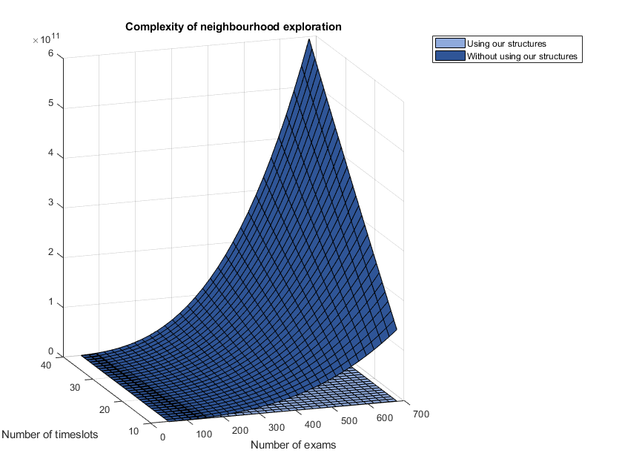
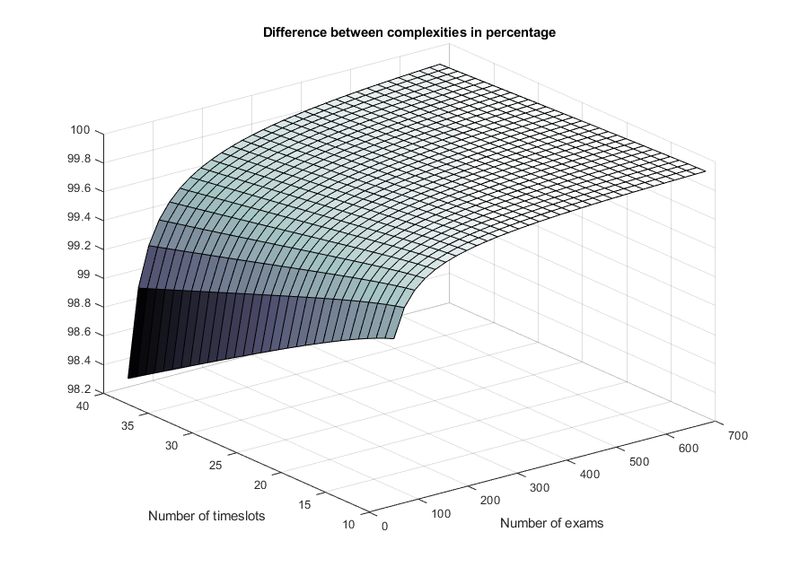
Data Structures
GRASP
Notes:
So, as you can see on the left side of the screen, we computed theorical computational costs using our structures or not. Of course, it’s better to use the structures we mentioned before, according to the MEANINGFUL computational advantage earned. We can notice that for every combination timeslot/exam we have a great gap between the two surfaces: the only one similarity between them is in some trivial cases that are not worth considering. On the right side, there’s the difference between the two costs, represented as a percentage (the graphic starts from 98%, so…)

Slide 21
Destroy
GRASP
In order to be extra careful in avoiding to get stuck in flat regions and local minima:
Adjust dynamically the neighborhood generations
    Do it faster
    Do it more randomly
Dynamically enlarge tabu list tenure
If nothing above works, we tear down the solution by mixing up exams and timeslots only ensuring feasability
Notes:
To avoid getting stuck in local minima, as explained before, during the execution we ADAPT the functions used to generate the neighborhood and the length of the tabu list. ANYWAY, it can happen that it wouldn’t be sufficient. So what are we going to do? We use a function to destroy our solution. In which way? We do a large number of RANDOM moves, guaranteeing only feasibility of the solution. This phase is really fast because each iteration has a computational cost of BIG-O OF ONE, since we’re not interested in computing penalty.

Slide 22
Parameters Tuning
We deviced a Logger to run our solver with different parameters each time, according to our will and print out a certain file
From:
Mathematical analysis (Plots and Multiple Regression)
To:
Notes:
We developed a script in C to generate the LOGS AUTOMATICALLY: they may be LOCAL to a single execution (describing in a detailed way the parameters and penalties) or GLOBAL to several executions (we execute the program a lot of times using different sets of parameters, then aggregate information about the results). We used some plots to analize them, and also, we used multiple regression to test the effect of some parameters, and their relevance.

Slide 23
Results
Notes:
Nevertheless the plot can show some noise, due to the fact that we plotted the results obtained by running the algorithm just one time, it’s evident that the results are getting better and better with time: SO OUR ALGORITHM HAS THE ABILITY TO ESCAPE LOCAL MINIMA.

Slide 24
Utilities
«Deep Destroy»: solution destruction function which call the initialization procedure on randomly chosen timeslots, obtaining a new set of groups; than we will try to refit the exams only in the required number of timeslots;
Notes:
We have also implemented other functionalities; however we have found, experimentally, that they are worst. For example:
-Deep Destroy: it is a solution destruction function which does not change exams randomly, but it selects a certain number of different timeslots and all exams contained; at this point the initializaation function is called again and it puts these exams in the selected slots. Since this process could slow down the execution flow, additional timeslots may be considered; then exams in additional groups are put in the “real” ones in order to obtain a feasible solution. If this final step was not possible, the idea would be iterated using both new exams and the previous ones.

Slide 25
Utilities
Monitoring Techniques: beyond only taking into account non improving cycles, we used temperature, distance and exponential smoothing with trend
Notes:
-We have introduced also other monitoring techniques, instead of non improvement cycles; for example: exponential smoothing with trend (to eliminate noisy values and to understand solution’s trend), a distance function (which converges to zero in the case of local minima) or the temperature (where we put togheter the penalty and the non-improvement cycles)

Slide 26

Future Development
Collect more data in order to refine the parameter tuning through a more accurate mathematical analysis
Follow the project on Github:
«/Sebat95/OMA»
Notes:
Future aim is to collect more data in order to make more detailed mathematical analysis, for instance about multiple regression mentioned previously, where more meaningful resùlts could be obtained.

Slide 27
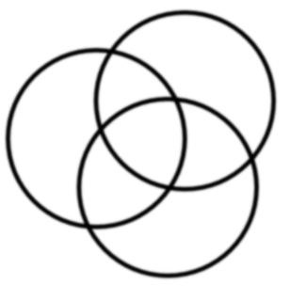
Thanks for Your Attention
We stand ready to listen and to answer all Your questions
Notes:
Thanks for your attention.

