Slide 1
COS30045 · DATA VISUALISATION
Project Stand Up 2
Hospitalised Injuries from Road Crashes in Australia
Team: Team 7 · Sanghun Shin (Sean) · Sebastian Haney
Week 11 · Semester 1, 2026

Slide 2
Today's Stand Up
01
02
03
Progress Since Week 10
Design Book Update
Website & D3.js Status
What was completed
Section 3 revised · Wireframe added
HTML skeleton · Chart files
04
05
KNIME Workflow
Next Steps
Sebastian's completed workflow
Plan for final submission

Slide 3
01 Progress Since Week 10
Sean — Completed
Sebastian — Completed
✔ Wireframe prototype designed ✔ Design Book Section 3 revised ✔ Tab navigation structure decided (Total / Trend / Age & Gender) ✔ Chart plan finalised (Line · Bar · Scatterplot · Histogram) ✔ Shared filter bar interaction designed
✔ KNIME workflow completed ✔ All 3 datasets cleaned & filtered ✔ 5 CSV files exported ✔ Design Book Section 2 written (Data exploration & KNIME steps) ✔ KNIME screenshots added to
Design Book

Slide 4
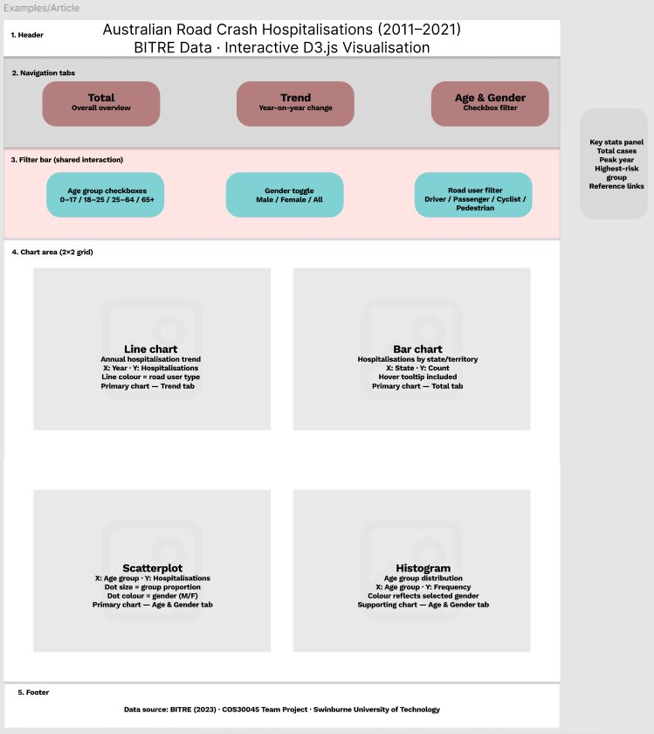
02 Design Book Update
Section 3 — Revised
Figure 1 — Wireframe Prototype
3.1 Website Design
Single-page app · Tab switching (Total / Trend /
Age & Gender) · Key Stats panel · 2×2 chart grid
3.2 Visualisation Design
Line chart · Bar chart · Scatterplot · Histogram
ColorBrewer palette · Tufte & Munzner principles
3.3 Interaction Design
Shared filter bar · Age / Gender / Road user filters
Tooltip on hover · Reset button

Slide 5
03 Website & D3.js Status
Website File Structure
Chart Coding Plan
index.html style.css js/ linechart.js barchart.js scatterplot.js histogram.js shared.js data/ national_annual.csv state_annual.csv road_user_annual.csv demographics_age.csv first_nations_annual.csv
Line chart
Tab: Trend · File: linechart.js · Data: national_annual.csv
Bar chart
Tab: Total · File: barchart.js · Data: state_annual.csv
Scatterplot
Tab: Age & Gender · File: scatterplot.js · Data: demographics_age.csv
Histogram
Tab: Age & Gender · File: histogram.js · Data: demographics_age.csv

Slide 6
04 KNIME Workflow — Completed ✔
Dataset | Key Steps | Output CSV | Status
National Hospitalisation (117,919 rows) | Row filter (traffic only) GroupBy year Sum aggregation | national_annual.csv road_user_annual.csv demographics_age.csv | ✔ Done
State & Territory (1,372 rows) | Column rename GroupBy state + year Sum aggregation | state_annual.csv | ✔ Done
First Nations (352 rows) | Row filter (traffic only) String→Number conversion GroupBy year | first_nations_annual.csv | ✔ Done
KNIME file (Team_7_Hospital_Injuries_workflow.knwf) submitted with this Stand Up package.
5 CSV files ready for D3.js integration · Hosted in GitHub repository

Slide 7
05 Next Steps
Sean
Implement tab switching (Total / Trend / Age & Gender) in D3.js
Week 11
Sean
Code Line chart — national_annual.csv · year-on-year trend
Week 11
Sean
Code Bar chart — state_annual.csv · state comparison
Week 11
Sebastian
Code Scatterplot — demographics_age.csv · age × gender
Week 11–12
Sebastian
Code Histogram — demographics_age.csv · age distribution
Week 11–12
Both
Connect shared filter bar to all 4 charts
Week 12
Both
Add tooltip hover to all charts · Final Design Book sections
Week 12

Slide 8
Thank You
GitHub: github.com/Armydun1/Assignment-Project-Design-Book-and-Website-Team7-
Submission: Design Book (Updated) · This PowerPoint · KNIME Workflow File
COS30045 Data Visualisation · Team 7 · Swinburne University of Technology

