Slide 1
Codecademy Machine Learning Course: Date-A-Scientist
Machine Learning Fundamentals
Seb Galer
October 2018

Slide 2
Outline
Background
Exploration of the data
Question 1
Question 2
Further Work

Slide 3
Background
The data analysed here was provided by OKCupid and consists of the following sections:
body_type
diet
drinks
drugs
education
ethnicity
height
income
job
offspring
orientation
pets
religion
sex
sign
smokes
speaks
status
essay0 - My self summary
essay1 - What I’m doing with my life
essay2 - I’m really good at
essay3 - The first thing people usually notice about me
essay4 - Favourite books, movies, show, music, and food
essay5 - The six things I could never do without
essay6 - I spend a lot of time thinking about
essay7 - On a typical Friday night I am
essay8 - The most private thing I am willing to admit
essay9 - You should message me if…

Slide 4
Exploration of the data
The dataset contains results for 59946 users comprised of 35829 males and 24117 females.
For this work I will be examining the information stored in the essays as well as education, religion, income and speaks to look for trends and correlations.
As is often the case for real world data there are many sections that are incomplete and a balance must be struck between dropping data and bias due to incompleteness. For this purpose any blank essay questions were filled with blank comments (‘ ’) whilst records with missing data in the other columns being considered were dropped leaving 36950 records (22097/14853 male/female).

Slide 5
Exploration of the data
The education and religion sections contain the following breakdown and labels.
Label | Counts | Label | Counts
agnosticism but not too serious about it | 2531 | atheism and very serious about it | 525
agnosticism | 2521 | catholicism and somewhat serious about it | 518
other | 2376 | other and very serious about it | 484
agnosticism and laughing about it | 2353 | buddhism and laughing about it | 443
catholicism but not too serious about it | 2154 | buddhism and somewhat serious about it | 351
atheism | 1989 | christianity and laughing about it | 348
other and laughing about it | 1954 | buddhism | 345
atheism and laughing about it | 1936 | agnosticism and very serious about it | 294
christianity but not too serious about it | 1838 | judaism and somewhat serious about it | 255
christianity | 1713 | hinduism but not too serious about it | 224
judaism but not too serious about it | 1481 | hinduism | 100
other but not too serious about it | 1472 | catholicism and very serious about it | 96
atheism but not too serious about it | 1253 | buddhism and very serious about it | 64
catholicism | 926 | hinduism and somewhat serious about it | 58
christianity and somewhat serious about it | 864 | hinduism and laughing about it | 43
atheism and somewhat serious about it | 810 | islam but not too serious about it | 40
other and somewhat serious about it | 791 | islam | 39
catholicism and laughing about it | 686 | judaism and very serious about it | 22
judaism and laughing about it | 644 | islam and somewhat serious about it | 19
buddhism but not too serious about it | 622 | islam and laughing about it | 14
agnosticism and somewhat serious about it | 609 | hinduism and very serious about it | 14
judaism | 580 | islam and very serious about it | 12
christianity and very serious about it | 539
Level | Counts | Level | Counts
graduated from college/university | 16013 | working on law school | 167
graduated from masters program | 6139 | dropped out of two-year college | 156
working on college/university | 4119 | working on med school | 145
graduated from two-year college | 1171 | two-year college | 136
working on masters program | 1155 | dropped out of masters program | 113
graduated from high school | 1085 | dropped out of ph.d program | 101
graduated from ph.d program | 913 | dropped out of high school | 84
dropped out of college/university | 846 | working on high school | 67
working on two-year college | 805 | masters program | 59
graduated from law school | 781 | high school | 57
working on ph.d program | 685 | space camp | 38
graduated from space camp | 505 | ph.d program | 17
college/university | 465 | dropped out of law school | 14
dropped out of space camp | 420 | law school | 14
working on space camp | 347 | dropped out of med school | 8
graduated from med school | 320 | med school | 5
# Generated with
print(df_cleaned.education.value_counts())
print(df_cleaned.religion.value_counts())

Slide 6
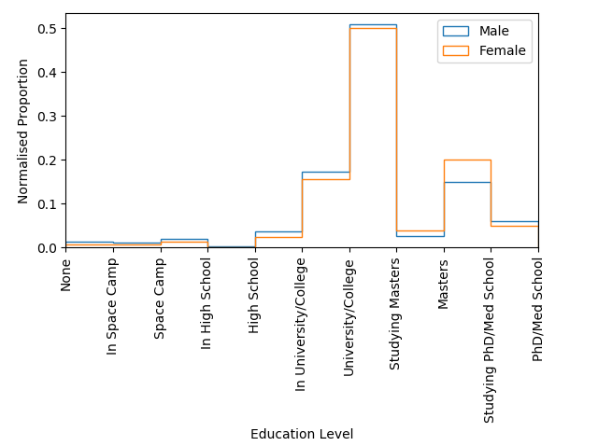
Exploration of the data - Education
To reduce the number of categories these were mapped as a new column as follows where a drop out is considered the level below the course dropped out from. The graph to the right shows the split by gender showing very similar education levels at most levels except Phd/Med school in progress.
Level | Map
PhD/Med School completed | 10
PhD/Med School in progress | 9
Masters completed/graduate | 8
Masters in progress | 7
College/University/Law School completed | 6
College/University/Law School in progress | 5
High School completed | 4
High School in progress | 3
Space Camp | 2
Space Camp in progress | 1
Space Camp drop out | 0
plt.hist(male_data.mapped_education, bins=10, histtype='step', density=True, fill=False) plt.hist(female_data.mapped_education, bins=10, histtype='step', density=True, fill=False) plt.xlabel("Education Level") plt.ylabel("Normalised Proportion") plt.legend(['Male', 'Female']) plt.xlim(0, 5) plt.xticks(np.arange(11), ('None', 'In Space Camp', 'Space Camp', 'In High School', 'High School', 'In University/College', 'University/College', 'Studying Masters', 'Masters', 'Studying PhD/Med School', 'PhD/Med School'), rotation=90) plt.show()
Note that due to lack of familiarity with the American education system this may not be a truly accurate reflection of education levels. This may lead to bias/incorrect results later.
# Generated with
df_cleaned['mapped_education'] = df_cleaned.education.map(education_map)

Slide 7
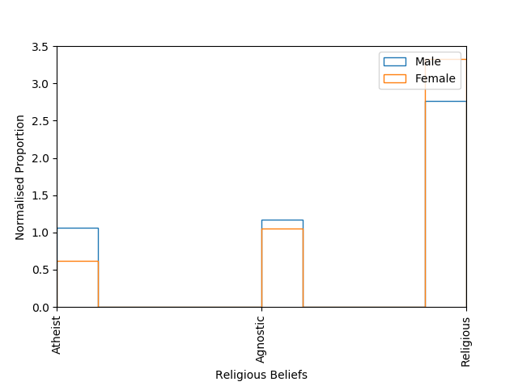
Exploration of the data - Religion
To reduce the number of categories these were mapped as a new column as follows where the additional comments indicating strength of faith were dropped to reduce the number of categories.
Level | Map
Religious (all categories) | 2
Agnostic | 1
Atheist | 0
The lack of strength of faith may add a skew to the data and should be considered when interpreting the results.
plt.hist(male_data.mapped_religion, bins=10, histtype='step', density=True, fill=False) plt.hist(female_data.mapped_religion, bins=10, histtype='step', density=True, fill=False) plt.xlabel("Religious Beliefs") plt.ylabel("Normalised Proportion") plt.legend(['Male', 'Female']) plt.xlim(0, 2) plt.xticks(np.arange(3), ('Atheist', 'Agnostic', 'Religious'), rotation=90) plt.show()
# Generated with
df_cleaned['mapped_religion'] = df_cleaned.religion.map(religion_map)

Slide 8
Question 1
Does positivity increase with education level, religious belief and income? Can these factors be used to predict a user’s level of positivity?
Approach
Train a Naïve Bayes algorithm on sentiment to measure the sentiment of the essay answers. Use classification type methods to predict sentiment.
Limitations
Limited labelling accuracy for religion and education, NB model accuracy, how truthful people are in answering the questions (especially the essay questions), the length of essay questions may skew sentiment scoring.

Slide 9
Question 1
from sklearn.model_selection import train_test_split from sklearn.feature_extraction.text import CountVectorizer from sklearn.naive_bayes import MultinomialNB
sentiment_header = ['sentiment', 'number', 'date', 'query', 'user', 'tweet'] sentiment_data = pd.read_csv('training.1600000.processed.noemoticon.csv', encoding="ISO-8859-1", names=sentiment_header)
sentiment_data.drop(['user', 'number', 'date', 'query'], axis=1, inplace=True)
counter = CountVectorizer() counter.fit(sentiment_data.tweet) sentiment_counts = counter.transform(sentiment_data.tweet) X_train, X_test, y_train, y_test = train_test_split(sentiment_counts, sentiment_data.sentiment, test_size=0.2, random_state=1) classifier = MultinomialNB() classifier.fit(X_train, y_train) print('Naive Bayes prediction score is %.1f%%' % (classifier.score(X_test, y_test)*100))
for column in sub_columns[3:]: new_col_name = column + '_sentiment' sentiment_list.append(new_col_name) df_cleaned[new_col_name] = classifier.predict(counter.transform(df_cleaned[column])) df_cleaned['overall_sentiment'] = df_cleaned[sentiment_list].mean(axis=1) # aggregate essay sentiments
The Naïve Bayes MultinomialNB model was selected from the sklearn library
It was then trained with a 1.6 Million sentiment labelled tweet dataset available from: https://www.kaggle.com/kazanova/sentiment140
The data was prepared with the sklearn.feature_extraction.text library CountVectorizer and sklearn’s train_test_split.
This model was then used to calculate a sentiment score for each essay answer and a total overall score.
The model accuracy, score, recall and precision were all 0.782 which is fair to good. It took 68s to train the Naïve Bayes model (several minutes on i5 6400 windows PC) and required ~1.5GB of RAM.
Better algorithms can score much higher than this.

Slide 10
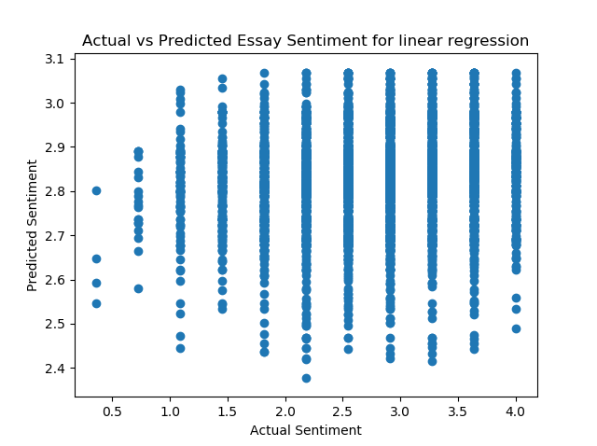
Question 1 - predictions
The Linear Regression and KNN regressor models from sklearn were used to investigate correlation between essay sentiment and income, education level and religious belief.
These results indicate little to no correlation and whilst KNN scored lower both scores are too low to draw a meaningful conclusion regarding model performance.
 | Linear Regressor | KNN Regressor
Score | 0.024 | 0.013
Mean Squared Error | 0.417 | 0.540
Time (s) | 0.3 | 64
# Relevant code
from sklearn.linear_model import LinearaRegression
features = ['mapped_education', 'mapped_religion', 'scaled_income', 'normalised_income', 'income', 'no_of_languages'] XC_train, XC_test, yc_train, yc_test = train_test_split(df_cleaned[features], df_cleaned['overall_sentiment'], test_size=0.2, random_state=1) lm = LinearRegression() lm.fit(XC_train, yc_train) yc_predict = lm.predict(XC_test) print("Train score: %f" % lm.score(XC_train, yc_train)) print("Test score: %f" % lm.score(XC_test, yc_test))
plt.scatter(yc_test, yc_predict) plt.xlabel("Actual Sentiment") plt.ylabel("Predicted Sentiment") plt.title("Actual vs Predicted Essay Sentiment for linear regression") plt.show()

Slide 11
Question 2
Can you predict the number of languages someone speaks from their education level?
Approach
Given the number of languages spoken in the speaks column determine what, if any, correlation there is to education level.
Limitations
Limited labelling accuracy for number of languages and education, how truthful people are in answering the questions.

Slide 12
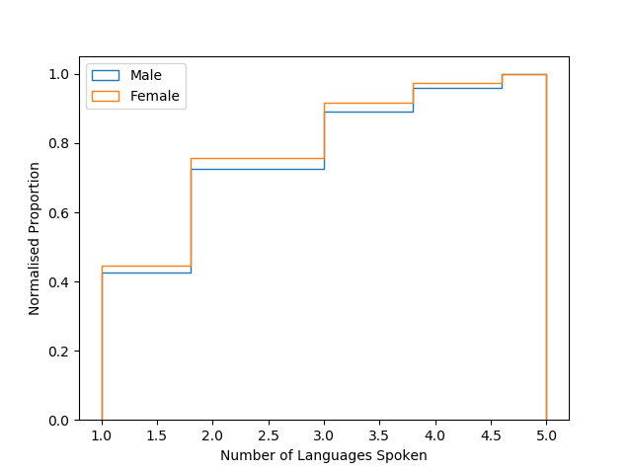
Question 2
The data for the number of languages was prepared by splitting the speaks data into number of languages.
print(df_cleaned['speaks’].head(10))
## OUTCOME
0 english
1 english (fluently), spanish (poorly), french (...
5 english (fluently), chinese (okay)
7 english, spanish (okay)
8 english
9 english (fluently)
11 english (fluently), sign language (poorly)
13 english
14 english
15 english (fluently), spanish (okay)
df_cleaned['no_of_languages'] = df_cleaned['speaks'].str.split(',').str.len()
plt.hist(male_data.no_of_languages, bins=10, histtype='step', density=True, fill=False, cumulative=True) plt.hist(female_data.no_of_languages, bins=10, histtype='step', density=True, fill=False, cumulative=True) plt.xlabel("Number of Languages Spoken") plt.ylabel("Normalised Proportion") plt.legend(['Male', 'Female'], loc='upper left') plt.show()

Slide 13
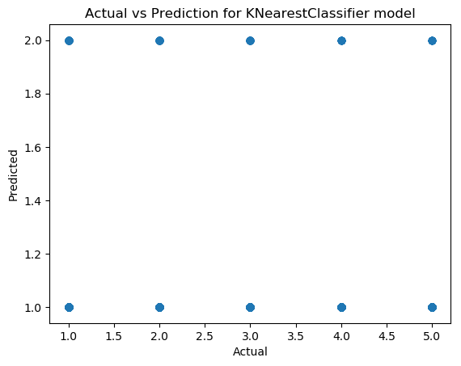
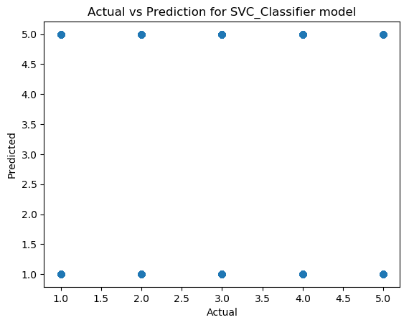
Question 2
The data was fit with sklearn’s K-Nearest Classifier and Support Vector Machine Classifier algorithms. A linear regressor was also run however it scored 0.007 with an mean squared error of 1.127.
Both models are fairly simple although SVM required considerably more time to run. The model metrics were:
 | KNN | SVM
Accuracy | 0.434 | 0.349
Recall | 0.434 | 0.349
Precision | 0.434 | 0.349
Time (s) | 91 | 209
Whilst the scores for KNN were higher the plot shows it only guessed two classes. This is likely due to the class imbalance where ~70% of entries spoke 1 or 2 languages. This was accounted for in the SVM model using class weights.
plt.hist(male_data.no_of_languages, bins=10, histtype='step', density=True, fill=False, cumulative=True) plt.hist(female_data.no_of_languages, bins=10, histtype='step', density=True, fill=False, cumulative=True) plt.xlabel("Number of Languages Spoken") plt.ylabel("Normalised Proportion") plt.legend(['Male', 'Female'], loc='upper left') plt.show()

Slide 14
Conclusions
Question 1
The sentiment of a tweet or sentence can be measured, with some confidence, using the Naïve Bayes algorithm trained with a sentiment based training set. However, there is virtually no correlation between this and the individual’s education level, religious belief and income.
Question 2
Some level of prediction can be made based on education but the models performed generally quite badly. KNN because it only predicted two of the five classes and SVM, despite predicting all classes scored lower. This suggest that the correlation is very weak as found with the linear regressor model which scored 0.007 with a mean squared error of 1.127.

Slide 15
Future Work
The first thing to investigate would be to refine the categorization of the education, religion and speaks data. For religion this would include further splitting the data by conviction of belief for speaks this would look at fluency in languages not just number.
Improve sentiment classification score using improved/alternative algorithms. Investigate whether a twitter training set is the most appropriate (use of words may well be different). Improve model optimization (sklearn’s gridsearchCV or similar) as only a single hyper parameter was investigated and only for a limited range of values.
Finally, work needs to be done to account for the class imbalance for KNN (either by balancing the set (removal or additional of entries) or by weighting.

