Slide 1





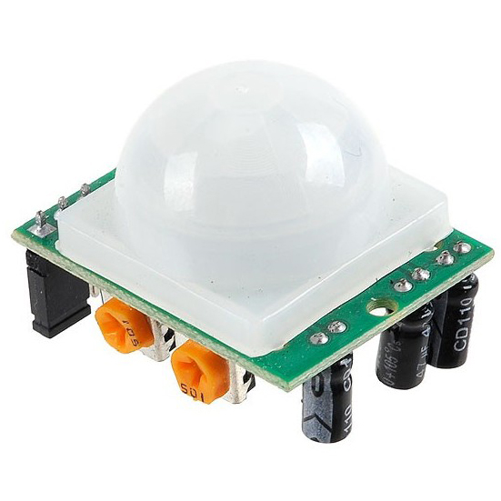
Raspberry Pi4(Raspbian)
Raspberry Pi4(webOS)
Database
Weather API
Face Recognition
User information
Image
Internal API (LS2)
External API
camera
Web Socket
PIR sensor
External device
Display device

