Slide 1
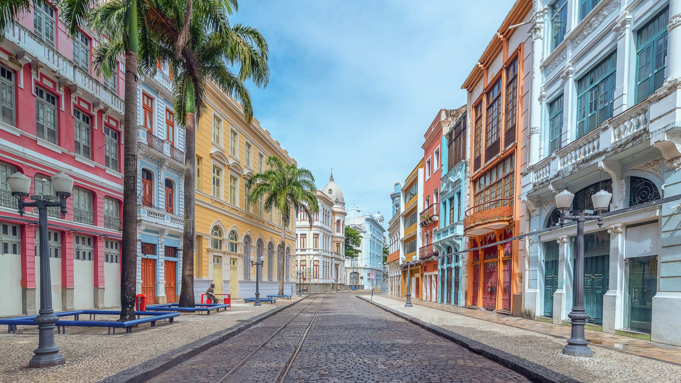
Machine Learning Final Project
Andrew Willy

Slide 2
Table of Contents
Business Background
Data Understanding and Data Exploration
Modelling and Evaluation
Deployment
Business Case study
Conclusion and Recomendation

Slide 3
Business Background

Slide 4
Background
We are a group of data scientist that currently are working with an organisations that currently trying to make Africa a better place with more consumable water. We are trying to reduce the time needed to check if the water is potable.

Slide 5
Business Objective
The objective of this project is to predict whether the water we analyze is safe to drink. So that people doesn’t get water poisoning by drinking the water. We are going to get fund from charity.

Slide 6
Expected Output
The output of this project is a prediction whether the water is potable or not.

Slide 7
Project Limitation
we are limited in time to make this project work and the data is also very minimum.

Slide 8
Analytic Approach
Performance Measures
Precision score, f1 score, recall score
To minimize the error of price predicition
Machine Learning Technique
Supervise learning (Classification)
To predict the potability of water

Slide 9
Data Understanding and Data Exploration

Slide 10
Data Collection
The dataset of water potability can be downloaded from Kaggle
Data Shape:
3276 rows
10 columns

Slide 11
Data Description
1. pH value:
PH is an important parameter in evaluating the acid–base balance of water. It is also the indicator of acidic or alkaline condition of water status. WHO has recommended maximum permissible limit of pH from 6.5 to 8.5. The current investigation ranges were 6.52–6.83 which are in the range of WHO standards.

Slide 12
Data Description
2. Hardness:
Hardness is mainly caused by calcium and magnesium salts. These salts are dissolved from geologic deposits through which water travels. The length of time water is in contact with hardness producing material helps determine how much hardness there is in raw water. Hardness was originally defined as the capacity of water to precipitate soap caused by Calcium and Magnesium.

Slide 13
Data Description
3. Solids (Total dissolved solids - TDS):
Water has the ability to dissolve a wide range of inorganic and some organic minerals or salts such as potassium, calcium, sodium, bicarbonates, chlorides, magnesium, sulfates etc. These minerals produced un-wanted taste and diluted color in appearance of water. This is the important parameter for the use of water. The water with high TDS value indicates that water is highly mineralized. Desirable limit for TDS is 500 mg/l and maximum limit is 1000 mg/l which prescribed for drinking purpose.

Slide 14
Data Description
4. Chloramines:
Chlorine and chloramine are the major disinfectants used in public water systems. Chloramines are most commonly formed when ammonia is added to chlorine to treat drinking water. Chlorine levels up to 4 milligrams per liter (mg/L or 4 parts per million (ppm)) are considered safe in drinking water.

Slide 15
Data Description
5. Sulfate:
Sulfates are naturally occurring substances that are found in minerals, soil, and rocks. They are present in ambient air, groundwater, plants, and food. The principal commercial use of sulfate is in the chemical industry. Sulfate concentration in seawater is about 2,700 milligrams per liter (mg/L). It ranges from 3 to 30 mg/L in most freshwater supplies, although much higher concentrations (1000 mg/L) are found in some geographic locations.

Slide 16
Data Description
6. Conductivity:
Pure water is not a good conductor of electric current rather’s a good insulator. Increase in ions concentration enhances the electrical conductivity of water. Generally, the amount of dissolved solids in water determines the electrical conductivity. Electrical conductivity (EC) actually measures the ionic process of a solution that enables it to transmit current. According to WHO standards, EC value should not exceeded 400 μS/cm.

Slide 17
Data Description
7. Organic_carbon:
Total Organic Carbon (TOC) in source waters comes from decaying natural organic matter (NOM) as well as synthetic sources. TOC is a measure of the total amount of carbon in organic compounds in pure water. According to US EPA < 2 mg/L as TOC in treated / drinking water, and < 4 mg/Lit in source water which is use for treatment.

Slide 18
Data Description
8. Trihalomethanes:
THMs are chemicals which may be found in water treated with chlorine. The concentration of THMs in drinking water varies according to the level of organic material in the water, the amount of chlorine required to treat the water, and the temperature of the water that is being treated. THM levels up to 80 ppm is considered safe in drinking water.

Slide 19
Data Description
9. Turbidity:
The turbidity of water depends on the quantity of solid matter present in the suspended state. It is a measure of light emitting properties of water and the test is used to indicate the quality of waste discharge with respect to colloidal matter. The mean turbidity value obtained for Wondo Genet Campus (0.98 NTU) is lower than the WHO recommended value of 5.00 NTU.

Slide 20
Data Description
10. Potability:
Indicates if water is safe for human consumption where 1 means Potable and 0 means Not potable.

Slide 21
Splitting Dataset
We split the data 80% for training and 20% for validating to simulate the real world.

Slide 22
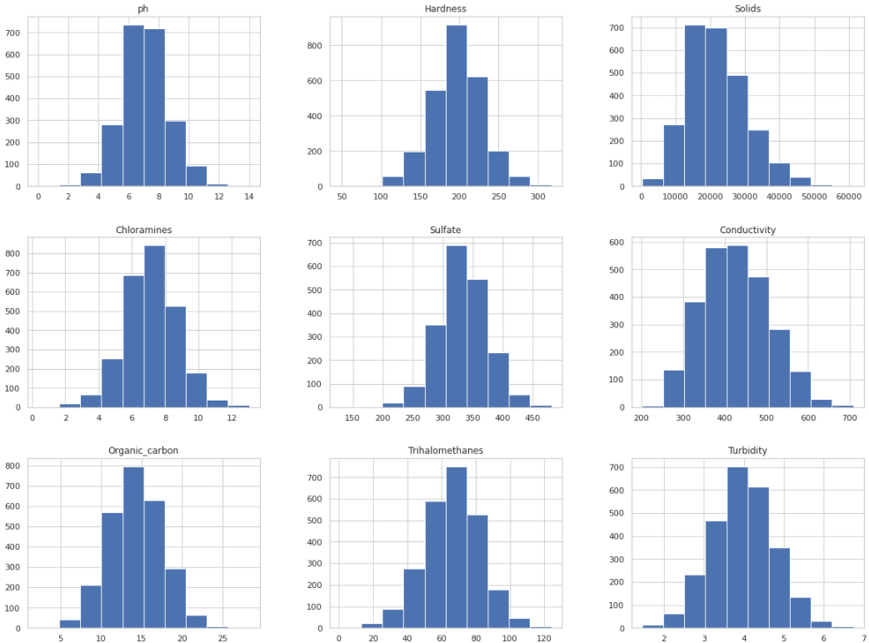
Data Distribution
The chart show that almost every data is normal distribution except conductivity which is a little bit right skewed.

Slide 23
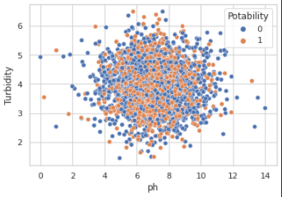
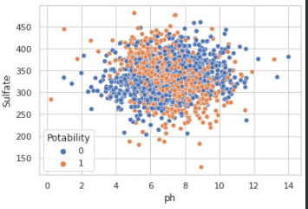
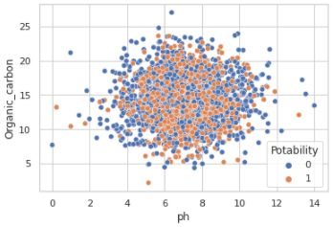
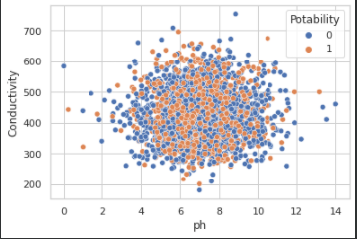
Features on Potability
This is the correlation between the features and the target

Slide 24
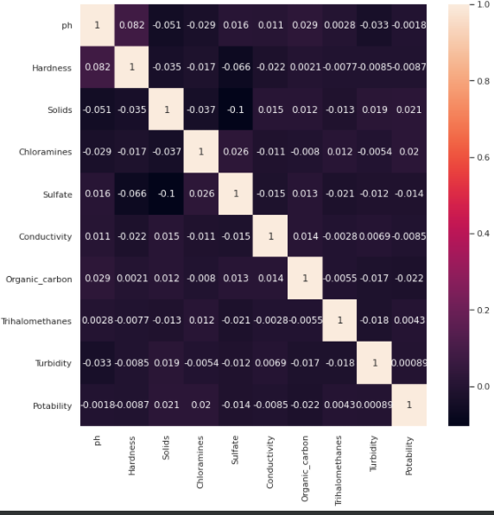
HeatMap

Slide 25
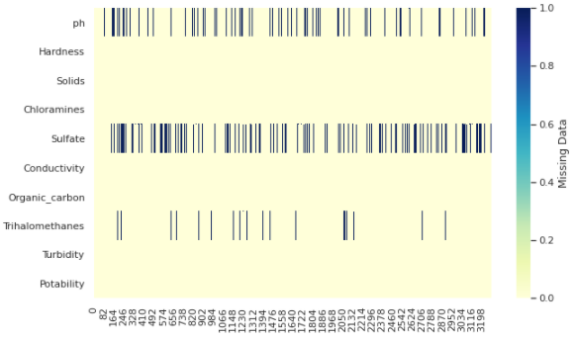
Handlin Missing Data
We try to impute the missing data with it mean

Slide 26
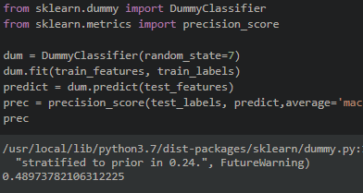
Modelling and Evaluation
BaseLine Model

Slide 27
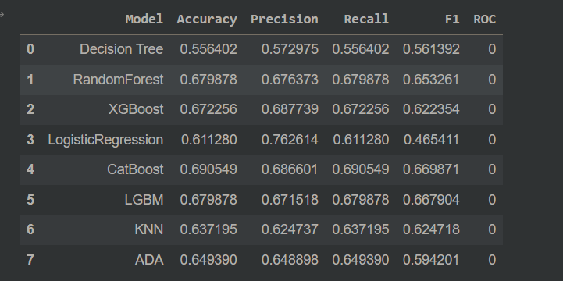
Training Model
We are focusing on accuracy of the model so we choose random forest

Slide 28
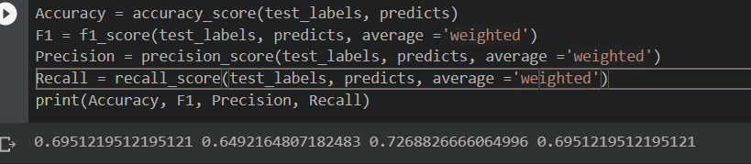

Tuning Result
The top one is Cat Boost
The bottom one is Random Forest

Slide 29
Deploy
Streamlit
Github
Heroku
Client

Slide 30
Conclusion and Recommendation
After testing several models, we conclude that CatBoost performed the best with accuracy of 69,5% on unseen data, which has been improved by 41% from baseline model.

Slide 31
Recommendation
You can try to find another dataset to join with this dataset
You can have a lot more data.
You can try another model to be tuned.

Slide 32
Thank you

