Slide 1



Data Cleaning with Pandas: A Comprehensive Guide
Data cleaning is a fundamental aspect of any data analysis workflow. It involves identifying and addressing inconsistencies, errors, and missing values in your dataset. Pandas, a powerful Python library, offers a rich set of tools for handling these challenges efficiently. This guide will delve into various data cleaning techniques using Pandas, providing practical examples and insights to enhance your data preparation skills.
by MENGAYE YECHALE

Slide 2
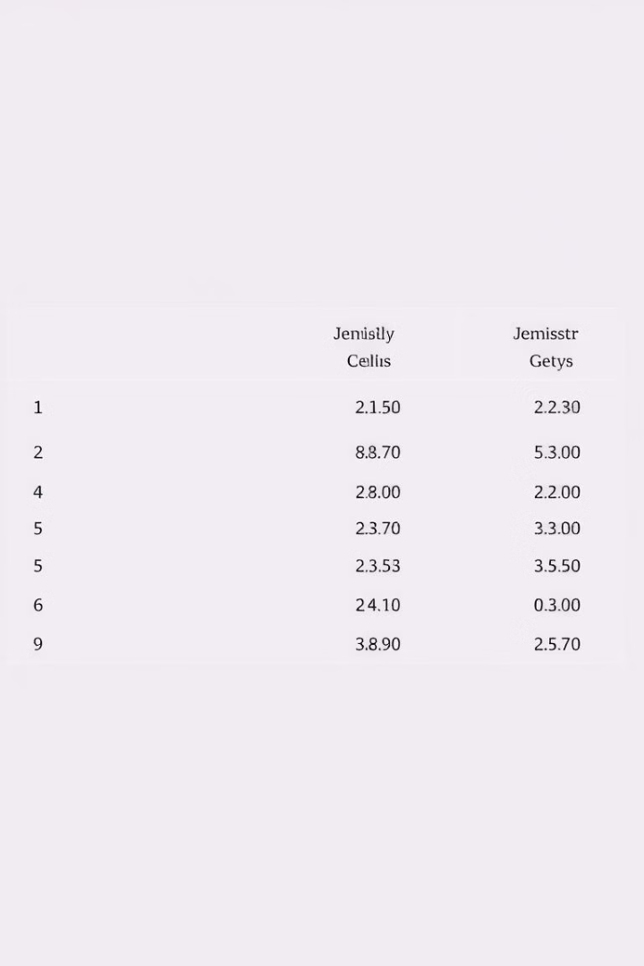
Handling Missing Data (NaN Values)
1
Identifying Missing Values
Missing data, often represented as NaN (Not a Number), can significantly impact data analysis. Pandas provides convenient methods to detect and analyze missing values.
2
Dropping Rows with Missing Data
If missing values are deemed insignificant or too numerous, dropping rows containing missing data can simplify your dataset. The `dropna()` function allows you to remove rows with any missing values or specify columns for dropping.
3
Filling Missing Values
Instead of dropping rows, you can fill in missing values with a specific value or by using imputation methods. `fillna()` allows you to replace NaN values with a constant, mean, median, or other strategies based on the nature of your data.

Slide 3
Removing Duplicates
Identifying Duplicates
Removing Duplicates
Duplicate entries can distort your analysis by inflating the count of certain data points. The `duplicated()` function identifies rows that are identical to a previous row in the DataFrame.
The `drop_duplicates()` function eliminates duplicate rows, ensuring that each row in your DataFrame represents a unique data point. You can specify columns to consider for duplication identification.

Slide 4
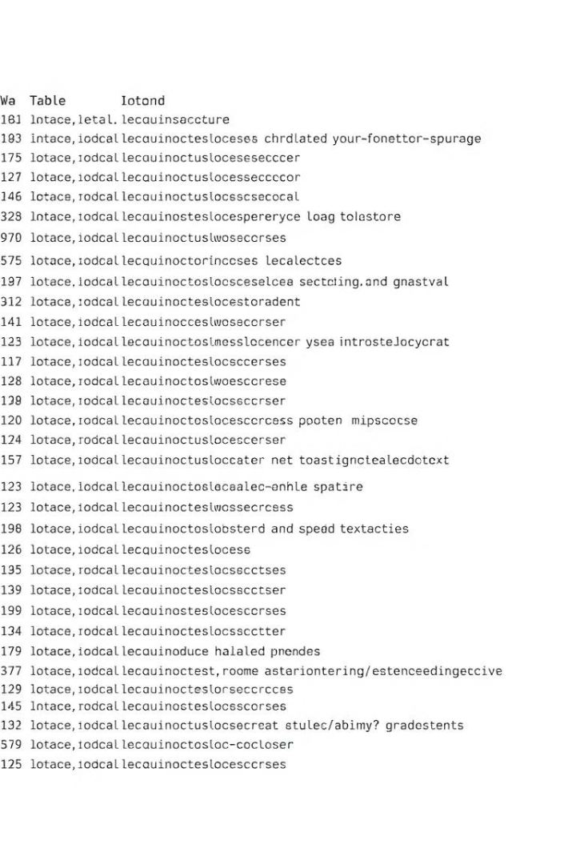



Standardizing Text Data
Inconsistent Text Formats
Text data often comes in various formats, such as capitalization differences, leading or trailing spaces, and inconsistent spellings. This inconsistency can hinder analysis.
Standardizing Text
Use methods like `str.strip()` to remove leading and trailing spaces, `str.title()` to capitalize the first letter of each word, and `str.lower()` or `str.upper()` for case conversions.
Replacing Specific Values
The `replace()` function enables you to systematically replace specific text values with desired replacements. This ensures consistent representation across your dataset.

Slide 5


Handling Inconsistent Data
Data Type
Example
Reason for Inconsistency
Solution
Numeric
'10.5', '10,5', '10.50'
Different decimal separators or formatting
Use `to_numeric()` with `errors='coerce'` to convert strings to numbers.
Date
'2023-03-15', '15/03/2023', 'March 15, 2023'
Different date formats
Use `to_datetime()` with appropriate format parameters.
Categorical
'Male', 'male', 'M'
Inconsistent capitalization or abbreviations
Use `str.lower()` or `str.upper()` for standardization.

Slide 6




Identifying Outliers
Descriptive Statistics
Use `describe()` to examine summary statistics like mean, median, minimum, and maximum values. Outliers might be evident as extreme values.
Visualizations
Visualizations like box plots and scatter plots can help identify data points that deviate significantly from the general pattern.
Domain Knowledge
Leverage your understanding of the data's context to determine if unusual values are genuine outliers or potentially valid data points.

Slide 7


Removing Outliers
Understanding Outlier Impact
Determine if outliers are due to errors or represent genuine extreme values. Understand their potential impact on statistical analysis and model performance.
1
2
Filtering Data
Use logical

