Slide 1



Data Visualization Using Only Pandas: A Detailed Guide
Pandas provides a powerful and flexible way to perform data visualization directly from your DataFrame. With Pandas, you can create various types of plots like line plots, bar plots, histograms, scatter plots, box plots, and pie charts without explicitly importing other plotting libraries like Matplotlib. The plot() method in Pandas is built on top of Matplotlib, making it a convenient tool for quick and simple visualizations.
by MENGAYE YECHALE

Slide 2
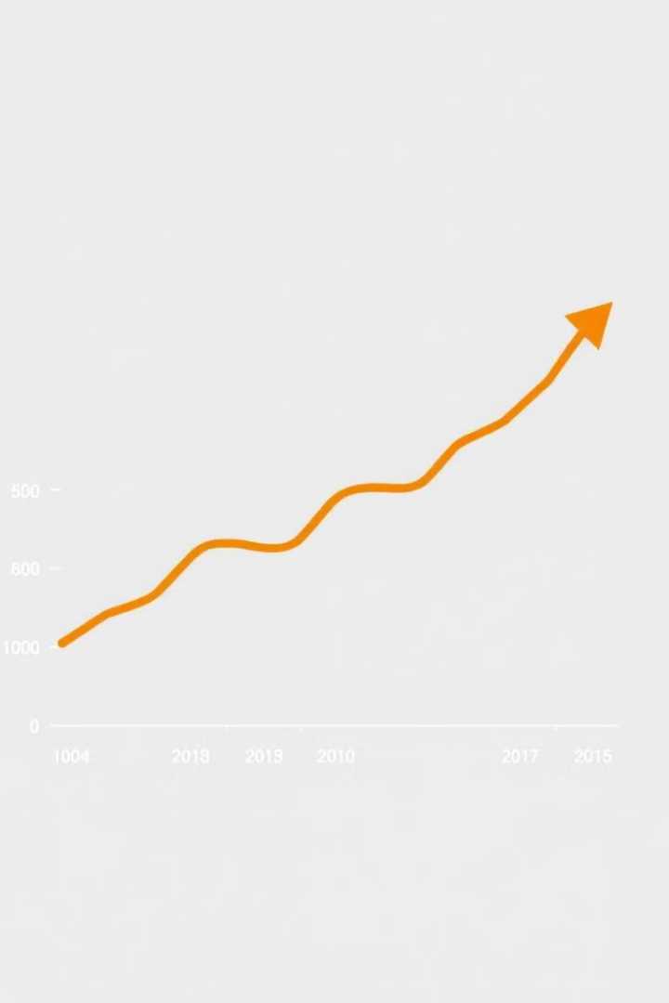
Line Plot
1
Purpose
A line plot is useful for visualizing trends over time or continuous data.
2
Example
python Copy code import pandas as pd # Sample data data = { 'Date': \['2024-01-01', '2024-01-02', '2024-01-03', '2024-01-04'\], 'Sales': \[100, 150, 120, 180\] } df = pd.DataFrame(data) # Creating a line plot df.plot(x='Date', y='Sales', title='Sales Over Time', ylabel='Sales')
3
Explanation
x='Date' specifies the column to be used for the x-axis. y='Sales' specifies the column to be used for the y-axis. title='Sales Over Time' adds a title to the plot. ylabel='Sales' labels the y-axis.

Slide 3
Bar Plot
Purpose
Example
Explanation
Bar plots are ideal for comparing different categories or groups.
python Copy code import pandas as pd # Sample data data = { 'Product': \['A', 'B', 'C', 'D'\], 'Revenue': \[1000, 1500, 1200, 1800\] } df = pd.DataFrame(data) # Creating a bar plot df.plot(x='Product', y='Revenue', kind='bar', title='Revenue by Product', ylabel='Revenue')
kind='bar' specifies that the plot should be a bar plot. The x-axis represents the different products, and the y-axis shows the corresponding revenue.

Slide 4
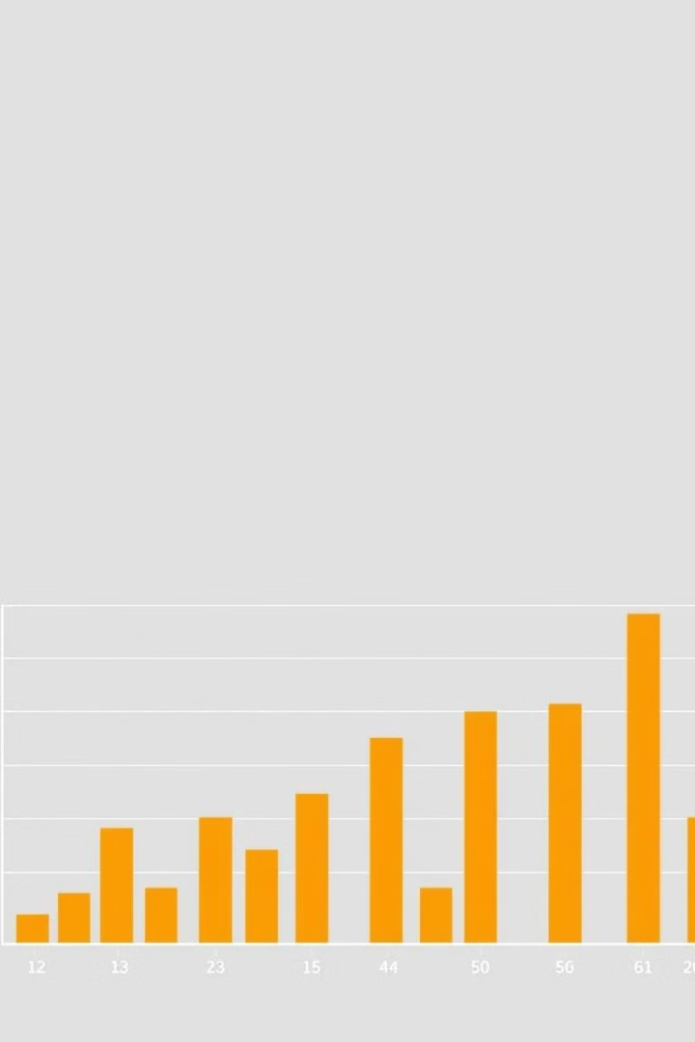
Histogram
1
Purpose
Histograms are useful for showing the distribution of a single numerical variable.
2
Example
python Copy code import pandas as pd # Sample data data = { 'Revenue': \[1000, 1500, 1200, 1700, 1600, 1300, 1400, 1900\] } df = pd.DataFrame(data) # Creating a histogram df\['Revenue'\].plot(kind='hist', bins=5, title='Revenue Distribution', xlabel='Revenue')
3
Explanation
kind='hist' specifies that the plot should be a histogram. bins=5 divides the data into 5 intervals. xlabel='Revenue' labels the x-axis.

Slide 5
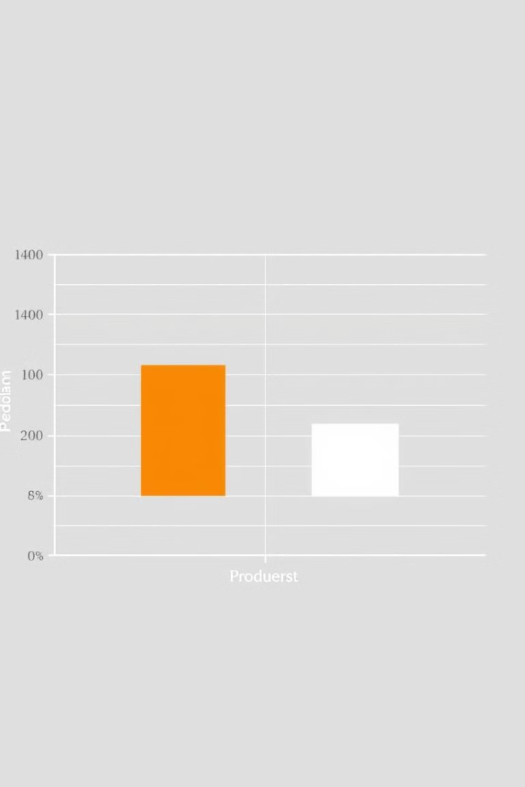
Box Plot
Purpose
Box plots are useful for visualizing the distribution and identifying outliers in your data.
Example
python Copy code import pandas as pd # Sample data data = { 'Product A': \[100, 120, 130, 140, 150\], 'Product B': \[80, 90, 100, 110, 120\] } df = pd.DataFrame(data) # Creating a box plot df.plot(kind='box', title='Box Plot for Product A and Product B')
Explanation
kind='box' specifies that the plot should be a box plot. This plot helps you see the median, quartiles, and potential outliers in the data.

Slide 6
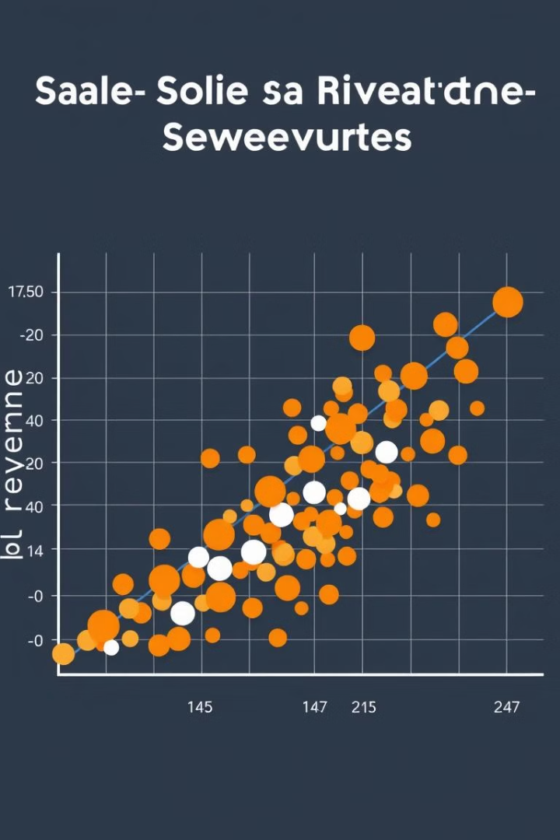
Scatter Plot
Purpose
Scatter plots are used to show the relationship between two numerical variables.
Example
python Copy code import pandas as pd # Sample data data = { 'Sales': \[100, 150, 200, 250, 300\], 'Revenue': \[1000, 1500, 2000, 2500, 3000\] } df = pd.DataFrame(data) # Creating a scatter plot df.plot(x='Sales', y='Revenue', kind='scatter', title='Sales vs. Revenue', xlabel='Sales', ylabel='Revenue')
Explanation
kind='scatter' specifies that the plot should be a scatter plot. This plot allows you to see if there is a correlation between Sales and Revenue.

Slide 7
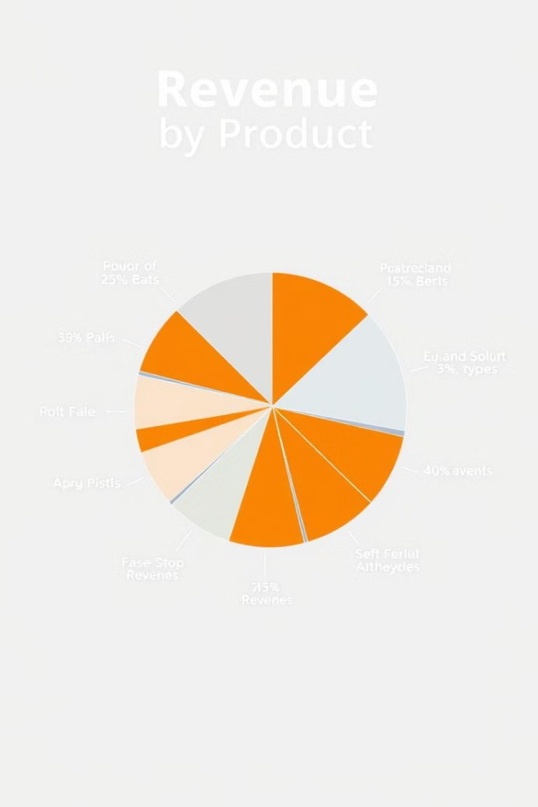



Pie Chart
Purpose
Pie charts are useful for showing the proportion of different categories within a whole.
Example
python Copy code import pandas as pd # Sample data data = { 'Product': \['A', 'B', 'C', 'D'\], 'Revenue': \[1000, 1500, 1200, 1800\] } df = pd.DataFrame(data) # Creating a pie chart df.set\_index('Product').plot(kind='pie', y='Revenue', autopct='%1.1f%%', title='Revenue Distribution by Product')
Explanation
set\_index('Product') is used to set the Product column as the index because the pie chart requires an index. kind='pie' specifies that the plot should be a pie chart. autopct='%1.1f%%' adds percentage labels to the slices.

Slide 8






Summary
Line Plot
Bar Plot
Histogram
Box Plot
Used for trends over time.
Best for comparing different categories.
Useful for understanding the distribution of data.
Helps in identifying the spread and outliers in data.
Scatter Plot
Pie Chart
Shows the relationship between two numerical variables.
Illustrates the proportion of parts to a whole.

