Slide 1
Data Model Explorer
From the data-model workbook to a Dataverse solution, in one offline page
Notes:
This deck walks through the Data Model Explorer: what problem it solves, how you use it to review and edit the data model, and how it turns the workbook into a Dataverse solution you import with one script.

Slide 2
Where we start: a manual process
Reviewing
Versions
Building
Hundreds of tables and thousands of fields, checked by eye for gaps and broken lookups.
New copies of the workbook arrive; working out what changed, and keeping review notes, is guesswork.
Every table, field and relationship is then created again by hand in Power Apps.
Notes:
The workbook is the source of truth for the data model, but reviewing it, tracking versions and building it in Dataverse have all been manual, slow and easy to get wrong.

Slide 3
One HTML file that does four jobs
Review
Edit
Overview, search, filters by area, automatic checks and the ERD.
Change values, add fields and relationships, set primary keys and table details.
Compare
Build
Load a newer version of the workbook, see what changed, and keep your edits.
Generate a Dataverse solution and import it with one PowerShell script.
Nothing to install, works offline, nothing is uploaded.
Notes:
It is a single HTML file. Open it in Chrome or Edge, drop the workbook on it, and it works entirely in the browser: no install, no server, and the workbook never leaves the machine.

Slide 4
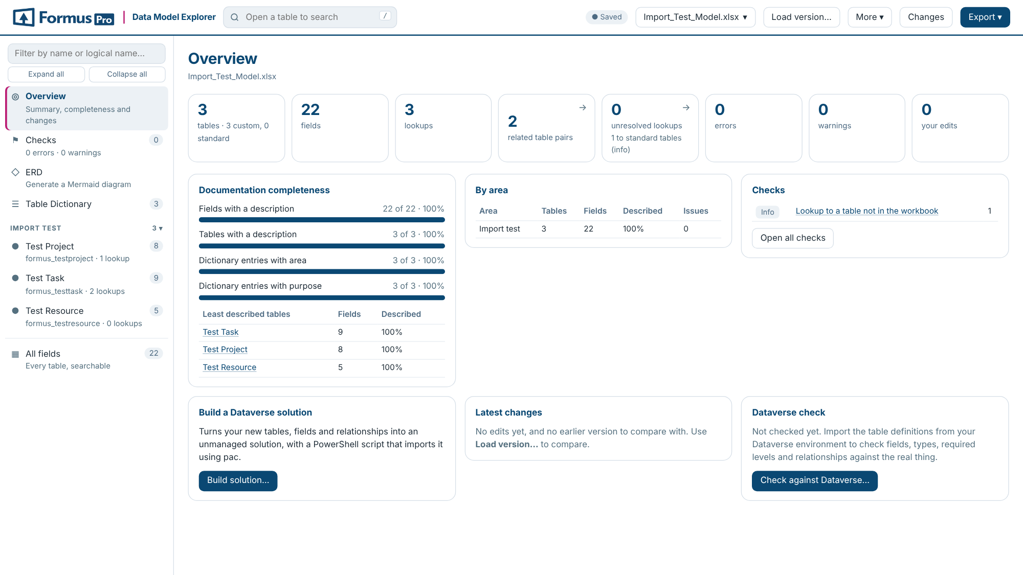
The model at a glance
Size of the model
Tables, fields, lookups and how they connect
How complete it is
Descriptions, areas and purposes, per table and area
What needs attention
Checks, latest changes, and one click to build the solution
Notes:
The Overview is the landing page once a workbook is open. It sizes the model, shows how complete the documentation is, and links straight to the checks and the solution builder. The screenshot shows the three-table import test model.

Slide 5
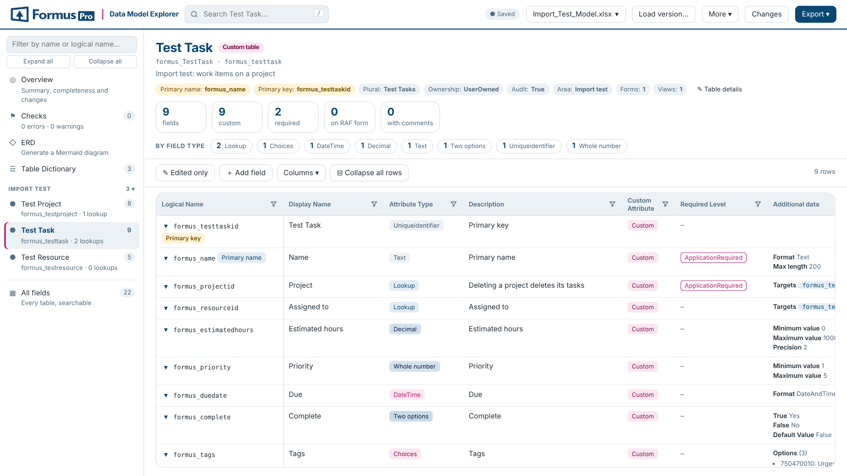
Search and edit every table
Find anything
Search, filter any column or area, or list every field at once
Edit in place
Double-click a cell; edits are kept in the browser and can be reverted
Keys marked
Primary key and primary name are tagged, and can be set on any field
Notes:
Each table tab in the workbook becomes a page: its details across the top, counts by field type, and the field list. Any column can be filtered. Edits are kept in the browser, highlighted, and listed in Changes, where each one can be reverted.

Slide 6
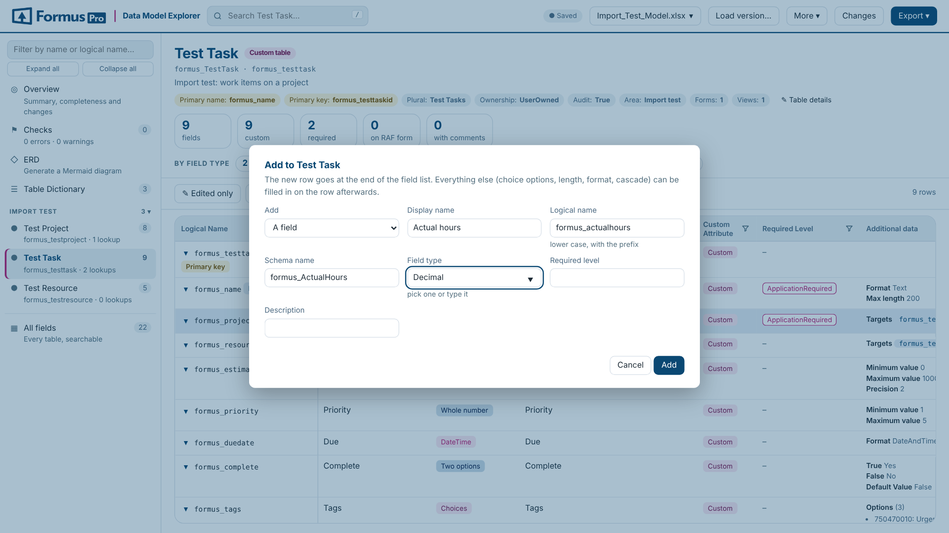
Add fields and relationships
Names suggested
Logical and schema names follow the display name, with your prefix
Lookups and N:N
Pick the related table; the relationship type is filled in
Template kept
Columns and table details the template has are added if missing
Notes:
Add field puts a new row at the end of a table’s field list. For a lookup or an N:N relationship it asks for the related table and records the relationship type. A workbook made from an older template gets the template’s missing columns, such as Relationship Type, so they can be filled in here.

Slide 7
Checks catch problems early
Severity | Examples
Error | Missing logical name or primary name column; duplicated field; primary key that isn’t a unique identifier
Warning | Lookup with no target table; relationship type or cascade that isn’t valid; field with no type
Info | Lookup to a standard table that has no tab; relationship type still to review; fields to build by hand
Checks update as you edit, filter by area and export to CSV. Optionally, compare the workbook with the live Dataverse environment.
Notes:
Checks run automatically over the whole model and recalculate after every edit. Each finding links to the table and field. With metadata saved from the Dataverse environment, the page also compares the workbook with what is really there.

Slide 8
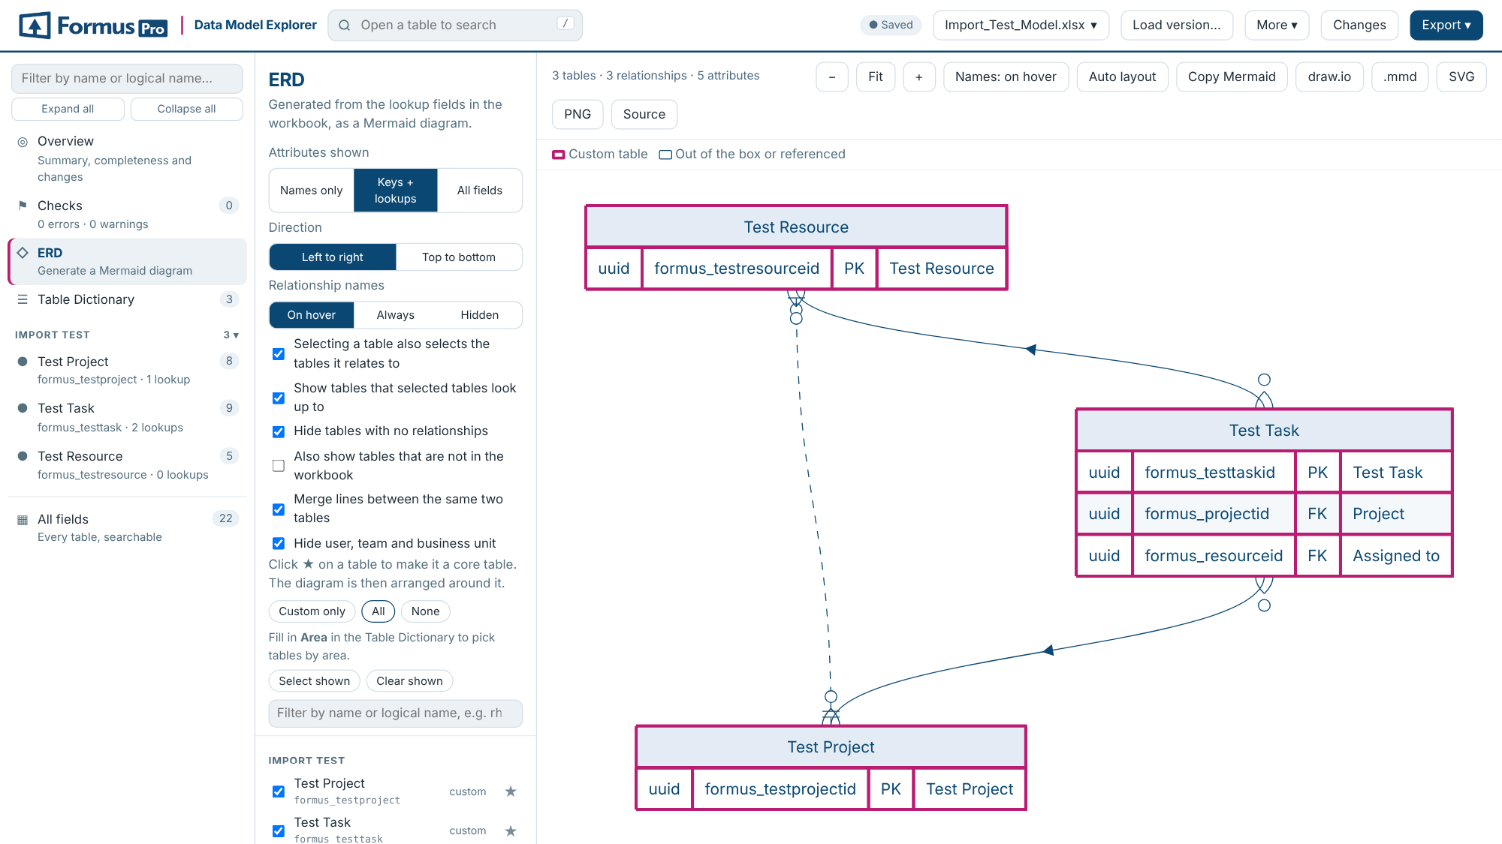
An ERD drawn from the lookups
Pick what to draw
By area, by table, or around one core table
Honest lines
Ends show one or many only where the relationship type is recorded
Take it with you
Export to draw.io, SVG, PNG or Mermaid
Notes:
The diagram is generated from the lookup fields, so it always matches the workbook. Tables can be dragged, and layouts are remembered. A relationship whose type isn’t recorded is drawn as a plain line and flagged for review, rather than guessed.

Slide 9
New versions keep your edits
When a new version arrives
Saving back safely
1. Load it: every difference is listed, from tables and fields to values, columns and relationships.
2. Your edits carry over. Where the new version changed a value you edited, you choose which to keep.
3. Each workbook keeps its own edits, so two clients’ models never mix.
Only the cells you edited are rewritten; formatting, validations and everything else stay as they were.
The file is read back and every edit checked. If any edit can’t be written, nothing is saved and your edits are kept.
Every download asks for a file name, suggesting the next version number.
Notes:
Loading a newer copy of the workbook compares it with the open one and carries your edits over. Saving back to the original only rewrites the cells you changed, then reads the file back to confirm every edit landed; if any can’t be written, nothing is saved and the edits are kept.

Slide 10
From workbook to Dataverse
One download holds
Workbook
Checked in the page
The unmanaged solution: tables, fields and relationships
import.ps1: installs pac if needed, signs in, imports
build-report.csv: everything included, left out or to build by hand
The list of calculated and rollup fields to create by hand
Generate
Name, version and publisher
import.ps1
Run in PowerShell
Development environment
Then export as managed
Notes:
Export, Dataverse solution, generates an unmanaged solution from the workbook in the browser. The download holds the solution zip, import.ps1, build-report.csv and the calculated and rollup fields list. import.ps1 installs the Power Platform CLI if needed, opens a browser to sign in, and imports. Import into development first, then export as managed for test and production.

Slide 11
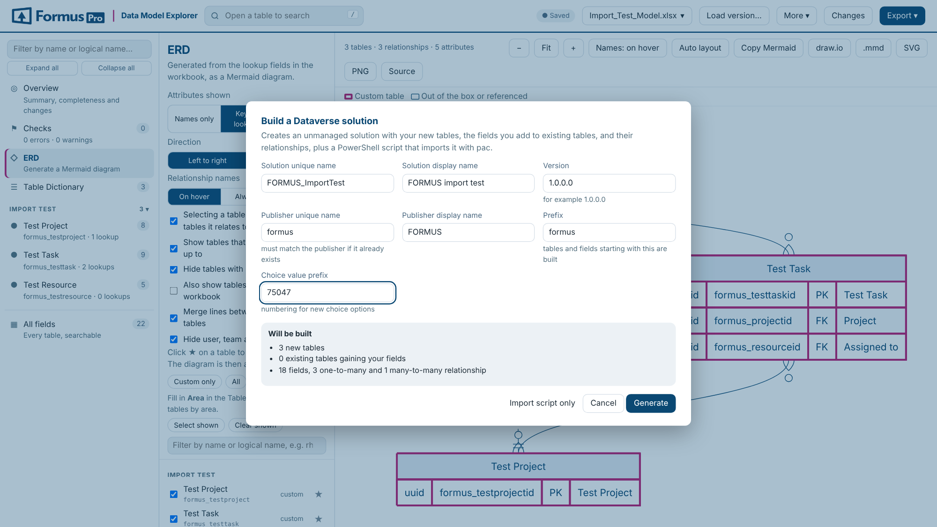
See what will be built first
Built for you
New tables with name and key, fields of every common type, lookups and N:N
Your fields on standard tables
Added without changing anything else about them
Listed to do by hand
Calculated and rollup fields, activity tables, image and file fields
Notes:
The dialog suggests the prefix and choice value prefix from the workbook. The publisher unique name must match the publisher already in the environment, or a second one is created. Anything that can’t be built is listed in build-report.csv with the reason, and calculated and rollup fields come as a per-table workbook to create by hand.

Slide 12
Tested, and now in real imports
How it is tested
Where it stands
230 automated tests run on every change.
Generated solutions are unpacked and re-packed with Microsoft’s own packaging tool.
The solution XML was compared element by element with solutions exported by Dataverse.
The first import into development stopped on a missing table label. That is fixed in version 1.9.1.
Next: re-run the three-table import test in development.
Then: build the full model.
Notes:
The page has 230 automated browser tests. Generated solutions pass Microsoft’s SolutionPackager unpack and pack, and their XML was compared with solutions exported by Dataverse. The first import into a development environment stopped on a missing table plural-name label; that is fixed in version 1.9.1, and the import test is being re-run.

Slide 13
Getting started
1
2
3
4
Open the Data Model Explorer HTML file in Chrome or Edge
Drop the data-model workbook on it, or a metadata export
Work through Checks until there are no errors
Build the solution and run import.ps1 against development
Notes:
The file is in the SharePointPCF repository under data-model-explorer, with a README and the import test workbook. Start with the import test model to see the whole flow end to end before using a real model.

