Slide 1
Data Model Explorer
Feature guide · version 1.9.3
Notes:
A detailed tour of every feature of the Data Model Explorer, section by section, with screenshots from the three-table import test model. The shorter overview deck covers the why; this one covers the how.

Slide 2
Contents
01
02
03
Getting started
Reviewing the model
The ERD
Opening workbooks, where they are kept, and the template
The Overview, browsing and searching, Checks, and comparing with Dataverse
Choosing tables, reading the lines, hiding relationships, and exports
04
05
06
Editing
Versions and saving
Building in Dataverse
Values, keys and table details, adding fields and relationships, and the change list
Loading a newer workbook, exporting, and saving back safely
The solution builder, what it creates, importing, and what to do after
Notes:
Six sections, following the order you use the page in: get the workbook in, review it, draw it, edit it, keep versions and save, then build it in Dataverse.

Slide 3
How it is built
One file
Offline and private
Data_Model_Explorer.html holds everything: the app, the libraries and the empty template. Open it in Chrome or Edge.
Nothing is installed or uploaded. Workbooks and edits stay in this browser profile only.
Template-driven
Safe with your files
Columns, table details and dropdowns come from the FormusPro template, which you can replace.
Only the cells you change are written, and the file is read back and checked before it is saved.
Notes:
Four design choices run through every feature. Because the HTML file holds only the empty template, it can be shared freely: anyone who opens it starts with nothing of yours.

Slide 4
01
Getting started
Opening workbooks, where they are kept, and the template
Notes:
Section 1: Getting started. Opening workbooks, where they are kept, and the template.

Slide 5
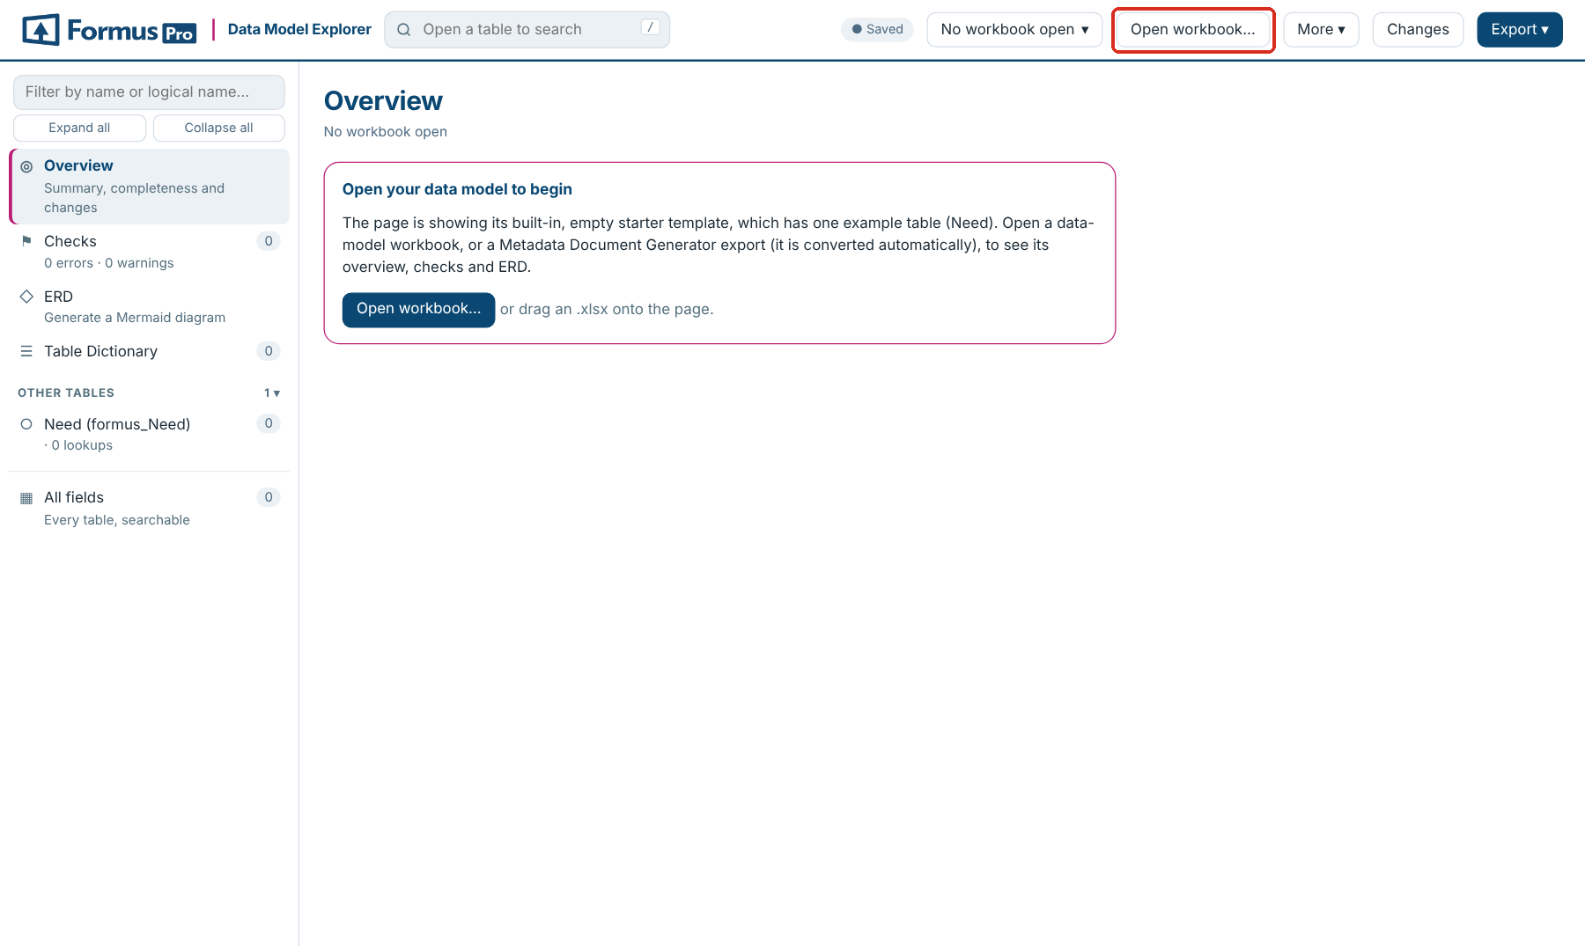
Opening a workbook
Open or drop
Click Open workbook… in the header, or drag the .xlsx onto the page
Metadata exports converted
A Metadata Document Generator export is converted to the template layout, with progress shown
Lands on the Overview
Tables are listed in the sidebar, grouped by area from the Table Dictionary
Chrome or Edge
Needed to save back to the original file; everything else works in any modern browser
Notes:
The first time, the page shows the empty template and says so. A workbook already in the template layout opens straight away; a Metadata Document Generator export is converted first and keeps the export’s name.

Slide 6
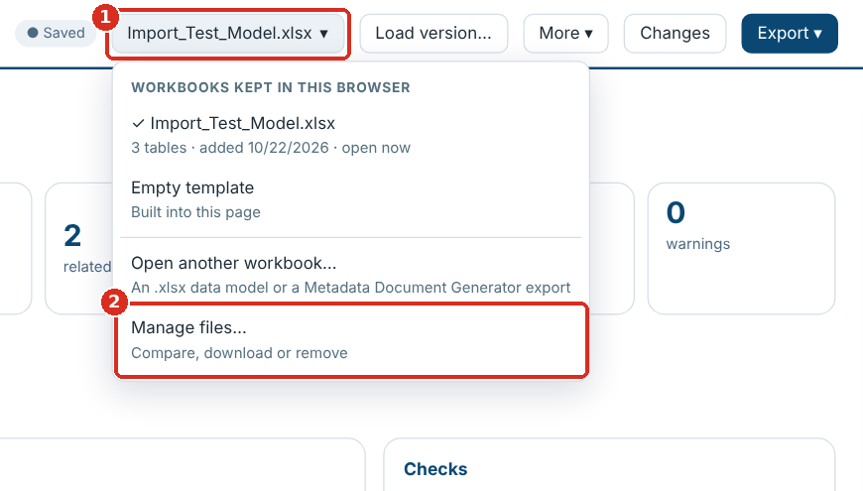
Several workbooks, kept apart
Newer or different?
Opening a second file asks: a newer version carries your edits over; a different workbook gets its own
Switch any time
The workbook selector in the header lists every workbook kept in this browser
Manage files…
Shows them all, and Remove all… clears them
Where it is kept
Workbooks in IndexedDB, edits and layouts in local storage. Saved in the header confirms it
Notes:
Edits are kept per workbook, so two clients’ models never mix. Nothing is kept in the HTML file itself: send it to someone and they start with the empty template.

Slide 7
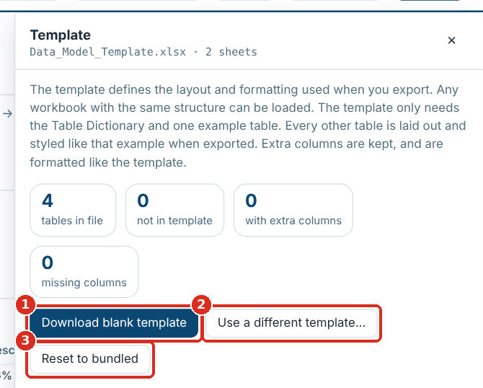
The template behind the page
Built in
The current FormusPro template sets the columns, table details and dropdown options
Check a workbook
More ▾ → Template lists tables, columns and details that differ from it
Older workbooks upgraded
Missing columns and details are added in the page, marked added, and written when filled in
Use your own
Download blank template, change it in Excel, then Use a different template…
Notes:
Opening a workbook made from an older template adds the columns and table details it lacks, such as Relationship Type, Cascade Delete and Primary Name Column. A pink count on the Template button shows how many tables differ. Reset to bundled goes back to the built-in template.

Slide 8
What a template change does
Change in the template | Effect in the page
A new column in the header row | Read, shown, filterable and editable; added to workbooks that lack it
Text in the hint row above a column | Shown as the column’s tooltip and written with the column
An Excel data-validation list | Its options become the column’s dropdown
A new label row in the table details | Shown in ✎ Table details and added to tables that lack it
Fonts, colours, widths | Used by New version in template format
Keep the layout when editing the template: the Table Dictionary, and one example table tab with its detail rows, hint row and header row starting Logical Name, Schema Name. A new column needs a code change only if the solution builder or a check should use it.
Notes:
The template is the contract between the workbook and the page. Most changes take effect without any change to the page: reopen the workbook or reload the page after switching templates.

Slide 9
02
Reviewing the model
The Overview, browsing and searching, Checks, and comparing with Dataverse
Notes:
Section 2: Reviewing the model. The Overview, browsing and searching, Checks, and comparing with Dataverse.

Slide 10
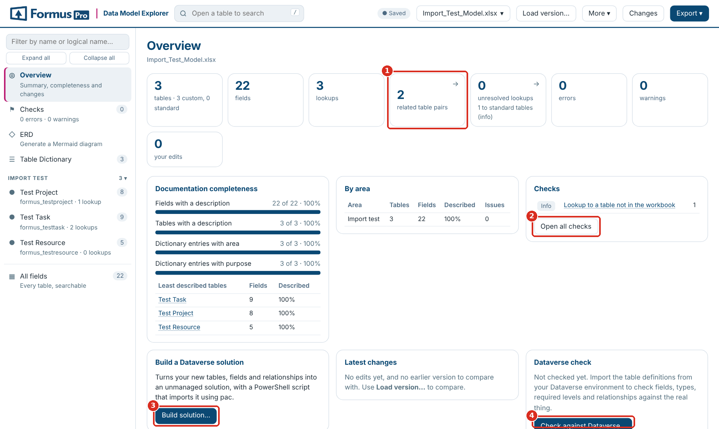
The Overview
Counts that open lists
Tables, fields, lookups, related pairs, unresolved lookups, errors, warnings, your edits
Completeness
Descriptions, areas and purposes, and the least described tables
By area
Tables, fields, how much is described and issues, per area
Shortcuts
Open all checks, Build solution… and Check against Dataverse…
Notes:
The landing page once a workbook is open. When the page reopens a workbook from last time, the Overview says which one, so you can switch if it isn’t the one you want. Latest changes shows your recent edits, or the differences from the previous version.

Slide 11
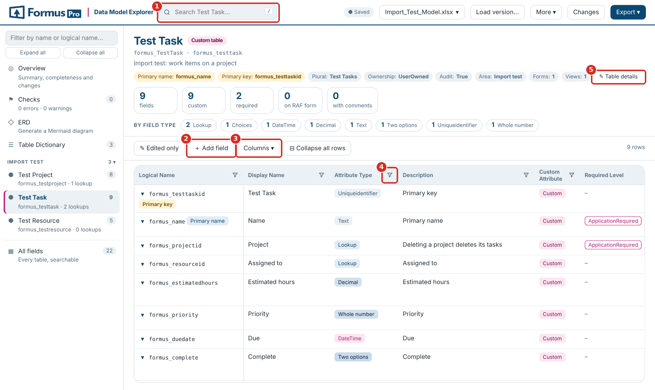
Browsing and searching
Every tab is a page
Details along the top, counts by field type, then the field list
Search and filter
The header search (shortcut /), a funnel on every column, Edited only, Area
All fields
Every field of every table in one searchable list
Your view
Columns ▾ shows or hides columns; expand or collapse long rows
Notes:
Schema Name, Type and Relationship Name are hidden by default and can be shown from Columns. Active filters show above the grid with a × to clear each one. Clicking a field-type count filters to that type.

Slide 12
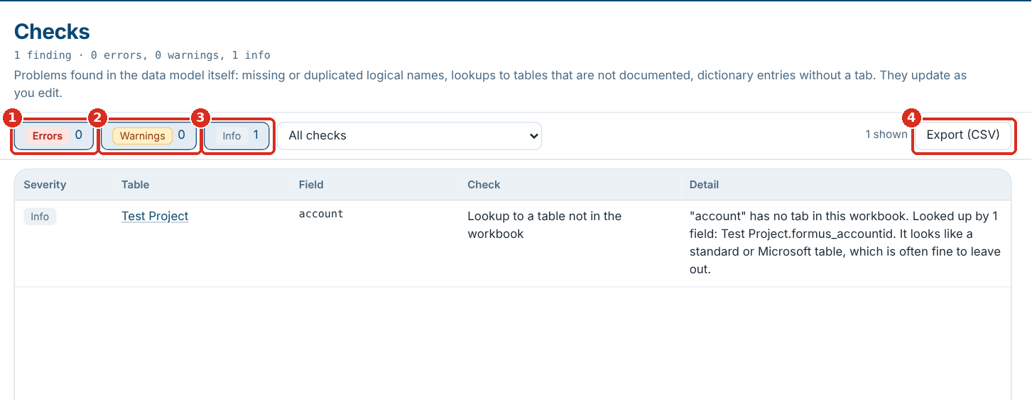
Checks
Always current
Runs over the whole model and updates as you edit
Straight to the field
Each finding names the table and field and opens it when clicked
Filter
Errors, Warnings and Info with counts, plus Area and search
Share
Export (CSV) downloads the list
Notes:
Clear the errors before building a solution: a table with an error is not built. Checks starting “Dataverse” appear only after loading Dataverse metadata.

Slide 13
What Checks look for
Severity | Check | How to fix it
Error | No primary name column, or not in the field list, or not single-line text | Set as primary name on a Text field
Error | Primary key is not a unique identifier | Keep the table name + id; use an alternate key
Error | Missing logical name; duplicate field or tab; relationship name used twice | Fill in, remove or rename
Warning | No attribute type; lookup without targets or to a table not in the workbook | Fill in Attribute Type or Targets:
Warning | Relationship type or cascade not valid; N:N with an unknown table | N:1 on lookups, N:N on relationship rows
Warning | Table Dictionary and tabs don’t match | Match the dictionary to the tabs
Info | Relationship type not recorded; calculated or rollup field to build by hand | Set N:1 once confirmed; nothing to fix
Info | Logical name format; custom field without prefix; no primary key listed | Usually Microsoft’s own fields
Notes:
The full list, with every check, is in the user guide. Errors block the build for that table, warnings are worth fixing before you build, and info findings are for review.

Slide 14
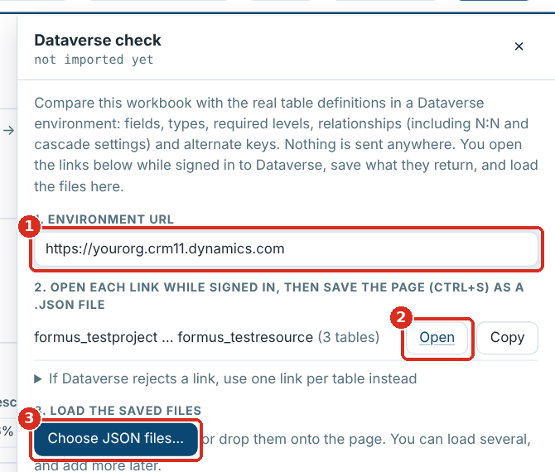
Comparing with Dataverse
Enter the environment
The page builds one metadata link per 20 tables
Open and save
Open each link while signed in and save it (Ctrl+S) as .json
Load the files
Choose JSON files… or drop them; add more any time
See the differences
Fields, types, required levels, relationships and keys, in Checks and on each table
Notes:
The page stays offline: you open the links yourself in a browser signed in to Dataverse. Findings include fields and relationships missing from Dataverse, types or required levels that differ, and custom Dataverse fields or relationships the workbook doesn’t document. Remove imported metadata forgets it.

Slide 15
03
The ERD
Choosing tables, reading the lines, hiding relationships, and exports
Notes:
Section 3: The ERD. Choosing tables, reading the lines, hiding relationships, and exports.

Slide 16
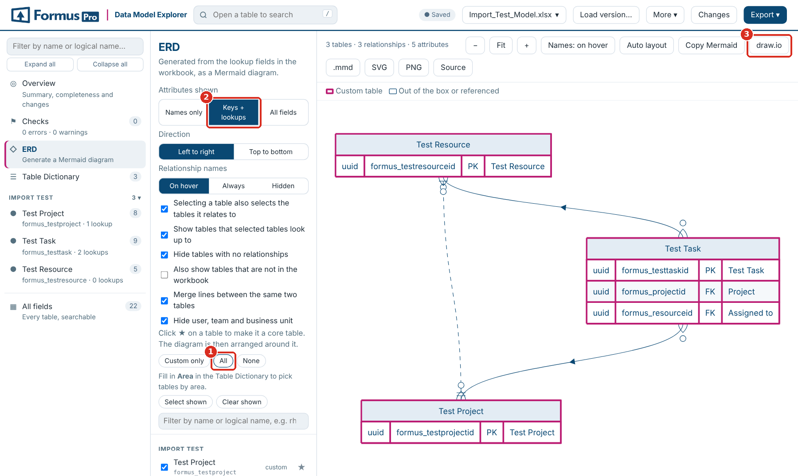
Drawing the ERD
Pick tables
Tick them, filter and Select shown, or Custom only, All, None, or by area
Core tables
★ lays the diagram out around a table and brings its neighbours
What boxes show
Names only, Keys + lookups or All fields; left to right or top to bottom
Your layout
Drag tables; layouts are remembered. Opens at screen size; Fit fits the panel
Notes:
The diagram is generated from the lookup fields, so it always matches the workbook. With many tables, draw a few dozen at a time. The page asks before drawing more than 80 tables.

Slide 17
Reading the ERD
The lines and boxes
Options
Ends (one or many) show only where the relationship type is recorded in the workbook.
A relationship with no recorded type is a plain grey line, listed in Checks for review.
N:N relationships are dashed.
Custom tables have a pink border; standard and referenced tables a plain one. Or colour by area.
Selecting a table also selects the tables it relates to
Show tables that selected tables look up to
Hide tables with no relationships
Also show tables not in the workbook
Merge lines between the same two tables
Hide user, team and business unit
Show N:N relationships from Dataverse
Notes:
The diagram never guesses a relationship type: an unrecorded type is drawn neutrally and flagged, so the ERD can be trusted as a picture of what is written down.

Slide 18
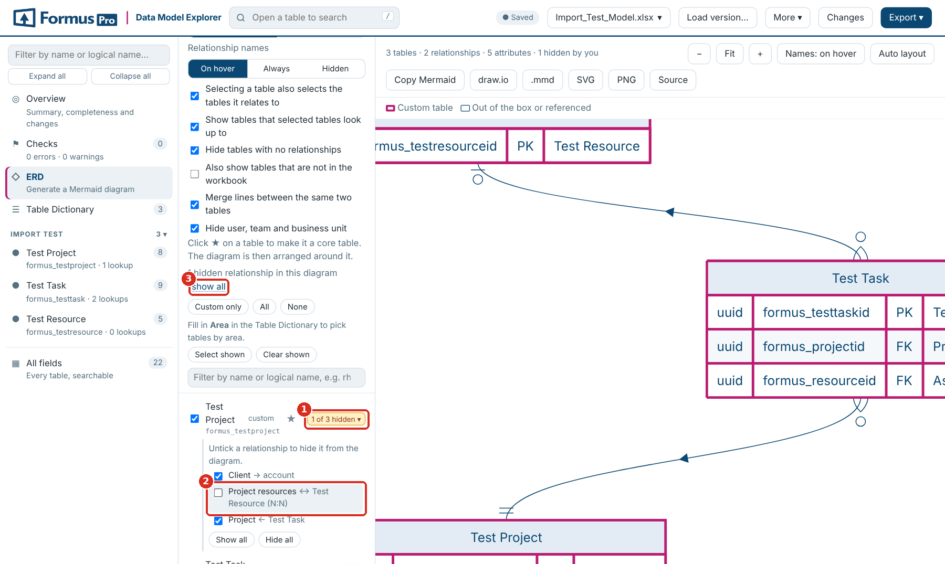
Hiding relationships
NEW IN 1.9.3
Every relationship listed
Click the count beside a table: its lookups →, lookups to it ←, and N:N ↔
Untick to hide
Gone from the diagram and every export; a table it alone brought in drops out
Per table, at a glance
Hide all or Show all per table; the button reads, say, 1 of 3 hidden
Nothing moves
Tables keep their places; show all brings everything back; the choice is remembered
Notes:
Useful for presentation diagrams: hide the audit lookups or a busy N:N without removing the tables. The ERD info line counts how many relationships you have hidden in the current diagram.

Slide 19
Taking the diagram with you
draw.io
SVG
PNG
.mmd
Copy Mermaid
An editable diagram with your layout, ready to keep working on in draw.io
Sharp at any size, for documents and wikis
A picture, up to 8,000 pixels across
The Mermaid source as a file
The source on the clipboard, for Markdown, Azure DevOps or GitHub
Exports follow what you see: the tables you picked, the attributes shown, the relationships you hid, and your layout. Source opens the read-only Mermaid text beside the diagram.
Notes:
All five exports are generated in the browser. The draw.io file keeps positions and colours, so it is the best starting point for a diagram you will keep editing by hand.

Slide 20
04
Editing
Values, keys and table details, adding fields and relationships, and the change list
Notes:
Section 4: Editing. Values, keys and table details, adding fields and relationships, and the change list.

Slide 21
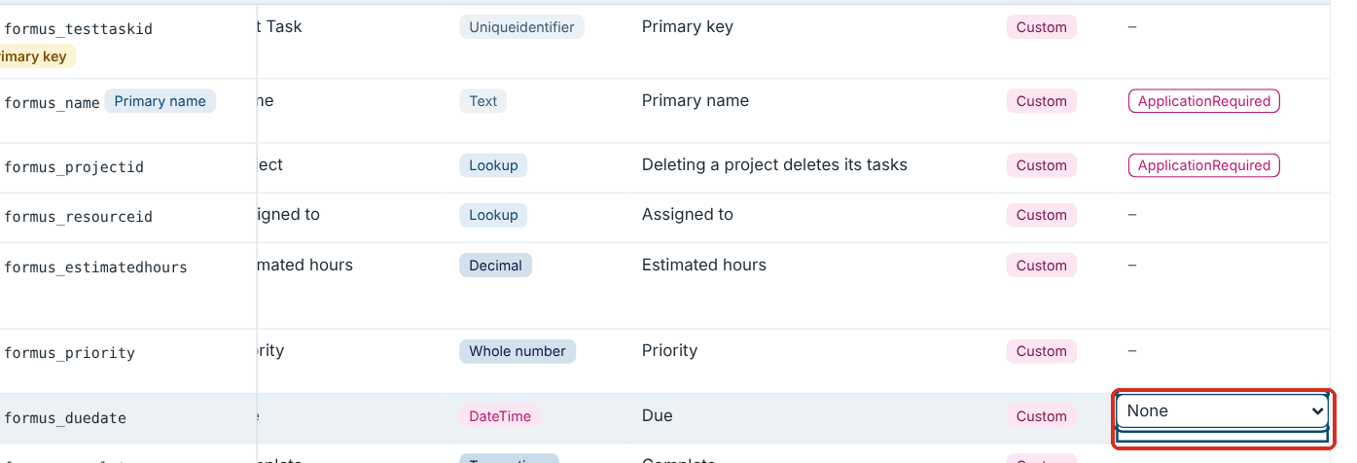
Editing values
Double-click a cell
Or click a row and edit in its panel. Enter saves, Esc cancels
Dropdowns
Fixed-value columns edit as a dropdown; + New value… adds one
Visible edits
Edited cells are highlighted; the panel shows the original with revert
Keyboard
Shift+Enter for a new line; j and k move between rows in the panel
Notes:
Dropdown columns include Attribute Type, Required Level, Relationship Type and Cascade Delete. Their options come from the template’s data-validation lists. Every edit is stored in the browser as you make it.

Slide 22
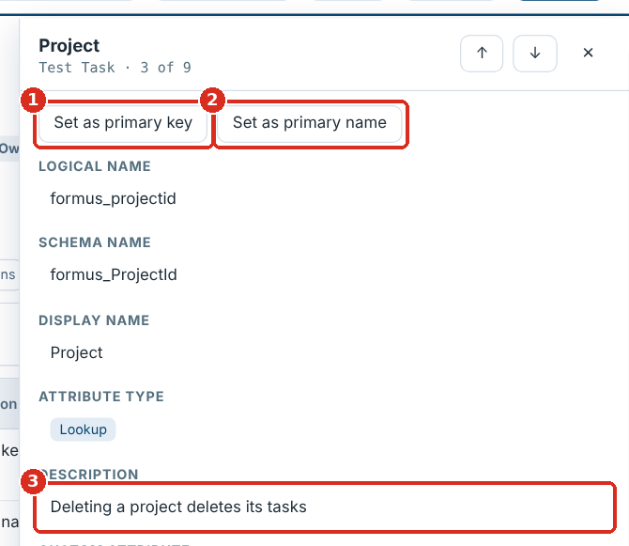
Keys and table details
Shown in the header
Primary name and primary key; an unrecorded key shows as assumed
Tagged in the list
The two fields carry Primary key and Primary name tags
Set on any field
Set as primary key or Set as primary name in the field’s panel
✎ Table details
Ownership, notes, activities and every other detail row, including missing ones
Notes:
Dataverse primary keys are always unique identifiers created with the table, so marking a text or number field as the key is flagged in Checks; use an alternate key to keep other values unique. The primary name must be single-line text.

Slide 23
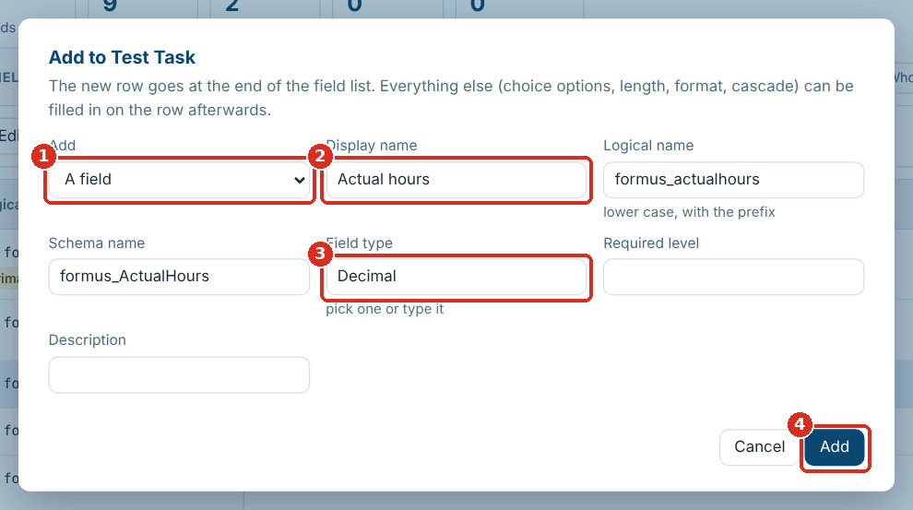
Adding fields and relationships
A field or an N:N
Choose the kind, then type the display name
Names follow
Actual hours becomes formus_actualhours and formus_ActualHours
Lookups and N:N
Pick the related table: Targets and the relationship type are filled in
Then the details
The new row is tagged ADDED and opens for options, length, cascade
Notes:
A name already in the table is refused. Added rows go at the end of the field list and are written into the empty rows after it when saving. On other sheets, such as the Table Dictionary, + Add row adds a blank row. Remove row takes an added row out again.

Slide 24
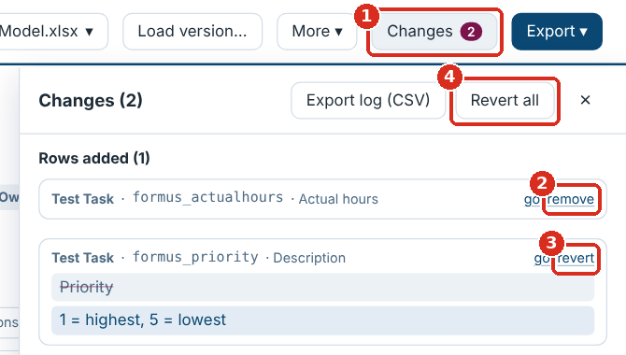
Reviewing and undoing changes
Everything in one list
Rows added, table details changed, and each cell as original against new
Go or revert
Jump to any edit, or undo it on its own
Revert all
Undo everything at once
Keep a record
Export log (CSV) downloads the list
Notes:
Changes is also where a newer version’s conflicts are settled: values the new version changed that you had also edited are listed under Needs your attention.

Slide 25
05
Versions and saving
Loading a newer workbook, exporting, and saving back safely
Notes:
Section 5: Versions and saving. Loading a newer workbook, exporting, and saving back safely.

Slide 26
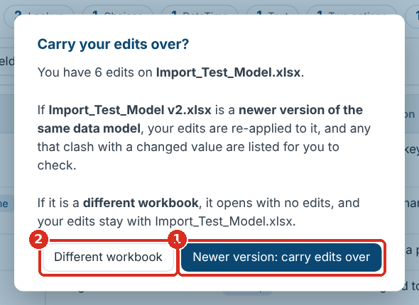
Loading a newer version
Every difference
Tables, fields, values, columns, details, forms, views and lookup targets
Edits carry over
Conflicts go to Needs your attention: Keep mine or Use new version
Added rows too
If the new version already has the field, you choose which to keep
Share the differences
Version differences (CSV) in the Export menu
Notes:
Click Load version… or drop the new file and choose newer version. Tables are matched by tab name and fields by logical name, so row order doesn’t matter. An edit to a field the new version no longer has can be discarded in Changes.

Slide 27
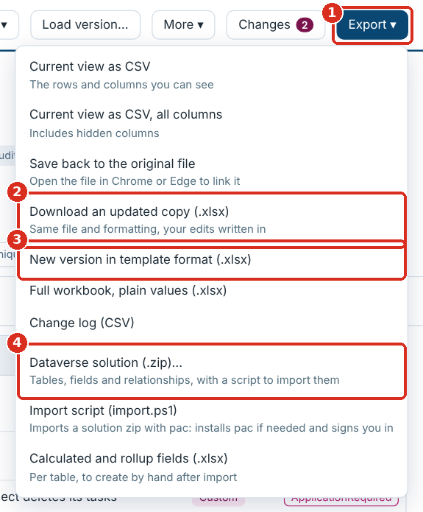
The Export menu
Export | What you get
Save back to the original file | Your edits written into the file on disk (Chrome or Edge, opened with the button)
Download an updated copy | The same file and formatting with your edits written in
New version in template format | The whole workbook rebuilt and styled by the template, with a Change log sheet
Full workbook, plain values | Values only, no styling
Current view as CSV | The rows you can see, with visible or all columns
Change log · Version differences | Your edits, or the differences between versions, as CSV
Notes:
Choose Save back or Download an updated copy to keep the client’s file exactly as it is apart from your edits; choose New version in template format to bring an old workbook fully up to the current template.

Slide 28
Saving back safely
What is guaranteed
Name the file
Model v1.2 is suggested as Model v1.3
Only the cells you changed are rewritten; formatting and validations stay byte for byte
Added rows go into the empty rows after the field list, new details above it
If anything can’t be written, nothing is saved and your edits are kept
Write your edits
Into the original or a copy
Read it back
Every edit checked in the saved file
Saved
Or the reason it was stopped
Notes:
The usual reason a save is stopped is that there is no empty row for an added field before the Forms section. Then use New version in template format, or add empty rows in Excel and reload. Every workbook download asks for a file name first, suggesting the next version number.

Slide 29
06
Building in Dataverse
The solution builder, what it creates, importing, and what to do after
Notes:
Section 6: Building in Dataverse. The solution builder, what it creates, importing, and what to do after.

Slide 30
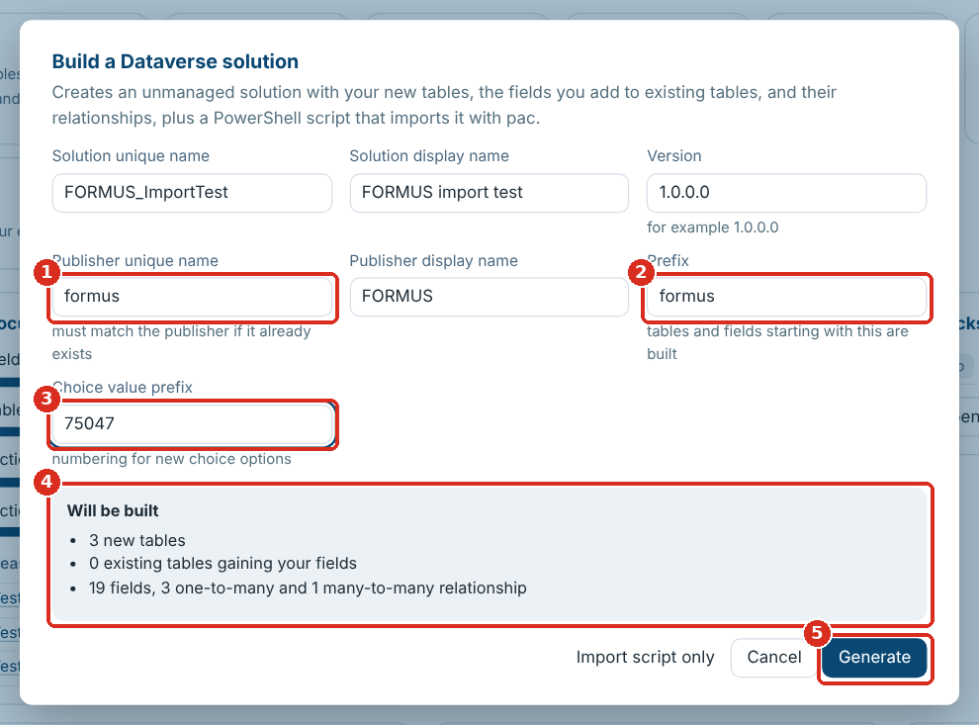
Generating the solution
Solution and version
Unique and display name; raise the four-part version for each import
Publisher
The unique name must exactly match the environment’s, or a second is created
Prefixes
Publisher prefix and choice value prefix, suggested from the workbook
Will be built
What is new, added to standard tables, to build by hand or left out
Notes:
Export → Dataverse solution (.zip)… or Build solution… on the Overview. Tables and fields starting with the prefix are built. Generate downloads one zip named after the solution and version. Clear the errors in Checks first.

Slide 31
What the solution contains
Built for you
Listed in the report instead
New tables with primary name, key, ownership, notes and audit
Your fields on standard tables, leaving the rest of them alone
A relationship per lookup and customer lookup, with cascade; every N:N
Lengths, formats, ranges, precision, choices, defaults, required level, field security
Calculated and rollup fields (with a workbook to build them)
Activity tables and lookups to several tables
Image and file fields; choices with no options
Tables with no primary name, or a key that isn’t a GUID
Forms and views
Notes:
The solution XML matches what Dataverse itself exports, checked element by element against exported solutions. Anything not built is listed in build-report.csv with the reason.

Slide 32
One download
File | What it is
<SolutionName>_<version>.zip | The unmanaged solution
import.ps1 | Imports it with the Power Platform CLI, installing it if needed
build-report.csv | Every table, field and relationship: included, not included (and why), or to build by hand
calculated-and-rollup-fields.xlsx | The fields to create by hand, per table, with a column for the formula
README.txt | The import steps
Export → Import script (import.ps1) downloads the script on its own, for a solution zip you already have.
Notes:
Unzip the download into a folder and run the script from there. The script imports the one solution zip in its folder, or the one given with -SolutionPath.

Slide 33
Importing with import.ps1
Options
Unzip
Into a folder, then open PowerShell there
-EnvironmentUrl: the environment to import into
-Check: run Microsoft’s solution checker first
-SolutionPath: import a different zip
Blocked? Run Unblock-File .\import.ps1 once
Run the script
.\import.ps1 -EnvironmentUrl https://…
Sign in
pac is installed if missing; a browser opens
Imported and published
Into development first
Notes:
You need PowerShell 7 or Windows PowerShell 5.1, and the System Customizer or System Administrator role. A large model can take several minutes to import. If the import fails, the message says why and nothing is changed: fix the workbook, raise the version and generate again.

Slide 34
After the import
1
2
3
Check the report
Build by hand
Turn on activities
Deal with anything marked Not included in build-report.csv
Create the calculated and rollup fields with their formulas
For tables with Has Activities set
4
5
6
Forms and views
Compare
Promote
Lay them out in Power Apps
Optionally, run the Dataverse check to confirm everything landed
Export from development as managed for test and production
Notes:
Has Activities is not a setting in the solution file, so tables that need it are listed as a step to do by hand after the import.

Slide 35
Common questions
Problem or question | What to do
A table shows that isn’t in my workbook | Pick yours in the workbook selector, or Manage files… → Remove all…
My edits disappeared after opening a file | It was opened as a different workbook: switch back in the selector
Saving was stopped | Read the reason; usually no empty row is left. Use New version in template format
Save back is greyed out | Open the file with Open workbook… (not by dragging) in Chrome or Edge
The import created a second publisher | The unique name didn’t match. Generate again with the exact name
Windows refuses to run import.ps1 | Unblock-File .\import.ps1, or -ExecutionPolicy Bypass for that session
Can I share the HTML file? | Yes: it holds only the empty template. Nothing is uploaded
Notes:
The user guide’s troubleshooting section has the full list.

Slide 36
Quality and resources
How it is tested
Where to find more
241 automated browser tests run on every change.
Generated solutions are unpacked and re-packed with Microsoft’s own packaging tool.
The solution XML was compared element by element with solutions exported by Dataverse.
import.ps1 is parsed with PowerShell 7.4 and run against a stand-in for pac.
User guide with marked screenshots (Markdown and Word)
A narrated 2-minute walkthrough video
The short overview deck
Import_Test_Model.xlsx: three tables to try the whole flow
All in the SharePointPCF repository, under data-model-explorer
Notes:
Everything referred to in this deck is in the repository under data-model-explorer: the HTML file, docs/User_Guide.md and .docx, docs/Walkthrough.mp4, docs/Data_Model_Explorer_Overview.pptx, and samples/Import_Test_Model.xlsx.

Slide 37
Getting started
Four steps from workbook to Dataverse
1
2
3
4
Open the Data Model Explorer HTML file in Chrome or Edge
Drop the data-model workbook on it, or a metadata export
Work through Checks until there are no errors
Build the solution and run import.ps1 against development
Notes:
Start with the import test model to see the whole flow end to end before using a real model.

