Slide 1
Spatial-Temporal Neural Networks for Traffic Systems
Conf. dr. Ichim Bogdan
Bomher Sebastian

Slide 2
Traffic
The traffic system is composed of roads or the pavement on which the participants in traffic travel at a certain speed to reach their individual goals.
Participants in traffic are pedestrians and vehicles.
Each participant has its own destination.
Traffic networks are complex and nonlinear, depending on multiple external factors.
The main variables that are considered in traffic flow theory are density, speed, and flow.

Slide 3
The problem
Traffic is getting heavier as time passes by and cities population increases.
Densely populated cities have the worst congestion times.
As of 2022, Bucharest is ranked the 8th worst congested city in the world.
A study showed that a person driving in New York City has to spend on average 92 hours a year in traffic.

Slide 4
Motivation
Lower congestion brings the following benefits:
Fewer accidents and safer roads.
Reduced pollution.
Reduced wasted time.
Free flow attracts investors, boosting the economy.
Reduced stress and anxiety.

Slide 5
Traffic Optimization
Traffic congestion can be optimized by lowering congestion. This can be done in multiple ways:
Better infrastructure.
Smaller vehicles such as bicycles or motorbikes.
More people in a single vehicle, such as public transportation.
Supervised traffic systems such as the metro system.
Better route planning for individual vehicles.

Slide 6
A.I. in Traffic Systems
Modern applications in route planning relies on user input for prediction.
Neural Networks can be used to predict average speed or waiting times without user input and ahead of time.
Graph Neural Networks are good at using graphs as a spatial dependency.
Recurrent Neural Networks are good at resolving temporal dependencies.

Slide 7
A solution
Predicting average speeds at key points in a city.
Using Recurrent Graph Neural Networks for prediction.
Using manual or generated maps as graphs for the models.
Experiment with different-sized graphs of intersections or the entire city.
Experiment with different map configurations.
Multiple GNN models and statistical models

Slide 8
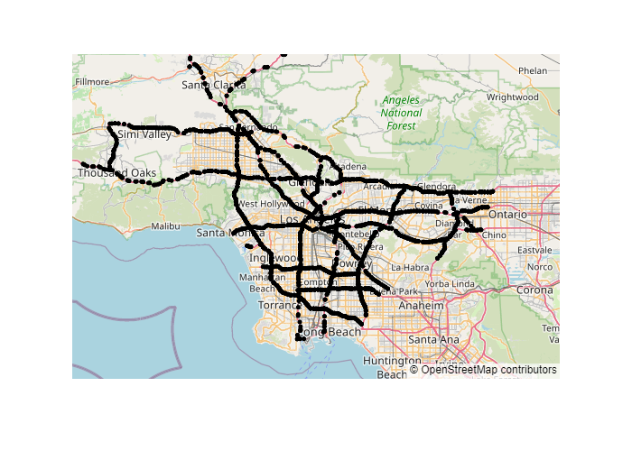
Project Data
Sensor nodes from the traffic of Los Angeles for July 2021.
2800 individual sensors.
Aggregate data every 5 minutes.
Predict only weekdays.
Key points are downton intersections

Slide 9
Map Generation
Map is generated by two criteria: Adjacency and edge weight.
Adjacency is computed as:
Manual
Generative
Linear Regression computing.
Edges weight are computed as:
Geodesic
Road distance.

Slide 10
Dataset Sizes & Models
Four Dataset Sizes:
Manual
Tiny
Small
Medium
Three Neural network models:
STCONV
GCLSTM
DCRNN
Three statistical models:
Linear Regression
ARIMA
SARIMA

Slide 11
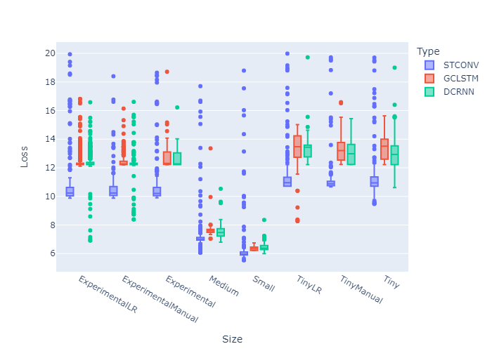
Dataset Sizes & Models Results
Larger datasets performed better but have a higher training time.
STCONV performed best overall.
DCRNN and GCLSTM had better outliers.

Slide 12
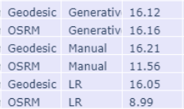
Map Configurations Results
DCRNN, Experimental
OSRM (Travel distance) performed better than the Geodesic distance
Linear Regression generation performed the best, with Manual second and Generative last.

Slide 13
Conclusion & Further Development
Recurrent Graph Neural Networks predict accurately average speed in sensors.
Prediction can be used in route planning to lower traffic congestion.
Different sizes and map generations impact results.
Other types of map generation can be experimented on.
Different cities and models can be experimented on

Slide 14
Questions & Answers.

