Slide 1
Spatial-Temporal Neural Networks for Traffic Systems
Conf. dr. Ichim Bogdan
Bomher Sebastian

Slide 2
Problem
Motivation
Traffic is getting heavier as time passes by and cities population increases.
Densely populated cities have the worst congestion times.
As of 2022, Bucharest is ranked the 8th worst congested city in the world.
A study showed that a person driving in New York City has to spend on average 92 hours a year in traffic.
Lower congestion brings the following benefits:
Fewer accidents and safer roads.
Reduced pollution.
Reduced wasted time.
Free flow attracts investors, boosting the economy.
Reduced stress and anxiety.

Slide 3
Solution
Modern applications in route planning relies on user input for prediction.
Neural network models can predict average speeds at key points in a city without user input
Predictions made by using manual or generated maps as graphs for the models.
Experiment with different-sized graphs of intersections or the entire city. Experiment with different configurations.
Multiple GNN models and statistical models experimented

Slide 4
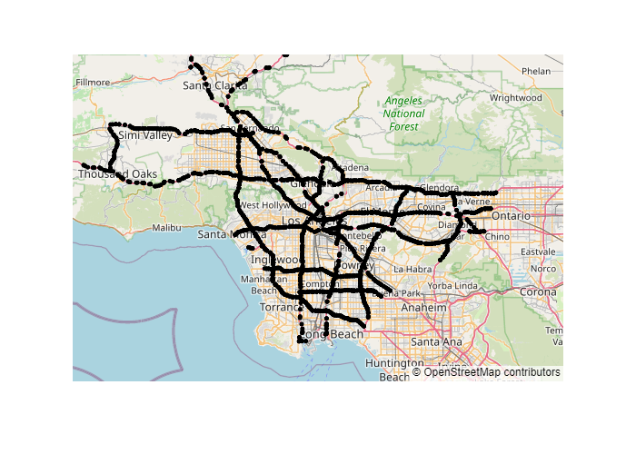
Project Data
Sensor nodes from the traffic of Los Angeles for July 2021.
2800 individual sensors.
Aggregate data every 5 minutes.
Predict only weekdays.
Key points are downtown intersections

Slide 5
Map Generation
Map is generated by two criteria: Adjacency and edge weight.
Adjacency is computed as:
Manual
Generative
Linear Regression computing.
Edges weight are computed as:
Geodesic
Road distance.

Slide 6
Dataset Sizes & Models
Four Dataset Sizes:
Manual
Tiny
Small
Medium
Three Neural network models:
STCONV
GCLSTM
DCRNN
Three statistical models:
Linear Regression
ARIMA
SARIMA

Slide 7
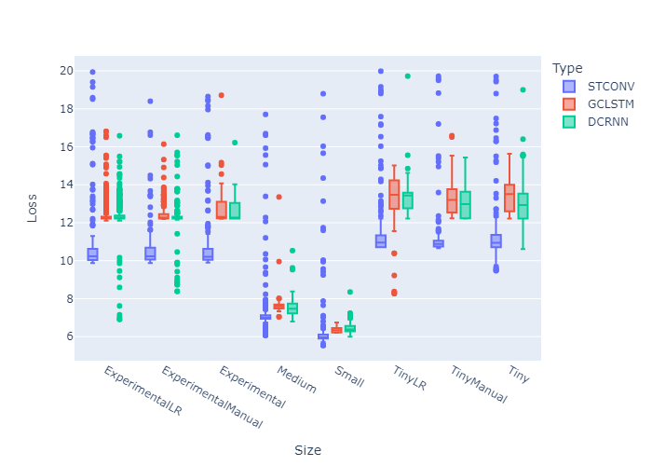
Dataset Sizes & Models Results
Larger datasets performed better but have a higher training time.
STCONV performed best overall.
DCRNN and GCLSTM had better outliers.

Slide 8
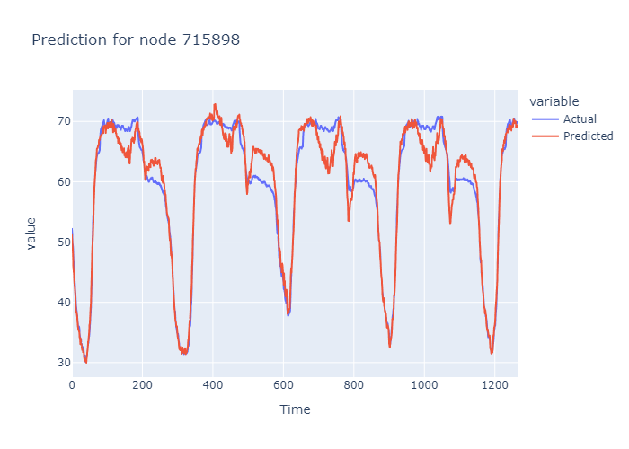
Single Node prediction
Prediction for test data (5 working days)
Highly accurate in congestion situations
Consistent throughout all days
Identifies congestion times

Slide 9
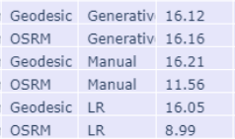
Map Configurations Results
DCRNN, Experimental
OSRM (Travel distance) performed better than the Geodesic distance
Linear Regression generation performed the best, with Manual second and Generative last.

Slide 10
Conclusion & Further Development
Recurrent Graph Neural Networks predict accurately average speed in sensors.
Prediction can be used in route planning to lower traffic congestion.
Different sizes and map generations impact results.
Other types of map generation can be experimented on.
Different cities and models can be experimented on

Slide 11
Questions & Answers.

