Slide 1
DATA ANALYSIS
Module Code: CA660
Lecture Block 2

Slide 2
PROBABILITY – Inferential Basis
COUNTING RULES – Permutations, Combinations
BASICS Sample Space, Event, Probabilistic Expt.
DEFINITION / Probability Types
AXIOMS (Basic Rules)
ADDITION RULE – general and special
from Union (of events or sets of points in space)
OR

Slide 3
Basics contd.
CONDITIONAL PROBABILITY
(Reduction in sample space)
MULTIPLICATION RULE – general and special from Intersection (of events or sets of points in space)
Chain Rule for multiple intersections
Probability distributions, from sets of possible outcomes.
Examples – think of one of each

Slide 4
Conditional Probability: BAYES A move towards “Likelihood” Statistics
More formally Theorem of Total Probability (Rule of Elimination)
If the events B₁ , B₂ , …,B_{k} constitute a partition of the sample space S, such that P{B_{i}} ≠ 0 for i = 1,2,…,k, then for any event A of S
So, if events B partition the space as above, then for any event A in S, where P{A} ≠ 0

Slide 5
Example - Bayes
40,000 people in a population of 2 million carry a particular virus. P{Virus} = P{V₁} = 0.0002. No Virus = event V₂
Tests to show presence/absence of virus, give results:
P{T / V₁ } =0.99 and P{T / V₂ } = 0.01
P{N / V₂ }=0.98 and P{N / V₁ }=0.02
where T is the event = positive test, N the event = negative test. (All a priori probabilities)
So
where events V_{i} partition the sample space
Total probability

Slide 6
Example - Bayes
A company produces components, using 3 non-overlapping work shifts. ‘Known’ that 50% of output produced in shift 1, 20% shift 2 and 30% shift 3. However QA shows % defectives in the shifts as follows:
Shift 1: 6%, Shift 2: 8%, Shift 3 (night): 15%
Typical Questions:
Q1: What % all components produced are likely to be defective?
Q2: Given that a defective component is found, what is the probability that it was produced in a given shift, Shift 3 say?

Slide 7
‘Decision’ Tree: useful representation
Shift1
0.06
Probabilities of states of nature
0.5
Defective
0.2
Shift 2
0.08
Defective
0.3
Shift 3
0.15
Defective
Soln. Q1
Soln. Q2

Slide 8
MEASURING PROBABILITIES – RANDOM VARIABLES & DISTRIBUTIONS
(Primer) If a statistical experiment only gives rise to real numbers, the outcome of the experiment is called a random variable. If a random variable X takes values X₁, X₂, … , X_{n} with probabilities p₁, p₂, … , p_{n} then the expected or average value of X is defined E[X] = p_{j} X_{j} and its variance is VAR[X] = E[X²] - E[X]² = p_{j} X_{j}² - E[X]²

Slide 9
Random Variable PROPERTIES
Sums and Differences of Random Variables Define the covariance of two random variables to be COVAR [ X, Y] =
E [(X - E[X]) (Y - E[Y]) ] = E[X Y] - E[X] E[Y] If X and Y are independent, COVAR [X, Y] = 0.
Lemmas E[ X ± Y] = E[X] ± E[Y] VAR [ X ± Y] = VAR [X] + VAR [Y]
± 2COVAR [X, Y]
and E[ k. X] = k .E[X] , VAR[ k. X] = k² .VAR[X]
for a constant k.

Slide 10
Example: R.V. characteristic properties
B =1 2 3 Totals R = 1 8 10 9 27 2 5 7 4 16 3 6 6 7 19 Totals 19 23 20 62 E[B] = {1(19)+2(23)+3(20) / 62 = 2.02 E[B²] = {1²(19)+2²(23)+3²(20) / 62 = 4.69 VAR[B] = ? E[R] = {1(27)+2(16)+3(19)} / 62 = 1.87 E[R²] = {1²(27)+2²(16)+3²(19)} / 62 = 4.23 VAR[R] = ?

Slide 11
Example Contd.
E[B+R] = { 2(8)+3(10)+4(9)+3(5)+4(7)+
5(4)+4(6)+5(6)+6(7)} / 62 = 3.89
E[(B + R)²] = {2²(8)+3²(10)+4²(9)+3²(5)+4²(7)+
5²(4)+4²(6)+5²(6)+6²(7)} / 62 = 16.47
VAR[(B+R)] = ? * E[BR] = E[B,R] = {1(8)+2(10)+3(9)+2(5)+4(7)+6(4)
+3(6)+6(6)+9(7)}/ 62 = 3.77
COVAR (BR) = ?
Alternative calculation to *
VAR[B] + VAR[R] + 2 COVAR[ B, R] Comment?

Slide 12
EXPECTATION/VARIANCE
Clearly,
and

Slide 13
PROPERTIES - Expectation/Variance etc. Prob. Distributions (p.d.f.s)
As for R.V.’s generally. For X a discrete R.V. with p.d.f. p{X}, then for any real-valued function g
e.g.
Applies for more than 2 R.V.s also
Variance - again has similar properties to previously:
e.g.

Slide 14
P.D.F./C.D.F.
If X is a R.V. with a finite countable set of possible outcomes, {x₁ , x₂,…..}, then the discrete probability distribution of X
and D.F. or C.D.F.
While, similarly, for X a R.V. taking any value along an interval of the real number line
So if first derivative exists, then
is the continuous pdf, with

Slide 15
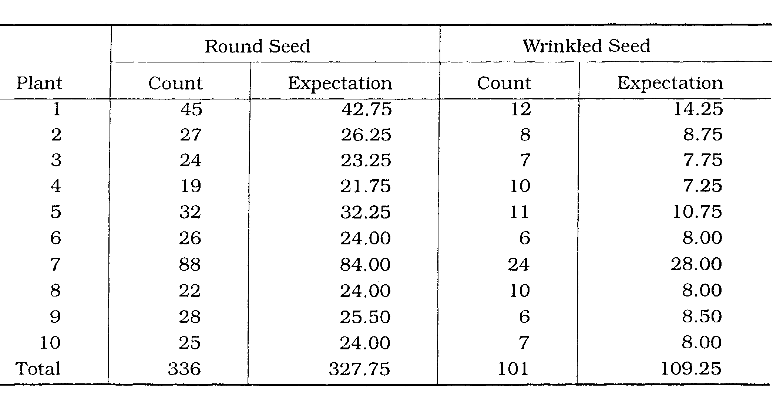
DISTRIBUTIONS - e.g. MENDEL’s PEAS

Slide 16
Multiple Distributions – Product Interest by Location
 | Dublin | Cork | Galway | Athlone | Total
Interested | 120(106) | 41(53) | 45(53) | 112(106) | 318
Not Interested | 35(49.67) | 38(24.83) | 40(24.83) | 36(49.67) | 149
Indifferent | 45(44.33) | 21(22.17) | 15(22.17) | 52(44.33) | 133
Total | 200 | 100 | 100 | 200 | 600

Slide 17
MENDEL’s Example
Let X record the no. of dominant A alleles in a randomly chosen genotype, then X= a R.V. with sample space S = {0,1,2}
Outcomes in S correspond to events
Note: Further, any function of X is also a R.V.
Where Z is a variable for seed character phenotype

Slide 18
Example contd.
So that, for Mendel’s data,
And so
And
Note: Z = ‘dummy’ or indicator. Could have chosen e.g. Q as a function of X s.t. Q = 0 round, (X > 0), Q = 1 wrinkled, (X=0). Then probabilities for Q opposite to those for Z with
and

Slide 19
JOINT/MARGINAL DISTRIBUTIONS
Joint cumulative distribution of X and Y, marginal cumulative for X, without regard to Y and joint distribution (p.d.f.) of X and Y then, respectively
where similarly for continuous case, e.g. (2) becomes

Slide 20
CONDITIONAL DISTRIBUTIONS
Conditional distribution of X, given that Y=y
where for X and Y independent and
Example: Mendel’s expt. Probability that a round seed (Z=1) is a homozygote AA i.e. (X=2)
i.e. JOINT
AND - i.e. joint or intersection as above

Slide 21
Example on Multiple Distributions –Product Interest by Location - rearranging
 | Dublin | Cork | Galway | Athlone | Total
Interested | 120 (106) | 41(53) | 45 (53) | 112 (106) | 318
Not Interested/Indifferent | 80 (94) | 59 (47) | 55 (47) | 88 (94) | 282
Total | 200 | 100 | 100 | 200 | 600

Slide 22
BAYES Developed Example: Bioinformatics Accuracy of Assembled DNA sequences
Want estimate of probability that ith letter of an assembled sequence is A,C,G, T or – (unknown)
Assume each fragment assembly correct, all portions equally reliable, sequencing errors independ^{t.} & uniform throughout sequence. Assume letters in sequence IID.
Let F* = {f₁, f₂ , …f_{N}} be the set of fragments
Fragments aligned into assembled sequence - correspond to columns i in matrix, while fragments correspond to rows j
Matrix elements x_{ij} are members of B* = {A,C,G,T, - , 0}
True sequence (in n columns) is s = {s₁, s₂ , …s_{n}} where s contained in {A,C,G,T,-} = A*

Slide 23
BAYES contd.
Track fragment orientat^{n.}
Thus need estimation of
= probability ith letter is from molecule “M”, given matrix elements(of fragments).
Assuming knowledge of sequencing error rates:
so that Bayes gives
Context = M
Summed options for b over M
Total Prob. of b

Slide 24
BAYES Developed Example: Business Informatics
Decision Trees: Actions, states of nature affecting profitability and risk.
Involve
Sequence of decisions, represented by boxes, outcomes, represented by circles. Boxes = decision nodes, circles = chance nodes.
On reaching a decision node, choose – path of your choice of best action.
Path away from chance node = state of nature, each having certain probability
Final step to build– cost (or utility value) within each chance node (expected payoff, based on state-of-nature probabilities) and of decision node action

Slide 25
Example
A Company wants to market a new line of computer tablets. Main concern is price to be set and for how long. Managers have a good idea of demand at each price, but want to get an idea of time it will take competitors to catch up with a similar product. Would like to retain a price for 2 years.
Decision problem: 4 possible alternatives say: A1: price €1500, A2 price €1750, A3: price €2000 A4: price €2500.
State-of-nature = catch up times: S1 : < 6 months, S2: 6-12 months, S3: 12-18 months, S4: > 18 months.
Past experience indicates P{S1}= 0.1, P{S2}=0.5,P{S3}=0.3, P{S4)=0.1
Need costs (payoff table) for various strategies ; non-trivial since involves price-demand, cost-volume, consumer preference info. etc. involved to specify payoff for each action. Conservative strategy = minimax, Risky strategy = maximise expected payoff

Slide 26
Ex contd. Profit/loss in millions euro
Selling price | < 6 mths: S1 | 6-12 mths: S2 | 12-18 mths:S3 | 18 mths: S4
A1 €1500 | 250 | 320 | 350 | 400
A2 €1750 | 150 | 260 | 300 | 370
A3 €2000 | 120 | 290 | 380 | 450
A4 €2500 | 80 | 280 | 410 | 550
State of Nature | Action with Largest Payoff | Opportunity Loss
S1 | A1 | A1: 250-250 = 0 A3: 250-120=130 A2:250-150 = 100 A4: 250-80 = 170
S2 | A1 | A1: 320-320 = 0 A3: 320-290=30 A2:320-260 = 60 A4: 320-280 = 40
S3 | A4 | A1: 410-350 = 60 A3: 410-380=30 A2: 410-300 = 110 A4: 410-410 = 0
S4 | A4 | A1: 550-400 = 60 A3: 550-450=30 A2: 550-370 = 110 A4: 550-550 = 0

Slide 27
Ex contd.
Maximum O.L. for actions (table summary below)is A1: 150, A2: 180, A3:130, A4:170. So minimax strategy is to sell at €2000 for 2 years*
? Expected profit for each action? Summarising O.L. and apply S-probabilities – second table below.
* Suppose want to maximise minimum payoff, what changes? (maximin strategy)
Selling price | < 6 mths: S1 | 6-12 mths: S2 | 12-18 mths:S3 | 18 mths: S4
A1 €1500 | 0 | 0 | 60 | 150
A2 €1750 | 100 | 60 | 110 | 180
A3 €2000 | 130 | 30 | 30 | 100
A4 €2500 | 170 | 40 | 0 | 0
Selling price | Expected Profit
A1 €1500 | (0.1)(250) + (0.5)(320) + (0.3)(350) + (0.1)(400) = 330** Preferred under Strategy 2
A2 €1750 | (0.1)(150) + (0.5)(260) +(0.3) (300) +(.1)(370) =272
A3 €2000 | (0.1)(120) + (0.5)(290) + (0.3)(380) + (0.1)450) = 316 but
A4 €2500 | (0.1)(80) + (0.5)(280) +(0.3)(410) +(0.1)(550) = 326 but

Slide 28
Decision Tree (1)– expected payoffs
250
S1
S2
320
S3
350
330
S4
Price €1500
400
S1
150
S2
S3
260
272
S4
300
Price €1750
370
S1
120
S2
290
Price €2000
S3
316
S4
380
450
S1
80
Price €2500
S2
280
S3
326
S4
410
550

Slide 29
Decision tree – strategy choice implications
250
S1
S2
320
S3
350
330
S4
⇒struck out alternatives i.e.not paths to use at this point in decision process.
Conclusion: Select a selling price of €1500 for an expected payoff of 330 (M€)
Price €1500
400
S1
150
272
S2
S3
260
S4
300
330
Price €1750
370
S1
120
316
S2
290
Price €2000
S3
S4
380
450
S1
80
Price €2500
S2
280
326
S3
Risk:Sensitivity to S-distribution choice.
How to calculate this?
S4
410
Largest expected payoff
550

Slide 30
Example Contd. Risk assessment – recall expectation and variance forms
E[X] = Expected Payoff (X) =
VAR[X] = E[X²] - E[X]² =
Action | Expected Payoff | Risk
A1 €1500 | 330 | [(250)²(0.1) + (320)²(0.5)+(350)²(0.3)+(400)²(0.1)]-(330)² = 1300
A2 €1750 | 272 | [(150)²(0.1) + (260)²(0.5)+(300)²(0.3)+(370)²(0.1)]-(272)² = 2756
A3 €2000 | 316 | [(120)²(0.1) + (290)²(0.5)+(380)²(0.3)+(450)²(0.1)]-(316)² = 7204
A4 €2500 | 326 | [(80)²(0.1) + (280)²(0.5)+(410)²(0.3)+(550)²(0.1)]-(326)² =14244

Slide 31
Re-stating Bayes & Value of Information
Bayes: given a final event (new information) B, the probablity that the event was reached along ith path corresponding to event E_{i} is:
So, supposing P{S_{i}} subjective and new information indicates this should increase
So, can maximise expected profit by replacing prior probabilities with corresponding posterior probabilities. Since information costs money, this helps to decide between (i) no info. purchased and using prior probs. to determine an action with maximum expected payoff (utility) vs (ii) purchasing info. and using posterior probs. since expected payoff (utility) for this decision could be larger than that obtained using prior probs only.

Slide 32
Contd.
Construct tree diagram with newinf. on the far right.
Obtain posterior probabilities along various branches from prior probabilities and conditional probabilities under each state of nature, e.g. for table on consultant input below – predicting interest rate increase
Expected payoffs etc. now calculated using the posterior probabilities
Past record Occurred Predicted by consultant | S1 P{S1)=0.3 | S2 P{S2=0.2} | S3 P{S3=0.5}
Increase= I₁ | 0.7 = P{I₁|S₁} | 0.4 = P{I₁|S₂} | 0.2 = P{I₁|S₃}
No Change= I₂ | 0.2 = P{I₂ |S₁} | 0.5 = P{I₂|S₂} | 0.2 = P{I₂|S₃}
Decrease = I₃ | 0.1 = P{I₃|S₁} | 0.1 = P{I₃|S₂} | 0.6 = P{I₃|S₃}
 | 1.0 | 1.0 | 1.0

Slide 33
Example: Bioinformatics: POPULATION GENETICS
Counts – Genotypic “frequencies”
GENE with n alleles, so n(n+1)/2 possible genotypes
Population Equilibrium HARDY-WEINBERG
Genes and “genotypic frequencies” constant from generation to generation (so simple relationships for genotypic and allelic frequencies)
e.g. 2 allele model p_{A,} p_{a} allelic freq. A, a respectively, so genotypic ‘frequencies’ are p_{AA} , p_{Aa} ,, p_{aa} , with
p_{AA} = p_{A} p_{A} = p_{A}²
p_{Aa} = p_{A} p_{a} + p_{a} p_{A} = 2 p_{A} p_{a}
p_{aa} = p_{a}²
(p_{A}+ p_{a} )² = p_{A}² + 2 p_{a} p_{A} + p_{a}²
One generation of Random mating. H-W at single locus

Slide 34
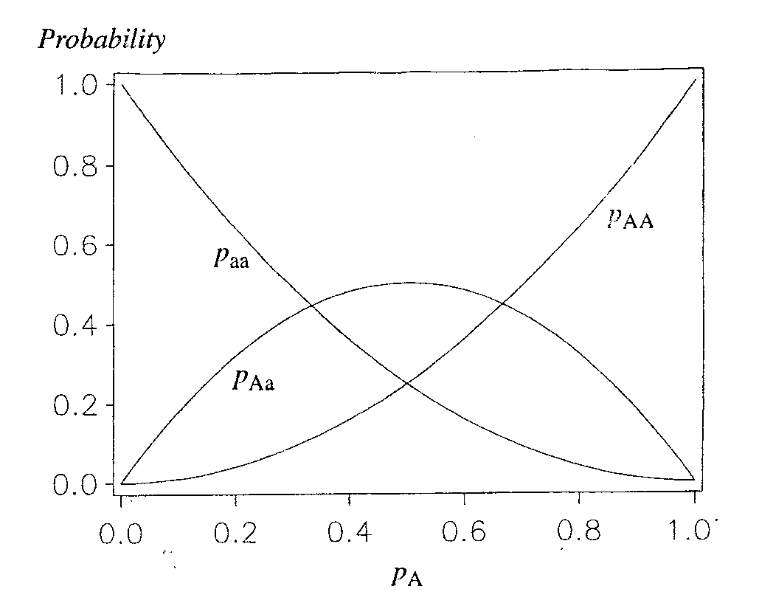
POPULATION PICTURE at one locus under H-W ≡m
NB : ‘Frequency’ heterozygote maximum for both allelic frequencies = 0.5 (see Fig.)
Also if rare allele A
So, if rare allele, probability high carried in heterozygous state: e.g. 99% chance for p_{A}= 0.01 say
p_{a}

Slide 35
Extended:Multiple Alleles Single Locus
p₁, p₂, .. p_{i} ,...p_{n} = “frequencies” alleles A₁, A₂, … A_{i} ,….A_{n ,} Possible genotypes = A₁₁, A₁₂ , ….. A_{ij} , … A_{nn}
Under H-W equilibrium, Expected genotype frequencies
(p₁+ p₂ +… p_{i} ... +p_{n}) (p₁+ p₂ +… p_{j} ... +p_{n})
= p₁² + 2p₁p₂ +…+ 2p_{i}p_{j}…..+ 2p_{n-1}p_{n} + p_{n}²
e.g. for 4 alleles, have 10 genotypes.
Proportion of heterozygosity in population clearly
P_{H} = 1 -∑_{i} p _{i} ² used in screening of
genetic markers

Slide 36
Example: Expected genotypic frequencies for a 4-allele system; H-W ≡m, proportion of heterozygosity in F2 progeny

Slide 37
GENERALISING: PROBABILITY RULES and PROPERTIES – Other Examples in brief
For loci, No. of genotypes, where n_{i} = No. alleles for locus i :
Changes in gene frequency–from migration, mutation, selection
Suppose native population has allelic freq. p_{n0} . Proportion m_{i} (relative to native population) migrates from ith of k populations to native population every generation; immigrants having allelic frequency p_{i}.
So allelic frequency in a mixed population :

Slide 38
Example: Backcross 2 locus model (AaBb × aabb) Observed and Expected frequencies Genotypic S.R 1:1 ; Expected S.R. crosses 1:1:1:1
Cross
Genotype 1 2 3 4 Pooled
Frequency AaBb 310(300) 36(30) 360(300) 74(60) 780(690)
Aabb 287(300) 23(30) 230(300) 50(60) 590(690)
aaBb 288(300) 23(30) 230(300) 44(60) 585(690)
aabb 315(300) 38(30) 380(300) 72(60) 805(690)
Marginal A Aa 597(600) 59(60) 590(600) 124(120) 1370(1380)
aa 603(600) 61(60) 610(600) 116(120) 1390(1380)
Marginal B Bb 598(600) 59(60) 590(600) 118(120) 1365(1380)
bb 602(600) 61(60) 610(600) 122(120) 1395(1380)
Sum 1200 120 1200 240 2760

