Slide 1
DATA ANALYSIS
Module Code: CA660
Lecture Block 4

Slide 2
HYPOTHESIS TESTING /Estimation
Starting Point of scientific research
e.g. No Genetic Linkage between the genetic markers and genes when we design a linkage mapping experiment H₀ : θ = 0.5 (No Linkage) (2-locus linkage experiment)
H₁ : θ ≠ 0.5 (two loci linked with specified R.F. = 0.2, say)
Critical Region
Given a cumulative probability distribution fn. of a test statistic, F(x) say, the critical region for the hypothesis test is the region of rejection in the distribution, i.e. the area under the probability curve where the observed test statistic value is unlikely to be observed if H₀ true. α or (α /2)= significance level

Slide 3
HT: Critical Regions and Symmetry
For a symmetric 2-tailed hypothesis test:
or
distinction = uni- or bi-directional alternative hypotheses
Non-Symmetric, 2-tailed
For a=0 or b=0, reduces to 1-tailed case

Slide 4
HT-Critical Values and Significance
Cut-off values for Rejection and Acceptance regions = Critical Values, so hypothesis test can be interpreted as comparison between critical values and observed hypothesis test statistic, i.e.
Significance Level : p-value is the probability of observing a sample outcome if H₀ true
is cum. prob. that expected value less than observed (test) statistic for data under H₀. For any p-value less than or equal to α, equivalent to H₀ rejected at significance level α and below.

Slide 5
Extensions and Examples: 1-Sample/2-Sample Estimation/Testing for Variances
Recall estimated sample variance
Recall form of χ² random variable
Given in C.I. form, but H.T. complementary of course. Thus 2-sided
H₀ : σ² = σ₀² , ∴ σ² from sample must be outside either limit to be in rejection region of H₀

Slide 6
Variances - continued
TWO-SAMPLE (in this case)
after manipulation - gives
and where, conveniently:
BLOCKED - like paired e.g. for mean. Depends on Experimental Designs (ANOVA) used.

Slide 7
Examples on Estimation/H.T. for Variances
Given a simple random sample, size 12, of animals studied to examine release of mediators in response to allergen inhalation. Known S.E. of sample mean = 0.4 from subject measurement.
Considering test of hypotheses
Can we claim on the basis of data that population variance is not 4?
From tables, critical values are 3.816 and 21.920 at 5% level, whereas data give
So can not reject H₀ at α=0.05

Slide 8
Examples contd.
Suppose two different marketing campaigns assessed, A and B.
Repeated observations on standard item sales give variance estimates:
Consider
Test statistic given by:
Critical values from tables for d.o.f. 9 and 19 = 3.52 for α/2 = 0.01 upper tail, while 1/F_{19,9} used for 0.01 in lower tail so lower tail critical value is = 1/4.84 = 0.207.
Result is thus ‘significant’ at 2-sided (2% or α = 0.02) level.
Conclusion : Reject H₀

Slide 9
Many-Sample Tests - Counts/ Frequencies Chi-Square ‘Goodness of Fit’
Basis
To test the hypothesis H₀ that a set of observations is consistent with a given probability distribution (p.d.f.). For a set of categories, (distribution values), record the observed O_{j} and expected E_{j} number of observations that occur in each
Under H₀, Test Statistic =
distribution, where k is the number of categories.
E.g. A test of expected segregation ratio is a test of this kind. So, for Backcross mating, expected counts for the 2 genotypic classes in progeny calculated using 0.5n, (B(n, 0.5)). For F2 mating, expected counts two homozygous classes, one heterozygous class are 0.25n,0.25n, 0.5n respectively. (With segregants for dominant gene, dominant/recessive exp. Counts thus = 0.75n and 0.25n respectively)

Slide 10
Examples – see also primer
Mouse data :
No. dominant genes(x) 0 1 2 3 4 5 Total
Obs. Freq in crosses 20 80 150 170 100 20 540
Asking, whether fitted by a Binomial, B(5, 0.5)
Expected frequencies =
expected probabilities (from formula or tables) × Total frequency (540)
So, for x = 0, exp. prob. = 0.03125. Exp. Freq. = 16.875
for x = 1, exp. prob. = 0.15625. Exp. Freq. = 84.375 etc.
So, Test statistic = (20-16.88)² /16.88 + (80-84.38)² / 84.38 + (150-168.75 )² /168.750 + (170-168.75) ² / 168.75 + (100-84.38)² / 84.38 + (20-16.88)² /16.88 = 6.364
The 0.05 critical value of χ ²₅ = 11.07, so can not reject H₀
Note: In general the chi square tests tend to be very conservative vis-a-vis other tests of hypothesis, (i.e. tend to give inconclusive results).

Slide 11
Chi-Square Contingency Test
To test two random variables are statistically independent
Under H₀, Expected number of observations for cell in row i and column j is the appropriate row total × the column total divided by the grand total. The test statistic for table n rows, m columns
Simply: the χ² distribution is the sum of squares of k independent random variables, i.e. defined in a k-dimensional space.
Constraints: e.g. forcing sum of observed and expected observations in a row or column to be equal, or e.g. estimating a parameter of parent distribution from sample values, reduces dimensionality of the space by 1 each time, so e.g. contingency table, with m rows, n columns has Expected row/column totals predetermined, so d.o.f. of the test statistic are (m-1) (n-1).

Slide 12
Example
In the following table and working, the figures in blue are expected values.
Policy 1 Policy 2 Policy 3 Policy 4 Policy 5 Totals
Char 1 2 (9.1) 16(21) 5(11.9) 5(8.75) 42(19.25) 70
Char 2 12 (9.1) 23(21) 13(11.9) 17(8.75) 5(19.25) 70
Char 3 12(7.8) 21(18) 16(10.2) 3(7.5) 8(16.5) 60
Totals 26 60 34 25 55 200
T.S. = (2 - 9.1)²/ 9.1 + (12 – 9.1)²/ 9.1 + (12-7.8)²/ 7.8 + (16 -21)²/21 + (23 - 21)²/ 21 + (21-18)²/18 + (5 -11.9)²/ 11.9 + (13-11.9)²/ 11.9 + (16 - 10.2)²/ 10.2 +(5 -8.75)²/ 8.75 + (17 -8.75)²/ 8.75 + (3 -7.5)²/ 7.5 +(42- 19.25)²/ 19.25 + (5 – 19.25)²/ 19.25 + (8 – 16.5)²/ 16.5 = 71.869
The 0 .01 critical value for χ ²₈ is 20.09 so H₀ rejected at the 0.01 level of significance.

Slide 13
χ²- Extensions
Example: Recall Mendel’s data, (earlier Lecture Block). The situation is one of multiple populations, i.e. round and wrinkled. Then
where subscript i indicates popn., m is the total number of popns. and n =No. plants, so calculate χ² for each cross & then sum.
Pooled χ² estimated using marginal frequencies under assumption same Segregation Ratio (S.R.) all 10 plants

Slide 14
χ² -Extensions - contd.
So, a typical “χ²-Table” for a single-locus segregation analysis, for n = No. genotypic classes and m = No. populations.
Source dof Chi-square
Total nm-1 χ²_{Total}
Pooled n-1 χ²_{Pooled}
Heterogeneity n(m-1) χ²_{Total} -χ²_{Pooled}
Thus for the Mendel experiment, these can be used to test separate null hypotheses, e.g.
(1) A single gene controls the seed character
(2) The F1 seed is round and heterozygous (Aa)
(3) Seeds with genotype aa are wrinkled
(4) The A allele (normal) is dominant to a allele (wrinkled)

Slide 15
Analysis of Variance/Experimental Design -Many samples, Means and Variances –refer to primer
Analysis of Variance (AOV or ANOVA) was
originally devised for agricultural statistics
on e.g. crop yields. Typically, row and column format, = small plots of a fixed size. The yield
y_{i, j} within each plot was recorded. One Way classification Model: y_{i, j} = + _{i} + _{i, j} _{i,j} ~ N (0, σ²) in the limit where = overall mean _{i} = effect of the i^{th} factor _{i, j} = error term. Hypothesis: H₀: ₁ = ₂ = … = _{m}
1
y_{1, 1}
y_{1, 2}
y_{1, 3}
y_{1, 4}
y_{1, 5}
2
y_{2, 1}
y_{2, 2}
y_{2, 3}
3
y_{3, 1}
y_{3, 2}
y_{3, 3}

Slide 16
Totals Means Factor 1 y_{1, 1} y_{1, 2} y_{1, 3} … y_{1,n1} T₁ = y_{1, j} y₁. = T₁ / n₁ 2 y_{2, 1} y_{2,, 2} y_{2, 3} y_{2, n2} T₂ = y_{2, j} y₂ . = T₂ / n₂ m y_{m, 1} y_{m, 2} y_{m, 3 …} y_{m, nm} T_{m} = y_{m, j} y_{m}. = T_{m} / n_{m} Overall mean y = y_{i, j} / n, where n = n_{i} Decomposition (Partition) of Sums of Squares: (y_{i, j} - y )² = n_{i} (y_{i} . - y )² + (y_{i, j} - y_{i} . )² Total Variation (Q) = Between Factors (Q₁) + Residual Variation (Q_{E} ) Under H₀ : Q / (n-1) -> ²_{n - 1}, Q₁ / (m - 1) -> ²_{m – 1} , Q_{E} / (n - m) -> ²_{n - m} Q₁ / ( m - 1 ) -> F_{m - 1, n - m} Q_{E} / ( n - m ) AOV Table: Variation D.F. Sums of Squares Mean Squares F Between m -1 Q₁= n_{i}(y_{i.} - y )² MS₁ = Q₁/(m - 1) MS₁/ MS_{E} Residual n - m Q_{E}= (y_{i, j} - y_{i .})² MS_{E} = Q_{E}/(n - m) Total n -1 Q = (y_{i, j.} - y )² Q /( n - 1)

Slide 17
Two-Way Classification Factor I Means Factor II y_{1, 1} y_{1, 2} y_{1, 3} y_{1, n} y₁. : : : : y_{m, 1} y_{m, 2} y_{m, 3} y_{m, n} y_{m}. Means y. ₁ y. ₂ y. ₃ y _{. n} y . . So we Write as y Partition SSQ: (y_{i, j} - y )² = n (y_{i} . - y )² + m (y . _{j} - y )² + (y_{i, j} - y_{i} . - y . _{j} + y )² Total Between Between Residual Variation Rows Columns Variation Model: y_{i, j} = + _{i} + _{j} + _{i, j} _{i, j} ~ N ( 0, σ²) H₀: All _{i} are equal. H₀: all _{j} are equal AOV Table: Variation D.F. Sums of Squares Mean Squares F Between m -1 Q₁= n (y_{i} . - y )² MS₁ = Q₁/(m - 1) MS₁/ MS_{E} Rows Between n -1 Q₂= m (y. _{j} - y )² MS₂ = Q₂/(n - 1) MS₂/ MS_{E} Columns Residual (m-1)(n-1) Q_{E}= (y_{i, j} - y_{i} . - y. _{j} + y)² MS_{E} = Q_{E}/(m-1)(n-1) Total mn -1 Q = (y_{i, j.} - y )² Q /( mn - 1)

Slide 18
Two-Way Example
ANOVA outline
Factor I 1 2 3 4 5 Totals Means Variation d.f. SSQ F
Fact II 1 20 18 21 23 20 102 20.4 Rows 3 76.95 18.86** 2 19 18 17 18 18 90 18.0 Columns 4 8.50 1.57 3 23 21 22 23 20 109 21.8 Residual 12 16.30 4 17 16 18 16 17 84 16.8
Totals 79 73 78 80 75 385 Total 19 101.75
Means 19.75 18.25 19.50 20.00 18.75 19.25 FYI software such as R,SAS,SPSS, MATLAB is designed for analysing these data, e.g. SPSS as spreadsheet recorded with variables in columns and individual observations in the rows. Thus the ANOVA data above would be written as a set of columns or rows, e.g.
Var. value 20 18 21 23 20 19 18 17 18 18 23 21 22 23 20 17 16 18 16 17 Factor 1 1 1 1 1 1 2 2 2 2 2 3 3 3 3 3 4 4 4 4 4 Factor 2 1 2 3 4 1 2 3 4 1 2 3 4 1 2 3 4 1 2 3 4

Slide 19
ANOVA Structure contd.
Model: y_{i} = β₀ + x_{i} + ε_{i} , ε_{i} ~NID(0, s²)
Partition: Variation Due to Regn. + Variation About Regn. = Total Variation
Explained Unexplained (Error or Residual)
Regression Model Interpretation( k independent variables) - ANOVA
AOV or ANOVA table
Source d.f. SSQ MSQ F Regression k SSR MSR MSR/MSE (again, upper tail test)
Error n-k-1 SSE MSE
Total n -1 SST - -
Note: Here = k independent variables. If k = 1, F-test ≡ t-test on n-k-1 dof.

Slide 20
Examples: Different ‘Experimental Designs’: What are the Mean Squares Estimating /Testing?
Factors & Type of Effects
1-Way Source dof MSQ E{MS}
Between k groups k-1 SS_{B} /k-1 σ² +nσ_{α}²
Within groups k(n-1) SS_{W} / k(n-1) σ²
Total nk-1
2-Way-A,B AB Fixed Random Mixed
E{MS A} σ² +nbκ²_{A}† σ² + nσ²_{AB} + nbσ²_{A} σ² + nσ²_{AB} + nbκ²_{A}
E{MS B} σ² +naκ²_{B} † σ² + nσ²_{AB} + naσ²_{B} σ² + nσ²_{AB} + naκ²_{B}
E{MS AB} σ² +nκ²_{AB} σ² + nσ²_{AB} σ² + nσ²_{AB}
E{MS Error} σ² σ² σ²
Model here: Many-way

Slide 21
Nested Designs
Model
Design p Batches (A)
↓ ↓ ↓ ↓
Trays (B) 1 2 3 4 …….q
Replicates ↓↓↓ ↓↓↓ … … …r per tray
ANOVA skeleton dof E{MS}
Between Batches p-1 σ²+rσ²_{B} + rqσ²_{A}
Between Trays p(q-1) σ²+rσ²_{B}
Within Batches
Between replicates pq(r-1) σ²
Within Trays
Total pqr-1

Slide 22
Linear (Regression) Models
Regression- again, see primer
Suppose want to model relationship
between markers and putative genes
GEnv 18 31 28 34 21 16 15 17 20 18
MARKER 10 15 17 20 12 7 5 9 16 8
Want straight line that best
approximates the data. Best is the line
is the line minimising the sum of squares
of vertical deviations of points from the line: SSQ = Σ ( Y_{i} - [ β₁X_{i} + β₀] ) ²
Setting partial derivatives of SSQ
w.r.t. β and β₀ to zero → Normal Equations
Y
Y_{i}
β X_{i} + β₀
0
X_{i}
X
GEnv
30
15
0
Marker
5

Slide 23
Example contd.
Model Assumptions - as for ANOVA (also a Linear Model)
Calculations give:
X Y X×X X×Y Y×Y
10 18 100 180 324
15 31 225 465 961
17 28 289 476 784
20 34 400 680 1156
12 21 144 252 441 7 16 49 112 256
5 15 25 75 225
9 17 81 133 289
16 20 256 320 400
8 18 64 144 324
Σ 119 218 1633 2857 5160
X = 11.9
Y = 21.8
Minimise
i.e.
Normal equations solutions:

Slide 24
Example contd.
Y_{i}
Y
Y
Y
Thus the regression line of Y on X is It is easy to see that ( X, Y ) satisfies the normal equations, so that the regression line of Y on X passes through the “Centre of Gravity” of the data. By expanding terms, we also get
Total Sum Error/Residual Sum Regression Sum of Squares of Squares of Squares SST = SSE + SSR X is the independent, Y the dependent variable and above info. can be represented in ANOVA table
X

Slide 25
LEAST SQUARES ESTIMATION - in general
Suppose want to find relationship between group of markers and phenotype of a trait
Y is an N×1 vector of observed trait values for
N individuals in a mapping population, X is an N×k matrix of re-coded marker data, β is a k×1 vector of unknown parameters and ε is an N×1 vector of residual errors, expectation = 0.
The Error SSQ is then
all terms in matrix/vector form
The Least Squares estimates of the unknown parameters β is that
which minimises ε^{T}ε . Differentiating this Error SSQ w.r.t. the different β’s and setting these differentiated equns. =0 gives the normal equns.

Slide 26
LSE - in general contd.
So
so L.S.E.
Hypothesis tests for parameters: use F-statistic - tests H₀ : β = 0 on k and N-k-1 dof
(assuming Total SSQ corrected for the mean)
Hypothesis tests for sub-sets of X’s, use F-statistic = ratio between residual SSQ for the reduced model and the full model.
has N-k dof, so to test H₀ : β_{i} = 0 use
with dimensions N-(k-1), assuming one
less X term, (set of β’s reduced by 1), so
tests that the subset of X’s is adequate

Slide 27
Prediction, Residuals
Prediction: Given value(s) of X(s), substitute in line/plane equn. to predict Y
Both point and interval estimates i.e. C.I. for “mean response” = line /plane. e.g. for S.L.R. C.L. for a
Prediction limits for new individual value (wider since Y_{new}=“μ” + ε )
General form same:
Residuals = Observed - Fitted (or Expected) values
Measures of goodness of fit, influence of outlying values of Y; used to investigate assumptions underlying regression, e.g. through plots.
{S.E.}
√ Residual variance

Slide 28
Correlation, Determination, Collinearity
Coefficient of Determination r² (or R²) where (0≤ R² ≤ 1) CoD = proportion of total variation that is associated with the regression. (Goodness of Fit)
r² = SSR/ SST = 1 - SSE / SST
Coefficient of correlation, r or R (0 ≤ R ≤ 1) is degree of association of X and Y (strength of linear relationship). Mathematically
Suppose r_{XY} ≅1, X is a function of Z and Y is a function of Z also. Does not follow that r_{XY} makes sense, as Z relationship may be hidden. Recognising hidden dependencies (collinearity) between variables difficult.
E.g. high r between heart disease deaths now and No. of cigarettes consumed twenty years earlier does not establish a cause-and-effect relationship.

Slide 29
Time Series
Assumptions underlying Linear Models, (ANOVA, Regression)
Errors
Mean and variance,
Normally where variance homogeneous
Independently
but time series imply sequential, trend or relationship, dependence …
Failure of assumptions.
Role of Residual Plots /Statistics– to investigate assumptions’ validity
e.g. standardised residuals vs supposed independent variable ‘X’, demonstrates need for additional independent variables, variance not homogeneous , ‘trend’ (non-independence), where X can be seen as ‘sequential ‘ in some sense.
Note: In practice, T.S. as long as possible.

Slide 30
Steps
Step. 1: Line graph (seeks components : model type additive, multiplicative)
trend or consistent long-term movement,
seasonality (regular periodicity within a shorter time-frame)
cyclical variation (gradual movement typically about the trend – e.g.
due to business/economic conditions – not usually regular
irregular activity –residual/noise: (not observable/predictable)
Step 2: Decomposition and analysis : e.g. assume multiplicative model
No seasonality: (i) trend ‘line’ or curve, (ii) ratio of data to trend
measures cyclical effect, (iii) what’s left = irregular.
Seasonality: (i) compute seasonal index each time period, (e.g. by
month) (ii) deseasonalise data (iii)trend of deseasonalised data etc…

Slide 31
Difficulties – ref. handout example
Seasonal Index calculation : somewhat subjective m.a. period
1. calculate moving totals (summing observations for each set of 4 (quarterly) or 12 (monthly) time periods
2. average and centre the totals by calculating centred moving averages
3. Divide each observation in the series by its centred moving average
4. List these ratios by columns of quarters (or months or etc.)
5. For each column, determine mean of these ratios = unadjusted seasonal indices
6. Make a final adjustment to ensure that the final seasonal indices sum to 4 (or 12 or..); these adjusted means are the adjusted seasonal indices.
B. Forecasting : Qualitative (Delphi) vs Quantitative (i) Regression or (ii) Formal T.S. model
Illustrative Examples - follow

Slide 32
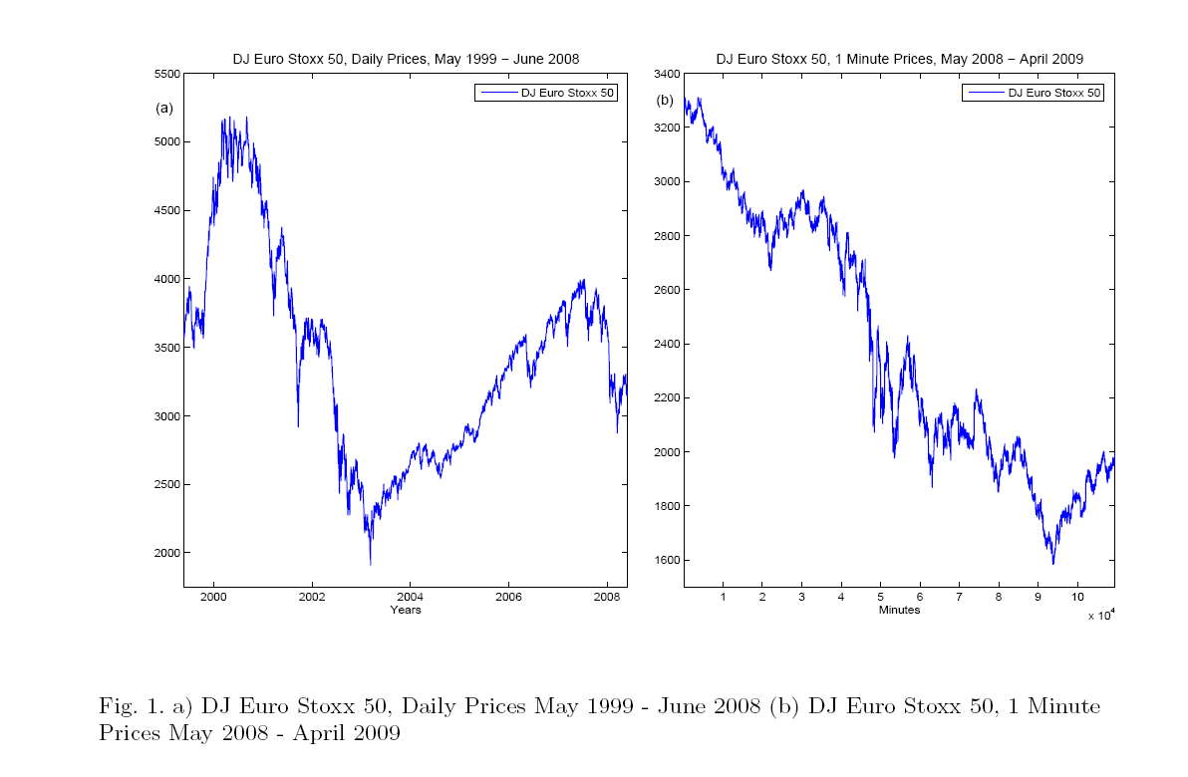

Slide 33
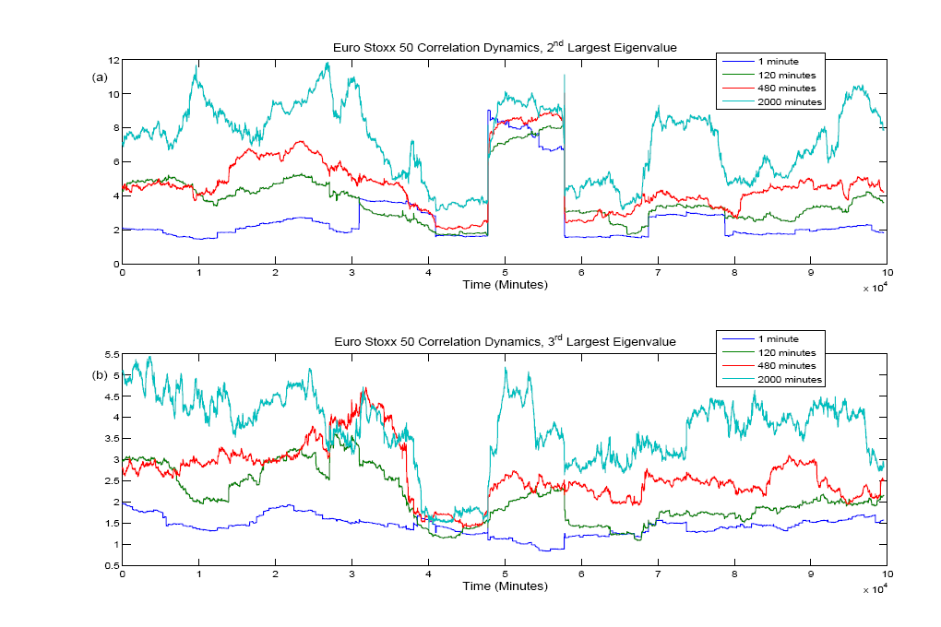

Slide 34
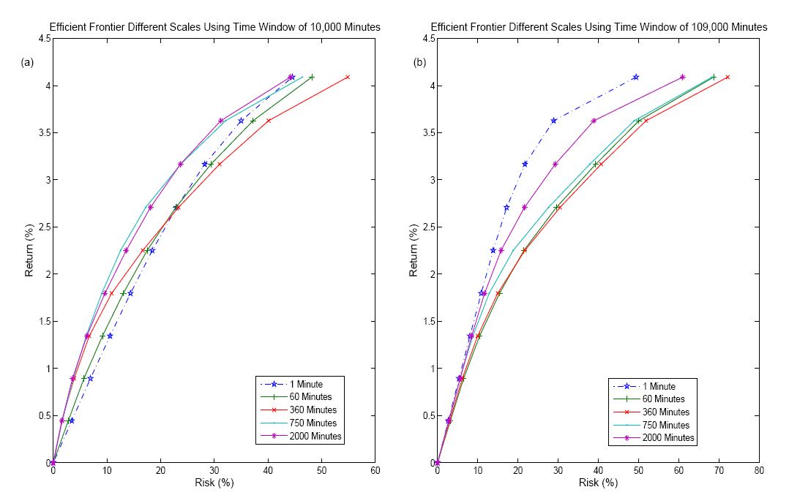

Slide 35
