Slide 1
Chapter 7
Estimating Population Values
A Course In Business Statistics
4th Edition

Slide 2
Chapter Goals
After completing this chapter, you should be able to:
Distinguish between a point estimate and a confidence interval estimate
Construct and interpret a confidence interval estimate for a single population mean using both the z and t distributions
Determine the required sample size to estimate a single population mean within a specified margin of error
Form and interpret a confidence interval estimate for a single population proportion

Slide 3
Confidence Intervals
Content of this chapter
Confidence Intervals for the Population Mean, μ
  when Population Standard Deviation σ is Known
  when Population Standard Deviation σ is Unknown
Determining the Required Sample Size
Confidence Intervals for the Population Proportion, p

Slide 4
Point and Interval Estimates
A point estimate is a single number,
a confidence interval provides additional information about variability
Lower
Confidence
Limit
Upper
Confidence
Limit
Point Estimate
Width of
confidence interval

Slide 5
Point Estimates
We can estimate a
Population Parameter …
with a Sample
Statistic
(a Point Estimate)
Mean
μ
x
Proportion
p
p

Slide 6
Confidence Intervals
How much uncertainty is associated with a point estimate of a population parameter?
An interval estimate provides more information about a population characteristic than does a point estimate
Such interval estimates are called confidence intervals

Slide 7
Confidence Interval Estimate
An interval gives a range of values:
  Takes into consideration variation in sample statistics from sample to sample
  Based on observation from 1 sample
  Gives information about closeness to unknown population parameters
  Stated in terms of level of confidence
    Never 100% sure

Slide 8


Estimation Process
Random Sample
I am 95% confident that μ is between 40 & 60.
Population
Mean
x = 50
(mean, μ, is unknown)
Sample

Slide 9
General Formula
The general formula for all confidence intervals is:
Point Estimate ± (Critical Value)(Standard Error)

Slide 10
Confidence Level
Confidence Level
  Confidence in which the interval will contain the unknown population parameter
A percentage (less than 100%)

Slide 11
Confidence Level, (1-α)
(continued)
Suppose confidence level = 95%
Also written (1 - α) = .95
A relative frequency interpretation:
  In the long run, 95% of all the confidence intervals that can be constructed will contain the unknown true parameter
A specific interval either will contain or will not contain the true parameter
  No probability involved in a specific interval

Slide 12
Confidence Intervals
Confidence
Intervals
Population
Mean
Population
Proportion
σ Known
σ Unknown

Slide 13
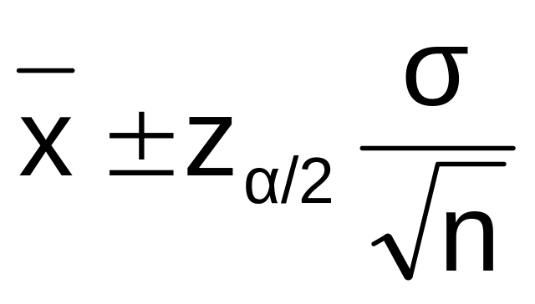
Confidence Interval for μ
(σ Known)
Assumptions
  Population standard deviation σ is known
  Population is normally distributed
  If population is not normal, use large sample
Confidence interval estimate

Slide 14
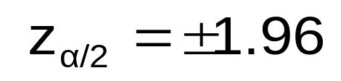

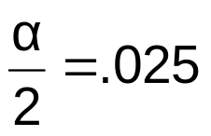
Finding the Critical Value
Consider a 95% confidence interval:
z units:
z_{.025}= -1.96
0
z_{.025}= 1.96
x units:
Lower
Confidence
Limit
Upper
Confidence
Limit
Point Estimate
Point Estimate

Slide 15
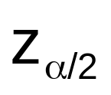

Common Levels of Confidence
Commonly used confidence levels are 90%, 95%, and 99%
Confidence Coefficient,
Confidence Level
z value,
80%
90%
95%
98%
99%
99.8%
99.9%
.80
.90
.95
.98
.99
.998
.999
1.28
1.645
1.96
2.33
2.57
3.08
3.27

Slide 16



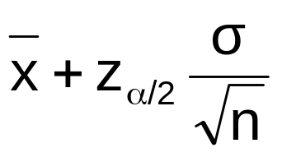
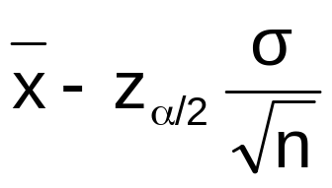
Interval and Level of Confidence
Sampling Distribution of the Mean
x
Intervals extend from
to
x₁
x₂
100(1-α)%
of intervals constructed contain μ;
100α% do not.
Confidence Intervals

Slide 17
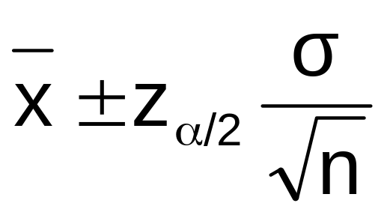
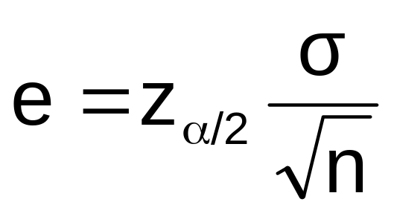


Margin of Error
Margin of Error (e): the amount added and subtracted to the point estimate to form the confidence interval
Example: Margin of error for estimating μ, σ known:

Slide 18
Factors Affecting Margin of Error
Data variation, σ : e as σ
Sample size, n : e as n
Level of confidence, 1 - α : e if 1 - α

Slide 19

Example
A sample of 11 circuits from a large normal population has a mean resistance of 2.20 ohms. We know from past testing that the population standard deviation is .35 ohms.
Determine a 95% confidence interval for the true mean resistance of the population.

Slide 20
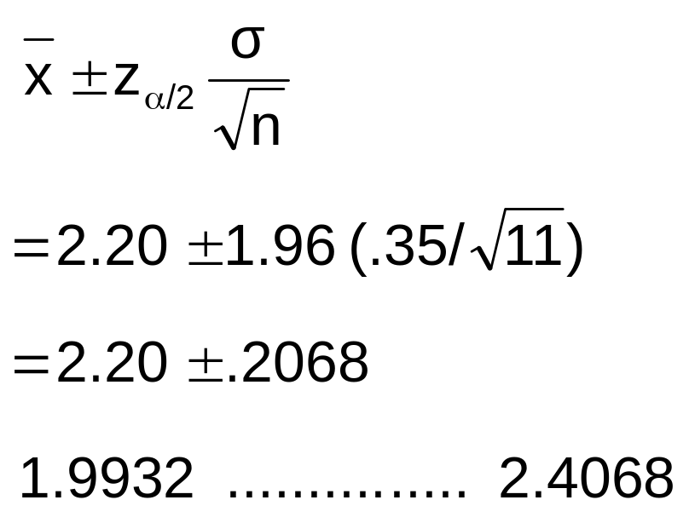
Example
(continued)
A sample of 11 circuits from a large normal population has a mean resistance of 2.20 ohms. We know from past testing that the population standard deviation is .35 ohms.
Solution:

Slide 21
Interpretation
We are 98% confident that the true mean resistance is between 1.9932 and 2.4068 ohms
Although the true mean may or may not be in this interval, 98% of intervals formed in this manner will contain the true mean
An incorrect interpretation is that there is 98% probability that this interval contains the true population mean.
(This interval either does or does not contain the true mean, there is no probability for a single interval)

Slide 22
Confidence Intervals
Confidence
Intervals
Population
Mean
Population
Proportion
σ Known
σ Unknown

Slide 23
Confidence Interval for μ
(σ Unknown)
If the population standard deviation σ is unknown, we can substitute the sample standard deviation, s
This introduces extra uncertainty, since s is variable from sample to sample
So we use the t distribution instead of the normal distribution

Slide 24
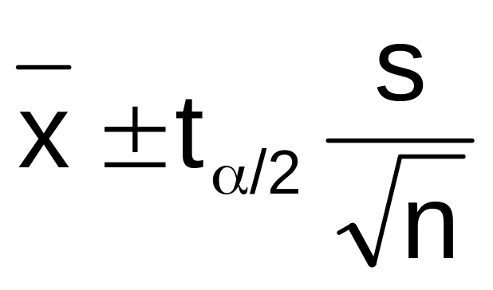
Confidence Interval for μ
(σ Unknown)
(continued)
Assumptions
  Population standard deviation is unknown
  Population is normally distributed
  If population is not normal, use large sample
Use Student’s t Distribution
Confidence Interval Estimate

Slide 25
Student’s t Distribution
The t is a family of distributions
The t value depends on degrees of freedom (d.f.)
  Number of observations that are free to vary after sample mean has been calculated
d.f. = n - 1

Slide 26
Degrees of Freedom (df)
  Idea: Number of observations that are free to vary
  after sample mean has been calculated
  Example: Suppose the mean of 3 numbers is 8.0
    Let x₁ = 7
    Let x₂ = 8
    What is x₃?
If the mean of these three values is 8.0,
then x₃ must be 9
(i.e., x₃ is not free to vary)
Here, n = 3, so degrees of freedom = n -1 = 3 – 1 = 2
(2 values can be any numbers, but the third is not free to vary for a given mean)

Slide 27
Student’s t Distribution
Note: t z as n increases
Standard Normal
(t with df = ∞)
t (df = 13)
t-distributions are bell-shaped and symmetric, but have ‘fatter’ tails than the normal
t (df = 5)
t
0

Slide 28
Student’s t Table
Upper Tail Area
Let: n = 3
df = n - 1 = 2
α = .10
α/2 =.05
df
.25
.10
.05
1
1.000
3.078
6.314
2
0.817
1.886
2.920
3
0.765
1.638
2.353
α/2 = .05
The body of the table contains t values, not probabilities
0
2.920
t

Slide 29
t distribution values
With comparison to the z value
Confidence t t t z
Level (10 d.f.) (20 d.f.) (30 d.f.) ____
.80 1.372 1.325 1.310 1.28
.90 1.812 1.725 1.697 1.64
.95 2.228 2.086 2.042 1.96
.99 3.169 2.845 2.750 2.57
Note: t z as n increases

Slide 30
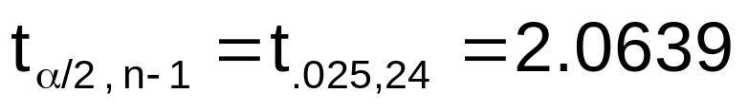
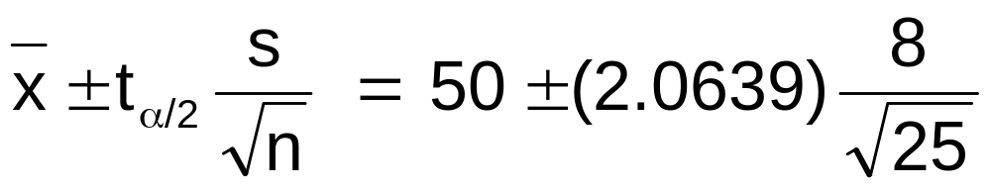
Example
A random sample of n = 25 has x = 50 and
s = 8. Form a 95% confidence interval for μ
  d.f. = n – 1 = 24, so
  The confidence interval is
46.698 …………….. 53.302

Slide 31

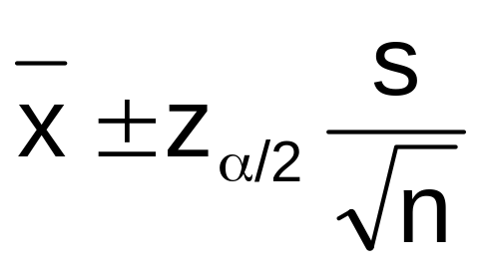
Approximation for Large Samples
Since t approaches z as the sample size increases, an approximation is sometimes used when n ≥ 30:
Technically
correct
Approximation
for large n

Slide 32
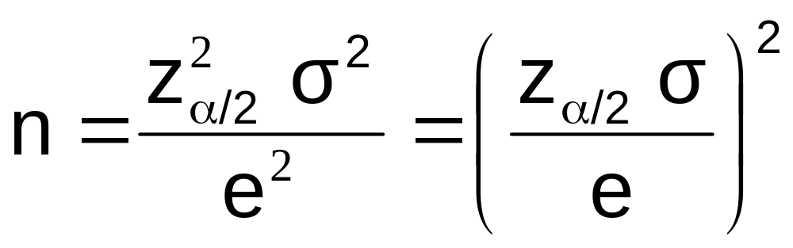
Determining Sample Size
The required sample size can be found to reach a desired margin of error (e) and
level of confidence (1 - α)
  Required sample size, σ known:

Slide 33
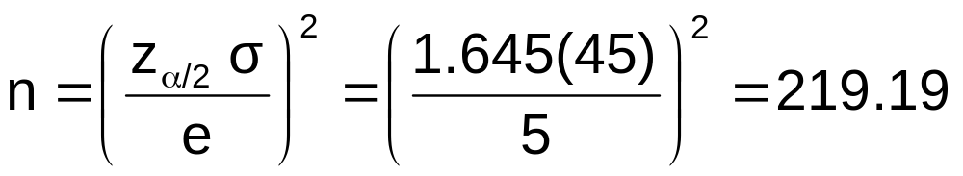
Required Sample Size Example
If σ = 45, what sample size is needed to be 90% confident of being correct within ± 5?
So the required sample size is n = 220
(Always round up)

Slide 34
If σ is unknown
If unknown, σ can be estimated when using the required sample size formula
  Use a value for σ that is expected to be at least as large as the true σ
  Select a pilot sample and estimate σ with the sample standard deviation, s

Slide 35
Confidence Intervals
Confidence
Intervals
Population
Mean
Population
Proportion
σ Known
σ Unknown

Slide 36
Confidence Intervals for the
Population Proportion, p
An interval estimate for the population proportion ( p ) can be calculated by adding an allowance for uncertainty to the sample proportion ( p )

Slide 37
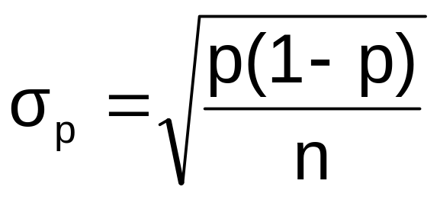
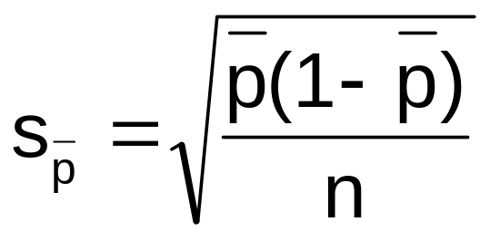
Confidence Intervals for the
Population Proportion, p
(continued)
Recall that the distribution of the sample proportion is approximately normal if the sample size is large, with standard deviation
We will estimate this with sample data:

Slide 38
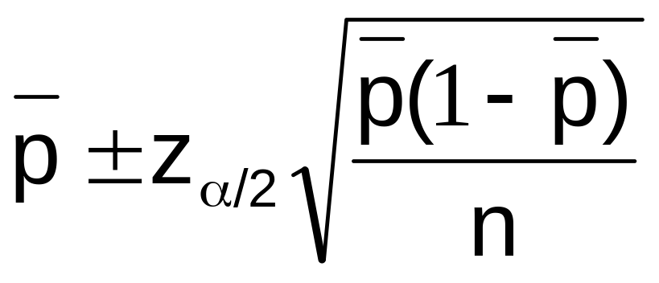
Confidence interval endpoints
Upper and lower confidence limits for the population proportion are calculated with the formula
where
  z is the standard normal value for the level of confidence desired
  p is the sample proportion
  n is the sample size

Slide 39

Example
A random sample of 100 people shows that 25 are left-handed.
Form a 95% confidence interval for the true proportion of left-handers

Slide 40
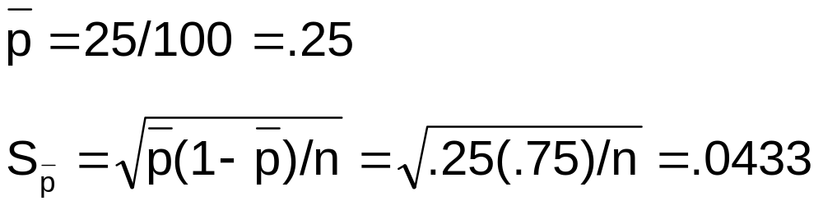
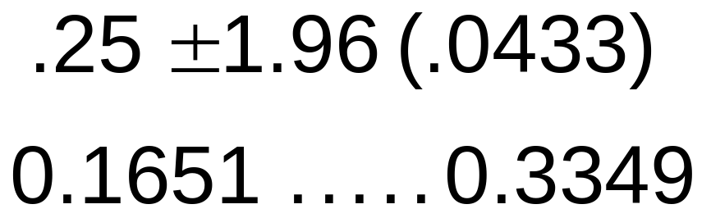
Example
(continued)
A random sample of 100 people shows that 25 are left-handed. Form a 95% confidence interval for the true proportion of left-handers.
1.
2.
3.

Slide 41
Interpretation
We are 95% confident that the true percentage of left-handers in the population is between
16.51% and 33.49%.
Although this range may or may not contain the true proportion, 95% of intervals formed from samples of size 100 in this manner will contain the true proportion.

Slide 42
Changing the sample size
Increases in the sample size reduce the width of the confidence interval.
Example:
  If the sample size in the above example is doubled to 200, and if 50 are left-handed in the sample, then the interval is still centered at .25, but the width shrinks to
.19 …… .31

Slide 43
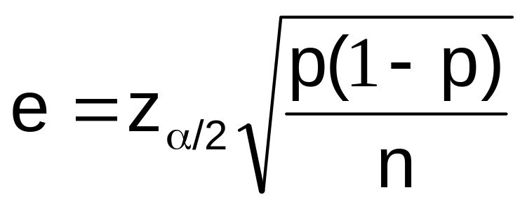
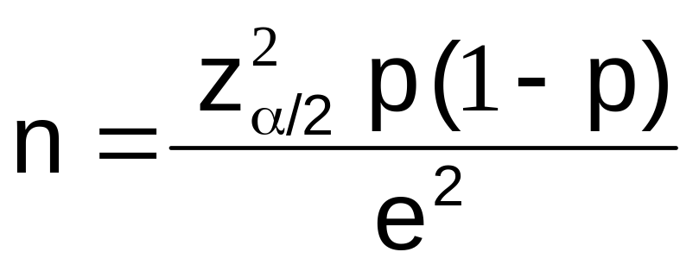
Finding the Required Sample Size for proportion problems
Define the
margin of error:
Solve for n:
p can be estimated with a pilot sample, if necessary (or conservatively use p = .50)

Slide 44
What sample size...?
How large a sample would be necessary to estimate the true proportion defective in a large population within 3%, with 95% confidence?
(Assume a pilot sample yields p = .12)

Slide 45
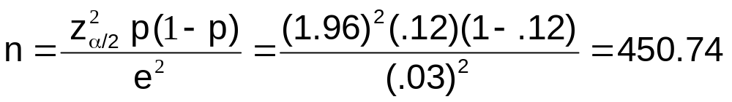
What sample size...?
(continued)
Solution:
For 95% confidence, use Z = 1.96
E = .03
p = .12, so use this to estimate p
So use n = 451

Slide 46
Using PHStat
PHStat can be used for confidence intervals for the mean or proportion
two options for the mean: known and unknown population standard deviation
required sample size can also be found

Slide 47
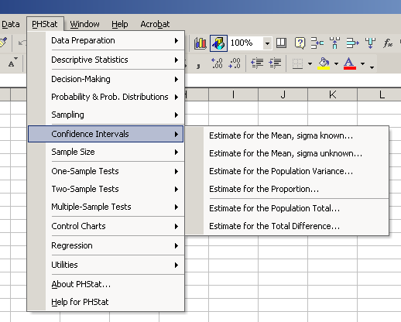
PHStat Interval Options
options

Slide 48
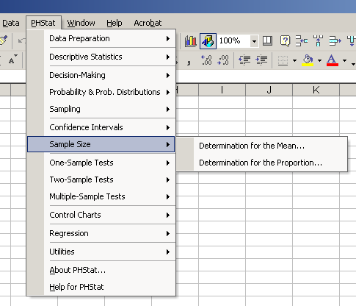
PHStat Sample Size Options

Slide 49
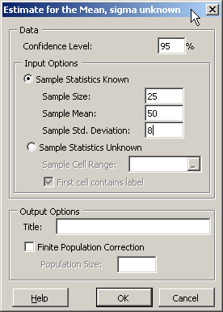
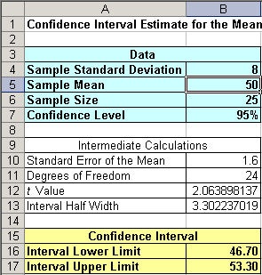
Using PHStat
(for μ, σ unknown)
A random sample of n = 25 has x = 50 and
s = 8. Form a 95% confidence interval for μ

Slide 50
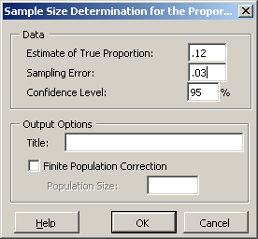
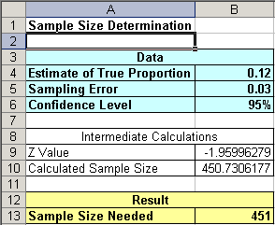
Using PHStat
(sample size for proportion)
How large a sample would be necessary to estimate the true proportion defective in a large population within 3%, with 95% confidence?
(Assume a pilot sample yields p = .12)

Slide 51
Chapter Summary
Illustrated estimation process
Discussed point estimates
Introduced interval estimates
Discussed confidence interval estimation for the mean (σ known)
Addressed determining sample size
Discussed confidence interval estimation for the mean (σ unknown)
Discussed confidence interval estimation for the proportion

