Slide 1
Chapter 8
Introduction to
Hypothesis Testing
A Course In Business Statistics
4th Edition

Slide 2
Chapter Goals
After completing this chapter, you should be able to:
Formulate null and alternative hypotheses for applications involving a single population mean or proportion
Formulate a decision rule for testing a hypothesis
Know how to use the test statistic, critical value, and p-value approaches to test the null hypothesis
Know what Type I and Type II errors are
Compute the probability of a Type II error

Slide 3

What is a Hypothesis?
A hypothesis is a claim
(assumption) about a
population parameter:
  population mean
  population proportion
Example: The mean monthly cell phone bill of this city is μ = $42
Example: The proportion of adults in this city with cell phones is p = .68

Slide 4
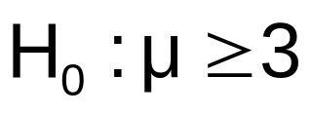

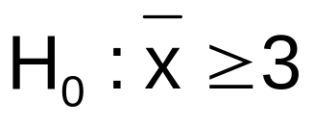
The Null Hypothesis, H₀
States the assumption (numerical) to be tested
  Example: The average number of TV sets in U.S. Homes is at least three ( )
Is always about a population parameter, not about a sample statistic

Slide 5

The Null Hypothesis, H₀
(continued)
Begin with the assumption that the null hypothesis is true
  Similar to the notion of innocent until
  proven guilty
Refers to the status quo
Always contains “=” , “≤” or “≥” sign
May or may not be rejected

Slide 6
The Alternative Hypothesis, H_{A}
Is the opposite of the null hypothesis
  e.g.: The average number of TV sets in U.S. homes is less than 3 ( H_{A}: μ < 3 )
Challenges the status quo
Never contains the “=” , “≤” or “≥” sign
May or may not be accepted
Is generally the hypothesis that is believed (or needs to be supported) by the researcher

Slide 7
Hypothesis Testing Process
Claim: the
population
mean age is 50.
(Null Hypothesis:
Population
H₀: μ = 50 )
Now select a random sample
Is
x
=
20
likely if μ = 50?
If not likely,
Suppose
the sample
REJECT
mean age
is 20: x = 20
Sample
Null Hypothesis

Slide 8
Reason for Rejecting H₀
Sampling Distribution of x
x
20
μ = 50
If H₀ is true
... then we reject the null hypothesis that μ = 50.
If it is unlikely that we would get a sample mean of this value ...
... if in fact this were
the population mean…

Slide 9
Level of Significance, α
Defines unlikely values of sample statistic if null hypothesis is true
  Defines rejection region of the sampling distribution
Is designated by α , (level of significance)
  Typical values are .01, .05, or .10
Is selected by the researcher at the beginning
Provides the critical value(s) of the test

Slide 10
Level of Significance and the Rejection Region
Level of significance =
α
Represents
critical value
H₀: μ ≥ 3 H_{A}: μ < 3
α
Rejection region is shaded
Lower tail test
0
H₀: μ ≤ 3 H_{A}: μ > 3
α
Upper tail test
0
H₀: μ = 3 H_{A}: μ ≠ 3
α
α
/2
/2
Two tailed test
0

Slide 11
Errors in Making Decisions
Type I Error
  Reject a true null hypothesis
  Considered a serious type of error
  The probability of Type I Error is α
    Called level of significance of the test
    Set by researcher in advance

Slide 12
Errors in Making Decisions
(continued)
Type II Error
  Fail to reject a false null hypothesis
  The probability of Type II Error is β

Slide 13
Outcomes and Probabilities
Possible Hypothesis Test Outcomes
State of Nature
Decision
H₀ True
H₀ False
Do Not
No error
(1 - )
Type II Error
( β )
Reject
Key:
Outcome
(Probability)
α
H
0
Reject
Type I Error
( )
No Error
( 1 - β )
H
α
0

Slide 14
Type I & II Error Relationship
Type I and Type II errors can not happen at
the same time
  Type I error can only occur if H₀ is true
  Type II error can only occur if H₀ is false
If Type I error probability ( α ) , then
Type II error probability ( β )

Slide 15
Factors Affecting Type II Error
All else equal,
  β when the difference between hypothesized parameter and its true value
  β when α
  β when σ
  β when n

Slide 16

Critical Value
Approach to Testing
Convert sample statistic (e.g.: ) to test statistic ( Z or t statistic )
Determine the critical value(s) for a specified
level of significance α from a table or computer
If the test statistic falls in the rejection region, reject H₀ ; otherwise do not reject H₀

Slide 17
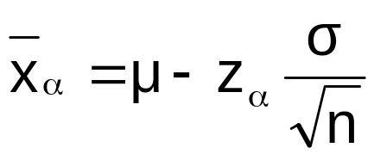
Lower Tail Tests
H₀: μ ≥ 3
H_{A}: μ < 3
The cutoff value,
or , is called a critical value
-z_{α}
x_{α}
α
Reject H₀
Do not reject H₀
-z_{α}
0
x_{α}
μ

Slide 18
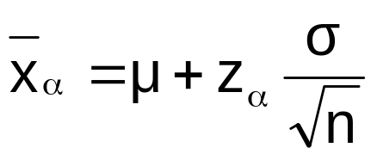
Upper Tail Tests
H₀: μ ≤ 3
H_{A}: μ > 3
The cutoff value,
or , is called a critical value
z_{α}
x_{α}
α
Do not reject H₀
Reject H₀
0
z_{α}
μ
x_{α}

Slide 19
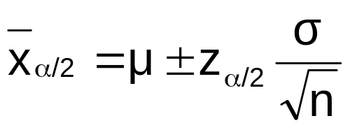
Two Tailed Tests
There are two cutoff values (critical values):
or
H₀: μ = 3 H_{A}: μ ≠ 3
± z_{α/2}
α/2
α/2
x_{α/2}
Lower
Upper
x_{α/2}
Reject H₀
Do not reject H₀
Reject H₀
-z_{α/2}
0
z_{α/2}
x_{α/2}
μ₀
x_{α/2}
Lower
Upper

Slide 20
Critical Value
Approach to Testing
Convert sample statistic ( ) to a test statistic
( Z or t statistic )
x
Hypothesis
Tests for μ
σ Known
σ Unknown

Slide 21
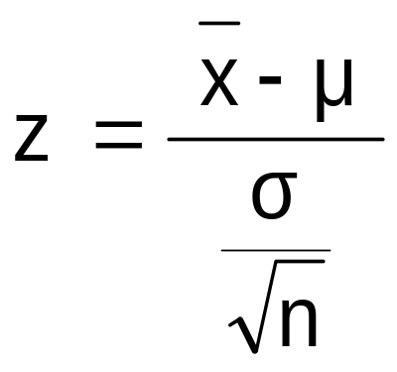
Calculating the Test Statistic
Hypothesis
Tests for μ
σ Known
σ Unknown
The test statistic is:

Slide 22
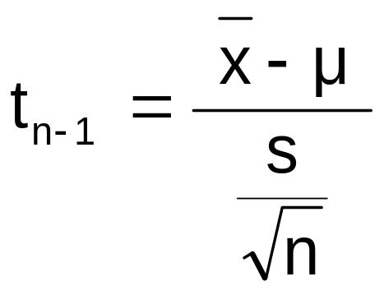
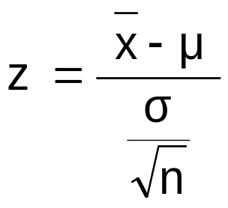
Calculating the Test Statistic
(continued)
Hypothesis
Tests for μ
σ Known
σ Unknown
The test statistic is:
But is sometimes approximated using a z:
Working With
Large Samples

Slide 23
Calculating the Test Statistic
(continued)
Hypothesis
Tests for μ
σ Known
σ Unknown
The test statistic is:
Using
Small
Samples
(The population must be approximately normal)

Slide 24
Review: Steps in Hypothesis Testing
1. Specify the population value of interest
2. Formulate the appropriate null and alternative hypotheses
3. Specify the desired level of significance
4. Determine the rejection region
5. Obtain sample evidence and compute the test statistic
6. Reach a decision and interpret the result

Slide 25
Hypothesis Testing Example
Test the claim that the true mean # of TV sets in US homes is at least 3.
(Assume σ = 0.8)
1. Specify the population value of interest
  The mean number of TVs in US homes
2. Formulate the appropriate null and alternative hypotheses
  H₀: μ ≥ 3 H_{A}: μ < 3 (This is a lower tail test)
3. Specify the desired level of significance
  Suppose that α = .05 is chosen for this test

Slide 26
Hypothesis Testing Example
(continued)
4. Determine the rejection region
α = .05
Reject H₀
Do not reject H₀
-z_{α}= -1.645
0
This is a one-tailed test with α = .05.
Since σ is known, the cutoff value is a z value:
Reject H₀ if z < z_{α} = -1.645 ; otherwise do not reject H₀

Slide 27
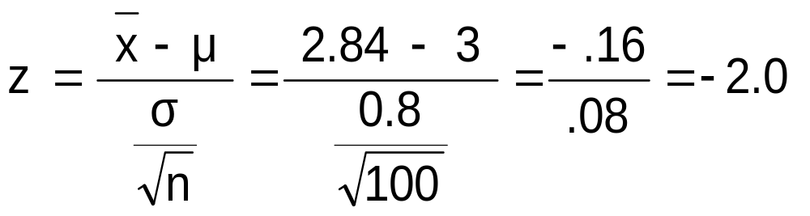
Hypothesis Testing Example
5. Obtain sample evidence and compute the test statistic
Suppose a sample is taken with the following results: n = 100, x = 2.84 (σ = 0.8 is assumed known)
  Then the test statistic is:

Slide 28
Hypothesis Testing Example
(continued)
6. Reach a decision and interpret the result
α = .05
z
Reject H₀
Do not reject H₀
-1.645
0
-2.0
Since z = -2.0 < -1.645, we reject the null hypothesis that the mean number of TVs in US homes is at least 3

Slide 29
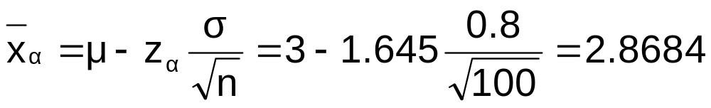
Hypothesis Testing Example
(continued)
An alternate way of constructing rejection region:
Now expressed in x, not z units
α = .05
x
Reject H₀
Do not reject H₀
2.8684
3
2.84
Since x = 2.84 < 2.8684, we reject the null hypothesis

Slide 30
p-Value Approach to Testing
Convert Sample Statistic (e.g. ) to Test Statistic ( z or t statistic )
Obtain the p-value from a table or computer
Compare the p-value with α
  If p-value < α , reject H₀
  If p-value ≥ α , do not reject H₀
x

Slide 31
p-Value Approach to Testing
(continued)
p-value: Probability of obtaining a test statistic more extreme ( ≤ or ≥ ) than the observed sample value given H₀ is true
  Also called observed level of significance
  Smallest value of α for which H₀ can be rejected

Slide 32
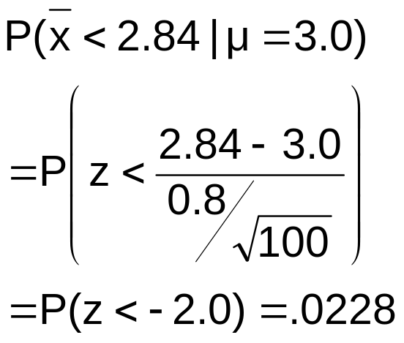
p-value example
Example: How likely is it to see a sample mean of 2.84 (or something further below the mean) if the true mean is μ = 3.0?
α = .05
p-value =.0228
x
2.8684
3
2.84

Slide 33
p-value example
(continued)
Compare the p-value with α
  If p-value < α , reject H₀
  If p-value ≥ α , do not reject H₀
α = .05
Here: p-value = .0228
α = .05
Since .0228 < .05, we reject the null hypothesis
p-value =.0228
2.8684
3
2.84

Slide 34
Example: Upper Tail z Test for Mean (σ Known)
A phone industry manager thinks that customer monthly cell phone bill have increased, and now average over $52 per month. The company wishes to test this claim. (Assume σ = 10 is known)
Form hypothesis test:
H₀: μ ≤ 52 the average is not over $52 per month
H_{A}: μ > 52 the average is greater than $52 per month
(i.e., sufficient evidence exists to support the
manager’s claim)

Slide 35
Example: Find Rejection Region
(continued)
Suppose that α = .10 is chosen for this test
Find the rejection region:
Reject H₀
α = .10
Do not reject H₀
Reject H₀
0
z_{α}=1.28
Reject H₀ if z > 1.28

Slide 36
Review:
Finding Critical Value - One Tail
Standard Normal Distribution Table (Portion)
What is z given α = 0.10?
.90
.10
.08
Z
.07
.09
α = .10
1.1
.3790
.3810
.3830
.50
.40
1.2
.3980
.3997
.4015
z
0
1.28
1.3
.4147
.4162
.4177
Critical Value
= 1.28

Slide 37
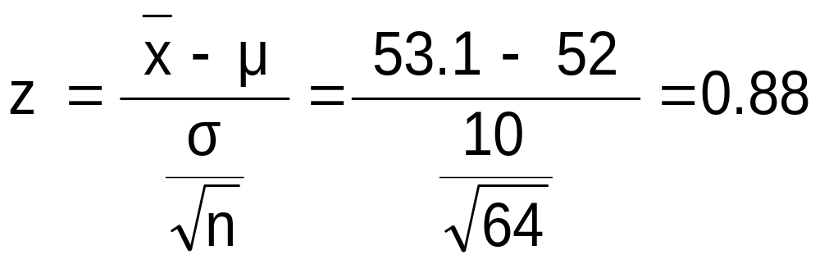
Example: Test Statistic
(continued)
Obtain sample evidence and compute the test statistic
Suppose a sample is taken with the following results: n = 64, x = 53.1 (σ=10 was assumed known)
  Then the test statistic is:

Slide 38
Example: Decision
(continued)
Reach a decision and interpret the result:
Reject H₀
α = .10
Do not reject H₀
1.28
Reject H₀
0
z = .88
Do not reject H₀ since z = 0.88 ≤ 1.28
i.e.: there is not sufficient evidence that the
mean bill is over $52

Slide 39
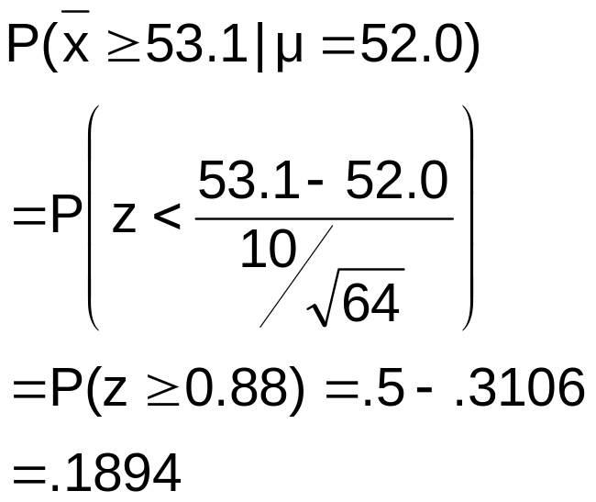
p -Value Solution
(continued)
Calculate the p-value and compare to α
p-value = .1894
Reject H₀
α = .10
0
Do not reject H₀
1.28
Reject H₀
z = .88
Do not reject H₀ since p-value = .1894 > α = .10

Slide 40

Example: Two-Tail Test
(σ Unknown)
The average cost of a hotel room in New York is said to be $168 per night. A random sample of 25 hotels resulted in x = $172.50 and
s = $15.40. Test at the
α = 0.05 level.
(Assume the population distribution is normal)
H₀: μ = 168 H_{A}: μ ≠ 168

Slide 41
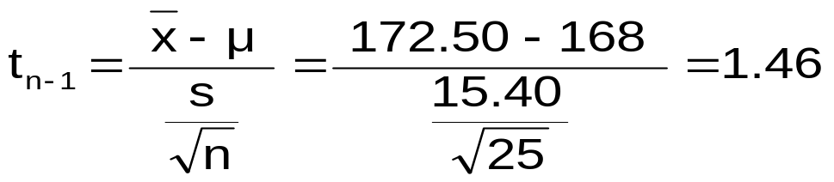
Example Solution: Two-Tail Test
H₀: μ = 168 H_{A}: μ ≠ 168
α/2=.025
α/2=.025
α = 0.05
n = 25
σ is unknown, so
use a t statistic
Critical Value:
t₂₄ = ± 2.0639
Reject H₀
Do not reject H₀
Reject H₀
-t_{α/2}
t_{α/2}
0
-2.0639
2.0639
1.46
Do not reject H₀: not sufficient evidence that true mean cost is different than $168

Slide 42
Hypothesis Tests for Proportions
Involves categorical values
Two possible outcomes
  “Success” (possesses a certain characteristic)
  “Failure” (does not possesses that characteristic)
Fraction or proportion of population in the “success” category is denoted by p

Slide 43
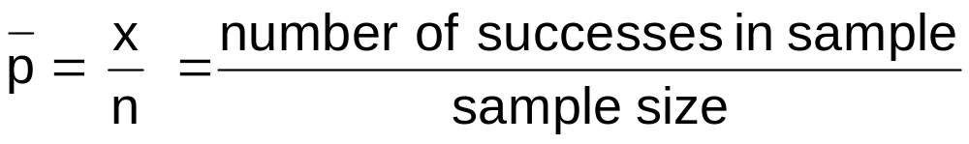
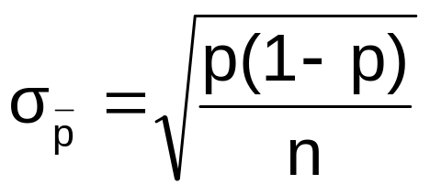
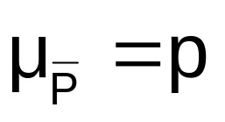
Proportions
(continued)
Sample proportion in the success category is denoted by p
When both np and n(1-p) are at least 5, p can be approximated by a normal distribution with mean and standard deviation

Slide 44
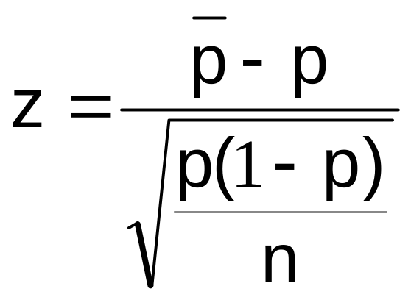
Hypothesis Tests for Proportions
The sampling distribution of p is normal, so the test statistic is a z value:
Hypothesis
Tests for p
np ≥ 5
and
n(1-p) ≥ 5
np < 5
or
n(1-p) < 5
Not discussed in this chapter

Slide 45

Example: z Test for Proportion
A marketing company claims that it receives 8% responses from its mailing. To test this claim, a random sample of 500 were surveyed with 25 responses. Test at the α = .05 significance level.
Check:
n p = (500)(.08) = 40
n(1-p) = (500)(.92) = 460
✓

Slide 46
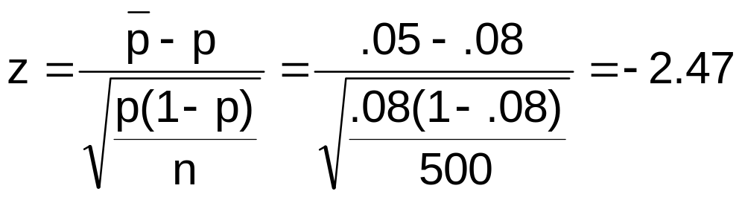
Z Test for Proportion: Solution
Test Statistic:
H₀: p = .08 H_{A}: p ≠ .08
α = .05
n = 500, p = .05
Critical Values: ± 1.96
Decision:
Reject H₀ at α = .05
Reject
Reject
Conclusion:
.025
.025
There is sufficient evidence to reject the company’s claim of 8% response rate.
z
-1.96
0
1.96
-2.47

Slide 47
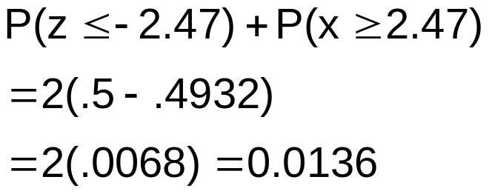
p -Value Solution
(continued)
Calculate the p-value and compare to α
(For a two sided test the p-value is always two sided)
Do not reject H₀
Reject H₀
Reject H₀
p-value = .0136:
α/2 = .025
α/2 = .025
.0068
.0068
-1.96
0
1.96
z = -2.47
z = 2.47
Reject H₀ since p-value = .0136 < α = .05

Slide 48
Type II Error
Type II error is the probability of
failing to reject a false H₀
Suppose we fail to reject H₀: μ ≥ 52
when in fact the true mean is μ = 50
α
50
52
Reject
H₀: μ ≥ 52
Do not reject
H₀ : μ ≥ 52

Slide 49
Type II Error
(continued)
Suppose we do not reject H₀: μ ≥ 52 when in fact the true mean is μ = 50
This is the range of x where H₀ is not rejected
This is the true distribution of x if μ = 50
50
52
Reject
H₀: μ ≥ 52
Do not reject
H₀ : μ ≥ 52

Slide 50
Type II Error
(continued)
Suppose we do not reject H₀: μ ≥ 52 when in fact the true mean is μ = 50
Here, β = P( x ≥ cutoff ) if μ = 50
α
β
50
52
Reject
H₀: μ ≥ 52
Do not reject
H₀ : μ ≥ 52

Slide 51

Calculating β
Suppose n = 64 , σ = 6 , and α = .05
(for H₀ : μ ≥ 52)
So β = P( x ≥ 50.766 ) if μ = 50
α
50
50.766
52
Reject
H₀: μ ≥ 52
Do not reject
H₀ : μ ≥ 52

Slide 52
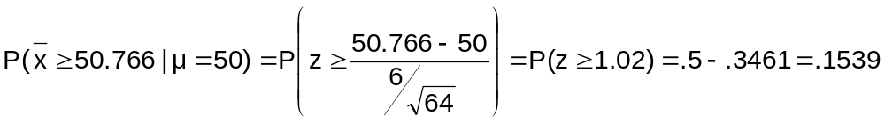
Calculating β
(continued)
Suppose n = 64 , σ = 6 , and α = .05
Probability of type II error:
β = .1539
α
50
52
Reject
H₀: μ ≥ 52
Do not reject
H₀ : μ ≥ 52

Slide 53
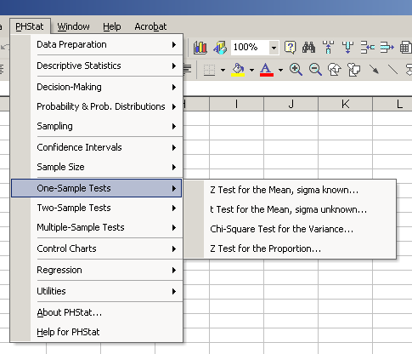
Using PHStat
Options

Slide 54
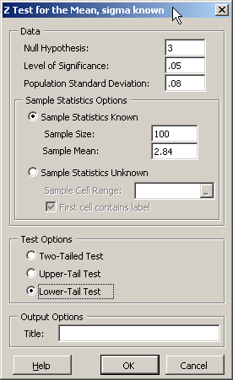
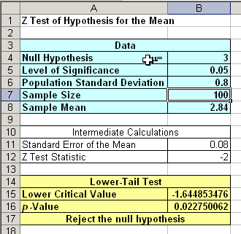
Sample PHStat Output
Input
Output

Slide 55
Chapter Summary
Addressed hypothesis testing methodology
Performed z Test for the mean (σ known)
Discussed p–value approach to hypothesis testing
Performed one-tail and two-tail tests . . .

Slide 56
Chapter Summary
(continued)
Performed t test for the mean (σ unknown)
Performed z test for the proportion
Discussed type II error and computed its probability

