Slide 1
Chapter 9
Estimation and Hypothesis Testing for Two Population Parameters
A Course In Business Statistics
4th Edition

Slide 2
Chapter Goals
After completing this chapter, you should be able to:
Test hypotheses or form interval estimates for
  two independent population means
    Standard deviations known
    Standard deviations unknown
  two means from paired samples
  the difference between two population proportions
  Set up a contingency analysis table and perform a chi-square test of independence

Slide 3
Estimation for Two Populations
Estimating two population values
Population means, independent samples
Paired samples
Population proportions
Examples:
Group 1 vs. independent Group 2
Same group before vs. after treatment
Proportion 1 vs.
Proportion 2

Slide 4
Difference Between Two Means
Population means, independent samples
*
Goal: Form a confidence interval for the difference between two population means, μ₁ – μ₂
σ₁ and σ₂ known
The point estimate for the difference is
x₁ – x₂

Slide 5
Independent Samples
Different data sources
  Unrelated
  Independent
    Sample selected from one population has no effect on the sample selected from the other population
Use the difference between 2 sample means
Use z test or pooled variance t test
Population means, independent samples
*
σ₁ and σ₂ known

Slide 6
σ₁ and σ₂ known
Population means, independent samples
Assumptions:
Samples are randomly and
independently drawn
population distributions are
normal or both sample sizes
are ≥ 30
Population standard
deviations are known
*
σ₁ and σ₂ known

Slide 7
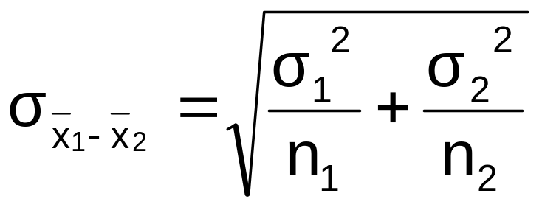
σ₁ and σ₂ known
(continued)
When σ₁ and σ₂ are known and both populations are normal or both sample sizes are at least 30, the test statistic is a z-value…
Population means, independent samples
*
σ₁ and σ₂ known
…and the standard error of
x₁ – x₂ is

Slide 8
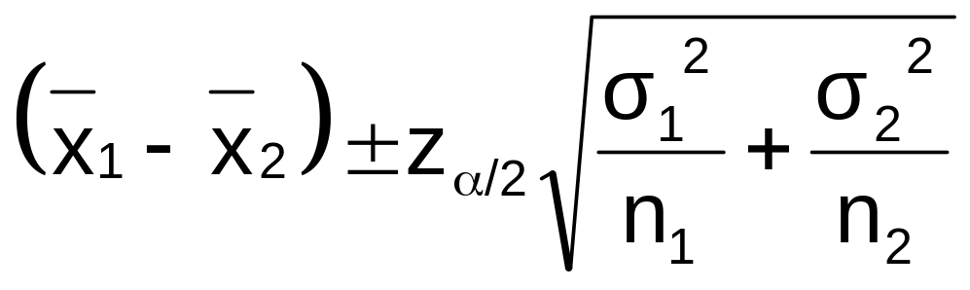
σ₁ and σ₂ known
(continued)
Population means, independent samples
The confidence interval for
μ₁ – μ₂ is:
*
σ₁ and σ₂ known

Slide 9
σ₁ and σ₂ unknown
Population means, independent samples
Assumptions:
populations are normally
distributed
the populations have equal
variances
samples are independent
σ₁ and σ₂ known
*
σ₁ and σ₂ unknown,

Slide 10
σ₁ and σ₂ unknown
(continued)
Forming interval estimates:
The population variances
are assumed equal, so use
the two sample standard
deviations and pool them to
estimate σ
the test statistic is a t value
with (n₁ + n₂ – 2) degrees
of freedom
Population means, independent samples
σ₁ and σ₂ known
*
σ₁ and σ₂ unknown,

Slide 11
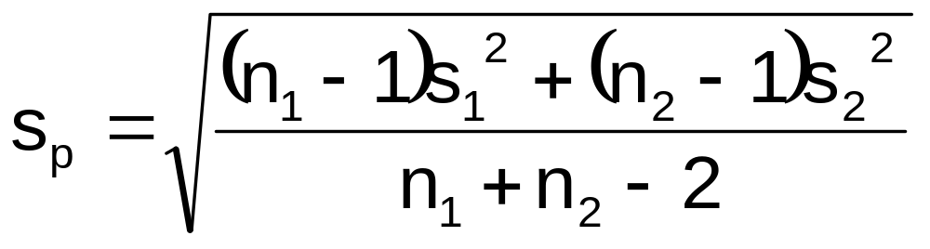
σ₁ and σ₂ unknown
(continued)
The pooled standard deviation is
Population means, independent samples
σ₁ and σ₂ known
*
σ₁ and σ₂ unknown

Slide 12
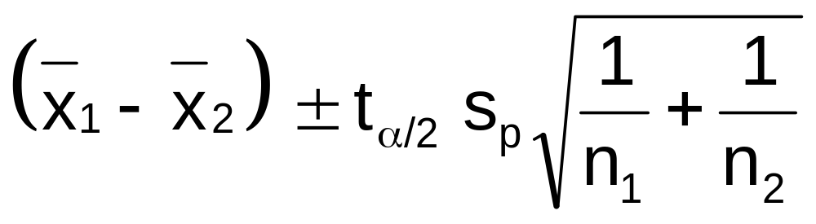
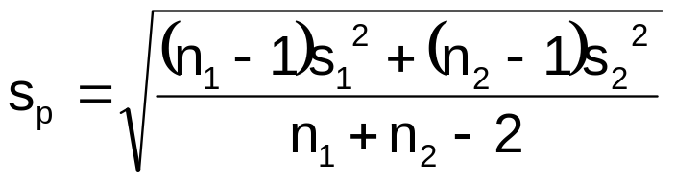
σ₁ and σ₂ unknown
(continued)
Population means, independent samples
The confidence interval for
μ₁ – μ₂ is:
σ₁ and σ₂ known
Where t_{α/2} has (n₁ + n₂ – 2) d.f.,
and
*
σ₁ and σ₂ unknown

Slide 13
Paired Samples
Tests Means of 2 Related Populations
      Paired or matched samples
      Repeated measures (before/after)
      Use difference between paired values:
Eliminates Variation Among Subjects
Assumptions:
  Both Populations Are Normally Distributed
  Or, if Not Normal, use large samples
Paired samples
  d = x₁ - x₂

Slide 14
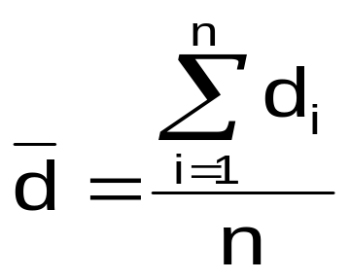
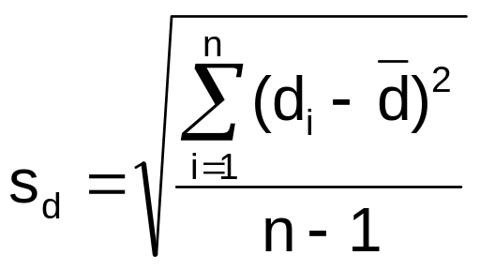
Paired Differences
The i^{th} paired difference is d_{i} , where
Paired samples
  d_{i} = x_{1i} - x_{2i}
The point estimate for the population mean paired difference is d :
The sample standard deviation is
n is the number of pairs in the paired sample

Slide 15
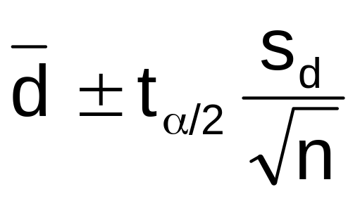
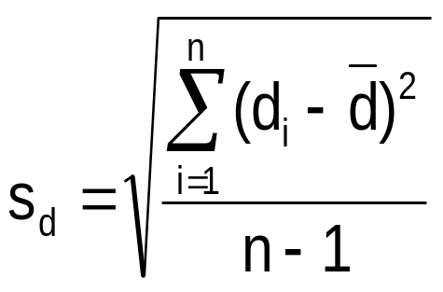
Paired Differences
(continued)
The confidence interval for d is
Paired samples
Where t_{α/2} has
n - 1 d.f. and s_{d} is:
n is the number of pairs in the paired sample

Slide 16
Hypothesis Tests for the Difference Between Two Means
Testing Hypotheses about μ₁ – μ₂
Use the same situations discussed already:
  Standard deviations known or unknown

Slide 17
Hypothesis Tests for
Two Population Proportions
Two Population Means, Independent Samples
Lower tail test:
H₀: μ₁ ≥ μ₂
H_{A}: μ₁ < μ₂
i.e.,
H₀: μ₁ – μ₂ ≥ 0
H_{A}: μ₁ – μ₂ < 0
Upper tail test:
H₀: μ₁ ≤ μ₂
H_{A}: μ₁ > μ₂
i.e.,
H₀: μ₁ – μ₂ ≤ 0
H_{A}: μ₁ – μ₂ > 0
Two-tailed test:
H₀: μ₁ = μ₂
H_{A}: μ₁ ≠ μ₂
i.e.,
H₀: μ₁ – μ₂ = 0
H_{A}: μ₁ – μ₂ ≠ 0

Slide 18
Hypothesis tests for μ₁ – μ₂
Population means, independent samples
σ₁ and σ₂ known
Use a z test statistic
σ₁ and σ₂ unknown
Use s to estimate unknown σ , use a t test statistic and pooled standard deviation

Slide 19
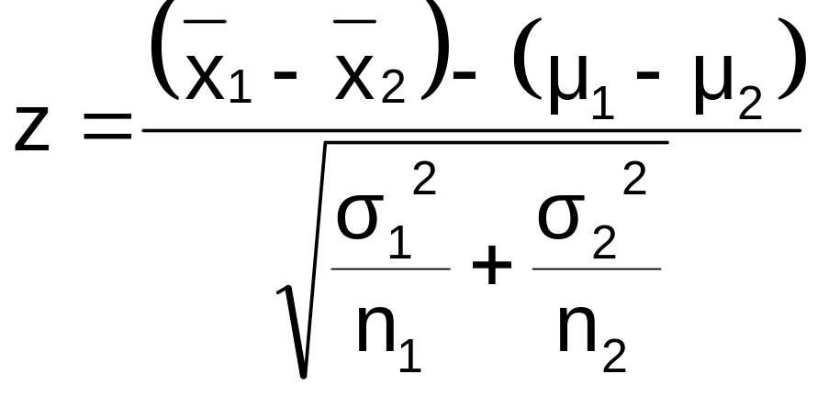
σ₁ and σ₂ known
Population means, independent samples
The test statistic for
μ₁ – μ₂ is:
*
σ₁ and σ₂ known
σ₁ and σ₂ unknown

Slide 20
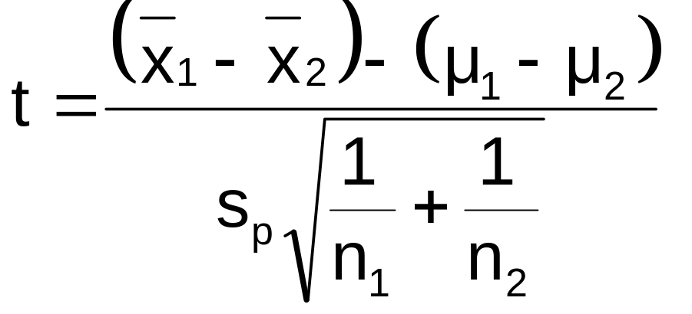
σ₁ and σ₂ unknown
The test statistic for
μ₁ – μ₂ is:
Population means, independent samples
σ₁ and σ₂ known
*
Where t_{α/2} has (n₁ + n₂ – 2) d.f.,
and
σ₁ and σ₂ unknown

Slide 21
Hypothesis tests for μ₁ – μ₂
Two Population Means, Independent Samples
Lower tail test:
H₀: μ₁ – μ₂ ≥ 0
H_{A}: μ₁ – μ₂ < 0
Upper tail test:
H₀: μ₁ – μ₂ ≤ 0
H_{A}: μ₁ – μ₂ > 0
Two-tailed test:
H₀: μ₁ – μ₂ = 0
H_{A}: μ₁ – μ₂ ≠ 0
α
α
α/2
α/2
-z_{α}
z_{α}
-z_{α/2}
z_{α/2}
Reject H₀ if z < -z_{α}
Reject H₀ if z > z_{α}
Reject H₀ if z < -z_{α/2}
or z > z_{α/2}

Slide 22

Pooled t Test: Example
You’re a financial analyst for a brokerage firm. Is there a difference in dividend yield between stocks listed on the NYSE & NASDAQ? You collect the following data:
NYSE NASDAQ
Number 21 25
Sample mean 3.27 2.53
Sample std dev 1.30 1.16
Assuming equal variances, is
there a difference in average
yield (α = 0.05)?

Slide 23
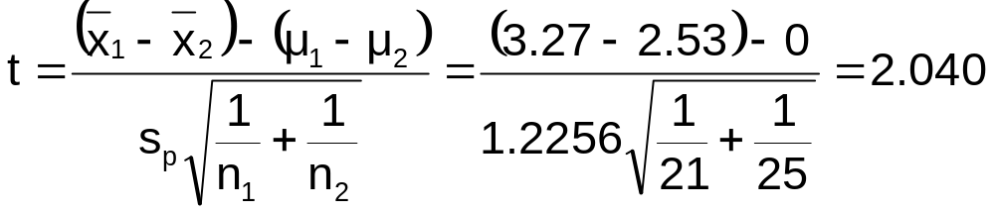
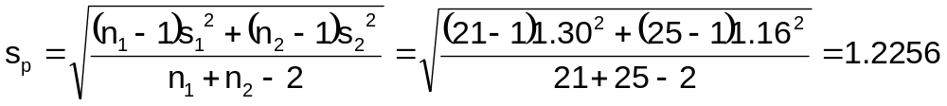
Calculating the Test Statistic
The test statistic is:

Slide 24
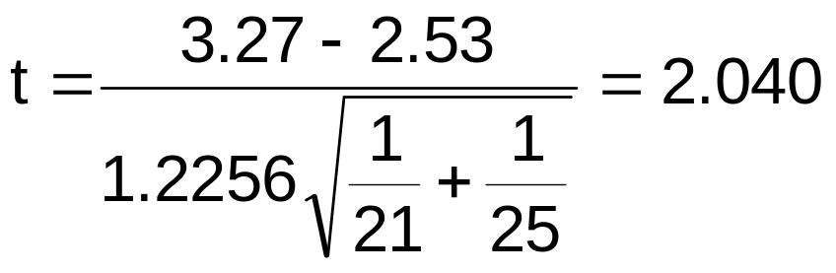
Solution
H₀: μ₁ - μ₂ = 0 i.e. (μ₁ = μ₂)
H_{A}: μ₁ - μ₂ ≠ 0 i.e. (μ₁ ≠ μ₂)
α = 0.05
df = 21 + 25 - 2 = 44
Critical Values: t = ± 2.0154
Test Statistic:
Reject H₀
Reject H₀
.025
.025
-2.0154
0
2.0154
t
2.040
Decision:
Conclusion:
Reject H₀ at α = 0.05
There is evidence of a difference in means.

Slide 25
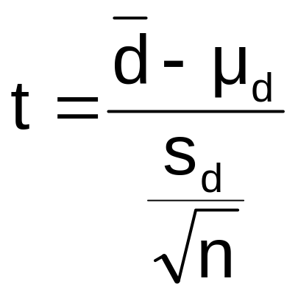
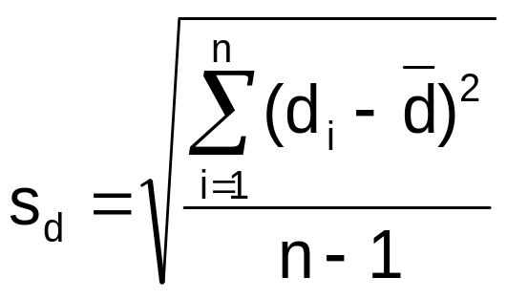
Hypothesis Testing for Paired Samples
The test statistic for d is
Paired samples
n is the number of pairs in the paired sample
Where t_{α/2} has n - 1 d.f.
and s_{d} is:

Slide 26
Hypothesis Testing for
Paired Samples
(continued)
Paired Samples
Lower tail test:
H₀: μ_{d} ≥ 0
H_{A}: μ_{d} < 0
Upper tail test:
H₀: μ_{d} ≤ 0
H_{A}: μ_{d} > 0
Two-tailed test:
H₀: μ_{d} = 0
H_{A}: μ_{d} ≠ 0
α
α
α/2
α/2
-t_{α}
t_{α}
-t_{α/2}
t_{α/2}
Reject H₀ if t < -t_{α}
Reject H₀ if t > t_{α}
Reject H₀ if t < -t_{α/2}
or t > t_{α/2}
Where t has n - 1 d.f.

Slide 27
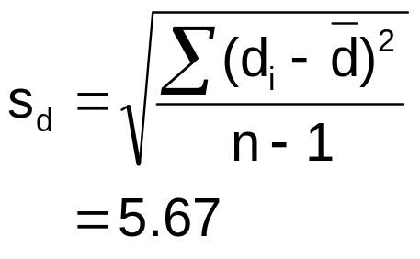
Paired Samples Example
Assume you send your salespeople to a “customer service” training workshop. Is the training effective? You collect the following data:
Number of Complaints: (2) - (1)
Salesperson Before (1) After (2) Difference, d_{i}
C.B. 6 4 - 2
T.F. 20 6 -14
M.H. 3 2 - 1
R.K. 0 0 0
M.O. 4 0 - 4
-21
Σ
d_{i}
d =
n
= -4.2

Slide 28
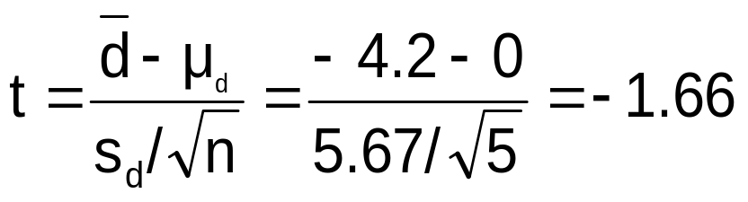
Paired Samples: Solution
Has the training made a difference in the number of complaints (at the 0.01 level)?
Reject
Reject
H₀: μ_{d} = 0
H_{A}: μ_{d} ≠ 0
α/2
α/2
α = .01
d =
- 4.2
- 4.604 4.604
- 1.66
Critical Value = ± 4.604 d.f. = n - 1 = 4
Decision: Do not reject H₀
(t stat is not in the reject region)
Test Statistic:
Conclusion: There is not a significant change in the number of complaints.

Slide 29
Two Population Proportions
Goal: Form a confidence interval for or test a hypothesis about the difference between two population proportions, p₁ – p₂
Population proportions
Assumptions:
n₁p₁ ≥ 5 , n₁(1-p₁) ≥ 5
n₂p₂ ≥ 5 , n₂(1-p₂) ≥ 5
The point estimate for the difference is
p₁ – p₂

Slide 30
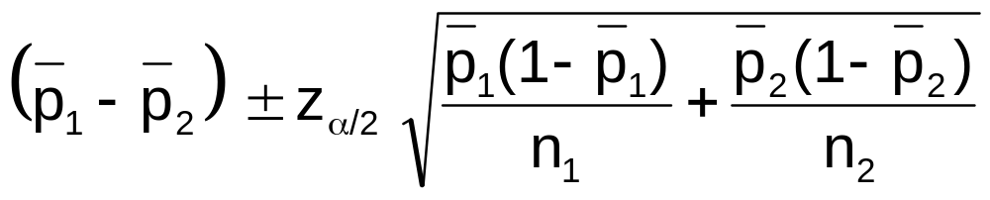
Confidence Interval for
Two Population Proportions
Population proportions
The confidence interval for
p₁ – p₂ is:

Slide 31
Hypothesis Tests for
Two Population Proportions
Population proportions
Lower tail test:
H₀: p₁ ≥ p₂
H_{A}: p₁ < p₂
i.e.,
H₀: p₁ – p₂ ≥ 0
H_{A}: p₁ – p₂ < 0
Upper tail test:
H₀: p₁ ≤ p₂
H_{A}: p₁ > p₂
i.e.,
H₀: p₁ – p₂ ≤ 0
H_{A}: p₁ – p₂ > 0
Two-tailed test:
H₀: p₁ = p₂
H_{A}: p₁ ≠ p₂
i.e.,
H₀: p₁ – p₂ = 0
H_{A}: p₁ – p₂ ≠ 0

Slide 32
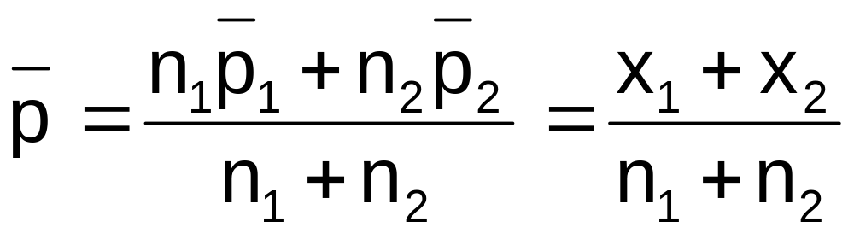
Two Population Proportions
Since we begin by assuming the null hypothesis is true, we assume p₁ = p₂ and pool the two p estimates
Population proportions
The pooled estimate for the overall proportion is:
where x₁ and x₂ are the numbers from
samples 1 and 2 with the characteristic of interest

Slide 33
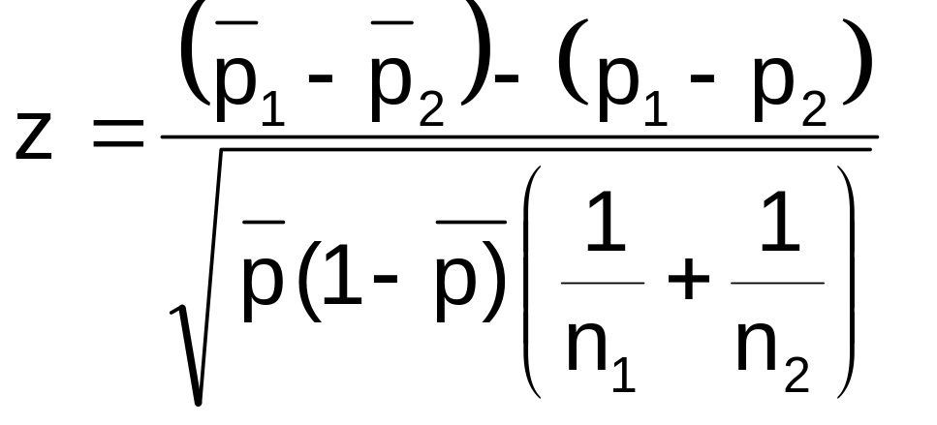
Two Population Proportions
(continued)
Population proportions
The test statistic for
p₁ – p₂ is:

Slide 34
Hypothesis Tests for
Two Population Proportions
Population proportions
Lower tail test:
H₀: p₁ – p₂ ≥ 0
H_{A}: p₁ – p₂ < 0
Upper tail test:
H₀: p₁ – p₂ ≤ 0
H_{A}: p₁ – p₂ > 0
Two-tailed test:
H₀: p₁ – p₂ = 0
H_{A}: p₁ – p₂ ≠ 0
α
α
α/2
α/2
-z_{α}
z_{α}
-z_{α/2}
z_{α/2}
Reject H₀ if z < -z_{α}
Reject H₀ if z > z_{α}
Reject H₀ if z < -z_{α/2}
or z > z_{α/2}

Slide 35

Example:
Two population Proportions
Is there a significant difference between the proportion of men and the proportion of women who will vote Yes on Proposition A?
In a random sample, 36 of 72 men and 31 of 50 women indicated they would vote Yes
Test at the .05 level of significance

Slide 36
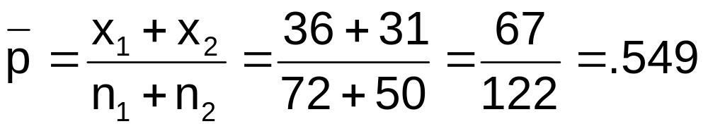
Example:
Two population Proportions
(continued)
The hypothesis test is:
H₀: p₁ – p₂ = 0 (the two proportions are equal)
H_{A}: p₁ – p₂ ≠ 0 (there is a significant difference between proportions)
The sample proportions are:
  Men: p₁ = 36/72 = .50
  Women: p₂ = 31/50 = .62
The pooled estimate for the overall proportion is:

Slide 37
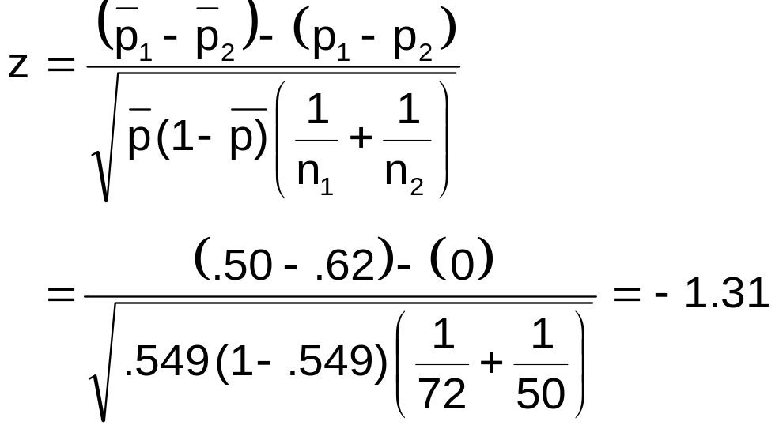
Example:
Two population Proportions
(continued)
Reject H₀
Reject H₀
The test statistic for p₁ – p₂ is:
.025
.025
-1.96
1.96
-1.31
Decision: Do not reject H₀
Conclusion: There is not significant evidence of a difference in proportions who will vote yes between men and women.
Critical Values = ±1.96
For α = .05

Slide 38
Two Sample Tests in EXCEL
For independent samples:
Independent sample Z test with variances known:
  Tools | data analysis | z-test: two sample for means
Independent sample Z test with large sample
  Tools | data analysis | z-test: two sample for means
  If the population variances are unknown, use sample variances
For paired samples (t test):
  Tools | data analysis… | t-test: paired two sample for means

Slide 39
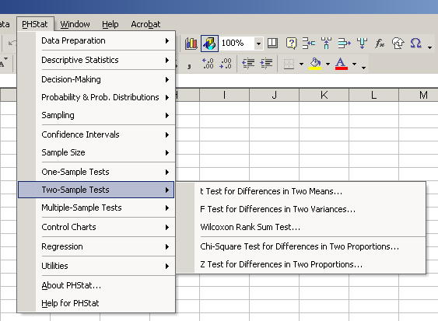
Two Sample Tests in PHStat

Slide 40
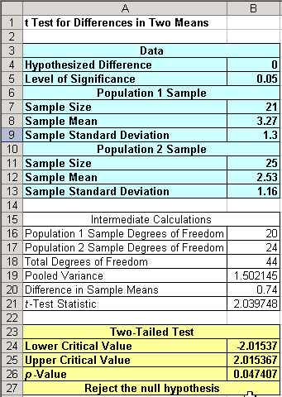
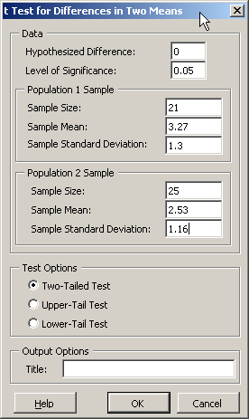
Two Sample Tests in PHStat
Input
Output

Slide 41
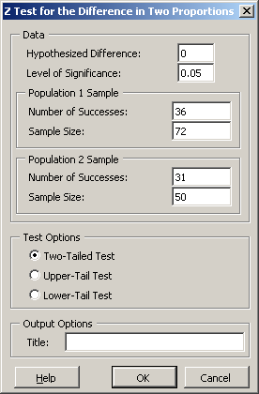
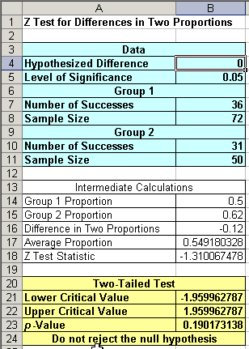
Two Sample Tests in PHStat
Input
Output

Slide 42
Contingency Tables
Contingency Tables
Situations involving multiple population proportions
Used to classify sample observations according to two or more characteristics
Also called a crosstabulation table.

Slide 43
Contingency Table Example
Left-Handed vs. Gender
Dominant Hand: Left vs. Right
Gender: Male vs. Female
H₀: Hand preference is independent of gender
H_{A}: Hand preference is not independent of gender

Slide 44
Contingency Table Example
(continued)
Sample results organized in a contingency table:
Gender | Hand Preference
 | Left | Right
Female | 12 | 108 | 120
Male | 24 | 156 | 180
 | 36 | 264 | 300
sample size = n = 300:
120 Females, 12 were left handed
180 Males, 24 were left handed

Slide 45
Logic of the Test
H₀: Hand preference is independent of gender
H_{A}: Hand preference is not independent of gender
If H₀ is true, then the proportion of left-handed females should be the same as the proportion of left-handed males
The two proportions above should be the same as the proportion of left-handed people overall

Slide 46
Finding Expected Frequencies
120 Females, 12 were left handed
180 Males, 24 were left handed
Overall:
P(Left Handed)
= 36/300 = .12
If independent, then
P(Left Handed | Female) = P(Left Handed | Male) = .12
So we would expect 12% of the 120 females and 12% of the 180 males to be left handed…
i.e., we would expect (120)(.12) = 14.4 females to be left handed
(180)(.12) = 21.6 males to be left handed

Slide 47
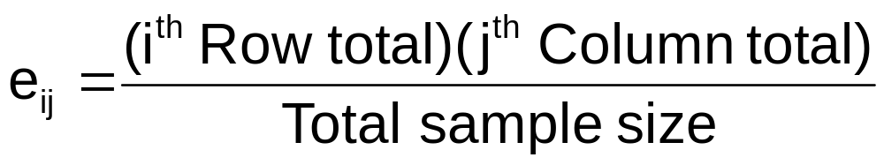
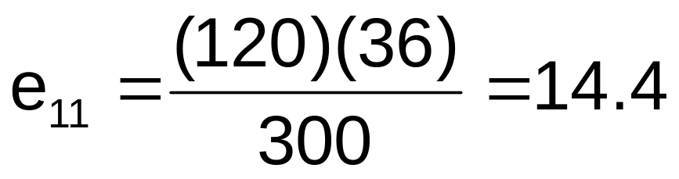
Expected Cell Frequencies
(continued)
Expected cell frequencies:
Example:

Slide 48
Observed v. Expected Frequencies
Observed frequencies vs. expected frequencies:
Gender | Hand Preference
 | Left | Right
Female | Observed = 12 Expected = 14.4 | Observed = 108 Expected = 105.6 | 120
Male | Observed = 24 Expected = 21.6 | Observed = 156 Expected = 158.4 | 180
 | 36 | 264 | 300

Slide 49
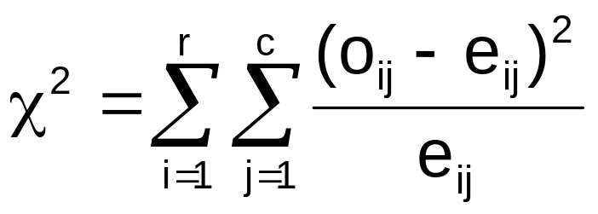

The Chi-Square Test Statistic
The Chi-square contingency test statistic is:
where:
o_{ij} = observed frequency in cell (i, j)
e_{ij} = expected frequency in cell (i, j)
r = number of rows
c = number of columns

Slide 50
Observed v. Expected Frequencies
Gender | Hand Preference
 | Left | Right
Female | Observed = 12 Expected = 14.4 | Observed = 108 Expected = 105.6 | 120
Male | Observed = 24 Expected = 21.6 | Observed = 156 Expected = 158.4 | 180
 | 36 | 264 | 300

Slide 51
Contingency Analysis
Decision Rule:
If χ² > 3.841, reject H₀, otherwise, do not reject H₀
Here, χ² = 0.6848 < 3.841, so we
do not reject H₀ and conclude that gender and hand preference are independent
α = 0.05
χ²
χ²_{.05} = 3.841
Do not reject H₀
Reject H₀

Slide 52
Chapter Summary
Used the chi-square goodness-of-fit test to determine whether data fits a specified distribution
  Example of a discrete distribution (uniform)
  Example of a continuous distribution (normal)
Used contingency tables to perform a chi-square test of independence
  Compared observed cell frequencies to expected cell frequencies

Slide 53
Chapter Summary
Compared two independent samples
  Formed confidence intervals for the differences between two means
  Performed Z test for the differences in two means
  Performed t test for the differences in two means
Compared two related samples (paired samples)
  Formed confidence intervals for the paired difference
  Performed paired sample t tests for the mean difference
Compared two population proportions
  Formed confidence intervals for the difference between two population proportions
  Performed Z-test for two population proportions
Used contingency tables to perform a chi-square test of independence

