Slide 1
Chapter 11
Analysis of Variance
A Course In Business Statistics
4th Edition

Slide 2
Chapter Goals
After completing this chapter, you should be able to:
Recognize situations in which to use analysis of variance
Understand different analysis of variance designs
Perform a single-factor hypothesis test and interpret results
Conduct and interpret post-analysis of variance pairwise comparisons procedures
Set up and perform randomized blocks analysis

Slide 3
Chapter Overview
Analysis of Variance (ANOVA)
One-Way
ANOVA
Randomized
Complete
Block ANOVA
F-test
F-test
Tukey-
Kramer
test
Fisher’s Least
Significant
Difference test

Slide 4
General ANOVA Setting
Investigator controls one or more independent variables
  Called factors (or treatment variables)
  Each factor contains two or more levels (or categories/classifications)
Observe effects on dependent variable
  Response to levels of independent variable
Experimental design: the plan used to test hypothesis

Slide 5
One-Way Analysis of Variance
Evaluate the difference among the means of three or more populations
  Examples: Accident rates for 1st, 2nd, and 3rd shift
  Expected mileage for five brands of tires
Assumptions
  Populations are normally distributed
  Populations have equal variances
  Samples are randomly and independently drawn

Slide 6
Completely Randomized Design
Experimental units (subjects) are assigned randomly to treatments
Only one factor or independent variable
  With two or more treatment levels
Analyzed by
  One-factor analysis of variance (one-way ANOVA)
Called a Balanced Design if all factor levels have equal sample size

Slide 7
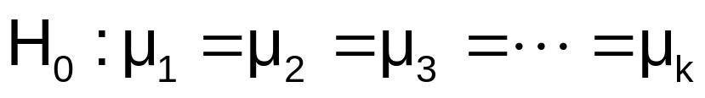
Hypotheses of One-Way ANOVA
  All population means are equal
  i.e., no treatment effect (no variation in means among groups)
  At least one population mean is different
  i.e., there is a treatment effect
  Does not mean that all population means are different (some pairs may be the same)

Slide 8

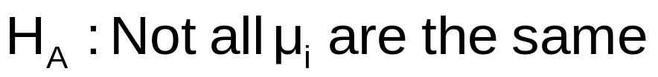
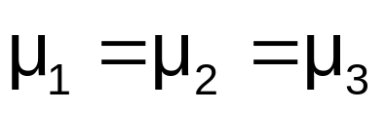
One-Factor ANOVA
All Means are the same:
The Null Hypothesis is True
(No Treatment Effect)

Slide 9
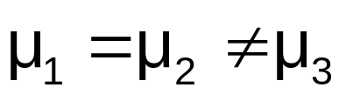
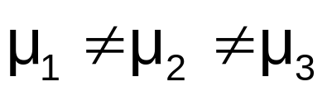
One-Factor ANOVA
(continued)
At least one mean is different:
The Null Hypothesis is NOT true
(Treatment Effect is present)
or

Slide 10
Partitioning the Variation
Total variation can be split into two parts:
SST = SSB + SSW
SST = Total Sum of Squares
SSB = Sum of Squares Between
SSW = Sum of Squares Within

Slide 11
Partitioning the Variation
(continued)
SST = SSB + SSW
Total Variation = the aggregate dispersion of the individual data values across the various factor levels (SST)
Between-Sample Variation = dispersion among the factor sample means (SSB)
Within-Sample Variation = dispersion that exists among the data values within a particular factor level (SSW)

Slide 12
Partition of Total Variation
Total Variation (SST)
Variation Due to Factor (SSB)
+
Variation Due to Random Sampling (SSW)
=
Commonly referred to as:
Sum of Squares Between
Sum of Squares Among
Sum of Squares Explained
Among Groups Variation
Commonly referred to as:
Sum of Squares Within
Sum of Squares Error
Sum of Squares Unexplained
Within Groups Variation

Slide 13
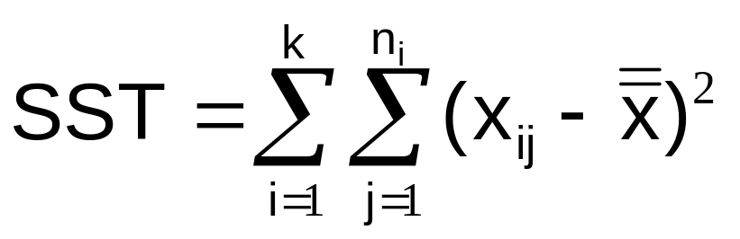

Total Sum of Squares
SST = SSB + SSW
Where:
SST = Total sum of squares
k = number of populations (levels or treatments)
n_{i} = sample size from population i
x_{ij} = j^{th} measurement from population i
x = grand mean (mean of all data values)

Slide 14
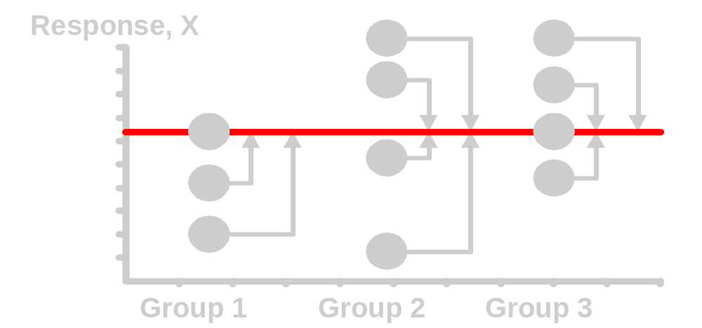
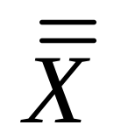
Total Variation
(continued)

Slide 15
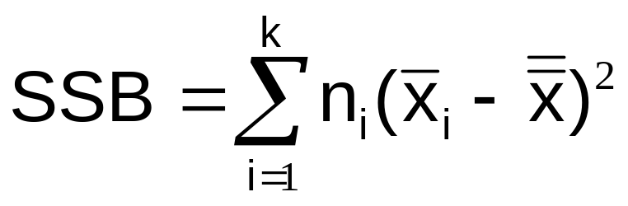
Sum of Squares Between
SST = SSB + SSW
Where:
SSB = Sum of squares between
k = number of populations
n_{i} = sample size from population i
x_{i} = sample mean from population i
x = grand mean (mean of all data values)

Slide 16
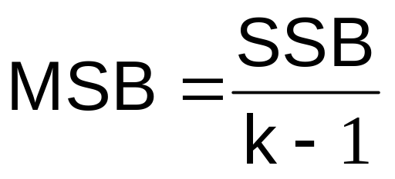


Between-Group Variation
Variation Due to
Differences Among Groups
Mean Square Between = SSB/degrees of freedom

Slide 17
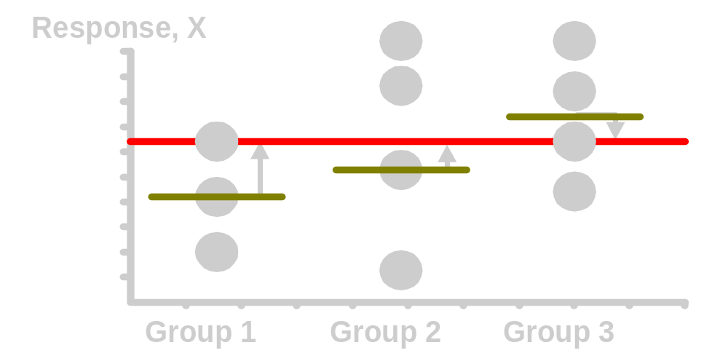
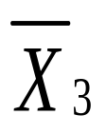
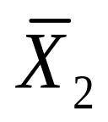
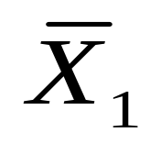
Between-Group Variation
(continued)

Slide 18
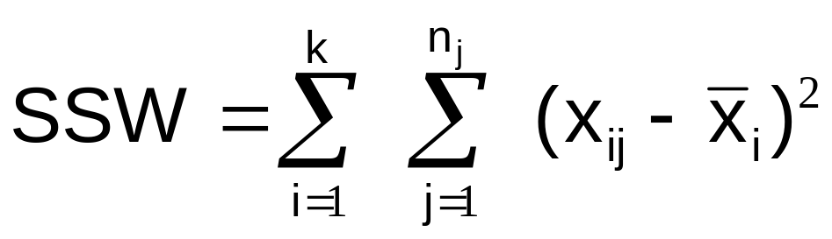
Sum of Squares Within
SST = SSB + SSW
Where:
SSW = Sum of squares within
k = number of populations
n_{i} = sample size from population i
x_{i} = sample mean from population i
x_{ij} = j^{th} measurement from population i

Slide 19
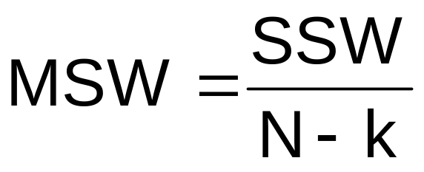
Within-Group Variation
Summing the variation within each group and then adding over all groups
Mean Square Within = SSW/degrees of freedom

Slide 20
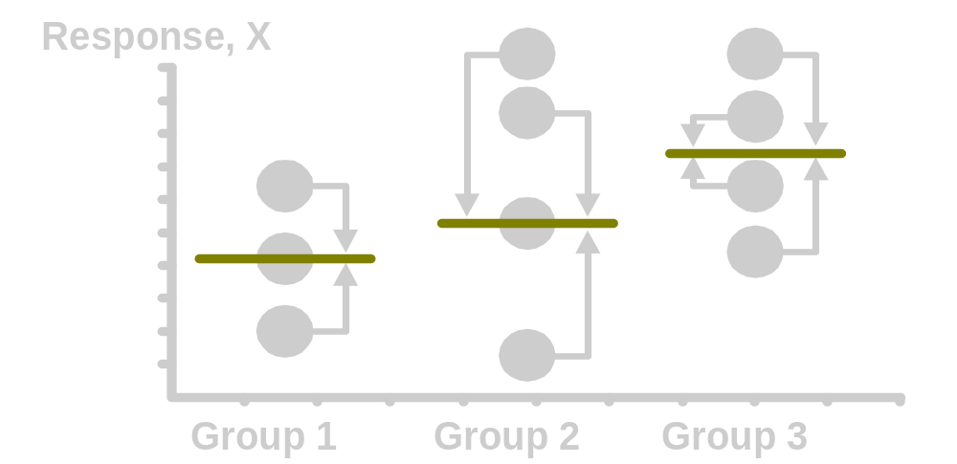
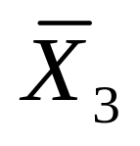
Within-Group Variation
(continued)

Slide 21
One-Way ANOVA Table
Source of Variation
SS
df
MS
F ratio
Between Samples
SSB
MSB
SSB
k - 1
MSB =
F =
k - 1
MSW
Within Samples
SSW
SSW
N - k
MSW =
N - k
SST =
SSB+SSW
Total
N - 1
k = number of populations
N = sum of the sample sizes from all populations
df = degrees of freedom

Slide 22
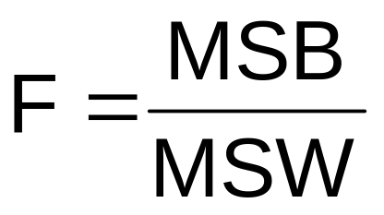
One-Factor ANOVA
F Test Statistic
H₀: μ₁= μ₂ = … = μ _{k}
H_{A}: At least two population means are different
Test statistic
    MSB is mean squares between variances
    MSW is mean squares within variances
Degrees of freedom
  df₁ = k – 1 (k = number of populations)
  df₂ = N – k (N = sum of sample sizes from all populations)

Slide 23
Interpreting One-Factor ANOVA
F Statistic
The F statistic is the ratio of the between estimate of variance and the within estimate of variance
  The ratio must always be positive
  df₁ = k -1 will typically be small
  df₂ = N - k will typically be large
The ratio should be close to 1 if
H₀: μ₁= μ₂ = … = μ_{k} is true
The ratio will be larger than 1 if
H₀: μ₁= μ₂ = … = μ_{k} is false

Slide 24


One-Factor ANOVA
F Test Example
You want to see if three different golf clubs yield different distances. You randomly select five measurements from trials on an automated driving machine for each club. At the .05 significance level, is there a difference in mean distance?
Club 1 Club 2 Club 3
254 234 200
263 218 222
241 235 197
237 227 206
251 216 204

Slide 25
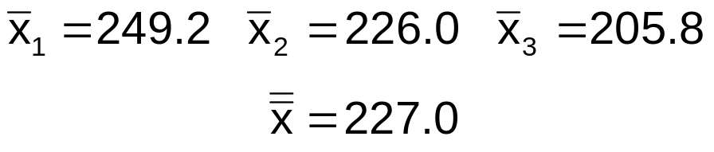
One-Factor ANOVA Example: Scatter Diagram
Distance
Club 1 Club 2 Club 3
254 234 200
263 218 222
241 235 197
237 227 206
251 216 204
270
260
250
240
230
220
210
200
190
•
•
•
•
•
•
•
•
•
•
•
•
•
•
•
1 2 3
Club

Slide 26
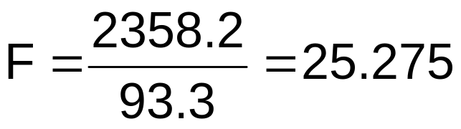
One-Factor ANOVA Example Computations
Club 1 Club 2 Club 3
254 234 200
263 218 222
241 235 197
237 227 206
251 216 204
x₁ = 249.2
x₂ = 226.0
x₃ = 205.8
x = 227.0
n₁ = 5
n₂ = 5
n₃ = 5
N = 15
k = 3
SSB = 5 [ (249.2 – 227)² + (226 – 227)² + (205.8 – 227)² ] = 4716.4
SSW = (254 – 249.2)² + (263 – 249.2)² +…+ (204 – 205.8)² = 1119.6
MSB = 4716.4 / (3-1) = 2358.2
MSW = 1119.6 / (15-3) = 93.3

Slide 27
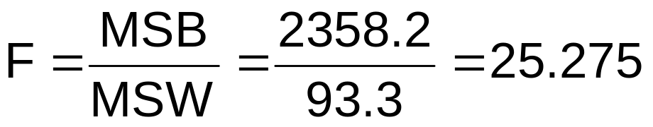
One-Factor ANOVA Example Solution
H₀: μ₁ = μ₂ = μ₃
H_{A}: μ_{i} not all equal
α = .05
df₁= 2 df₂ = 12
Test Statistic:
Decision:
Conclusion:
Critical Value:
F_{α} = 3.885
Reject H₀ at α = 0.05
α = .05
There is evidence that at least one μ_{i} differs from the rest
0
Do not
reject H₀
Reject H₀
F = 25.275
F_{.05} = 3.885

Slide 28
ANOVA -- Single Factor:
Excel Output
EXCEL: tools | data analysis | ANOVA: single factor
SUMMARY
Groups | Count | Sum | Average | Variance
Club 1 | 5 | 1246 | 249.2 | 108.2
Club 2 | 5 | 1130 | 226 | 77.5
Club 3 | 5 | 1029 | 205.8 | 94.2
ANOVA
Source of Variation | SS | df | MS | F | P-value | F crit
Between Groups | 4716.4 | 2 | 2358.2 | 25.275 | 4.99E-05 | 3.885
Within Groups | 1119.6 | 12 | 93.3
Total | 5836.0 | 14

Slide 29
The Tukey-Kramer Procedure
Tells which population means are significantly different
  e.g.: μ₁ = μ₂ ≠ μ₃
  Done after rejection of equal means in ANOVA
Allows pair-wise comparisons
  Compare absolute mean differences with critical range
μ
=
μ
μ
x
1
2
3

Slide 30
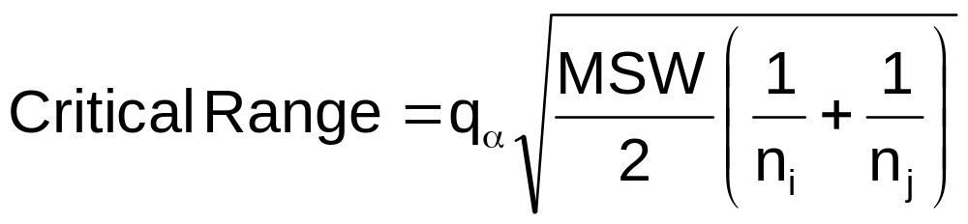
Tukey-Kramer Critical Range
where:
q_{α} = Value from standardized range table with k and N - k degrees of freedom for the desired level of α
MSW = Mean Square Within
n_{i} and n_{j} = Sample sizes from populations (levels) i and j

Slide 31
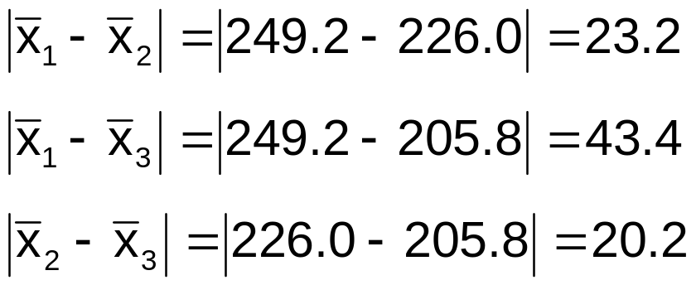
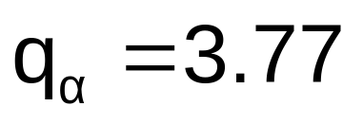
The Tukey-Kramer Procedure: Example
1. Compute absolute mean differences:
Club 1 Club 2 Club 3
254 234 200
263 218 222
241 235 197
237 227 206
251 216 204
2. Find the q value from the table in appendix J with k and N - k degrees of freedom for the desired level of α

Slide 32
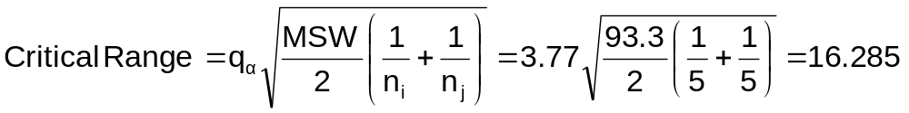
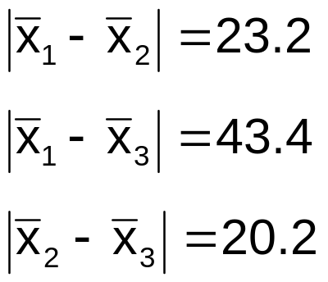
The Tukey-Kramer Procedure: Example
3. Compute Critical Range:
4. Compare:
5. All of the absolute mean differences are greater than critical range. Therefore there is a significant difference between each pair of means at 5% level of significance.

Slide 33
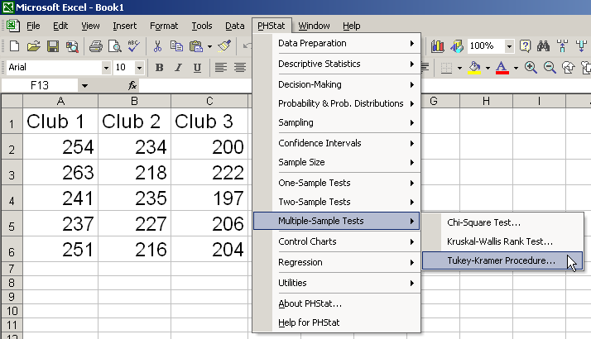
Tukey-Kramer in PHStat

Slide 34
Randomized Complete Block ANOVA
Like One-Way ANOVA, we test for equal population means (for different factor levels, for example)...
...but we want to control for possible variation from a second factor (with two or more levels)
Used when more than one factor may influence the value of the dependent variable, but only one is of key interest
Levels of the secondary factor are called blocks

Slide 35
Partitioning the Variation
Total variation can now be split into three parts:
SST = SSB + SSBL + SSW
SST = Total sum of squares
SSB = Sum of squares between factor levels
SSBL = Sum of squares between blocks
SSW = Sum of squares within levels

Slide 36
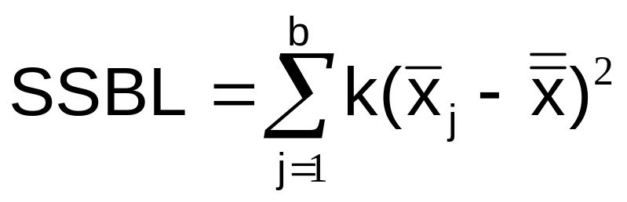
Sum of Squares for Blocking
SST = SSB + SSBL + SSW
Where:
k = number of levels for this factor
b = number of blocks
x_{j} = sample mean from the j^{th} block
x = grand mean (mean of all data values)

Slide 37
Partitioning the Variation
Total variation can now be split into three parts:
SST = SSB + SSBL + SSW
SST and SSB are computed as they were in One-Way ANOVA
SSW = SST – (SSB + SSBL)

Slide 38
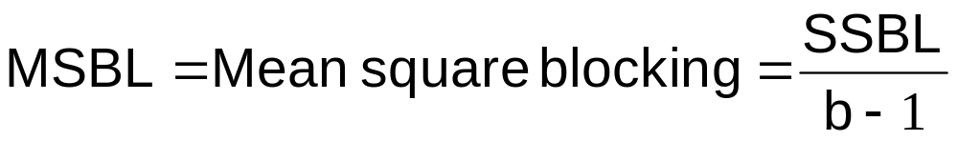
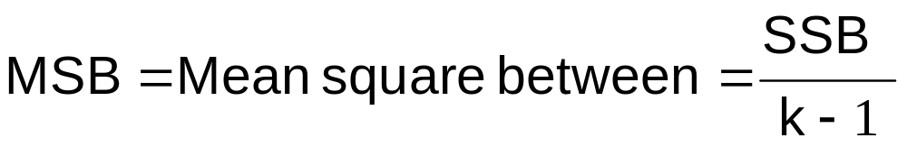
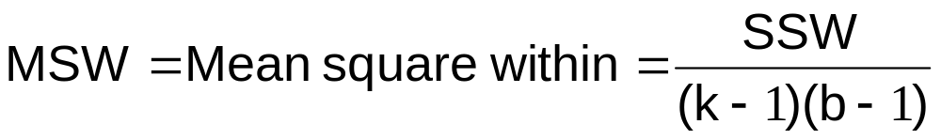
Mean Squares

Slide 39
Randomized Block ANOVA Table
Source of Variation
SS
df
MS
F ratio
Between Blocks
MSBL
SSBL
b - 1
MSBL
MSW
Between Samples
MSB
SSB
k - 1
MSB
MSW
Within Samples
SSW
(k–1)(b-1)
MSW
Total
SST
N - 1
k = number of populations N = sum of the sample sizes from all populations
b = number of blocks df = degrees of freedom

Slide 40
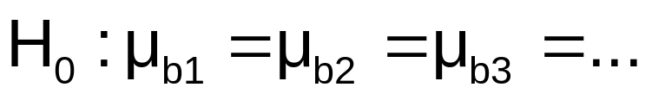
Blocking Test
MSBL
F =
Blocking test: df₁ = b - 1
df₂ = (k – 1)(b – 1)
MSW
Reject H₀ if F > F_{α}

Slide 41
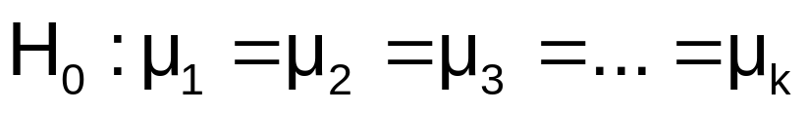
Main Factor Test
MSB
F =
Main Factor test: df₁ = k - 1
df₂ = (k – 1)(b – 1)
MSW
Reject H₀ if F > F_{α}

Slide 42
Fisher’s
Least Significant Difference Test
To test which population means are significantly different
  e.g.: μ₁ = μ₂ ≠ μ₃
  Done after rejection of equal means in randomized block ANOVA design
Allows pair-wise comparisons
  Compare absolute mean differences with critical range
μ
=
μ
μ
x
1
2
3

Slide 43
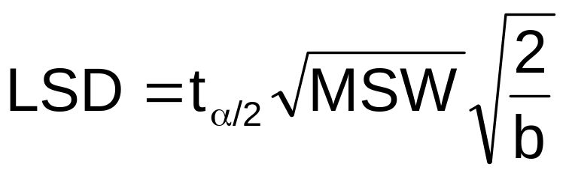
Fisher’s Least Significant Difference (LSD) Test
where:
t_{α/2} = Upper-tailed value from Student’s t-distribution
for α/2 and (k -1)(n - 1) degrees of freedom
MSW = Mean square within from ANOVA table
b = number of blocks
k = number of levels of the main factor

Slide 44

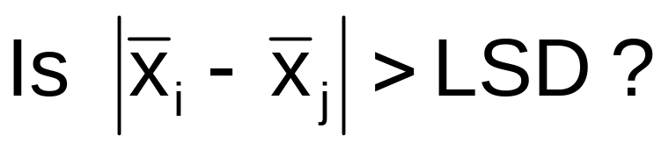
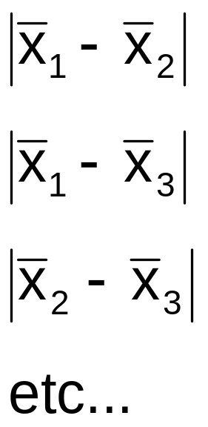
Fisher’s Least Significant Difference (LSD) Test
(continued)
Compare:
If the absolute mean difference is greater than LSD then there is a significant difference between that pair of means at the chosen level of significance.

Slide 45
Chapter Summary
Described one-way analysis of variance
  The logic of ANOVA
  ANOVA assumptions
  F test for difference in k means
  The Tukey-Kramer procedure for multiple comparisons
Described randomized complete block designs
  F test
  Fisher’s least significant difference test for multiple comparisons
Described two-way analysis of variance
  Examined effects of multiple factors and interaction

