Slide 1
Chapter 12
Introduction to Linear Regression and Correlation Analysis
A Course In Business Statistics
4th Edition

Slide 2
Chapter Goals
After completing this chapter, you should be able to:
Calculate and interpret the simple correlation between two variables
Determine whether the correlation is significant
Calculate and interpret the simple linear regression equation for a set of data
Understand the assumptions behind regression analysis
Determine whether a regression model is significant

Slide 3
Chapter Goals
(continued)
After completing this chapter, you should be able to:
Calculate and interpret confidence intervals for the regression coefficients
Recognize regression analysis applications for purposes of prediction and description
Recognize some potential problems if regression analysis is used incorrectly
Recognize nonlinear relationships between two variables

Slide 4
Scatter Plots and Correlation
A scatter plot (or scatter diagram) is used to show the relationship between two variables
Correlation analysis is used to measure strength of the association (linear relationship) between two variables
  Only concerned with strength of the relationship
  No causal effect is implied

Slide 5
Scatter Plot Examples
Linear relationships
Curvilinear relationships
y
y
x
x
y
y
x
x

Slide 6
Scatter Plot Examples
(continued)
Strong relationships
Weak relationships
y
y
x
x
y
y
x
x

Slide 7
Scatter Plot Examples
(continued)
No relationship
y
x
y
x

Slide 8
Correlation Coefficient
(continued)
The population correlation coefficient ρ (rho) measures the strength of the association between the variables
The sample correlation coefficient r is an estimate of ρ and is used to measure the strength of the linear relationship in the sample observations

Slide 9
Features of ρ and r
Unit free
Range between -1 and 1
The closer to -1, the stronger the negative linear relationship
The closer to 1, the stronger the positive linear relationship
The closer to 0, the weaker the linear relationship

Slide 10
Examples of Approximate r Values
y
y
y
x
x
x
r = -1
r = -.6
r = 0
y
y
x
x
r = +.3
r = +1

Slide 11
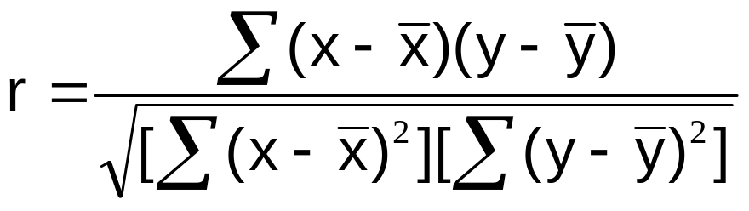
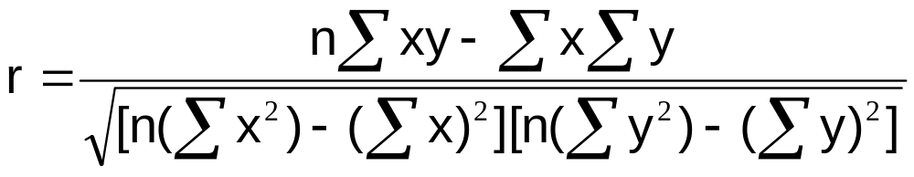
Calculating the
Correlation Coefficient
Sample correlation coefficient:
or the algebraic equivalent:
where:
r = Sample correlation coefficient
n = Sample size
x = Value of the independent variable
y = Value of the dependent variable

Slide 12

Calculation Example
Tree Height | Trunk Diameter
y | x | xy | y² | x²
35 | 8 | 280 | 1225 | 64
49 | 9 | 441 | 2401 | 81
27 | 7 | 189 | 729 | 49
33 | 6 | 198 | 1089 | 36
60 | 13 | 780 | 3600 | 169
21 | 7 | 147 | 441 | 49
45 | 11 | 495 | 2025 | 121
51 | 12 | 612 | 2601 | 144
Σ=321 | Σ=73 | Σ=3142 | Σ=14111 | Σ=713

Slide 13
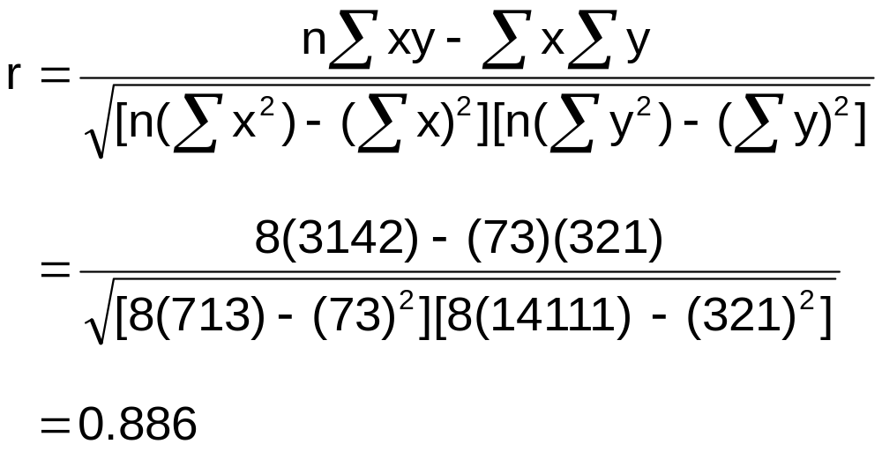
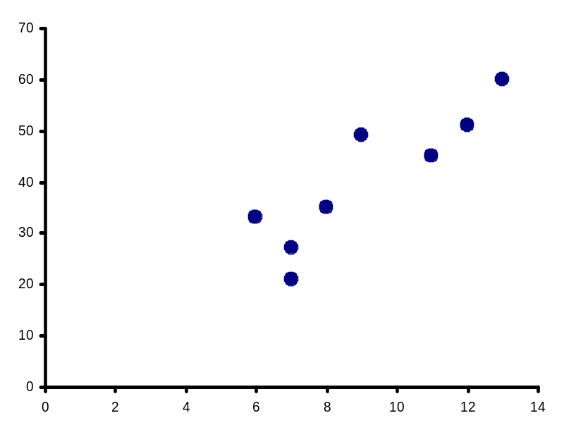
Calculation Example
(continued)
Tree
Height,
y
r = 0.886 → relatively strong positive
linear association between x and y
Trunk Diameter, x

Slide 14
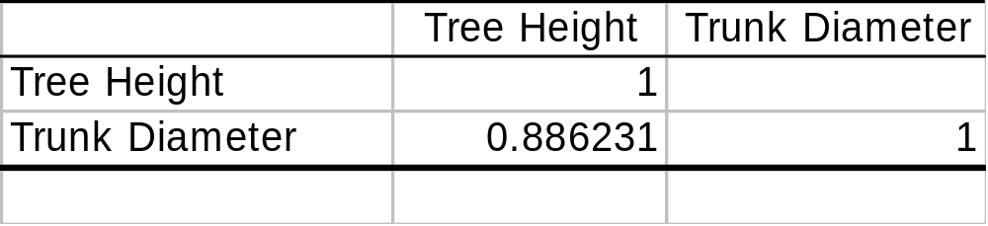
Excel Output
Excel Correlation Output
Tools / data analysis / correlation…
Correlation between
Tree Height and Trunk Diameter

Slide 15
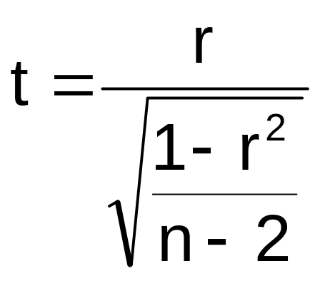
Significance Test for Correlation
Hypotheses
  H₀: ρ = 0 (no correlation)
  H_{A}: ρ ≠ 0 (correlation exists)
Test statistic
  (with n – 2 degrees of freedom)

Slide 16
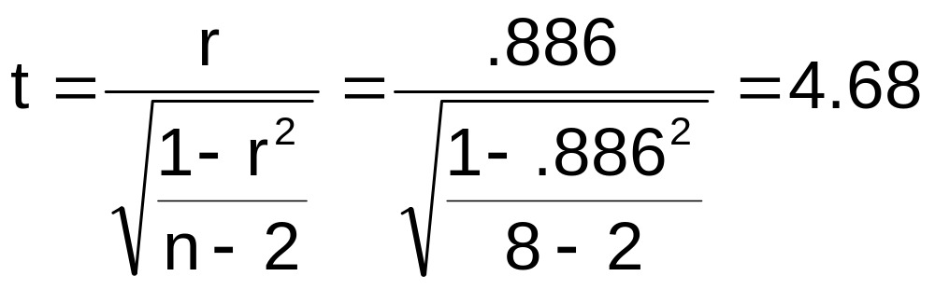
Example: Produce Stores
Is there evidence of a linear relationship between tree height and trunk diameter at the .05 level of significance?
H₀: ρ = 0 (No correlation)
H₁: ρ ≠ 0 (correlation exists)
α =.05 , df = 8 - 2 = 6

Slide 17
Example: Test Solution
Decision:
Reject H₀
Conclusion:
There is evidence of a linear relationship at the 5% level of significance
d.f. = 8-2 = 6
α/2=.025
α/2=.025
Reject H₀
-t_{α/2}
Do not reject H₀
t_{α/2}
Reject H₀
0
-2.4469
2.4469
4.68

Slide 18
Introduction to Regression Analysis
Regression analysis is used to:
  Predict the value of a dependent variable based on the value of at least one independent variable
  Explain the impact of changes in an independent variable on the dependent variable
Dependent variable: the variable we wish to explain
Independent variable: the variable used to explain the dependent variable

Slide 19
Simple Linear Regression Model
Only one independent variable, x
Relationship between x and y is described by a linear function
Changes in y are assumed to be caused by changes in x

Slide 20
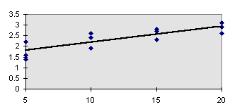
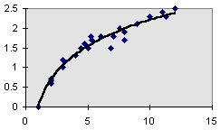
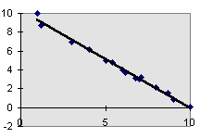
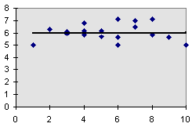
Types of Regression Models
Positive Linear Relationship
Relationship NOT Linear
Negative Linear Relationship
No Relationship

Slide 21
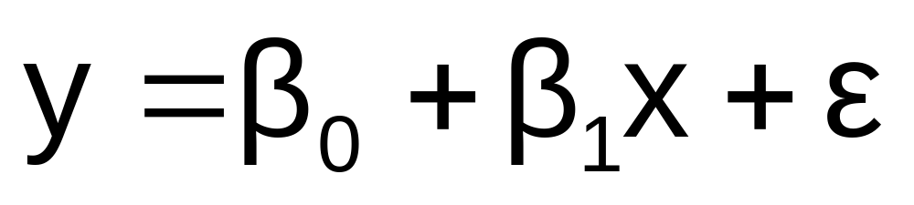
Population Linear Regression
The population regression model:
Population Slope
Coefficient
Random Error term, or residual
Population
y intercept
Independent Variable
Dependent Variable
Linear component
Random Error
component

Slide 22
Linear Regression Assumptions
Error values (ε) are statistically independent
Error values are normally distributed for any given value of x
The probability distribution of the errors is normal
The probability distribution of the errors has constant variance
The underlying relationship between the x variable and the y variable is linear

Slide 23
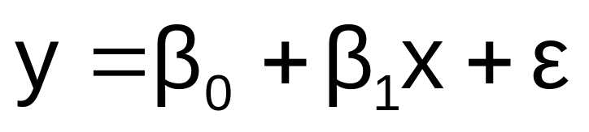
Population Linear Regression
(continued)
y
Observed Value of y for x_{i}
ε_{i}
Slope = β₁
Predicted Value of y for x_{i}
Random Error for this x value
Intercept = β₀
x_{i}
x

Slide 24
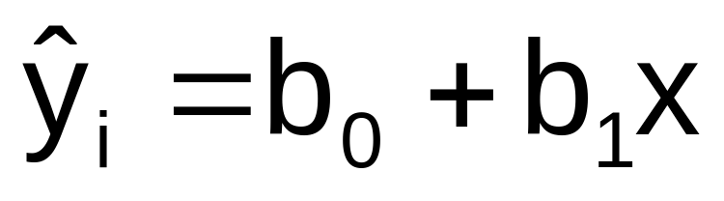
Estimated Regression Model
The sample regression line provides an estimate of the population regression line
Estimated (or predicted) y value
Estimate of the regression
intercept
Estimate of the regression slope
Independent variable
The individual random error terms e_{i} have a mean of zero

Slide 25
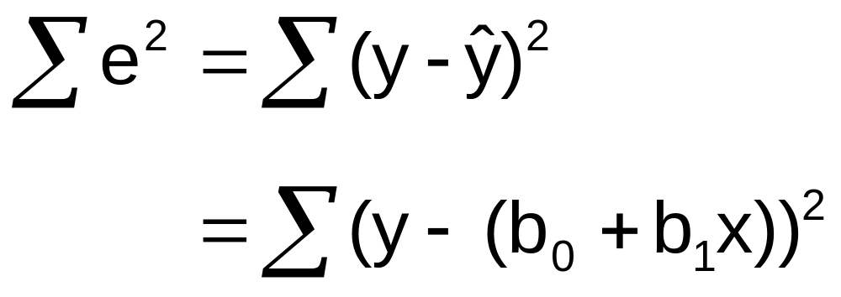
Least Squares Criterion
b₀ and b₁ are obtained by finding the values of b₀ and b₁ that minimize the sum of the squared residuals

Slide 26
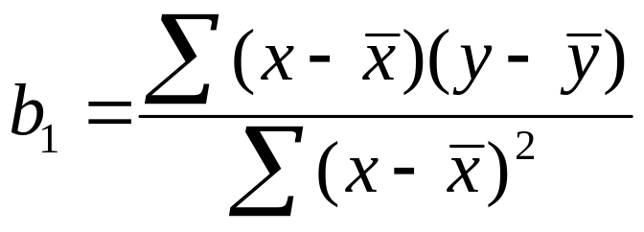
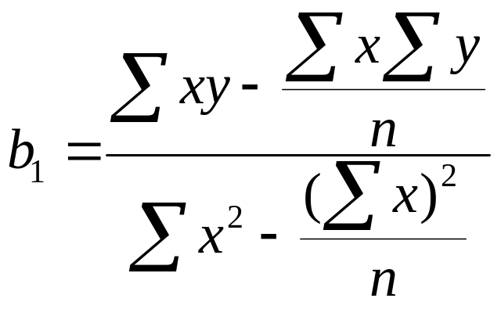
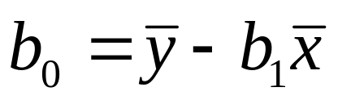
The Least Squares Equation
The formulas for b₁ and b₀ are:
algebraic equivalent:
and

Slide 27
Interpretation of the
Slope and the Intercept
b₀ is the estimated average value of y when the value of x is zero
b₁ is the estimated change in the average value of y as a result of a one-unit change in x

Slide 28
Finding the Least Squares Equation
The coefficients b₀ and b₁ will usually be found using computer software, such as Excel or Minitab
Other regression measures will also be computed as part of computer-based regression analysis

Slide 29

Simple Linear Regression Example
A real estate agent wishes to examine the relationship between the selling price of a home and its size (measured in square feet)
A random sample of 10 houses is selected
  Dependent variable (y) = house price in $1000s
  Independent variable (x) = square feet

Slide 30
Sample Data for House Price Model
House Price in $1000s (y) | Square Feet (x)
245 | 1400
312 | 1600
279 | 1700
308 | 1875
199 | 1100
219 | 1550
405 | 2350
324 | 2450
319 | 1425
255 | 1700

Slide 31
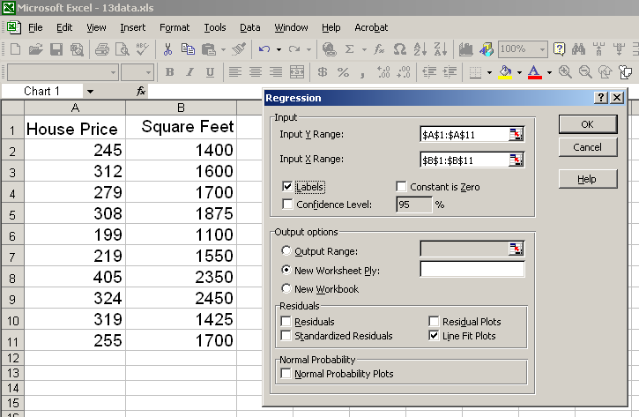
Regression Using Excel
Tools / Data Analysis / Regression

Slide 32
Excel Output
Regression Statistics
Multiple R | 0.76211
R Square | 0.58082
Adjusted R Square | 0.52842
Standard Error | 41.33032
Observations | 10
ANOVA | df | SS | MS | F | Significance F
Regression | 1 | 18934.9348 | 18934.9348 | 11.0848 | 0.01039
Residual | 8 | 13665.5652 | 1708.1957
Total | 9 | 32600.5000
 | Coefficients | Standard Error | t Stat | P-value | Lower 95% | Upper 95%
Intercept | 98.24833 | 58.03348 | 1.69296 | 0.12892 | -35.57720 | 232.07386
Square Feet | 0.10977 | 0.03297 | 3.32938 | 0.01039 | 0.03374 | 0.18580
The regression equation is:

Slide 33
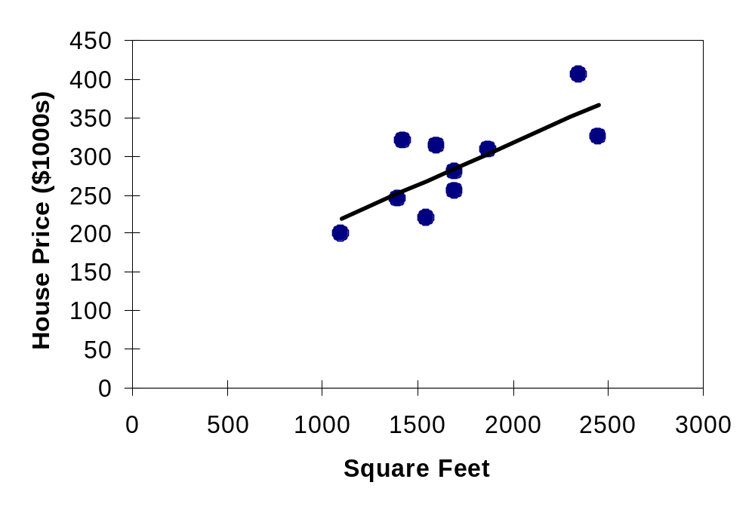
Graphical Presentation
House price model: scatter plot and regression line
Slope
= 0.10977
Intercept
= 98.248

Slide 34
Interpretation of the
Intercept, b₀
b₀ is the estimated average value of Y when the value of X is zero (if x = 0 is in the range of observed x values)
  Here, no houses had 0 square feet, so b₀ = 98.24833 just indicates that, for houses within the range of sizes observed, $98,248.33 is the portion of the house price not explained by square feet

Slide 35
Interpretation of the
Slope Coefficient, b₁
b₁ measures the estimated change in the average value of Y as a result of a one-unit change in X
  Here, b₁ = .10977 tells us that the average value of a house increases by .10977($1000) = $109.77, on average, for each additional one square foot of size

Slide 36
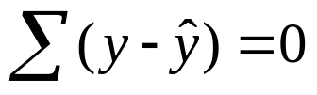
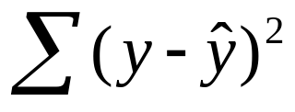
Least Squares Regression Properties
The sum of the residuals from the least squares regression line is 0 ( )
The sum of the squared residuals is a minimum (minimized )
The simple regression line always passes through the mean of the y variable and the mean of the x variable
The least squares coefficients are unbiased estimates of β₀ and β₁

Slide 37

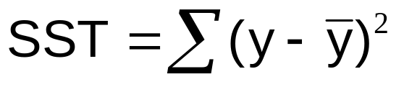
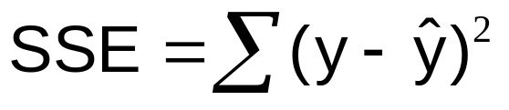
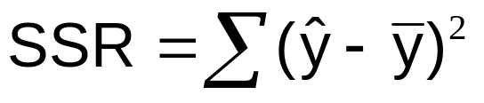


Explained and Unexplained Variation
Total variation is made up of two parts:
Total sum of Squares
Sum of Squares Error
Sum of Squares Regression
where:
= Average value of the dependent variable
y = Observed values of the dependent variable
= Estimated value of y for the given x value

Slide 38
Explained and Unexplained Variation
(continued)
SST = total sum of squares
  Measures the variation of the y_{i} values around their mean y
SSE = error sum of squares
  Variation attributable to factors other than the relationship between x and y
SSR = regression sum of squares
  Explained variation attributable to the relationship between x and y

Slide 39
Explained and Unexplained Variation
(continued)
y
y_{i}
∧
∧
SSE = ∑(y_{i} - y_{i} )²
y
_
SST = ∑(y_{i} - y)²
∧
y
_
∧
_
SSR = ∑(y_{i} - y)²
_
y
y
x
X_{i}

Slide 40
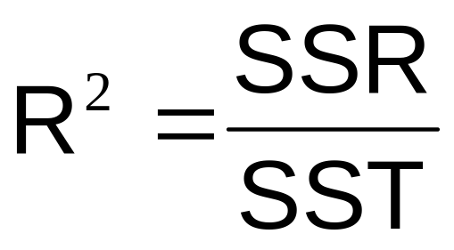
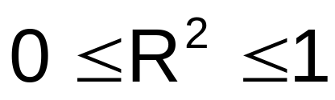
Coefficient of Determination, R²
The coefficient of determination is the portion of the total variation in the dependent variable that is explained by variation in the independent variable
The coefficient of determination is also called R-squared and is denoted as R²
where

Slide 41
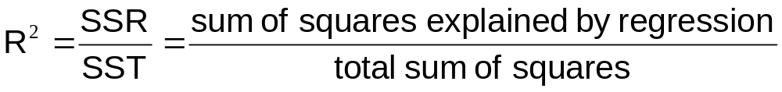
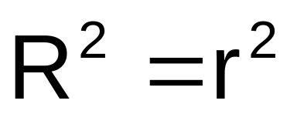
Coefficient of Determination, R²
(continued)
Coefficient of determination
Note: In the single independent variable case, the coefficient of determination is
where:
R² = Coefficient of determination
r = Simple correlation coefficient

Slide 42
Examples of Approximate
R² Values
y
R² = 1
Perfect linear relationship between x and y:
100% of the variation in y is explained by variation in x
x
R² = 1
y
x
R² = +1

Slide 43
Examples of Approximate
R² Values
y
0 < R² < 1
Weaker linear relationship between x and y:
Some but not all of the variation in y is explained by variation in x
x
y
x

Slide 44
Examples of Approximate
R² Values
R² = 0
y
No linear relationship between x and y:
The value of Y does not depend on x. (None of the variation in y is explained by variation in x)
x
R² = 0

Slide 45
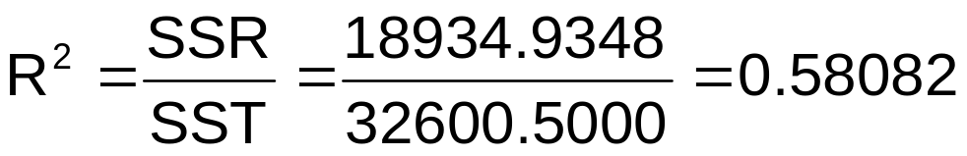
Excel Output
Regression Statistics
Multiple R | 0.76211
R Square | 0.58082
Adjusted R Square | 0.52842
Standard Error | 41.33032
Observations | 10
ANOVA | df | SS | MS | F | Significance F
Regression | 1 | 18934.9348 | 18934.9348 | 11.0848 | 0.01039
Residual | 8 | 13665.5652 | 1708.1957
Total | 9 | 32600.5000
 | Coefficients | Standard Error | t Stat | P-value | Lower 95% | Upper 95%
Intercept | 98.24833 | 58.03348 | 1.69296 | 0.12892 | -35.57720 | 232.07386
Square Feet | 0.10977 | 0.03297 | 3.32938 | 0.01039 | 0.03374 | 0.18580
58.08% of the variation in house prices is explained by variation in square feet

Slide 46
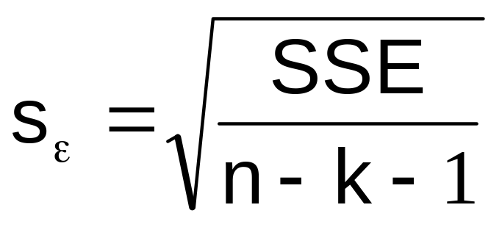
Standard Error of Estimate
The standard deviation of the variation of observations around the regression line is estimated by
Where
SSE = Sum of squares error
n = Sample size
k = number of independent variables in the model

Slide 47
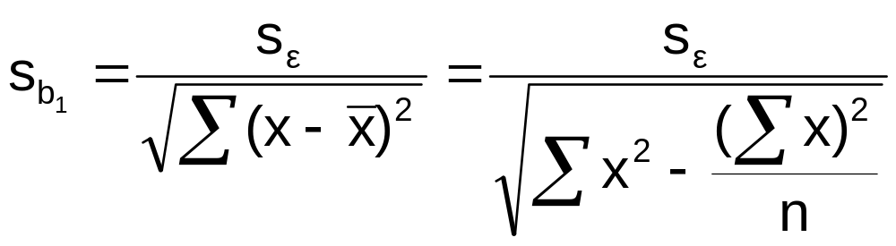
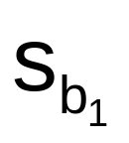
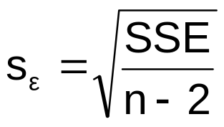
The Standard Deviation of the Regression Slope
The standard error of the regression slope coefficient (b₁) is estimated by
where:
= Estimate of the standard error of the least squares slope
= Sample standard error of the estimate

Slide 48
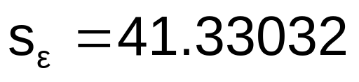
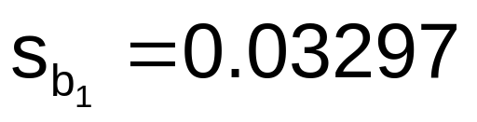
Excel Output
Regression Statistics
Multiple R | 0.76211
R Square | 0.58082
Adjusted R Square | 0.52842
Standard Error | 41.33032
Observations | 10
ANOVA | df | SS | MS | F | Significance F
Regression | 1 | 18934.9348 | 18934.9348 | 11.0848 | 0.01039
Residual | 8 | 13665.5652 | 1708.1957
Total | 9 | 32600.5000
 | Coefficients | Standard Error | t Stat | P-value | Lower 95% | Upper 95%
Intercept | 98.24833 | 58.03348 | 1.69296 | 0.12892 | -35.57720 | 232.07386
Square Feet | 0.10977 | 0.03297 | 3.32938 | 0.01039 | 0.03374 | 0.18580

Slide 49




Comparing Standard Errors
Variation of observed y values from the regression line
Variation in the slope of regression lines from different possible samples
y
y
x
x
y
y
x
x

Slide 50
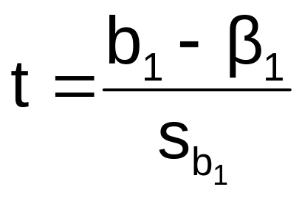

Inference about the Slope: t Test
t test for a population slope
  Is there a linear relationship between x and y?
Null and alternative hypotheses
  H₀: β₁ = 0 (no linear relationship)
  H₁: β₁ ≠ 0 (linear relationship does exist)
Test statistic
where:
b₁ = Sample regression slope
coefficient
β₁ = Hypothesized slope
s_{b1} = Estimator of the standard
error of the slope

Slide 51
Inference about the Slope: t Test
(continued)
Estimated Regression Equation:
House Price in $1000s (y) | Square Feet (x)
245 | 1400
312 | 1600
279 | 1700
308 | 1875
199 | 1100
219 | 1550
405 | 2350
324 | 2450
319 | 1425
255 | 1700
The slope of this model is 0.1098
Does square footage of the house affect its sales price?

Slide 52
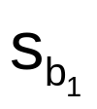
Inferences about the Slope: t Test Example
Test Statistic: t = 3.329
b₁
t
H₀: β₁ = 0
H_{A}: β₁ ≠ 0
From Excel output:
 | Coefficients | Standard Error | t Stat | P-value
Intercept | 98.24833 | 58.03348 | 1.69296 | 0.12892
Square Feet | 0.10977 | 0.03297 | 3.32938 | 0.01039
d.f. = 10-2 = 8
Decision:
Conclusion:
Reject H₀
α/2=.025
α/2=.025
There is sufficient evidence that square footage affects house price
Reject H₀
Do not reject H₀
Reject H₀
-t_{α/2}
t_{α/2}
0
-2.3060
2.3060
3.329

Slide 53
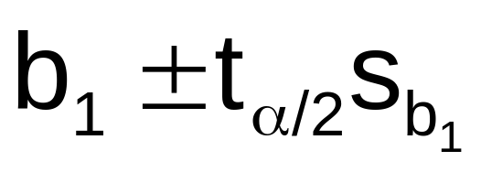
Regression Analysis for Description
Confidence Interval Estimate of the Slope:
d.f. = n - 2
Excel Printout for House Prices:
 | Coefficients | Standard Error | t Stat | P-value | Lower 95% | Upper 95%
Intercept | 98.24833 | 58.03348 | 1.69296 | 0.12892 | -35.57720 | 232.07386
Square Feet | 0.10977 | 0.03297 | 3.32938 | 0.01039 | 0.03374 | 0.18580
At 95% level of confidence, the confidence interval for the slope is (0.0337, 0.1858)

Slide 54
Regression Analysis for Description
 | Coefficients | Standard Error | t Stat | P-value | Lower 95% | Upper 95%
Intercept | 98.24833 | 58.03348 | 1.69296 | 0.12892 | -35.57720 | 232.07386
Square Feet | 0.10977 | 0.03297 | 3.32938 | 0.01039 | 0.03374 | 0.18580
Since the units of the house price variable is $1000s, we are 95% confident that the average impact on sales price is between $33.70 and $185.80 per square foot of house size
This 95% confidence interval does not include 0.
Conclusion: There is a significant relationship between house price and square feet at the .05 level of significance

Slide 55
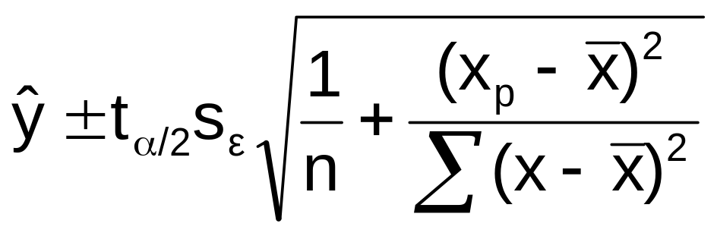
Confidence Interval for the Average y, Given x
Confidence interval estimate for the
mean of y given a particular x_{p}
Size of interval varies according to distance away from mean, x

Slide 56
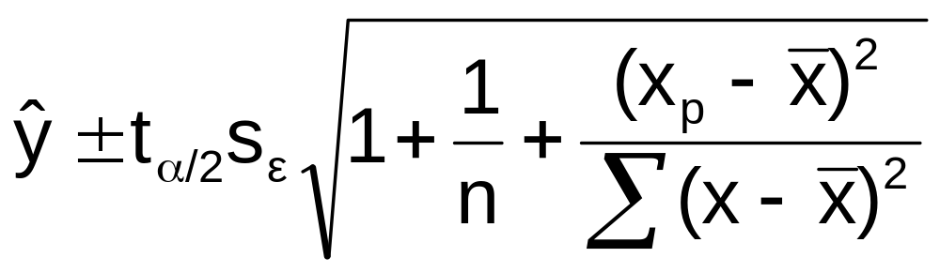
Confidence Interval for an Individual y, Given x
Confidence interval estimate for an
Individual value of y given a particular x_{p}
This extra term adds to the interval width to reflect the added uncertainty for an individual case

Slide 57
Interval Estimates for Different Values of x
Prediction Interval for an individual y, given x_{p}
y
Confidence Interval for the mean of y, given x_{p}
∧
y = b₀ + b₁x
x
x
x_{p}

Slide 58
Example: House Prices
Estimated Regression Equation:
House Price in $1000s (y) | Square Feet (x)
245 | 1400
312 | 1600
279 | 1700
308 | 1875
199 | 1100
219 | 1550
405 | 2350
324 | 2450
319 | 1425
255 | 1700
Predict the price for a house with 2000 square feet

Slide 59
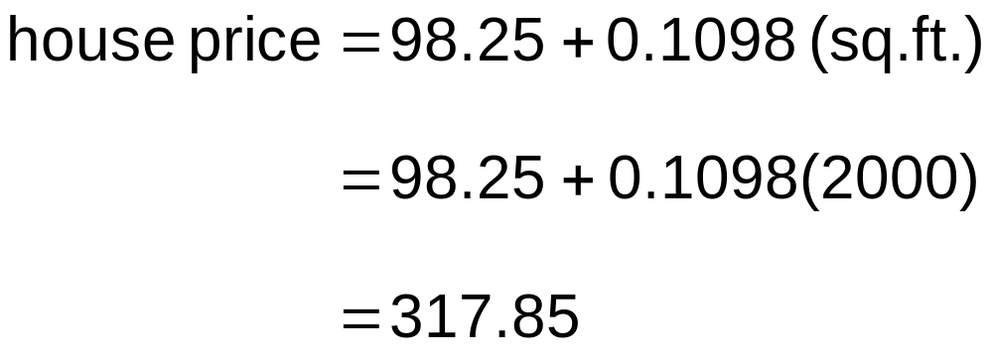
Example: House Prices
(continued)
Predict the price for a house with 2000 square feet:
The predicted price for a house with 2000 square feet is 317.85($1,000s) = $317,850

Slide 60
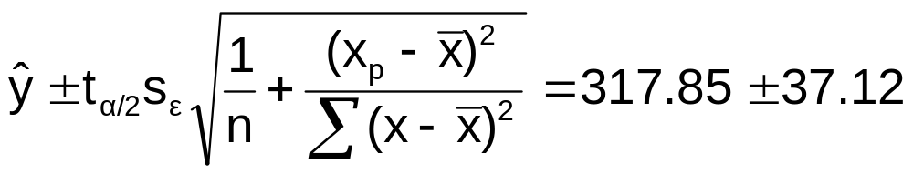
Estimation of Mean Values: Example
Confidence Interval Estimate for E(y)|x_{p}
Find the 95% confidence interval for the average price of 2,000 square-foot houses
∧
Predicted Price Y_{i} = 317.85 ($1,000s)
The confidence interval endpoints are 280.66 -- 354.90, or from $280,660 -- $354,900

Slide 61
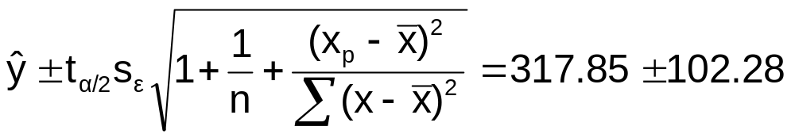
Estimation of Individual Values: Example
Prediction Interval Estimate for y|x_{p}
Find the 95% confidence interval for an individual house with 2,000 square feet
∧
Predicted Price Y_{i} = 317.85 ($1,000s)
The prediction interval endpoints are 215.50 -- 420.07, or from $215,500 -- $420,070

Slide 62
Finding Confidence and Prediction Intervals PHStat
In Excel, use
PHStat | regression | simple linear regression …
  Check the
  “confidence and prediction interval for X=”
  box and enter the x-value and confidence level desired

Slide 63
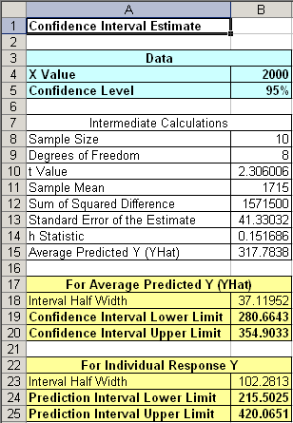
Finding Confidence and Prediction Intervals PHStat
(continued)
Input values
Confidence Interval Estimate for E(y)|x_{p}
Prediction Interval Estimate for y|x_{p}

Slide 64
Residual Analysis
Purposes
  Examine for linearity assumption
  Examine for constant variance for all levels of x
  Evaluate normal distribution assumption
Graphical Analysis of Residuals
  Can plot residuals vs. x
  Can create histogram of residuals to check for normality

Slide 65

Residual Analysis for Linearity
y
y
x
x
residuals
x
x
residuals
Not Linear
✓
Linear

Slide 66

Residual Analysis for
Constant Variance
y
y
x
x
residuals
x
x
residuals
✓
Non-constant variance
Constant variance

Slide 67
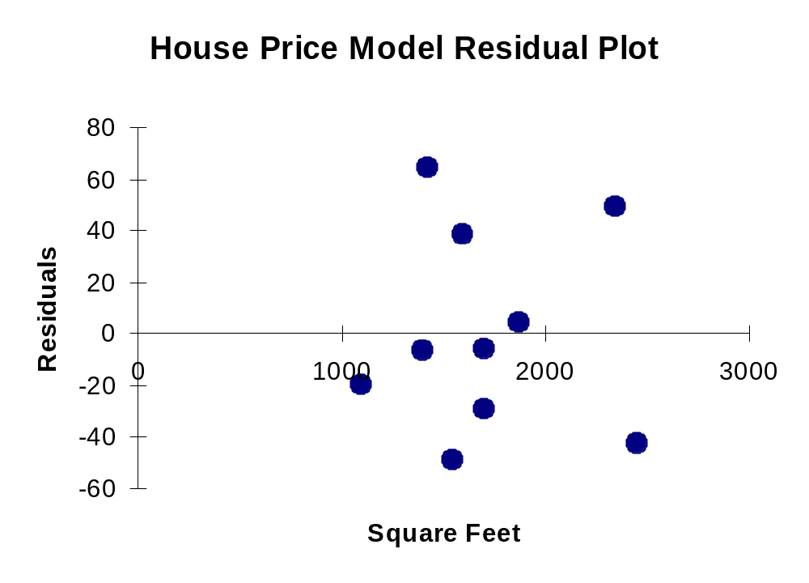
Excel Output
RESIDUAL OUTPUT
 | Predicted House Price | Residuals
1 | 251.92316 | -6.923162
2 | 273.87671 | 38.12329
3 | 284.85348 | -5.853484
4 | 304.06284 | 3.937162
5 | 218.99284 | -19.99284
6 | 268.38832 | -49.38832
7 | 356.20251 | 48.79749
8 | 367.17929 | -43.17929
9 | 254.6674 | 64.33264
10 | 284.85348 | -29.85348

Slide 68
Chapter Summary
Introduced correlation analysis
Discussed correlation to measure the strength of a linear association
Introduced simple linear regression analysis
Calculated the coefficients for the simple linear regression equation
Described measures of variation (R² and s_{ε})
Addressed assumptions of regression and correlation

Slide 69
Chapter Summary
(continued)
Described inference about the slope
Addressed estimation of mean values and prediction of individual values
Discussed residual analysis

