Slide 1
Chapter 13
Multiple Regression and Model Building
A Course In Business Statistics
4th Edition

Slide 2
Chapter Goals
After completing this chapter, you should be able to:
understand model building using multiple regression analysis
apply multiple regression analysis to business decision-making situations
analyze and interpret the computer output for a multiple regression model
test the significance of the independent variables in a multiple regression model

Slide 3
Chapter Goals
(continued)
After completing this chapter, you should be able to:
use variable transformations to model nonlinear relationships
recognize potential problems in multiple regression analysis and take the steps to correct the problems.
incorporate qualitative variables into the regression model by using dummy variables.

Slide 4
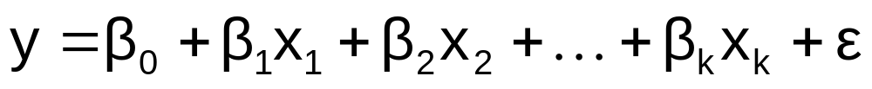
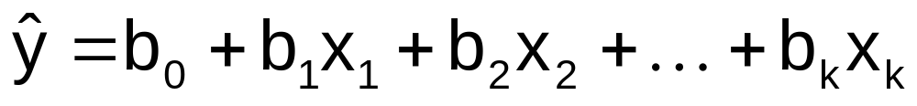
The Multiple Regression Model
Idea: Examine the linear relationship between
1 dependent (y) & 2 or more independent variables (x_{i})
Population model:
Y-intercept
Population slopes
Random Error
Estimated multiple regression model:
Estimated
(or predicted)
value of y
Estimated
intercept
Estimated slope coefficients

Slide 5
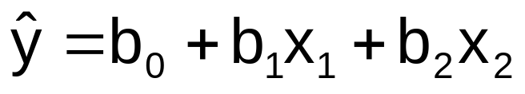
Multiple Regression Model
Two variable model
y
Slope for variable x₁
x₂
Slope for variable x₂
x₁

Slide 6
Multiple Regression Model
Two variable model
y
Sample observation
y_{i}
<
y_{i}
<
e = (y – y)
x_{2i}
x₂
x_{1i}
<
The best fit equation, y ,
is found by minimizing the
sum of squared errors, Σe²
x₁

Slide 7
Multiple Regression Assumptions
Errors (residuals) from the regression model:
e = (y – y)
<
The errors are normally distributed
The mean of the errors is zero
Errors have a constant variance
The model errors are independent

Slide 8
Model Specification
Decide what you want to do and select the dependent variable
Determine the potential independent variables for your model
Gather sample data (observations) for all variables

Slide 9
The Correlation Matrix
Correlation between the dependent variable and selected independent variables can be found using Excel:
  Tools / Data Analysis… / Correlation
Can check for statistical significance of correlation with a t test

Slide 10

Example
A distributor of frozen desert pies wants to evaluate factors thought to influence demand
  Dependent variable: Pie sales (units per week)
  Independent variables: Price (in $)
    Advertising ($100’s)
Data is collected for 15 weeks

Slide 11
Pie Sales Model
Week | Pie Sales | Price ($) | Advertising ($100s)
1 | 350 | 5.50 | 3.3
2 | 460 | 7.50 | 3.3
3 | 350 | 8.00 | 3.0
4 | 430 | 8.00 | 4.5
5 | 350 | 6.80 | 3.0
6 | 380 | 7.50 | 4.0
7 | 430 | 4.50 | 3.0
8 | 470 | 6.40 | 3.7
9 | 450 | 7.00 | 3.5
10 | 490 | 5.00 | 4.0
11 | 340 | 7.20 | 3.5
12 | 300 | 7.90 | 3.2
13 | 440 | 5.90 | 4.0
14 | 450 | 5.00 | 3.5
15 | 300 | 7.00 | 2.7
Multiple regression model:
Sales = b₀ + b₁ (Price)
+ b₂ (Advertising)
Correlation matrix:
 | Pie Sales | Price | Advertising
Pie Sales | 1
Price | -0.44327 | 1
Advertising | 0.55632 | 0.03044 | 1

Slide 12
Interpretation of Estimated Coefficients
Slope (b_{i})
  Estimates that the average value of y changes by b_{i} units for each 1 unit increase in X_{i} holding all other variables constant
  Example: if b₁ = -20, then sales (y) is expected to decrease by an estimated 20 pies per week for each $1 increase in selling price (x₁), net of the effects of changes due to advertising (x₂)
y-intercept (b₀)
  The estimated average value of y when all x_{i} = 0 (assuming all x_{i} = 0 is within the range of observed values)

Slide 13
Pie Sales Correlation Matrix
 | Pie Sales | Price | Advertising
Pie Sales | 1
Price | -0.44327 | 1
Advertising | 0.55632 | 0.03044 | 1
Price vs. Sales : r = -0.44327
  There is a negative association between
  price and sales
Advertising vs. Sales : r = 0.55632
  There is a positive association between
  advertising and sales

Slide 14
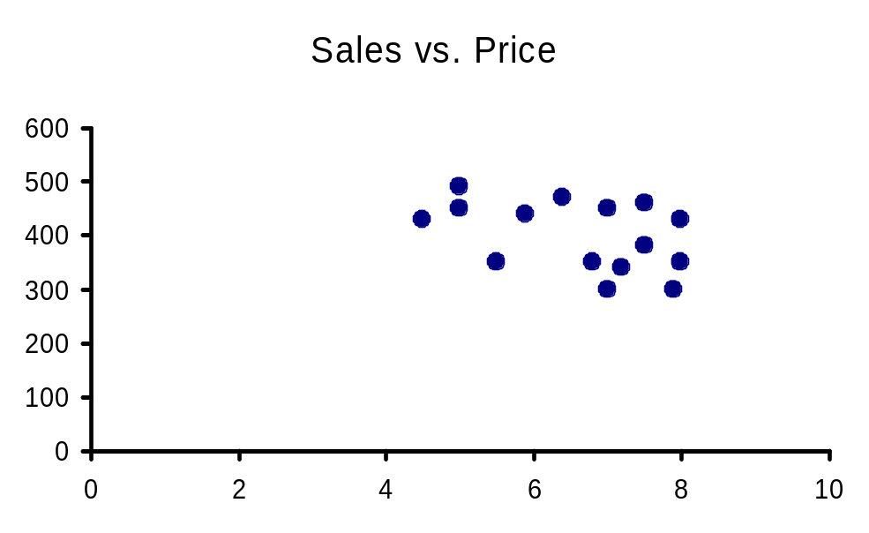
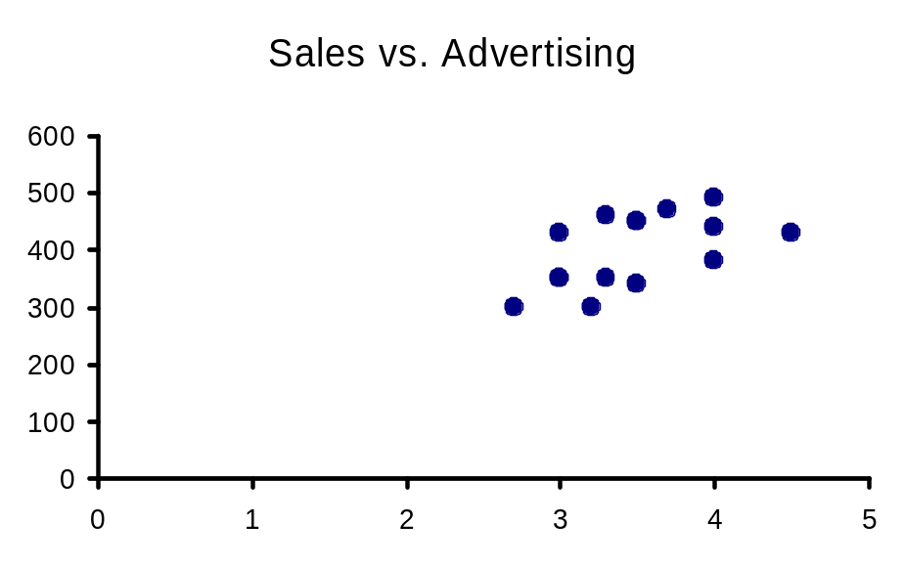
Scatter Diagrams
Sales
Sales
Price
Advertising

Slide 15
Estimating a Multiple Linear
Regression Equation
Computer software is generally used to generate the coefficients and measures of goodness of fit for multiple regression
Excel:
  Tools / Data Analysis... / Regression
PHStat:
  PHStat / Regression / Multiple Regression…

Slide 16
Multiple Regression Output
Regression Statistics
Multiple R | 0.72213
R Square | 0.52148
Adjusted R Square | 0.44172
Standard Error | 47.46341
Observations | 15
ANOVA | df | SS | MS | F | Significance F
Regression | 2 | 29460.027 | 14730.013 | 6.53861 | 0.01201
Residual | 12 | 27033.306 | 2252.776
Total | 14 | 56493.333
 | Coefficients | Standard Error | t Stat | P-value | Lower 95% | Upper 95%
Intercept | 306.52619 | 114.25389 | 2.68285 | 0.01993 | 57.58835 | 555.46404
Price | -24.97509 | 10.83213 | -2.30565 | 0.03979 | -48.57626 | -1.37392
Advertising | 74.13096 | 25.96732 | 2.85478 | 0.01449 | 17.55303 | 130.70888

Slide 17
The Multiple Regression Equation
where
Sales is in number of pies per week
Price is in $
Advertising is in $100’s.
b₁ = -24.975: sales will decrease, on average, by 24.975 pies per week for each $1 increase in selling price, net of the effects of changes due to advertising
b₂ = 74.131: sales will increase, on average, by 74.131 pies per week for each $100 increase in advertising, net of the effects of changes due to price

Slide 18
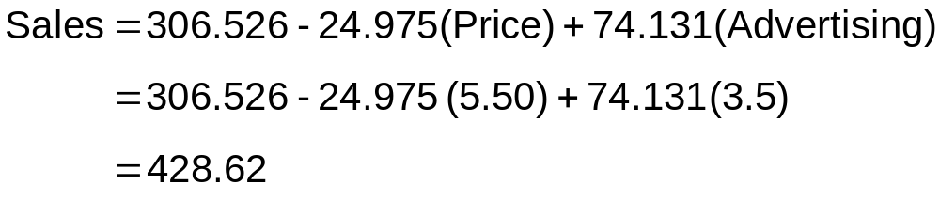
Using The Model to Make Predictions
Predict sales for a week in which the selling price is $5.50 and advertising is $350:
Note that Advertising is in $100’s, so $350 means that x₂ = 3.5
Predicted sales is 428.62 pies

Slide 19
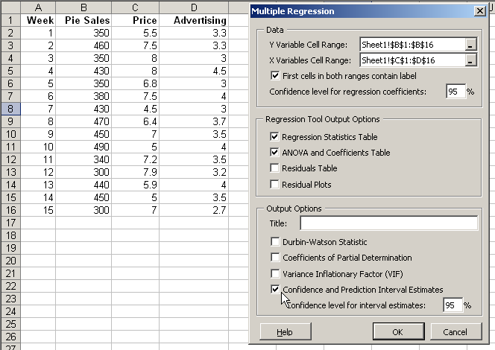
Predictions in PHStat
PHStat | regression | multiple regression …
Check the “confidence and prediction interval estimates” box

Slide 20
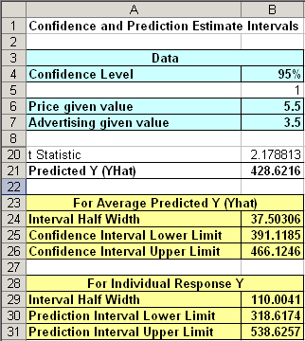
Predictions in PHStat
(continued)
Input values
<
Predicted y value
Confidence interval for the mean y value, given these x’s
<
Prediction interval for an individual y value, given these x’s
<

Slide 21
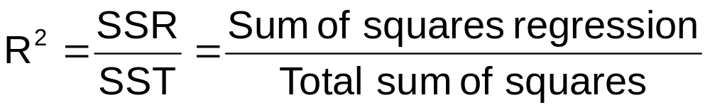
Multiple Coefficient of
Determination
Reports the proportion of total variation in y explained by all x variables taken together

Slide 22
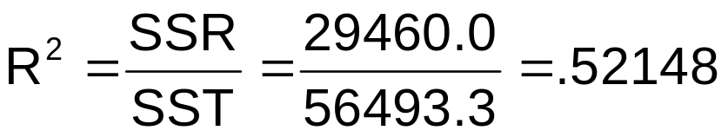
Multiple Coefficient of
Determination
(continued)
Regression Statistics
Multiple R | 0.72213
R Square | 0.52148
Adjusted R Square | 0.44172
Standard Error | 47.46341
Observations | 15
ANOVA | df | SS | MS | F | Significance F
Regression | 2 | 29460.027 | 14730.013 | 6.53861 | 0.01201
Residual | 12 | 27033.306 | 2252.776
Total | 14 | 56493.333
 | Coefficients | Standard Error | t Stat | P-value | Lower 95% | Upper 95%
Intercept | 306.52619 | 114.25389 | 2.68285 | 0.01993 | 57.58835 | 555.46404
Price | -24.97509 | 10.83213 | -2.30565 | 0.03979 | -48.57626 | -1.37392
Advertising | 74.13096 | 25.96732 | 2.85478 | 0.01449 | 17.55303 | 130.70888
52.1% of the variation in pie sales is explained by the variation in price and advertising

Slide 23
Adjusted R²
R² never decreases when a new x variable is added to the model
  This can be a disadvantage when comparing models
What is the net effect of adding a new variable?
  We lose a degree of freedom when a new x variable is added
  Did the new x variable add enough explanatory power to offset the loss of one degree of freedom?

Slide 24
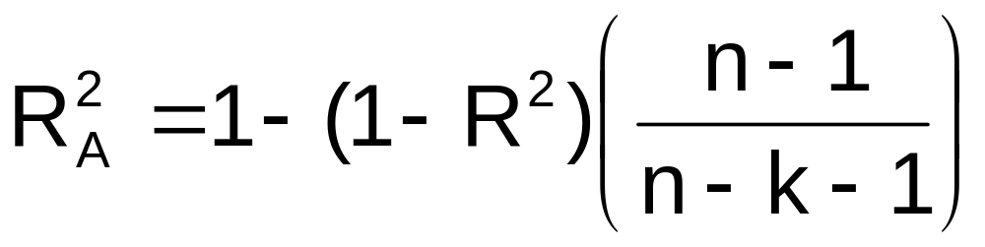
Adjusted R²
(continued)
Shows the proportion of variation in y explained by all x variables adjusted for the number of x variables used
  (where n = sample size, k = number of independent variables)
  Penalize excessive use of unimportant independent variables
  Smaller than R²
  Useful in comparing among models

Slide 25
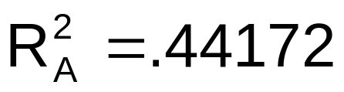
Multiple Coefficient of
Determination
(continued)
Regression Statistics
Multiple R | 0.72213
R Square | 0.52148
Adjusted R Square | 0.44172
Standard Error | 47.46341
Observations | 15
ANOVA | df | SS | MS | F | Significance F
Regression | 2 | 29460.027 | 14730.013 | 6.53861 | 0.01201
Residual | 12 | 27033.306 | 2252.776
Total | 14 | 56493.333
 | Coefficients | Standard Error | t Stat | P-value | Lower 95% | Upper 95%
Intercept | 306.52619 | 114.25389 | 2.68285 | 0.01993 | 57.58835 | 555.46404
Price | -24.97509 | 10.83213 | -2.30565 | 0.03979 | -48.57626 | -1.37392
Advertising | 74.13096 | 25.96732 | 2.85478 | 0.01449 | 17.55303 | 130.70888
44.2% of the variation in pie sales is explained by the variation in price and advertising, taking into account the sample size and number of independent variables

Slide 26
Is the Model Significant?
F-Test for Overall Significance of the Model
Shows if there is a linear relationship between all of the x variables considered together and y
Use F test statistic
Hypotheses:
  H₀: β₁ = β₂ = … = β_{k} = 0 (no linear relationship)
  H_{A}: at least one β_{i} ≠ 0 (at least one independent
  variable affects y)

Slide 27
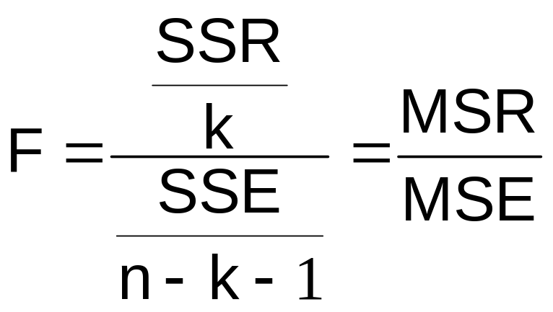
F-Test for Overall Significance
(continued)
Test statistic:
where F has (numerator) D₁ = k and
(denominator) D₂ = (n – k - 1)
degrees of freedom

Slide 28
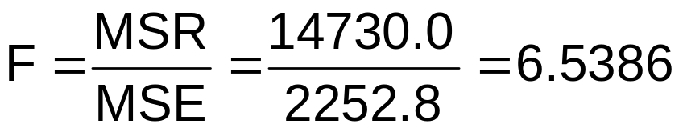
F-Test for Overall Significance
(continued)
Regression Statistics
Multiple R | 0.72213
R Square | 0.52148
Adjusted R Square | 0.44172
Standard Error | 47.46341
Observations | 15
ANOVA | df | SS | MS | F | Significance F
Regression | 2 | 29460.027 | 14730.013 | 6.53861 | 0.01201
Residual | 12 | 27033.306 | 2252.776
Total | 14 | 56493.333
 | Coefficients | Standard Error | t Stat | P-value | Lower 95% | Upper 95%
Intercept | 306.52619 | 114.25389 | 2.68285 | 0.01993 | 57.58835 | 555.46404
Price | -24.97509 | 10.83213 | -2.30565 | 0.03979 | -48.57626 | -1.37392
Advertising | 74.13096 | 25.96732 | 2.85478 | 0.01449 | 17.55303 | 130.70888
With 2 and 12 degrees of freedom
P-value for the F-Test

Slide 29
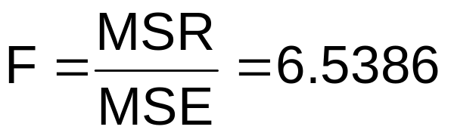
F-Test for Overall Significance
(continued)
H₀: β₁ = β₂ = 0
H_{A}: β₁ and β₂ not both zero
α = .05
df₁= 2 df₂ = 12
Test Statistic:
Decision:
Conclusion:
Critical Value:
F_{α} = 3.885
Reject H₀ at α = 0.05
The regression model does explain a significant portion of the variation in pie sales
(There is evidence that at least one independent variable affects y)
α = .05
0
F
Do not
reject H₀
Reject H₀
F_{.05} = 3.885

Slide 30
Are Individual Variables Significant?
Use t-tests of individual variable slopes
Shows if there is a linear relationship between the variable x_{i} and y
Hypotheses:
  H₀: β_{i} = 0 (no linear relationship)
  H_{A}: β_{i} ≠ 0 (linear relationship does exist
  between x_{i} and y)

Slide 31
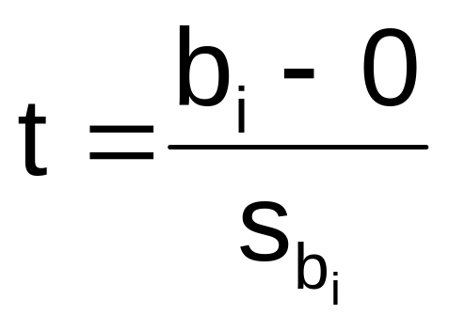
Are Individual Variables Significant?
(continued)
  H₀: β_{i} = 0 (no linear relationship)
  H_{A}: β_{i} ≠ 0 (linear relationship does exist
  between x_{i} and y)
  Test Statistic:
  (df = n – k – 1)

Slide 32
Are Individual Variables Significant?
(continued)
Regression Statistics
Multiple R | 0.72213
R Square | 0.52148
Adjusted R Square | 0.44172
Standard Error | 47.46341
Observations | 15
ANOVA | df | SS | MS | F | Significance F
Regression | 2 | 29460.027 | 14730.013 | 6.53861 | 0.01201
Residual | 12 | 27033.306 | 2252.776
Total | 14 | 56493.333
 | Coefficients | Standard Error | t Stat | P-value | Lower 95% | Upper 95%
Intercept | 306.52619 | 114.25389 | 2.68285 | 0.01993 | 57.58835 | 555.46404
Price | -24.97509 | 10.83213 | -2.30565 | 0.03979 | -48.57626 | -1.37392
Advertising | 74.13096 | 25.96732 | 2.85478 | 0.01449 | 17.55303 | 130.70888
t-value for Price is t = -2.306, with p-value .0398
t-value for Advertising is t = 2.855, with p-value .0145

Slide 33
Inferences about the Slope: t Test Example
From Excel output:
H₀: β_{i} = 0
H_{A}: β_{i} ≠ 0
 | Coefficients | Standard Error | t Stat | P-value
Price | -24.97509 | 10.83213 | -2.30565 | 0.03979
Advertising | 74.13096 | 25.96732 | 2.85478 | 0.01449
d.f. = 15-2-1 = 12
= .05
t_{α/2} = 2.1788
The test statistic for each variable falls in the rejection region (p-values < .05)
Decision:
Conclusion:
α/2=.025
α/2=.025
Reject H₀ for each variable
There is evidence that both Price and Advertising affect pie sales at α = .05
Reject H₀
Do not reject H₀
Reject H₀
-t_{α/2}
t_{α/2}
0
-2.1788
2.1788

Slide 34
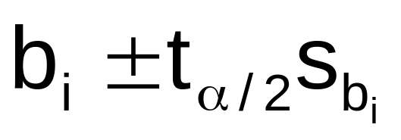
Confidence Interval Estimate for the Slope
Confidence interval for the population slope β₁
(the effect of changes in price on pie sales):
where t has
(n – k – 1) d.f.
 | Coefficients | Standard Error | … | Lower 95% | Upper 95%
Intercept | 306.52619 | 114.25389 | … | 57.58835 | 555.46404
Price | -24.97509 | 10.83213 | … | -48.57626 | -1.37392
Advertising | 74.13096 | 25.96732 | … | 17.55303 | 130.70888
Example: Weekly sales are estimated to be reduced by between 1.37 to 48.58 pies for each increase of $1 in the selling price

Slide 35
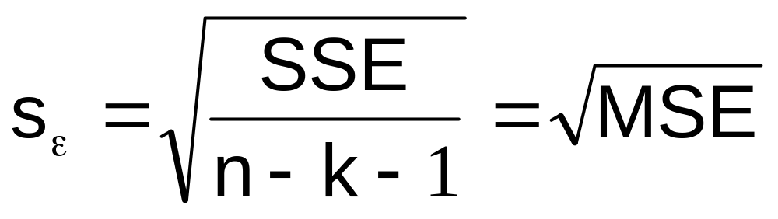
Standard Deviation of the Regression Model
The estimate of the standard deviation of the regression model is:
Is this value large or small? Must compare to the mean size of y for comparison

Slide 36
Standard Deviation of the Regression Model
(continued)
Regression Statistics
Multiple R | 0.72213
R Square | 0.52148
Adjusted R Square | 0.44172
Standard Error | 47.46341
Observations | 15
ANOVA | df | SS | MS | F | Significance F
Regression | 2 | 29460.027 | 14730.013 | 6.53861 | 0.01201
Residual | 12 | 27033.306 | 2252.776
Total | 14 | 56493.333
 | Coefficients | Standard Error | t Stat | P-value | Lower 95% | Upper 95%
Intercept | 306.52619 | 114.25389 | 2.68285 | 0.01993 | 57.58835 | 555.46404
Price | -24.97509 | 10.83213 | -2.30565 | 0.03979 | -48.57626 | -1.37392
Advertising | 74.13096 | 25.96732 | 2.85478 | 0.01449 | 17.55303 | 130.70888
The standard deviation of the regression model is 47.46

Slide 37

Standard Deviation of the Regression Model
(continued)
The standard deviation of the regression model is 47.46
A rough prediction range for pie sales in a given week is
Pie sales in the sample were in the 300 to 500 per week range, so this range is probably too large to be acceptable. The analyst may want to look for additional variables that can explain more of the variation in weekly sales

Slide 38
Multicollinearity
Multicollinearity: High correlation exists between two independent variables
This means the two variables contribute redundant information to the multiple regression model

Slide 39
Multicollinearity
(continued)
Including two highly correlated independent variables can adversely affect the regression results
  No new information provided
  Can lead to unstable coefficients (large standard error and low t-values)
  Coefficient signs may not match prior expectations

Slide 40
Some Indications of Severe Multicollinearity
Incorrect signs on the coefficients
Large change in the value of a previous coefficient when a new variable is added to the model
A previously significant variable becomes insignificant when a new independent variable is added
The estimate of the standard deviation of the model increases when a variable is added to the model

Slide 41
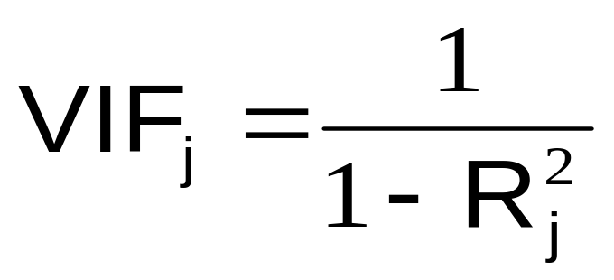
Detect Collinearity
(Variance Inflationary Factor)
VIF_{j} is used to measure collinearity:
R²_{j} is the coefficient of determination when the j^{th} independent variable is regressed against the remaining k – 1 independent variables
If VIF_{j} > 5, x_{j} is highly correlated with the other explanatory variables

Slide 42
Detect Collinearity in PHStat
PHStat / regression / multiple regression …
  Check the “variance inflationary factor (VIF)” box
Regression Analysis
Price and all other X
Regression Statistics
Multiple R | 0.030437581
R Square | 0.000926446
Adjusted R Square | -0.075925366
Standard Error | 1.21527235
Observations | 15
VIF | 1.000927305
Output for the pie sales example:
  Since there are only two explanatory variables, only one VIF is reported
    VIF is < 5
    There is no evidence of collinearity between Price and Advertising

Slide 43
Qualitative (Dummy) Variables
Categorical explanatory variable (dummy variable) with two or more levels:
  yes or no, on or off, male or female
  coded as 0 or 1
Regression intercepts are different if the variable is significant
Assumes equal slopes for other variables
The number of dummy variables needed is (number of levels - 1)

Slide 44
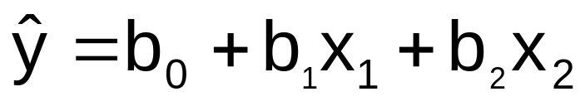
Dummy-Variable Model Example (with 2 Levels)
Let:
y = pie sales
x₁ = price
x₂ = holiday (X₂ = 1 if a holiday occurred during the week) (X₂ = 0 if there was no holiday that week)

Slide 45
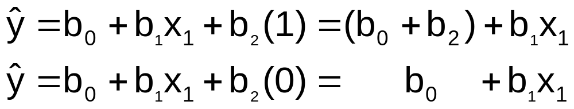
Dummy-Variable Model Example
(with 2 Levels)
(continued)
Holiday
No Holiday
Different intercept
Same slope
y (sales)
If H₀: β₂ = 0 is rejected, then
“Holiday” has a significant effect on pie sales
b₀ + b₂
Holiday
b₀
No Holiday
x₁ (Price)

Slide 46
Interpretation of the Dummy Variable Coefficient (with 2 Levels)
Example:
Sales: number of pies sold per week
Price: pie price in $
Holiday:
1 If a holiday occurred during the week
0 If no holiday occurred
b₂ = 15: on average, sales were 15 pies greater in weeks with a holiday than in weeks without a holiday, given the same price

Slide 47

Dummy-Variable Models
(more than 2 Levels)
The number of dummy variables is one less than the number of levels
Example:
y = house price ; x₁ = square feet
The style of the house is also thought to matter:
Style = ranch, split level, condo
Three levels, so two dummy variables are needed

Slide 48
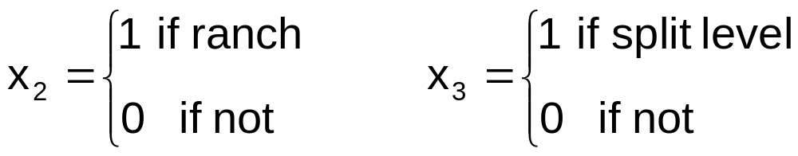
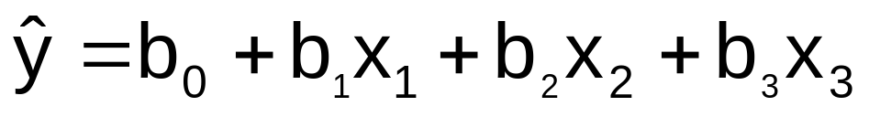
Dummy-Variable Models
(more than 2 Levels)
(continued)
Let the default category be “condo”
b₂ shows the impact on price if the house is a ranch style, compared to a condo
b₃ shows the impact on price if the house is a split level style, compared to a condo

Slide 49
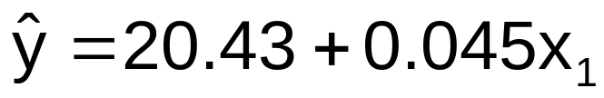
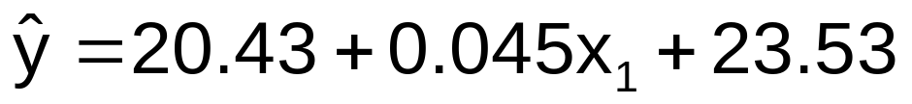
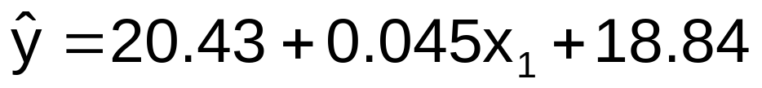
Interpreting the Dummy Variable Coefficients (with 3 Levels)
Suppose the estimated equation is
For a condo: x₂ = x₃ = 0
With the same square feet, a ranch will have an estimated average price of 23.53 thousand dollars more than a condo
For a ranch: x₃ = 0
With the same square feet, a ranch will have an estimated average price of 18.84 thousand dollars more than a condo.
For a split level: x₂ = 0

Slide 50
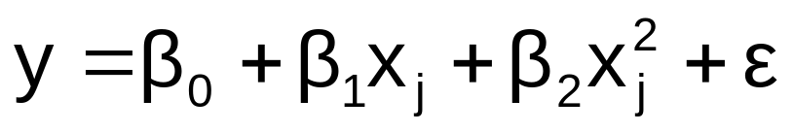
Nonlinear Relationships
The relationship between the dependent variable and an independent variable may not be linear
Useful when scatter diagram indicates non-linear relationship
Example: Quadratic model
  The second independent variable is the square of the first variable

Slide 51
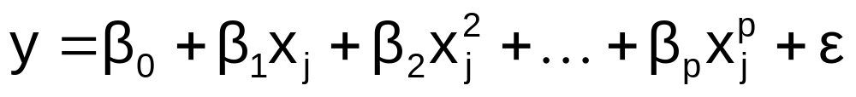
Polynomial Regression Model
General form:
where:
β₀ = Population regression constant
β_{i} = Population regression coefficient for variable x_{j} : j = 1, 2, …k
p = Order of the polynomial
ε_{i} = Model error
If p = 2 the model is a quadratic model:

Slide 52

Linear vs. Nonlinear Fit
y
y
x
x
residuals
x
x
residuals
Linear fit does not give random residuals
Nonlinear fit gives random residuals
✓

Slide 53
Quadratic Regression Model
Quadratic models may be considered when scatter diagram takes on the following shapes:
y
y
y
y
x₁
x₁
x₁
x₁
β₁ < 0
β₁ > 0
β₁ < 0
β₁ > 0
β₂ > 0
β₂ > 0
β₂ < 0
β₂ < 0
β₁ = the coefficient of the linear term
β₂ = the coefficient of the squared term

Slide 54
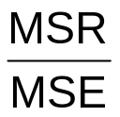
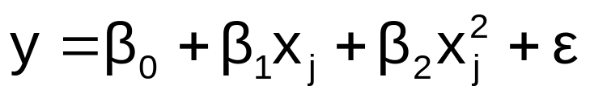
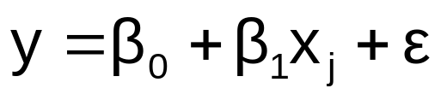
Testing for Significance: Quadratic Model
Test for Overall Relationship
  F test statistic =
Testing the Quadratic Effect
  Compare quadratic model
with the linear model
  Hypotheses
    (No 2nd order polynomial term)
    (2nd order polynomial term is needed)
H₀: β₂ = 0
H_{A}: β₂ ≠ 0

Slide 55
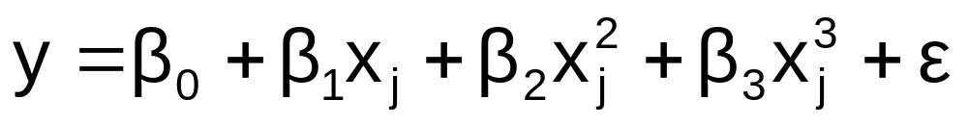
Higher Order Models
y
x
If p = 3 the model is a cubic form:

Slide 56
Interaction Effects
Hypothesizes interaction between pairs of x variables
  Response to one x variable varies at different levels of another x variable
Contains two-way cross product terms
Basic Terms
Interactive Terms

Slide 57
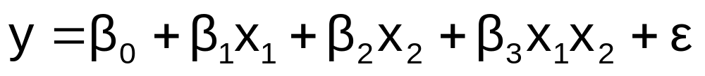
Effect of Interaction
Given:
Without interaction term, effect of x₁ on y is measured by β₁
With interaction term, effect of x₁ on y is measured by β₁ + β₃ x₂
Effect changes as x₂ increases

Slide 58
Interaction Example
y = 1 + 2x₁ + 3x₂ + 4x₁x₂
where x₂ = 0 or 1 (dummy variable)
y
x₂ = 1
12
y = 1 + 2x₁ + 3(1) + 4x₁(1)
= 4 + 6x₁
8
x₂ = 0
4
y = 1 + 2x₁ + 3(0) + 4x₁(0)
= 1 + 2x₁
0
x₁
0
0.5
1
1.5
Effect (slope) of x₁ on y does depend on x₂ value

Slide 59
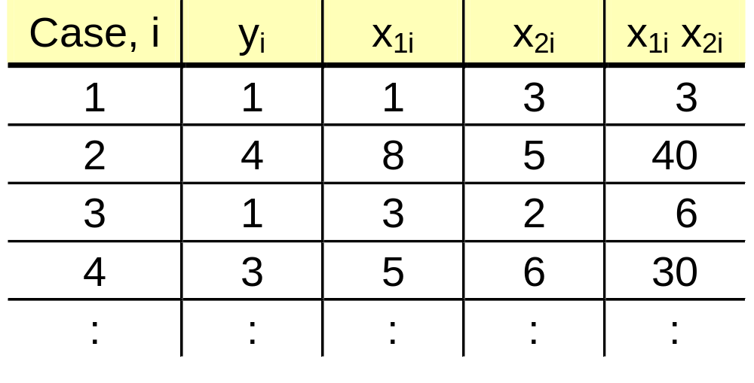
Interaction Regression Model Worksheet
multiply x₁ by x₂ to get x₁x₂, then
run regression with y, x₁, x₂ , x₁x₂

Slide 60
Evaluating Presence of Interaction
Hypothesize interaction between pairs of independent variables
Hypotheses:
  H₀: β₃ = 0 (no interaction between x₁ and x₂)
  H_{A}: β₃ ≠ 0 (x₁ interacts with x₂)

Slide 61
Model Building
Goal is to develop a model with the best set of independent variables
  Easier to interpret if unimportant variables are removed
  Lower probability of collinearity
Stepwise regression procedure
  Provide evaluation of alternative models as variables are added
Best-subset approach
  Try all combinations and select the best using the highest adjusted R² and lowest s_{ε}

Slide 62
Stepwise Regression
Idea: develop the least squares regression equation in steps, either through forward selection, backward elimination, or through standard stepwise regression
The coefficient of partial determination is the measure of the marginal contribution of each independent variable, given that other independent variables are in the model

Slide 63
Best Subsets Regression
Idea: estimate all possible regression equations using all possible combinations of independent variables
Choose the best fit by looking for the highest adjusted R² and lowest standard error s_{ε}
Stepwise regression and best subsets regression can be performed using PHStat, Minitab, or other statistical software packages

Slide 64
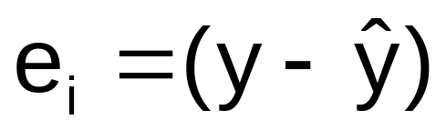
Aptness of the Model
Diagnostic checks on the model include verifying the assumptions of multiple regression:
  Each x_{i} is linearly related to y
  Errors have constant variance
  Errors are independent
  Error are normally distributed
Errors (or Residuals) are given by

Slide 65

Residual Analysis
residuals
x
x
residuals
✓
Non-constant variance
Constant variance
residuals
x
x
residuals
Not Independent
✓
Independent

Slide 66
The Normality Assumption
Errors are assumed to be normally distributed
Standardized residuals can be calculated by computer
Examine a histogram or a normal probability plot of the standardized residuals to check for normality

Slide 67
Chapter Summary
Developed the multiple regression model
Tested the significance of the multiple regression model
Developed adjusted R²
Tested individual regression coefficients
Used dummy variables
Examined interaction in a multiple regression model

Slide 68
Chapter Summary
(continued)
Described nonlinear regression models
Described multicollinearity
Discussed model building
  Stepwise regression
  Best subsets regression
Examined residual plots to check model assumptions

