Slide 1
Dr. Şebnem Er
Introduction to Statistics

Slide 2
Surrounded by Statistics
Let’s have a look at Prof. Hans Rosling’s
«The Joy of Stats» video.
Source: http://www.gapminder.org/videos/the-joy-of-stats/

Slide 3

The Joy of Stats

Slide 4
The Joy of Stats
If you want to watch the rest please check the website.
What did Prof. Rosling say?
«The world we live in is a wash with data that comes pouring in from everywhere around us. On its own, this data is just noise of confusion. To make sense of data, to find the meaning in it, we need a powerful branch of science: STATISTICS
Believe me there is nothing boring about Statistics, especially not today when we can make the data sing...»

Slide 5
As Prof. Rosling Says We Are Surrounded by Statistics
How are we surrounded by statistics? In which areas?
In Many areas:
  AACSB accreditation questionaires
  Medicine:
  Economics
  Food technologies
  Supermarkets
  Engineering
  Air traffic control systems
  Gambling
  Management
  Sports – Football, Basketball, Swimming etc. Coin toss before a match.
  Spam Filtering – Google!
  Customer Satisfaction
  Detecting Credit Card Fraud
  Crime Statistics

Slide 6
Surrounded by Statistics: In Medicine
Disease and mortality statistics :Understanding the processes by which plagues spread prevent them from decimating humanity:
  Not far from London's Piccadilly Circus Underground Station, if you take a few steps from the intersection of Broadwick Street and Lexington Street, you will stumble into a tubewell (water pump). Notice, the pump has no handle!

Slide 7
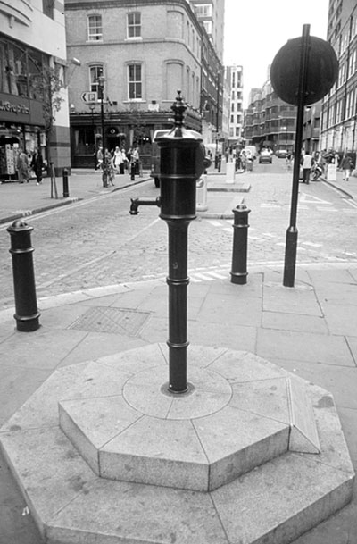

Slide 8
Start of cholera in London, 1854.
Now let us go back almost 160 years in time. It started in the early morning of Monday August 28, 1854 in the basement apartment.
There lived Sarah Lewis with her policeman husband Thomas and five-month old daughter.
The little girl started having diarrhea with its usual symptoms of vomiting, unable to keep down food or medicine, and passing pale, green slimy, watery, offensive-smelling stools. There were no disposable diapers those days. Mrs. Lewis cleaned infant daughter's soiled diapers in buckets of cold water that ran down the drain in front of the apartment. Just out Lewis' apartment, people gathered around a water pump to fetch water.
Over the next three days, people living nearby started to die as well as this little girl.
By the 7th day, September 3, there was full-edged cholera outbreak.
It was during this epidemic that John Snow, a London doctor, succeeded in tracing the epidemic to a single water pump on Broad Street in the Golden Square area.

Slide 9
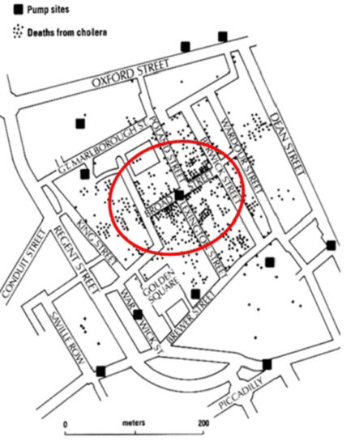
Snow and to the displeasure of the locals, a completely different kind of preventive measure was taken - the pump handle outside 40 Broad Street was removed on September 8. And immediately the number of new cases diminished.

Slide 10
Surrounded by Statistics: In Economics
Inflation
Economic Crisis
Economic Welfare
Income Distribution
Labour Statistics
Imports-Exports

Slide 11
Surrounded by Statistics
In Food Technologies: Decision of what to grow, how much to grow – demand/supply, how to process the yield... etc.
In Supermarkets: How to package, shelve design, combination of products in shelves, distribution of the products, advertisements, promotions, public days... etc.
In Engineering: Designing reliable computer systems and programmes... etc.
In Air Traffic Control Systems: These work in real time, collecting and processing data simultaneously.
In Gambling: Kemal Sunal’s film: Atla Gel Şaban ☺

Slide 12
Surrounded by Statistics
In Management: Decision making, predicting, visualising, interpreting the data of a department, corporation, production, personnell...
In Sports – Football, Basketball, Swimming etc.
In Spam Filtering – Google: Constructing spam filters which prevent obscene ads reaching your email inbox. They include things such as get-rich-quick schemes, prescription drugs, stock market tips, and dubious sexual aids. One estimate is that over 90 billion spam messages are sent each day – increases every day. The techniques behind the principles of preventing spam is based on statistics-probability.
In Customer Satisfaction: Surveys to learn the satisfaction level of our customers. Are they happy with the product or not?

Slide 13
Surrounded by Statistics
In Detecting Credit Card Fraud: Fraudulent transactions cost the bank money, and also cost the bank’s customers money. They have to be detected and prevented. Use statistics.
In Bus Arrival Times: IETT
In Crime Statistics: The City of Columbia, South Carolina crime map:
http://www.spotcrime.com/sc/columbia

Slide 14
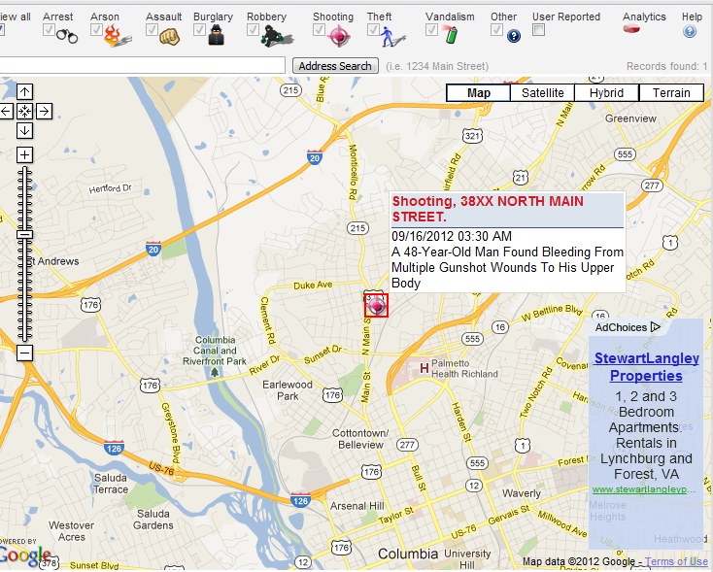
Surrounded by Statistics

Slide 15
I hope that it is clear that statistics is ubiquitous, in that it is applied in all walks of life.
Therefore, it is clearly important that no educated citizen should be unaware of basic statistical principles.

Slide 16
But, What is Statistics?
There are many descriptions:
  Technology of extracting meaning from data
  Methods used to collect, process, interpret data
  Technology of handling uncertainty
  Predicting the future or for making inferences about the unknown, or for producing convenient summaries of data
  A statistic is a numerical fact or summary
  Statistics is the scientific method in action – investigation.
  Science dealing with data about the condition of a state or community

Slide 17
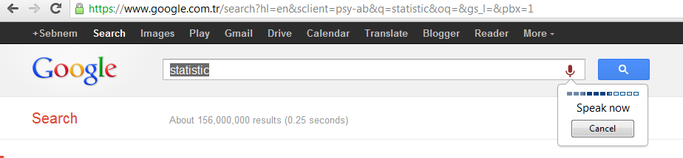
DATA
As obvious, statistics begins with data.
Data are typically numbers: the results of measurements, counts or other processes.
Data could be in the form of pictures, words, or even things such as electronic or acoustic signals: Google search by image, voice!

Slide 18
DATA
Data is evidence.
Without data, our ideas and theories about the world around us are mere speculations.
Data provide a grounding, linking our ideas and theories to reality, and to validate and test our understanding.

Slide 19
Chapter Goals
After completing this chapter, you should be able to:
Describe key data collection methods
Know key definitions:
  ♦Population vs. Sample ♦Primary vs. Secondary data types
  ♦Qualitative vs. Qualitative data ♦Time Series vs. Cross-Sectional data
Explain the difference between descriptive and
inferential statistics
Describe different sampling methods
A Course In Business Statistics, 4th © 2006 Prentice-Hall, Inc.
Chap 1-<number>

Slide 20
Tools of Statistics
Descriptive statistics
  Collecting, presenting, and describing data
Inferential statistics
  Drawing conclusions and/or making decisions concerning a population based only on sample data
A Course In Business Statistics, 4th © 2006 Prentice-Hall, Inc.
Chap 1-<number>

Slide 21

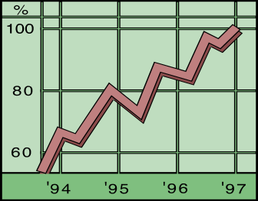
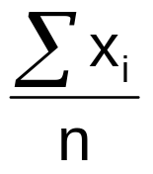
Descriptive Statistics
Collect data
  e.g. Survey, Observation,
  Experiments
Present data
  e.g. Charts and graphs
Characterize data
  e.g. Sample mean =
A Course In Business Statistics, 4th © 2006 Prentice-Hall, Inc.
Chap 1-<number>

Slide 22
Descriptive Statistics
Collect data
  e.g. Survey, Observation,
  Experiments
  When collecting data, we need to take special care to ensure that they do cover the aspects we are interested in, or about which we wish to draw conclusions.
A Course In Business Statistics, 4th © 2006 Prentice-Hall, Inc.
Chap 1-<number>

Slide 23
Descriptive Statistics
Data has 2 aspects
  One aspect is concerned with the objects we wish to study
  Second aspect is concerned with the characteristics of those objects we wish to study.
      e.g. Objects might be students in Business Faculty. We might be interested in their success levels in Maths module in which the characteristics will be the marks obtained in Maths module.
  In Statistics, we call the characteristics variables, with each object having a value of a variable.
A Course In Business Statistics, 4th © 2006 Prentice-Hall, Inc.
Chap 1-<number>

Slide 24
Data Types
Data
Qualitative
(Categorical)
Quantitative
(Numerical)
Examples:
Marital Status
Political Party
Eye Color
(Defined categories)
Discrete
Continuous
Examples:
Number of Children
Defects per hour
(Counted items)
Examples:
Weight
Voltage
(Measured characteristics)
A Course In Business Statistics, 4th © 2006 Prentice-Hall, Inc.
Chap 1-<number>

Slide 25
Data Types
Time Series Data
  Ordered data values observed over time
Cross Section Data
  Data values observed at a fixed point in time
A Course In Business Statistics, 4th © 2006 Prentice-Hall, Inc.
Chap 1-<number>

Slide 26
Data Types
 | Sales (in $1000’s)
 | 2003 | 2004 | 2005 | 2006
Atlanta | 435 | 460 | 475 | 490
Boston | 320 | 345 | 375 | 395
Cleveland | 405 | 390 | 410 | 395
Denver | 260 | 270 | 285 | 280
Time Series Data
Cross Section Data
A Course In Business Statistics, 4th © 2006 Prentice-Hall, Inc.
Chap 1-<number>

Slide 27
Data Measurement Levels
Numbers are universal and although they have only one property, their numerical value, we might choose to use that property in different ways.
  Student success: We might rank the marks, because we are interested in only whether one mark is higher than another. When we are interested in only with the order of the values in this way, we say we are treating the data as lying on an «ordinal» scale.
  When a farmer measures the amount of corn she has produced, she does not want to know whether she has grown more than last year. She wants to know how much she has produced: its actual weight. She compares the weight of corn with a standard weight, such as a ton (ratio of the weight of the corn the farmer has produced to the weight of one ton of corn). When we use the values in this way, we say we are treating the data as lying on a «ratio» scale.
  When we are interested in the number of girls and boys in a class, we simply count discrete well-defined units (students). Here we treat the data as lying on an «absolute-nominal» scale.
A Course In Business Statistics, 4th © 2006 Prentice-Hall, Inc.
Chap 1-<number>

Slide 28
Data Measurement Levels
Highest Level
Complete Analysis
Measurements
Ratio/Interval Data
Rankings
Ordered Categories
Higher Level
Mid-level Analysis
Ordinal Data
Categorical Codes ID Numbers Category Names
Lowest Level
Basic Analysis
Nominal Data
A Course In Business Statistics, 4th © 2006 Prentice-Hall, Inc.

Slide 29



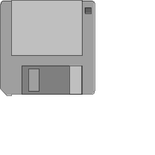

Data Sources
Primary
Data Collection
Secondary
Data Compilation
Print or Electronic
Observation
Survey
Experimentation
A Course In Business Statistics, 4th © 2006 Prentice-Hall, Inc.
Chap 1-<number>

Slide 30
Data Quality
A researcher has to collect good data.
A Course In Business Statistics, 4th © 2006 Prentice-Hall, Inc.
Chap 1-<number>

Slide 31
Survey Design Steps
Define the issue
  what are the purpose and objectives of the survey?
Define the population of interest
Formulate survey questions
  make questions clear and unambiguous
  use universally-accepted definitions
  limit the number of questions
A Course In Business Statistics, 4th © 2006 Prentice-Hall, Inc.
Chap 1-<number>

Slide 32
Survey Design Steps
(continued)
Pre-test the survey
  pilot test with a small group of participants
  assess clarity and length
Determine the sample size and sampling method
Select Sample and administer the survey
A Course In Business Statistics, 4th © 2006 Prentice-Hall, Inc.
Chap 1-<number>

Slide 33
Types of Questions
Closed-end Questions
  Select from a short list of defined choices
    Example: Major: __business __liberal arts
    __science __other
Open-end Questions
  Respondents are free to respond with any value, words, or statement
    Example: What did you like best about this course?
Demographic Questions
  Questions about the respondents’ personal characteristics
  Example: Gender: __Female __ Male
A Course In Business Statistics, 4th © 2006 Prentice-Hall, Inc.
Chap 1-<number>

Slide 34
Populations and Samples
A Population is the set of all items or individuals of interest
  Examples: All likely voters in the next election
All parts produced today
All sales receipts for November
A Sample is a subset of the population
  Examples: 1000 voters selected at random for interview
        A few parts selected for destructive testing
        Every 100th receipt selected for audit
A Course In Business Statistics, 4th © 2006 Prentice-Hall, Inc.
Chap 1-<number>

Slide 35
Population vs. Sample
Population
Sample
a b c d
ef gh i jk l m n
o p q rs t u v w
x y z
b c
g i n
o r u
y
A Course In Business Statistics, 4th © 2006 Prentice-Hall, Inc.
Chap 1-<number>

Slide 36
Why Sample?
Less time consuming than a census
Less costly to administer than a census
It is possible to obtain statistical results of a sufficiently high precision based on samples.
A Course In Business Statistics, 4th © 2006 Prentice-Hall, Inc.
Chap 1-<number>

Slide 37
Sampling Techniques
Samples
Non-Probability Samples
Probability Samples
Simple
Random
Systematic
Judgement
Convenience
Cluster
Stratified
A Course In Business Statistics, 4th © 2006 Prentice-Hall, Inc.
Chap 1-<number>

Slide 38
Statistical Sampling
Items of the sample are chosen based on known or calculable probabilities
Probability Samples
Simple
Random
Stratified
Systematic
Cluster
A Course In Business Statistics, 4th © 2006 Prentice-Hall, Inc.
Chap 1-<number>

Slide 39
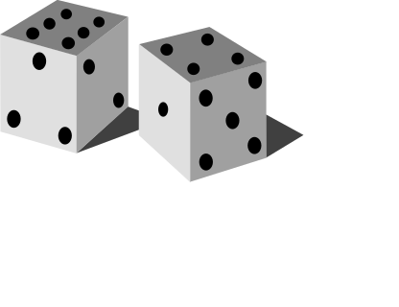
Simple Random Samples
Every individual or item from the population has an equal chance of being selected
Selection may be with replacement or without replacement
Samples can be obtained from a table of random numbers or computer random number generators
A Course In Business Statistics, 4th © 2006 Prentice-Hall, Inc.
Chap 1-<number>

Slide 40
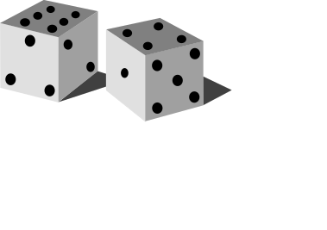
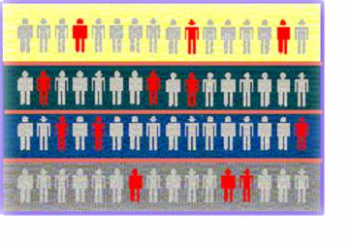

Stratified Samples
Population divided into subgroups (called strata) according to some common characteristic
Simple random sample selected from each subgroup
Samples from subgroups are combined into one
Population
Divided
into 4
strata
Sample
A Course In Business Statistics, 4th © 2006 Prentice-Hall, Inc.
Chap 1-<number>

Slide 41
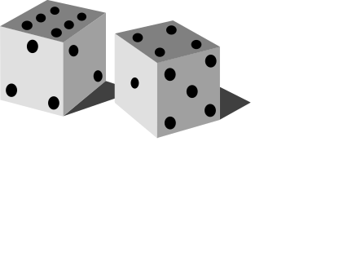
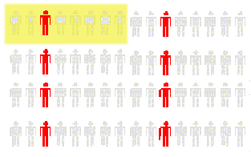
Systematic Samples
Decide on sample size: n
Divide frame of N individuals into groups of k individuals: k=N/n
Randomly select one individual from the 1st group
Select every k^{th} individual thereafter
N = 64
n = 8
k = 8
First Group
A Course In Business Statistics, 4th © 2006 Prentice-Hall, Inc.
Chap 1-<number>

Slide 42
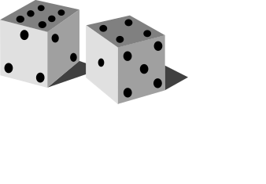
Cluster Samples
Population is divided into several “clusters,” each representative of the population
A simple random sample of clusters is selected
  All items in the selected clusters can be used, or items can be chosen from a cluster using another probability sampling technique
Population divided into 16 clusters.
Randomly selected clusters for sample
A Course In Business Statistics, 4th © 2006 Prentice-Hall, Inc.
Chap 1-<number>

Slide 43
Key Definitions
A population is the entire collection of things under consideration
  A parameter is a summary measure computed to describe a characteristic of the population
A sample is a portion of the population selected for analysis
  A statistic is a summary measure computed to describe a characteristic of the sample
A Course In Business Statistics, 4th © 2006 Prentice-Hall, Inc.
Chap 1-<number>

Slide 44
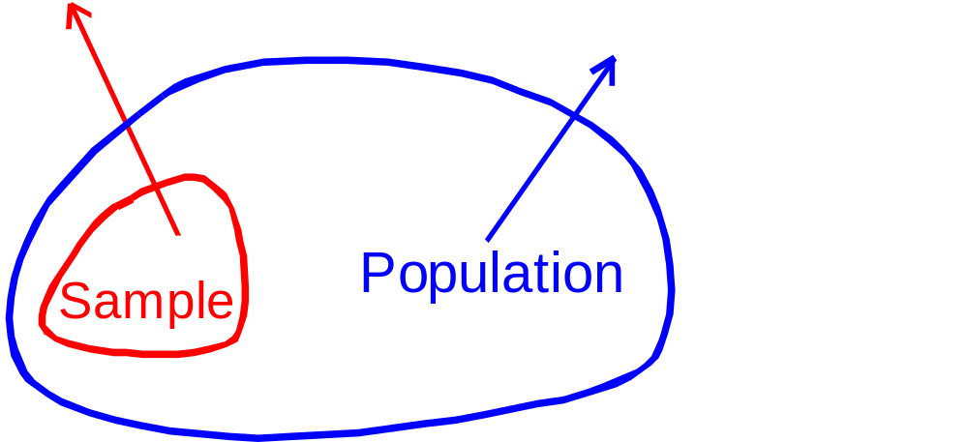
Inferential Statistics
Making statements about a population by examining sample results
Sample statistics Population parameters
(known) Inference (unknown, but can
be estimated from
sample evidence)
A Course In Business Statistics, 4th © 2006 Prentice-Hall, Inc.
Chap 1-<number>

Slide 45
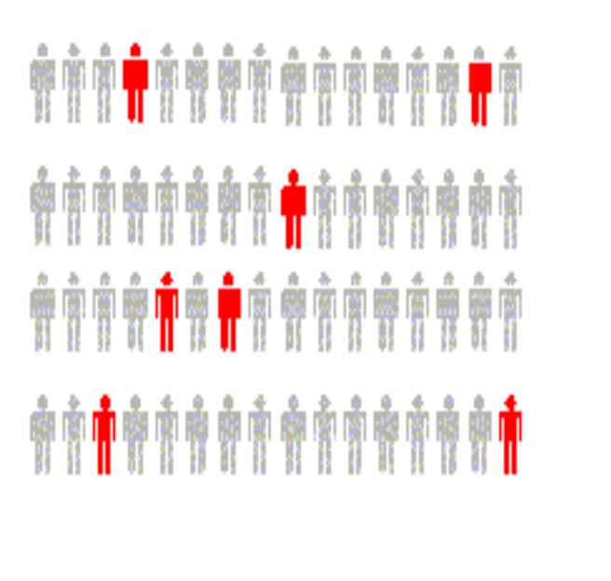
Inferential Statistics
Drawing conclusions and/or making decisions concerning a population based on sample results.
Estimation
  e.g.: Estimate the population mean weight using the sample mean weight
Hypothesis Testing
  e.g.: Use sample evidence to test the claim that the population mean weight is 120 pounds
A Course In Business Statistics, 4th © 2006 Prentice-Hall, Inc.
Chap 1-<number>

Slide 46
Chapter Summary
Reviewed key data collection methods
Introduced key definitions:
  ♦Population vs. Sample ♦Primary vs. Secondary data types
  ♦Qualitative vs. Qualitative data ♦Time Series vs. Cross-Sectional data
Examined descriptive vs. inferential statistics
Described different sampling techniques
Reviewed data types and measurement levels
A Course In Business Statistics, 4th © 2006 Prentice-Hall, Inc.
Chap 1-<number>

