Slide 1
Chapter 4
Using Probability and
Probability Distributions
A Course In Business Statistics
4th Edition
A Course In Business Statistics, 4th © 2006 Prentice-Hall, Inc.
Chap 4-<number>

Slide 2
Important Terms
Probability – the chance that an uncertain event will occur (always between 0 and 1)
Experiment – a process of obtaining outcomes for uncertain events
Elementary Event – the most basic outcome possible from a simple experiment
Sample Space – the collection of all possible elementary outcomes
A Course In Business Statistics, 4th © 2006 Prentice-Hall, Inc.
Chap 4-<number>

Slide 3
Examples
Example 1:
  Experiment: Tossing a coin (fair-coin) to observe what face turns up
  Experimental outcomes: HEAD, TAIL
  Probability of getting a HEAD is 0.5
Example 2:
  Experiment: Rolling a die (fair-die) to observe which number occurs
  Experimental outcomes: 1,2,3,4,5,6
  Probability of getting 3 is 1/6
Chap 4-<number>

Slide 4
Examples
Example 3:
  Experiment: Drawing a card from a deck (well-shuffled French deck)
  Experimental outcomes: ♣A, ♣ 2, ..., ♣ K, ♦A, ♦2,..., ♦K, ♥A, ♥2,..., ♥K, ♠A, ♠2,..., ♠K.
  Probability of getting an ACE (could be a club ♣, diamond ♦, heart ♥ and a spade ♠, among 4 of the French suits) is 4/52.
Chap 4-<number>

Slide 5

Sample Space
The Sample Space is the collection of all possible outcomes of an experiment
e.g. All 6 faces of a die:
e.g. All 52 cards of a bridge deck:
A Course In Business Statistics, 4th © 2006 Prentice-Hall, Inc.
Chap 4-<number>

Slide 6
Events
Elementary event – An outcome from a sample space with one characteristic
  Example: A red card from a deck of cards
Event – May involve two or more outcomes simultaneously
  Example: An ace that is also red from a deck of
  cards
A Course In Business Statistics, 4th © 2006 Prentice-Hall, Inc.
Chap 4-<number>

Slide 7
Example 1:
  Experiment: Toss a coin
  Sample space: S={H, T}
  Event: E={H} (looking for a head)
Example 2:
  Experiment: Roll a die
  Sample space: S={1, 2, 3, 4, 5, 6}
  Event: E={6} (Looking for a 6)
Example 3:
  Experiment: Draw a card from a 52 deck
  Sample space: S={♣A, ♣ 2, ..., ♣ K, ♦A, ♦2,..., ♦K, ♥A, ♥2,..., ♥K, ♠A, ♠2,..., ♠K}
  Event: E={♣A, ♦A, ♥A, ♠A} (Looking for an ACE)
Chap 4-<number>

Slide 8
Assigning Probability
Classical Probability Assessment
Number of ways E_{i} can occur
Total number of elementary events
P(E_{i}) =
Relative Frequency of Occurrence
Number of times E_{i} occurs
N
Relative Freq. of E_{i} =
Subjective Probability Assessment
An opinion or judgment by a decision maker about the likelihood of an event
A Course In Business Statistics, 4th © 2006 Prentice-Hall, Inc.
Chap 4-<number>

Slide 9
For example, to estimate the probability that a randomly selected consumer prefers a smart phone to all other phones, we perform an experiment in which we ask a randomly selected consumer for his or her preference.
There are two possible experimental outcomes: “prefers a smart phone” and “does not prefer a smart phone.”
However, we have no reason to believe that these experimental outcomes are equally likely, so we cannot use the classical method. We might perform the experiment, say, 1,000 times by surveying 1,000 randomly selected consumers.
Then, if 140 of those surveyed said that they prefer smart phones, we would estimate the probability that a randomly selected consumer prefers smart phones to all other soft drinks to be 140/1,000=0.14. This is called the relative frequency method for assigning probability.
Chap 4-<number>

Slide 10
If we cannot perform the experiment many times, we might estimate the probability by using our previous experience with similar situations, intuition, or special expertise that we may possess.
For example, a company president might estimate the probability of success for a onetime business venture to be 0.7. Here, on the basis of knowledge of the success of previous similar ventures, the opinions of company personnel, and other pertinent information, the president believes that there is a 70 percent chance the venture will be successful. When we use experience, intuitive judgement, or expertise to assess a probability, we call this a subjective probability. Such a probability may or may not have a relative frequency interpretation.
Chap 4-<number>

Slide 11
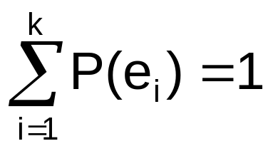
Rules of Probability
Rules for
Possible Values
and Sum
Individual Values
Sum of All Values
0 ≤ P(e_{i}) ≤ 1
For any event e_{i}
where:
k = Number of elementary events in the sample space
e_{i} = i^{th} elementary event
A Course In Business Statistics, 4th © 2006 Prentice-Hall, Inc.
Chap 4-<number>

Slide 12
If an event never occurs, then the probability of this event equals 0.
  The probability that I will be teaching in Yale University is 0.
If an event is certain to occur, then the probability of this event equals 1.
  The probability that you will graduate from IU School of Business is equal to 1, hopefully ☺
Chap 4-<number>

Slide 13
Visualizing Events
Contingency Tables
Tree Diagrams
Ace Not Ace Total
Black 2 24 26
Red 2 24 26
Total 4 48 52
Sample Space
Ace
2
24
2
24
Sample Space
Black Card
Full Deck
of 52 Cards
Not an Ace
Ace
Red Card
Not an Ace
A Course In Business Statistics, 4th © 2006 Prentice-Hall, Inc.
Chap 4-<number>

Slide 14
Elementary Events
A automobile consultant records fuel type and vehicle type for a sample of vehicles
  2 Fuel types: Gasoline, Diesel
  3 Vehicle types: Truck, Car, SUV
  6 possible elementary events:
  e₁ Gasoline, Truck
  e₂ Gasoline, Car
  e₃ Gasoline, SUV
  e₄ Diesel, Truck
  e₅ Diesel, Car
  e₆ Diesel, SUV
Truck
e₁
e₂
e₃
e₄
e₅
e₆
Car
Gasoline
SUV
Truck
Diesel
Car
SUV
A Course In Business Statistics, 4th © 2006 Prentice-Hall, Inc.
Chap 4-<number>

Slide 15
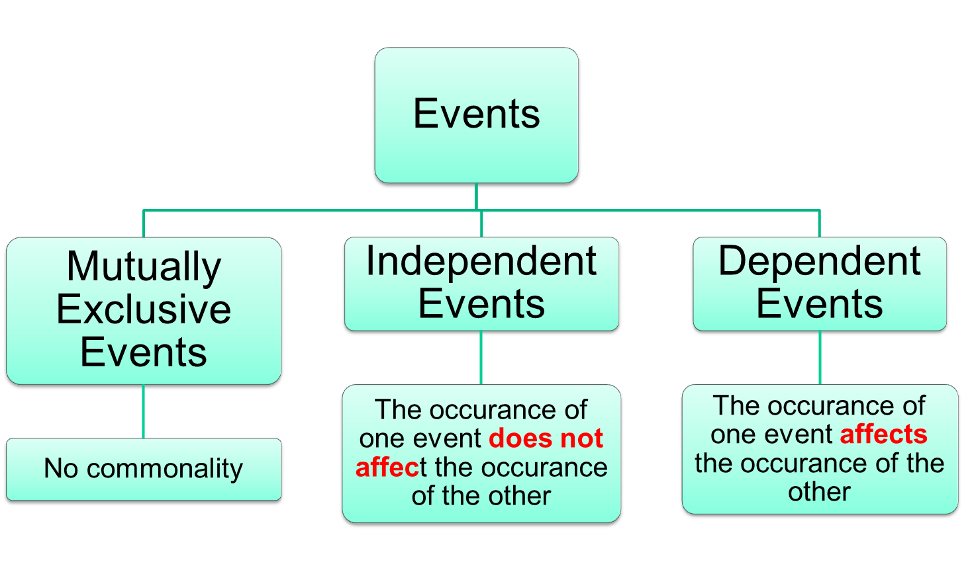
Probability Concepts
A Course In Business Statistics, 4th © 2006 Prentice-Hall, Inc.
Chap 4-<number>

Slide 16
Probability Concepts
Mutually Exclusive Events
  If event A occurs, then event B cannot occur
  A and B have no common elements
A card cannot be Black and Red at the same time.
B
A
Red
Cards
Black
Cards
A Course In Business Statistics, 4th © 2006 Prentice-Hall, Inc.
Chap 4-<number>

Slide 17
Probability Concepts
Independent and Dependent Events
  Independent: Occurrence of one does not influence the probability of occurrence of the other
  Dependent: Occurrence of one affects the probability of the other
A Course In Business Statistics, 4th © 2006 Prentice-Hall, Inc.
Chap 4-<number>

Slide 18
Independent vs. Dependent Events
Independent Events
  A = heads on one flip of fair coin
  B = heads on second flip of same coin
  Result of second flip does not depend on the result of the first flip.
Dependent Events
  A = rain forecasted on the news
  B = take umbrella to work
  Probability of the second event is affected by the occurrence of the first event
A Course In Business Statistics, 4th © 2006 Prentice-Hall, Inc.
Chap 4-<number>

Slide 19
Lottery Example
Claims: Certain numbers appear very often and one after another!!!
Is one week result of a lottery is dependent on the other week’s result?
Does the balls have a memory?
A Course In Business Statistics, 4th © 2006 Prentice-Hall, Inc.
Chap 4-<number>

Slide 20
Probability Rules
Complement Rule
Addition Rule
Multiplication Rule
A Course In Business Statistics, 4th © 2006 Prentice-Hall, Inc.
Chap 4-<number>

Slide 21


1. Complement Rule
The complement of an event A is the collection of all possible elementary events not contained in event A. The complement of event A is represented by A.
Complement Rule:
A
A
Or,
A Course In Business Statistics, 4th © 2006 Prentice-Hall, Inc.
Chap 4-<number>

Slide 22
The Intersection and Union of 2 Events
Given 2 events A and B,
  The intersection of A and B is the event consisting of the sample space outcomes belonging to both A and B. The intersection is denoted by ∩. Furthermore, ∩ denotes the probability that both A and B will simultaneously occur.
  The union of A and B is the event consisting of the sample space outcomes belonging to A or B (or both). The union is denoted U. Furthermore, U denotes the probability that A or B (or both) will occur.
A Course In Business Statistics, 4th © 2006 Prentice-Hall, Inc.
Chap 4-<number>

Slide 23
2. Addition Rule for Elementary Events
The probability of an event A_{i} is equal to the sum of the probabilities of the elementary events forming A_{i}.
That is, if:
A_{i} = {a₁, a₂, a₃}
then:
P(A_{i}) = P(a₁) + P(a₂) + P(a₃)
A Course In Business Statistics, 4th © 2006 Prentice-Hall, Inc.
Chap 4-<number>

Slide 24
Addition Rule for Two Events
(one or the other outcome happens)
Addition Rule:
P(A U B) = P(A) + P(B) - P(A ∩ B)
A
+
B
=
A
B
P(A U B) = P(A) + P(B) - P(A ∩ B)
Don’t count common elements twice!
A Course In Business Statistics, 4th © 2006 Prentice-Hall, Inc.
Chap 4-<number>

Slide 25
Addition Rule Example
P(Red or Ace) = P(Red) +P(Ace) - P(Red and Ace)
= 26/52 + 4/52 - 2/52 = 28/52
Don’t count the two red aces twice!
Color
Type
Total
Red
Black
Ace
2
2
4
Non-Ace
24
24
48
Total
26
26
52
A Course In Business Statistics, 4th © 2006 Prentice-Hall, Inc.
Chap 4-<number>

Slide 26
Addition Rule for
Mutually Exclusive Events
If A and B are mutually exclusive, then
  P(A ∩ B) = 0
  So
A
B
= 0
if mutually
exclusive
P(A U B) = P(A) + P(B) - P(A ∩ B)
= P(A) + P(B)
A Course In Business Statistics, 4th © 2006 Prentice-Hall, Inc.
Chap 4-<number>

Slide 27
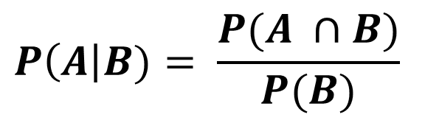
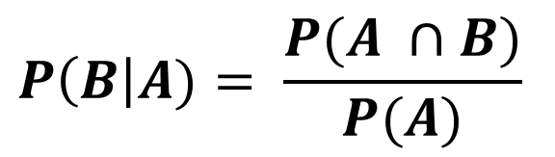
3. Conditional Probability
The probability of the event , given the condition that the event B has occurred, is written as P(A|B)—pronounced “the probability of A given B.” We often refer to such a probability as the conditional probability of A given B. Conditional probability for any two events A and B:
the probability of A given B
the probability of B given A
A Course In Business Statistics, 4th © 2006 Prentice-Hall, Inc.
Chap 4-<number>

Slide 28
Conditional Probability Example
Of the cars on a used car lot, 70% have air conditioning (AC) and 40% have a CD player (CD). 20% of the cars have both.
What is the probability that a car has a CD player, given that it has AC ?
i.e., we want to find P(CD | AC)
A Course In Business Statistics, 4th © 2006 Prentice-Hall, Inc.
Chap 4-<number>

Slide 29
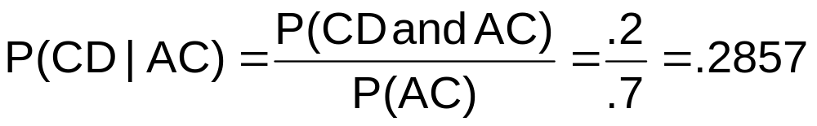
Conditional Probability Example
(continued)
Of the cars on a used car lot, 70% have air conditioning (AC) and 40% have a CD player (CD).
20% of the cars have both.
CD
No CD
Total
AC
.2
.5
.7
No AC
.2
.1
.3
Total
.4
.6
1.0
A Course In Business Statistics, 4th © 2006 Prentice-Hall, Inc.
Chap 4-<number>

Slide 30
Conditional Probability Example
(continued)
Given AC, we only consider the top row (70% of the cars). Of these, 20% have a CD player. 20% of 70% is about 28.57%.
CD
No CD
Total
AC
.2
.5
.7
No AC
.2
.1
.3
Total
.4
.6
1.0
A Course In Business Statistics, 4th © 2006 Prentice-Hall, Inc.
Chap 4-<number>

Slide 31


For Independent Events:
Conditional probability for independent events A, B:
A Course In Business Statistics, 4th © 2006 Prentice-Hall, Inc.
Chap 4-<number>

Slide 32
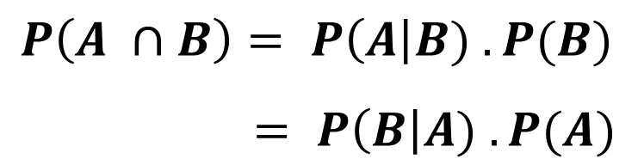
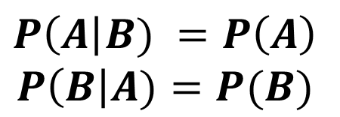

4. Multiplication Rules
(happening at the same time)
Multiplication rule for two events A and B:
Note: If A and B are independent, then
and the multiplication rule simplifies to
A Course In Business Statistics, 4th © 2006 Prentice-Hall, Inc.
Chap 4-<number>

Slide 33
Tree Diagram Example
P(A and E₁) = 0.8 x 0.2 = 0.16
Truck: P(E₁|A) = 0.2
Car: P(E₂|A) = 0.5
P(A and E₂) = 0.8 x 0.5 = 0.40
Gasoline P(A) = 0.8
SUV: P(E₃|A) = 0.3
P(A and E₃) = 0.8 x 0.3 = 0.24
Truck: P(E₁|B) = 0.6
P(B and E₁) = 0.2 x 0.6 = 0.12
Diesel
P(B) = 0.2
Car: P(E₂|B) = 0.1
P(B and E₂) = 0.2 x 0.1 = 0.02
SUV: P(E₃|B) = 0.3
P(B and E₃) = 0.2 x 0.3 = 0.06
A Course In Business Statistics, 4th © 2006 Prentice-Hall, Inc.
Chap 4-<number>

Slide 34
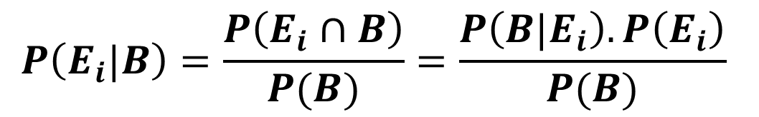
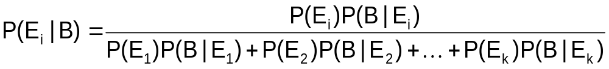
5. Bayes’ Theorem
where:
E_{i} = i^{th} event of interest of the k possible events
B = new event that might impact P(E_{i})
    Events E₁ to E_{k} are mutually exclusive and collectively exhaustive
Chap 4-<number>

Slide 35

Bayes’ Theorem Example
A drilling company has estimated a 40% chance of striking oil for their new well.
A detailed test has been scheduled for more information. Historically, 60% of successful wells have had detailed tests, and 20% of unsuccessful wells have had detailed tests.
Given that this well has been scheduled for a detailed test, what is the probability
that the well will be successful?
A Course In Business Statistics, 4th © 2006 Prentice-Hall, Inc.
Chap 4-<number>

Slide 36
Bayes’ Theorem Example
(continued)
Let S = successful well and UnS = unsuccessful well
P(S) = .4 , P(UnS) = .6 (prior probabilities)
Define the detailed test event as D
Conditional probabilities:
    P(D|S) = .6 P(D|UnS) = .2
Revised probabilities
Event | Prior Prob. | Conditional Prob. | Joint Prob. | Revised Prob.
S (successful) | .4 | .6 | .4*.6 = .24 | .24/.36 = .67
UnS (unsuccessful) | .6 | .2 | .6*.2 = .12 | .12/.36 = .33
Sum = .36
A Course In Business Statistics, 4th © 2006 Prentice-Hall, Inc.
Chap 4-<number>

Slide 37
Bayes’ Theorem Example
(continued)
Given the detailed test, the revised probability of a successful well has risen to .67 from the original estimate of .4
Event | Prior Prob. | Conditional Prob. | Joint Prob. | Revised Prob.
S (successful) | .4 | .6 | .4*.6 = .24 | .24/.36 = .67
U (unsuccessful) | .6 | .2 | .6*.2 = .12 | .12/.36 = .33
Sum = .36
A Course In Business Statistics, 4th © 2006 Prentice-Hall, Inc.
Chap 4-<number>

Slide 38
Probability Distributions
Probability distribution of
  discrete random variables
  continuous random variables
A Course In Business Statistics, 4th © 2006 Prentice-Hall, Inc.
Chap 4-<number>

Slide 39
Introduction to Probability Distributions
Random Variable
  Represents a possible numerical value from a random event
Random
Variables
Discrete
Random Variable
Continuous
Random Variable
A Course In Business Statistics, 4th © 2006 Prentice-Hall, Inc.
Chap 4-<number>

Slide 40

Discrete Random Variables
Can only assume a countable number of values
  Examples:
  Roll a die twice
Let x be the number of times 4 comes up
(then x could be 0, 1, or 2 times)
  Toss a coin 5 times.
  Let x be the number of heads
  (then x = 0, 1, 2, 3, 4, or 5)
A Course In Business Statistics, 4th © 2006 Prentice-Hall, Inc.
Chap 4-<number>

Slide 41
Discrete Probability Distribution
Experiment: Toss 2 Coins. Let x = # heads.
4 possible outcomes
Probability Distribution
T
T
x Value Probability
0 1/4 = .25
1 2/4 = .50
2 1/4 = .25
T
H
H
T
.50
.25
Probability
H
H
0 1 2 x
A Course In Business Statistics, 4th © 2006 Prentice-Hall, Inc.
Chap 4-<number>

Slide 42
Discrete Probability Distribution
A list of all possible [ x_{i} , P(x_{i}) ] pairs
x_{i} = Value of Random Variable (Outcome)
P(x_{i}) = Probability Associated with Value
x_{i}’s are mutually exclusive
  (no overlap)
x_{i}’s are collectively exhaustive
  (nothing left out)
0 ≤ P(x_{i}) ≤ 1 for each x_{i}
Σ P(x_{i}) = 1
A Course In Business Statistics, 4th © 2006 Prentice-Hall, Inc.
Chap 4-<number>

Slide 43
Discrete Random Variable
Summary Measures
Expected Value of a discrete distribution
(Weighted Average)
E(x) = Σx_{i} P(x_{i})
  Example: Toss 2 coins,
  x = # of heads,
  compute expected value of x:
E(x) = (0 x .25) + (1 x .50) + (2 x .25)
= 1.0
x P(x)
0 .25
1 .50
2 .25
A Course In Business Statistics, 4th © 2006 Prentice-Hall, Inc.
Chap 4-<number>

Slide 44
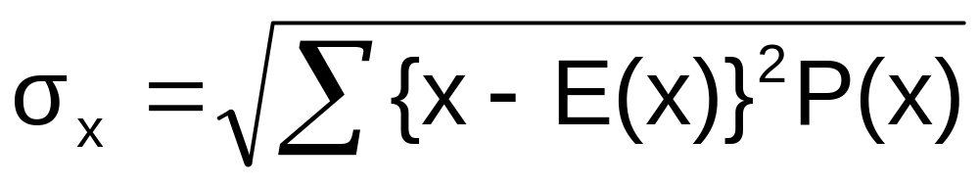
Discrete Random Variable
Summary Measures
(continued)
Standard Deviation of a discrete distribution
where:
E(x) = Expected value of the random variable
x = Values of the random variable
P(x) = Probability of the random variable having the value of x
A Course In Business Statistics, 4th © 2006 Prentice-Hall, Inc.
Chap 4-<number>

Slide 45
Discrete Random Variable
Summary Measures
(continued)
  Example: Toss 2 coins, x = # heads,
  compute standard deviation (recall E(x) = 1)
Possible number of heads = 0, 1, or 2
A Course In Business Statistics, 4th © 2006 Prentice-Hall, Inc.
Chap 4-<number>

Slide 46
Two Discrete Random Variables
Expected value of the sum of two discrete random variables:
E(x + y) = E(x) + E(y)
= Σ x P(x) + Σ y P(y)
(The expected value of the sum of two random variables is the sum of the two expected values)
A Course In Business Statistics, 4th © 2006 Prentice-Hall, Inc.
Chap 4-<number>

Slide 47
Covariance
Covariance between two discrete random variables:
σ_{xy} = Σ [x_{i} – E(x)][y_{j} – E(y)]P(x_{i}y_{j})
where:
x_{i} = possible values of the x discrete random variable
y_{j} = possible values of the y discrete random variable
P(x_{i} ,y_{j}) = joint probability of the values of x_{i} and y_{j} occurring
A Course In Business Statistics, 4th © 2006 Prentice-Hall, Inc.
Chap 4-<number>

Slide 48
Interpreting Covariance
Covariance between two discrete random variables:
σ_{xy} > 0 x and y tend to move in the same direction
σ_{xy} < 0 x and y tend to move in opposite directions
σ_{xy} = 0 x and y do not move closely together
A Course In Business Statistics, 4th © 2006 Prentice-Hall, Inc.
Chap 4-<number>

Slide 49
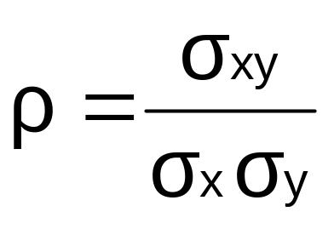
Correlation Coefficient
The Correlation Coefficient shows the strength of the linear association between two variables
where:
ρ = correlation coefficient (“rho”)
σ_{xy} = covariance between x and y
σ_{x} = standard deviation of variable x
σ_{y} = standard deviation of variable y
A Course In Business Statistics, 4th © 2006 Prentice-Hall, Inc.
Chap 4-<number>

Slide 50
Interpreting the
Correlation Coefficient
The Correlation Coefficient always falls between -1 and +1
ρ = 0 x and y are not linearly related.
The farther ρ is from zero, the stronger the linear relationship:
ρ = +1 x and y have a perfect positive linear relationship
ρ = -1 x and y have a perfect negative linear relationship
A Course In Business Statistics, 4th © 2006 Prentice-Hall, Inc.
Chap 4-<number>

Slide 51
Chapter Summary
Described approaches to assessing probabilities
Developed common rules of probability
Used Bayes’ Theorem for conditional probabilities
Distinguished between discrete and continuous probability distributions
Examined discrete probability distributions and their summary measures
A Course In Business Statistics, 4th © 2006 Prentice-Hall, Inc.
Chap 4-<number>

