Slide 1
Chapter 5 Discrete and Continuous Probability Distributions
A Course In Business Statistics
4th Edition

Slide 2
Chapter Goals
After completing this chapter, you should be able to:
Apply the binomial distribution to applied problems
Compute probabilities for the Poisson and hypergeometric distributions
Find probabilities using a normal distribution table and apply the normal distribution to business problems
Recognize when to apply the uniform and exponential distributions

Slide 3
Probability Distributions
Probability Distributions
Discrete
Probability Distributions
Continuous
Probability Distributions
Binomial
Normal
Poisson
Uniform
Hypergeometric
Exponential

Slide 4
Discrete Probability Distributions
A discrete random variable is a variable that can assume only a countable number of values
Many possible outcomes:
number of complaints per day
number of TV’s in a household
number of rings before the phone is answered
Only two possible outcomes:
gender: male or female
defective: yes or no
spreads peanut butter first vs. spreads jelly first

Slide 5
Continuous Probability Distributions
A continuous random variable is a variable that can assume any value on a continuum (can assume an uncountable number of values)
thickness of an item
time required to complete a task
temperature of a solution
height, in inches
These can potentially take on any value, depending only on the ability to measure accurately.

Slide 6
The Binomial Distribution
Probability Distributions
Discrete
Probability Distributions
Binomial
Poisson
Hypergeometric

Slide 7
The Binomial Distribution
Characteristics of the Binomial Distribution:
A trial has only two possible outcomes – “success” or “failure”
There is a fixed number, n, of identical trials
The trials of the experiment are independent of each other
The probability of a success, p, remains constant from trial to trial
If p represents the probability of a success, then
(1-p) = q is the probability of a failure

Slide 8
Binomial Distribution Settings
A manufacturing plant labels items as either defective or acceptable
A firm bidding for a contract will either get the contract or not
A marketing research firm receives survey responses of “yes I will buy” or “no I will not”
New job applicants either accept the offer or reject it

Slide 9
Counting Rule for Combinations
A combination is an outcome of an experiment where x objects are selected from a group of n objects
where:
n! =n(n - 1)(n - 2) . . . (2)(1)
x! = x(x - 1)(x - 2) . . . (2)(1)
0! = 1 (by definition)

Slide 10
Binomial Distribution Formula
n
!
P(x)
=
p
x
q
n
−
x
x !
(
−
)
n
x
!
P(x) = probability of x successes in n trials,
with probability of success p on each trial
x = number of ‘successes’ in sample,
(x = 0, 1, 2, ..., n)
p = probability of “success” per trial
q = probability of “failure” = (1 – p)
n = number of trials (sample size)
Example: Flip a coin four times, let x = # heads:
n = 4
p = 0.5
q = (1 - .5) = .5
x = 0, 1, 2, 3, 4

Slide 11
Binomial Distribution
The shape of the binomial distribution depends on the values of p and n
Mean
P(X)
n = 5 p = 0.1
.6
.4
Here, n = 5 and p = .1
.2
0
X
0
1
2
3
4
5
P(X)
n = 5 p = 0.5
.6
.4
Here, n = 5 and p = .5
.2
0
X
0
1
2
3
4
5

Slide 12
Binomial Distribution Characteristics
Mean
Variance and Standard Deviation
Where n = sample size
p = probability of success
q = (1 – p) = probability of failure

Slide 13
Binomial Characteristics
Examples
Mean
P(X)
n = 5 p = 0.1
.6
.4
.2
0
X
0
1
2
3
4
5
P(X)
n = 5 p = 0.5
.6
.4
.2
0
X
0
1
2
3
4
5

Slide 14
Using Binomial Tables
n = 10
x | p=.15 | p=.20 | p=.25 | p=.30 | p=.35 | p=.40 | p=.45 | p=.50
0 1 2 3 4 5 6 7 8 9 10 | 0.1969 0.3474 0.2759 0.1298 0.0401 0.0085 0.0012 0.0001 0.0000 0.0000 0.0000 | 0.1074 0.2684 0.3020 0.2013 0.0881 0.0264 0.0055 0.0008 0.0001 0.0000 0.0000 | 0.0563 0.1877 0.2816 0.2503 0.1460 0.0584 0.0162 0.0031 0.0004 0.0000 0.0000 | 0.0282 0.1211 0.2335 0.2668 0.2001 0.1029 0.0368 0.0090 0.0014 0.0001 0.0000 | 0.0135 0.0725 0.1757 0.2522 0.2377 0.1536 0.0689 0.0212 0.0043 0.0005 0.0000 | 0.0060 0.0403 0.1209 0.2150 0.2508 0.2007 0.1115 0.0425 0.0106 0.0016 0.0001 | 0.0025 0.0207 0.0763 0.1665 0.2384 0.2340 0.1596 0.0746 0.0229 0.0042 0.0003 | 0.0010 0.0098 0.0439 0.1172 0.2051 0.2461 0.2051 0.1172 0.0439 0.0098 0.0010 | 10 9 8 7 6 5 4 3 2 1 0
 | p=.85 | p=.80 | p=.75 | p=.70 | p=.65 | p=.60 | p=.55 | p=.50 | x
Examples:
n = 10, p = .35, x = 3: P(x = 3|n =10, p = .35) = .2522
n = 10, p = .75, x = 2: P(x = 2|n =10, p = .75) = .0004

Slide 15
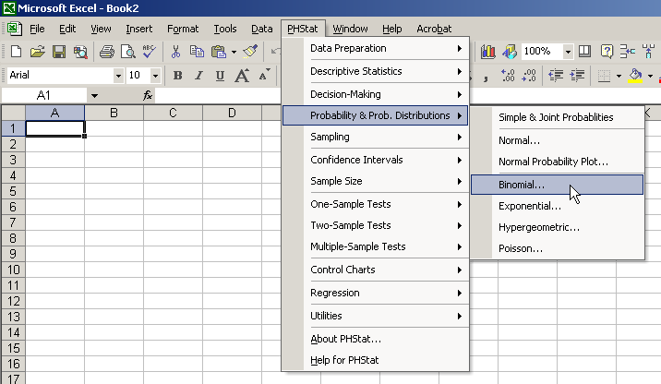
Using PHStat
Select PHStat / Probability & Prob. Distributions / Binomial…

Slide 16
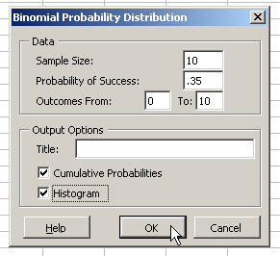
Using PHStat
Enter desired values in dialog box
Here: n = 10
p = .35
Output for x = 0
to x = 10 will be
generated by PHStat
Optional check boxes
for additional output

Slide 17
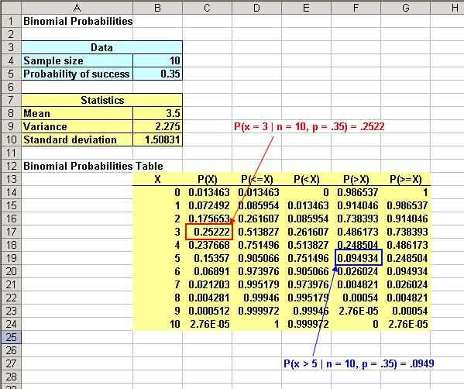
PHStat Output
P(x = 3 | n = 10, p = .35) = .2522
P(x > 5 | n = 10, p = .35) = .0949

Slide 18
The Hypergeometric Distribution
Probability Distributions
Discrete
Probability Distributions
Binomial
Poisson
Hypergeometric

Slide 19
The Hypergeometric Distribution
“n” trials in a sample taken from a finite population of size N
Sample taken without replacement
Trials are dependent
Concerned with finding the probability of “x” successes in the sample where there are “X” successes in the population

Slide 20
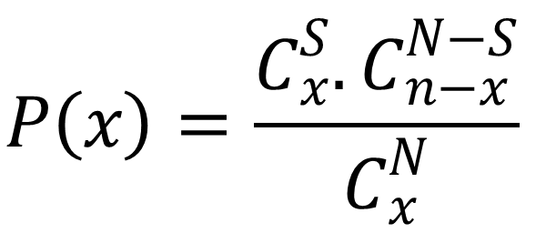
Hypergeometric Distribution Formula
(Two possible outcomes per trial)
$$P\left(x\right)=\frac{C_{x}^{S}{. C}_{n−x}^{N−S}}{C_{x}^{N}}$$
.
Where
N = Population size
S = number of successes in the population
n = sample size
x = number of successes in the sample
n – x = number of failures in the sample

Slide 21
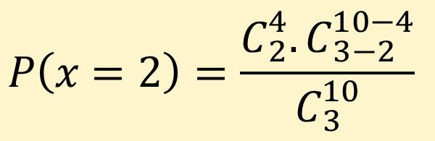
Hypergeometric Distribution Formula
Example: 3 Light bulbs were selected from 10. Of the 10 there were 4 defective. What is the probability that 2 of the 3 selected are defective?
N = 10 n = 3
S = 4 x = 2
$$P\left(x=2\right)=\frac{C_{2}^{4}{. C}_{3−2}^{10−4}}{C_{3}^{10}}$$

Slide 22
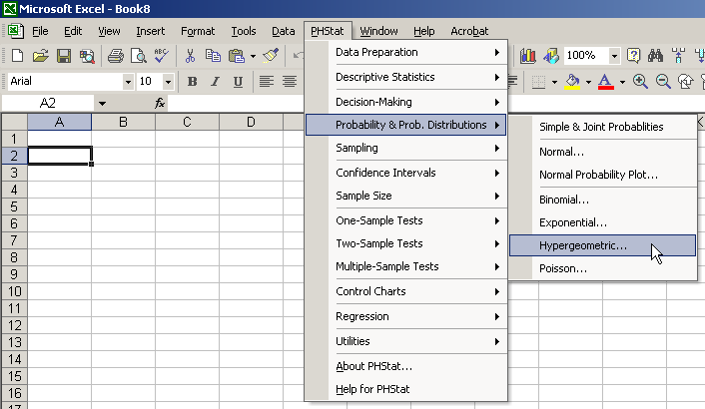
Hypergeometric Distribution in PHStat
Select:
PHStat / Probability & Prob. Distributions / Hypergeometric …

Slide 23
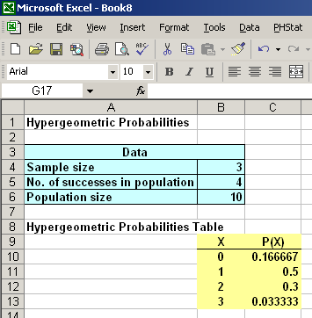
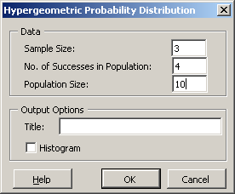
Hypergeometric Distribution in PHStat
(continued)
Complete dialog box entries and get output …
N = 10 n = 3
X = 4 x = 2
P(x = 2) = 0.3

Slide 24
The Poisson Distribution
Probability Distributions
Discrete
Probability Distributions
Binomial
Poisson
Hypergeometric

Slide 25
The Poisson Distribution
Uses of Poisson Distribution:
First proposed by Simeon Poisson (1781-1840)
The number of failures in a large computer system during a given day
The number of replacement orders for a part received by a firm in a given month
The number of ships arriving at a loading facility during a 6-hour loading period
The number of delivery trucks to arrive at a central warehouse in an hour

Slide 26
The Poisson Distribution
Uses of Poisson Distribution:
The number of dents, scrathes, or other defects in a large roll of sheet metal used to manufacture filters
The number of customers to arrive for flights during each 15 min time interval from 3pm to 6pm on weekdays
The number of customers to arrive at a checkout aisle in your local grocery store during a particular time interval

Slide 27
The Poisson Distribution
We can use the Poisson distribution to determine the probability of each of these random variables, which are characterized as the number of occurences or successes of a certain event in a given continuous interval (such as time or space – area, length).

Slide 28
The Poisson Distribution
Assumptions of the Poisson distribution:
The outcomes of interest are rare relative to the possible outcomes
The average number of outcomes of interest per time or space interval is λ and it is constant.
The number of outcomes of interest are random, and the occurrence of one outcome does not influence the chances of another outcome of interest
The probability of that an outcome of interest occurs in a given segment is the same for all segments

Slide 29
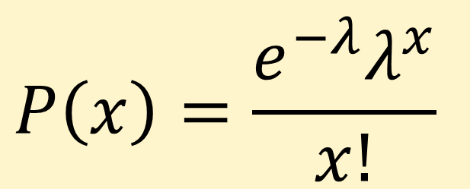
Poisson Distribution Formula
$$P\left(x\right)=\frac{e^{−λ}λ^{x}}{x!}$$
where:
x = the number of successes over a given time or space
λ = the expected number of successes per time or space unit, λ>0
e = base of the natural logarithm system (2.71828...)

Slide 30
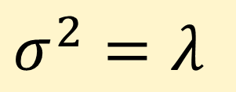
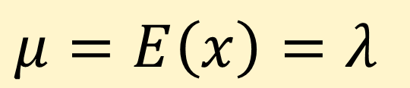
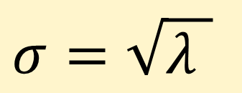
Poisson Distribution Characteristics
Mean
$$μ=E\left(x\right)=λ$$
Variance and Standard Deviation
$$σ^{2}=λ$$
$$σ=\sqrt{λ }$$

Slide 31
Using Poisson Tables
X | λt
 | 0.10 | 0.20 | 0.30 | 0.40 | 0.50 | 0.60 | 0.70 | 0.80 | 0.90
0 1 2 3 4 5 6 7 | 0.9048 0.0905 0.0045 0.0002 0.0000 0.0000 0.0000 0.0000 | 0.8187 0.1637 0.0164 0.0011 0.0001 0.0000 0.0000 0.0000 | 0.7408 0.2222 0.0333 0.0033 0.0003 0.0000 0.0000 0.0000 | 0.6703 0.2681 0.0536 0.0072 0.0007 0.0001 0.0000 0.0000 | 0.6065 0.3033 0.0758 0.0126 0.0016 0.0002 0.0000 0.0000 | 0.5488 0.3293 0.0988 0.0198 0.0030 0.0004 0.0000 0.0000 | 0.4966 0.3476 0.1217 0.0284 0.0050 0.0007 0.0001 0.0000 | 0.4493 0.3595 0.1438 0.0383 0.0077 0.0012 0.0002 0.0000 | 0.4066 0.3659 0.1647 0.0494 0.0111 0.0020 0.0003 0.0000
Example: Find P(x = 2) if λ = .05 and t = 100

Slide 32
Graph of Poisson Probabilities
Graphically:
λ = .05 and t = 100
X | λt = 0.50
0 1 2 3 4 5 6 7 | 0.6065 0.3033 0.0758 0.0126 0.0016 0.0002 0.0000 0.0000
P(x = 2) = .0758

Slide 33
Poisson Distribution Shape
The shape of the Poisson Distribution depends on the parameters λ and t:
λt = 0.50
λt = 3.0

Slide 34
Example 1 for Poisson Distrbution
Andrew Whittaker, computer centre manager, reports that his computer system experienced 3 component failures during the past 100 days.
a) What is the probability of no failures in a given day?
b) What is the probability of one or more component failures in a given day?
c) What is the probability of at least 2 failures in a 3-day period?

Slide 35
Example 2 for Poisson Distrbution
Customers arrive at a photocopying machine at an average rate of two every 5 mins. Assume that these arrivals are independent, with a constant arrival rate, and that this problem follows a Poisson model, with X denoting the number of arriving customers at a 5min period and mean λ=2. Find the probability that more than two customers arrive in a 5min period?

Slide 36
The Exponential Distribution
Probability Distributions
Continuous
Probability Distributions
Normal
Uniform
Exponential

Slide 37
The Exponential Distribution
Used to measure the time that elapses between two occurrences of an event (the time between arrivals)
Examples:
Time between trucks arriving at an unloading dock
Time between transactions at an ATM Machine
Time between phone calls to the main operator

Slide 38
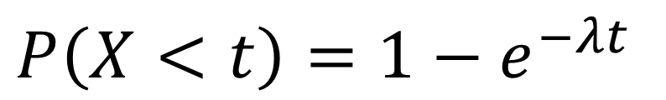
The Exponential Distribution
The probability that an arrival time is equal to or less than some specified time t is
$$P\left(X<t\right)=1−e^{−λt}$$
where 1/λ is the mean time between events
where λ is the mean occurence per time.
Note that if the number of occurrences per time period is Poisson with mean λ, then the time between occurrences is exponential with mean time 1/ λ

Slide 39
Exponential Distribution
(continued)
Shape of the exponential distribution
f(x)
λ = 3.0
(mean = .333)
λ = 1.0
(mean = 1.0)
= 0.5
(mean = 2.0)
x

Slide 40
Example
Example: Customers arrive at the claims counter at the rate of 15 per hour (Poisson distributed). What is the probability that the arrival time between consecutive customers is less than five minutes?
Time between arrivals is exponentially distributed with mean time between arrivals of 4 minutes (15 per 60 minutes, on average)
1/λ = 4.0, so λ = .25
P(x < 5) = 1 - e^{-λa} = 1 – e^{-(.25)(5)} = .7135

Slide 41
The Normal Distribution
Probability Distributions
Continuous
Probability Distributions
Normal
Uniform
Exponential

Slide 42
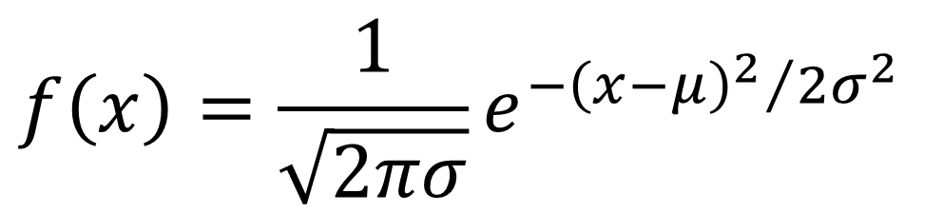
The Famous Normal Distribution
Also termed as Gaussian distribution
It is named after Carl Frederick Gauss, a German mathematician.
f(x)
σ
x
$$f\left(x\right)=\frac{1}{\sqrt{2πσ}}e^{{−{\left(x−μ\right)}^{2}}/{2σ^{2}}}$$
μ
Mean
= Median
= Mode

Slide 43
The Famous Normal Distribution
The dimensions of parts and weights of food packages often follow a normal distribution: Quality control
Total sales or production often follow a normal distribution: Marketing and production management
The patterns of stock and bond prices are often modeled using normal distribution: Economic modelling

Slide 44
The Normal Distribution
‘Bell Shaped’
Symmetrical
Mean, Median and Mode
are Equal
Location is determined by the mean, μ
Spread is determined by the standard deviation, σ
The random variable has an infinite theoretical range:
+ ∞ to − ∞
f(x)
σ
x
μ
Mean
= Median
= Mode

Slide 45
Many Normal Distributions
By varying the parameters μ and σ, we obtain different normal distributions

Slide 46
The Normal Distribution Shape
f(x)
Changing μ shifts the distribution left or right.
Changing σ increases or decreases the spread.
σ
μ
x

Slide 47
Finding Normal Probabilities
Probability is the area under the curve!
Probability is measured by the area under the curve
f(x)
P
(
a
≤
x
≤
b
)
a
b
x

Slide 48
Probability as Area Under the Curve
The total area under the curve is 1.0, and the curve is symmetric, so half is above the mean, half is below
f(x)
0.5
0.5
μ
x

Slide 49
Empirical Rules
What can we say about the distribution of values around the mean? There are some general rules:
f(x)
μ ± 1σ encloses about 68% of x’s
σ
σ
x
μ−1σ
μ
μ+1σ
68.26%

Slide 50
The Empirical Rule
(continued)
μ ± 2σ covers about 95% of x’s
μ ± 3σ covers about 99.7% of x’s
2σ
2σ
3σ
3σ
μ
x
μ
x
95.44%
99.72%

Slide 51
Importance of the Rule
If a value is about 2 or more standard
deviations away from the mean in a normal
distribution, then it is far from the mean
The chance that a value that far or farther
away from the mean is highly unlikely, given
that particular mean and standard deviation

Slide 52
The Standard Normal Distribution
Also known as the “z” distribution
Mean is defined to be 0
Standard Deviation is 1
f(z)
1
z
0
Values above the mean have positive z-values, values below the mean have negative z-values

Slide 53
The Standard Normal
Any normal distribution (with any mean and standard deviation combination) can be transformed into the standard normal distribution (z)
Need to transform x units into z units

Slide 54
Translation to the Standard Normal Distribution
Translate from x to the standard normal (the “z” distribution) by subtracting the mean of x and dividing by its standard deviation:

Slide 55
Example
If x is distributed normally with mean of 100 and standard deviation of 50, the z value for x = 250 is
This says that x = 250 is three standard deviations (3 increments of 50 units) above the mean of 100.

Slide 56
Comparing x and z units
μ = 100
σ = 50
100
250
x
0
3.0
z
Note that the distribution is the same, only the scale has changed. We can express the problem in original units (x) or in standardized units (z)

Slide 57
The Standard Normal Table
The Standard Normal table in the textbook (Appendix D)
gives the probability from the mean (zero)
up to a desired value for z
.4772
Example:
P(0 < z < 2.00) = .4772
0
2.00
z

Slide 58
The Standard Normal Table
(continued)
The column gives the value of z to the second decimal point
The row shows the value of z to the first decimal point
.
.
.
The value within the table gives the probability from z = 0 up to the desired z value
2.0
.4772
P(0 < z < 2.00) = .4772
2.0

Slide 59
General Procedure for Finding Probabilities
To find P(a < x < b) when x is distributed normally:
Draw the normal curve for the problem in
terms of x
Translate x-values to z-values
Use the Standard Normal Table

Slide 60
Z Table example
Suppose x is normal with mean 8.0 and standard deviation 5.0. Find P(8 < x < 8.6)
Calculate z-values:
8
8.6
x
0
0.12
Z
P(8 < x < 8.6)
= P(0 < z < 0.12)

Slide 61
Z Table example
(continued)
Suppose x is normal with mean 8.0 and standard deviation 5.0. Find P(8 < x < 8.6)
= 8
σ = 5
= 0
σ = 1
8
8.6
x
0
0.12
z
P(8 < x < 8.6)
P(0 < z < 0.12)

Slide 62
Solution: Finding P(0 < z < 0.12)
Standard Normal Probability
Table (Portion)
P(8 < x < 8.6)
= P(0 < z < 0.12)
z
.00
.01
.02
.0478
0.0
.0000
.0040
.0080
0.1
.0398
.0438
.0478
0.2
.0793
.0832
.0871
Z
0.3
.1179
.1217
.1255
0.00
0.12

Slide 63
Finding Normal Probabilities
Suppose x is normal with mean 8.0 and standard deviation 5.0.
Now Find P(x < 8.6)
Z
8.0
8.6

Slide 64
Finding Normal Probabilities
(continued)
Suppose x is normal with mean 8.0 and standard deviation 5.0.
Now Find P(x < 8.6)
.5000
.0478
P(x < 8.6)
= P(z < 0.12)
= P(z < 0) + P(0 < z < 0.12)
= .5 + .0478 = .5478
Z
0.00
0.12

Slide 65
Upper Tail Probabilities
Suppose x is normal with mean 8.0 and standard deviation 5.0.
Now Find P(x > 8.6)
Z
8.0
8.6

Slide 66
Upper Tail Probabilities
(continued)
Now Find P(x > 8.6)…
P(x > 8.6) = P(z > 0.12) = P(z > 0) - P(0 < z < 0.12)
= .5 - .0478 = .4522
.0478
.5000
.50 - .0478 = .4522
Z
Z
0
0
0.12
0.12

Slide 67
Lower Tail Probabilities
Suppose x is normal with mean 8.0 and standard deviation 5.0.
Now Find P(7.4 < x < 8)
Z
8.0
7.4

Slide 68
Lower Tail Probabilities
(continued)
Now Find P(7.4 < x < 8)…
The Normal distribution is symmetric, so we use the same table even if z-values are negative:
P(7.4 < x < 8)
= P(-0.12 < z < 0)
= .0478
.0478
Z
8.0
7.4

Slide 69
Normal Probabilities in PHStat
We can use Excel and PHStat to quickly
generate probabilities for any normal
distribution
We will find P(8 < x < 8.6) when x is
normally distributed with mean 8 and
standard deviation 5

Slide 70
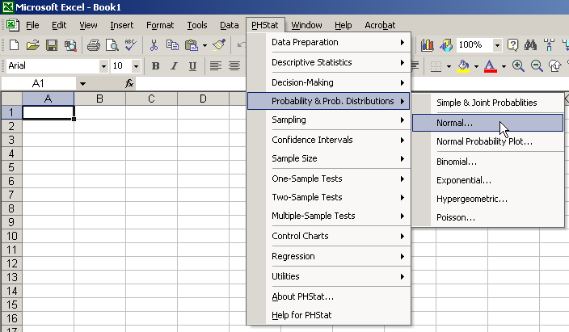
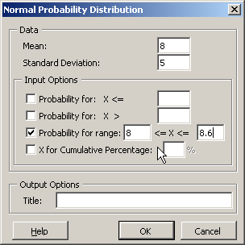
PHStat Dialogue Box
Select desired options and enter values

Slide 71
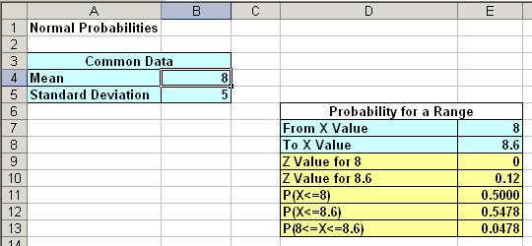
PHStat Output

Slide 72
The Uniform Distribution
Probability Distributions
Continuous
Probability Distributions
Normal
Uniform
Exponential

Slide 73
The Uniform Distribution
The uniform distribution is a probability distribution that has equal probabilities for all possible outcomes of the random variable

Slide 74
The Uniform Distribution
(continued)
The Continuous Uniform Distribution:
f(x) =
where
f(x) = value of the density function at any x value
a = lower limit of the interval
b = upper limit of the interval

Slide 75
Uniform Distribution
Example: Uniform Probability Distribution
Over the range 2 ≤ x ≤ 6:
1
f(x) = = .25 for 2 ≤ x ≤ 6
6 - 2
f(x)
.25
2
6
x

Slide 76
Chapter Summary
Reviewed key discrete distributions
binomial, poisson, hypergeometric
Reviewed key continuous distributions
normal, uniform, exponential
Found probabilities using formulas and tables
Recognized when to apply different distributions
Applied distributions to decision problems

